Slide 1
Life of An Academic in the 21st Century
Dr. IKM Mokhtarul Wadud
Deakin University, Australia

Slide 2
The Typical Roles of An Academic
Teaching (depending on the position)
Research
Administration

Slide 3
Generally, in the 21st century, academics have become busier with increased demand for
  good and effective teaching
  research (quality and quantity).
  professional services

Slide 4
Good and Effective Teaching
  Acquiring necessary qualification and skill
    Masters, Doctorate, other specialisations and training.
    Linguistic skills, multi-cultural values, ethics.
    Specific teaching qualifications: graduate diploma/ certificate in teaching (specially teaching at universities).
  Being absolutely serious
    Treat the students equally
    Put additional care for students with disadvantaged and/or less bright students
    Demonstrate passion

Slide 5
Good and Effective Teaching (Continued)
  Getting your teaching evaluated for improvement
    Teaching quality could be assessed by both students and peers
      ‘eValuate’ at Deakin University. Almost all universities around the developed world have teaching evaluation.
      Teaching evaluation needed both for individual instructors and for the course/ unit overall.
    Reflecting on the comments and feedback obtained and work towards improving specific areas of teaching.

Slide 6
Good and Effective Teaching (Continued)
Having a passion for pedagogical development and work continuously to achieve this
  Joint productive activity with students, developing language of the resources, contexualisation, teaching and encouraging complex/ critical thinking
Keeping uptodate with the current development of knowledge in the relevant fields
  Remain informed of the extant literature
  Creation and dissemination of knowledge generated through own R&D activities (projects, theses and publications).
Being familiar with new technologies and learning to use newer softwares
  Endure and learn through the transition to the digital age
  Learn new softwares and use of online ICT applications/ platform for online teaching and evaluation.

Slide 7
Good and Effective Teaching – Other Matters
Lectures and tutorials- to be cohesive with learning needs and objectives (not in Bangladesh)
Curriculum to be accurate and consistent with the level of students and other units offered.
Flexible arrangements for consultation.

Slide 8
Research
Research and Development (R&D) activities are the most important factors determining the reputation and ranking of a higher (tertiary) educational institution such as a university.
Research is an important determinant for incentives and job security for the academics– this is more so in the 21st century than ever before.

Slide 9
Research
R&D activities
  Actual research undertaken – experimental, survey based, other secondary data, theoretical.
  Without impact with appropriate recognition received are not valued.
  Must be published for recognition
    Peer reviewed
    Report of some funded projects.

Slide 10
Research- The might of publications
Publications are the ways to get research findings visible and recognised in the academia
The universities in the 2st century provide little or no alternatives to publications to their academics.
‘Publish or Perish’
Publication quality is a key to earn higher ranking.

Slide 11
Academic publication- Further points
Formal dissemination of new knowledge (research output) through a recognised mode (publication outlet).
Wikipedia Def.: Academic publishing is the subfield of publishing which distributes academic research and scholarship.
  Most academic work is published in academic journal article, book or thesis form.
  Most scientific and scholarly journals, and many academic and scholarly books, though not all, are based on some form of peer review or editorial refereeing to qualify texts for publication.

Slide 12
Academic publication types
Journal articles (full length and notes).
Books, book chapters and theses
  Research books and chapters.
  Theses (mostly considered upon publication as books).
  Textbooks (considered as contribution to T&L but not as prof. res. publications)
Conference papers.
Others: Media appearances etc. (imp. for visibility but not counted as research.)

Slide 13
Publication types and their relative significance
(1-2) Journal articles
(3) Research books and book chapters.
(4) Conference (selected) papers.
Journal articles, research books and book chapters are peer reviewed
For Conference papers either just the abstract or the entire paper is peer reviewed (the latter with some rejection rates could be indicative of the quality of the conferences).
  Some conferences have discussants for each of the papers submitted. This is a good way of providing detailed feedback on the presented papers.

Slide 14
Why journal articles matter the most?
Peer reviewed (in all cases).
Often published by prestigious university presses and academic publishers.
Concise yet comprehensive format of dissemination of new Knowledge (research results).
Regular appearance and formation of academic community/ followers.
Many reputed professional bodies associate themselves with one or more journals.

Slide 15
Journal publication: The process
(1) Initial Submission
  Prepare the first draft
  Send to colleagues and peers for comments
  Prepare the second draft
  Resend to selected colleagues/ external academics/supervisor(s)/ present at a conference
  Prepare the third draft
  Get professionally edited/ proofread (if needed)
  Submit to a selected journal (most submissions online now a days)

Slide 16
Journal publication: The process (continued)
(2) Desk editorial decision
    Forwarded to the reviewers: if the editor find the article as original work with significant contribution.
    Desk rejected: if the editors find the work to be trivial and not suitable for the journal.
    Note: Most editors would run through plagiarism checks to assess originality of the work.
(3) Under review
    Accepted for publication without revision (very rare).
    Conditional accepted subject to (mostly minor) revision.
    Simple review and resubmit.
    Rejected

Slide 17
Journal publication: The process (continued)
(4) Revision and resubmission (or ‘R&R’, as many put it)
    Amend the paper by comprehensively addressing each point/ issue raised by the reviewers. (It is better to do more than what may apparently feel just enough).
    Prepare a separate letter indicating how each of the points of the reviewers are addressed and where in the revised text they appear. (This needs to be precise and easy to follow.)
    For points raised by reviewers that are either inappropriate or invalid, first appreciate their thoughts and then politely justify your arguments and non incorporation of those changes.

Slide 18
(5) Further editorial decisions
    Accepted without the need for further revision.
    Second revision and resubmit.
    Rejected.

Slide 19
How do we choose the appropriate outlet (journal) for submission?
The dilemma between Quantity and Quality
  Higher number of journal articles regardless of adhering to quality: a common strategy- good for academics in many countries (incl. Bangladesh) where performance targets are set in numbers.
  ‘International’ versus ‘local’ tags could be misleading and vague.
  Quality assessment could be subjective for many journals (excluding the well known ones).
  Increased competition- with number of academics increasing at a pace much faster than the number of journals (incl business and econ journals).

Slide 20
How do we choose the appropriate outlet (journal) for submission? (continued)
Fixing the target
  Aim high but do not be too optimistic.
  Whether a publication is needed to achieve higher numbers (unconditionally, regardless of the quality).
  Whether a publication is sought in top journals (usually at the expense of high opportunity cost)

Slide 21
How do we choose the appropriate outlet (journal) for submission? (continued)
Which journals to submit to?
  If planning towards a doctorate then target article numbers (first two –three) and then publish in a better (ranked) one (This may earn you a scholarship.) ☺
  After doctorate and as ECR: Submit and try to get published in ranked journals (even low)
  Choose journals to combine quantity and quality – to get the ideal(!!) mix! (this recommendation vary across academics. But getting just one article in 20 years, even if in JoF, may convey limited message re the researcher’s ongoing skills compared to getting 10-15 good publications within the period.)

Slide 22
Life in the new millennium: The ERA of research quality
The ERA (excellence of research for Australia) motives
The need for ‘drive to maturity’
ERA → a comprehensive research quality evaluation across Australian universities against national and international benchmarks.
The unit of evaluation is broadly defined as the Field of Research (FoR).
ERA is based on expert review informed by a range of indicators
The first full round of ERA occurred in 2010 followed by two subsequent rounds of ERA in 2012, 2015 and 2018.

Slide 23
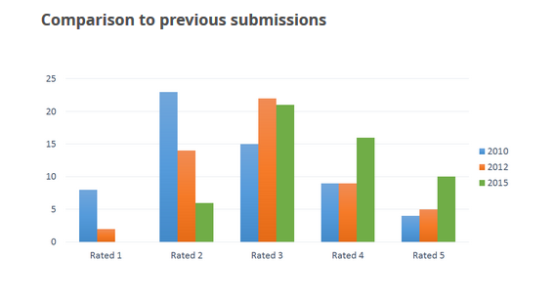
The ERA Rounds
ERA and Deakin University Australia

Slide 24
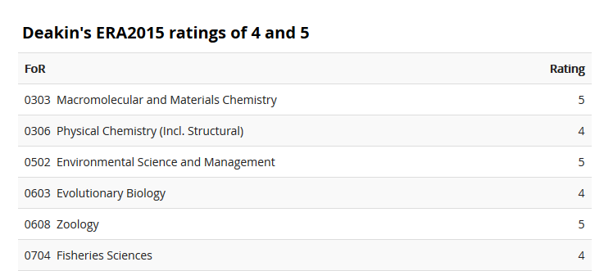
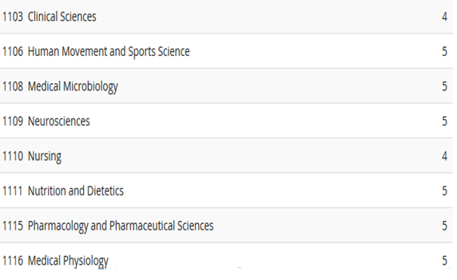
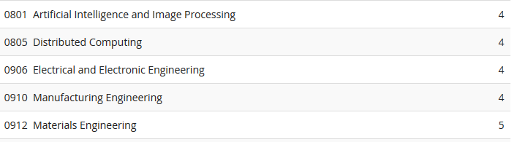
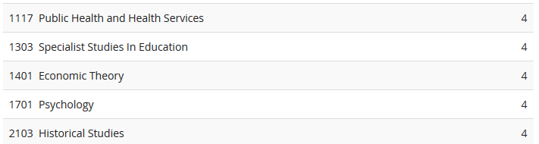


Slide 25
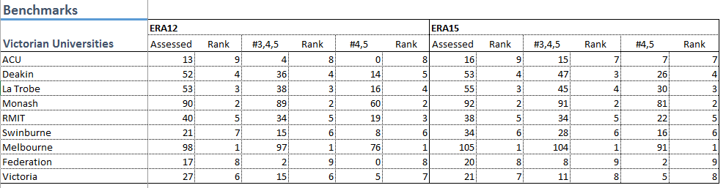

Slide 26
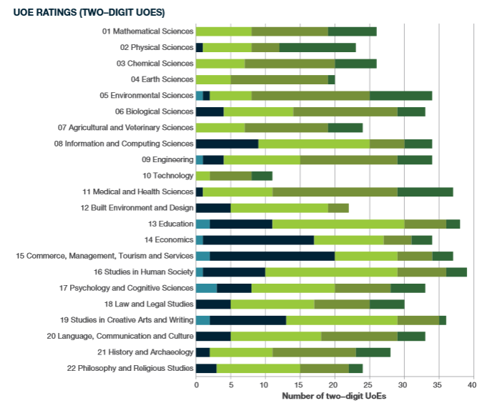
Nation Wide

Slide 27
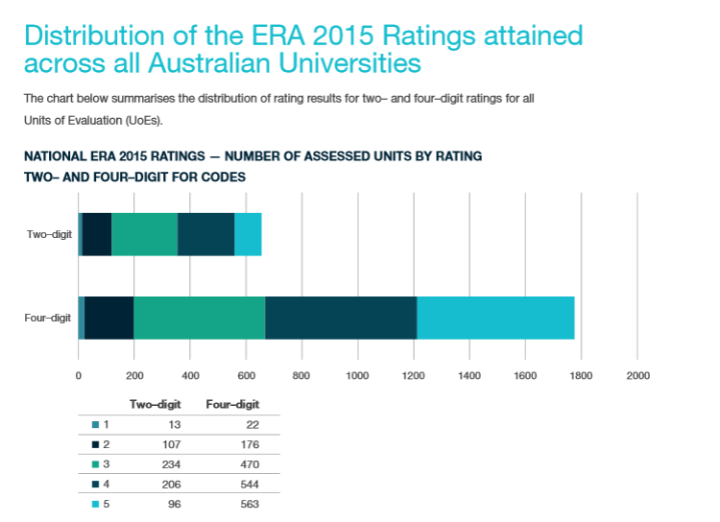

Slide 28
The ranking used in the Australian Business Schools
The ABDC (Australian Business Deans’ Council) list:
  Three types of raking of journals in business and in related areas
    A* journals
    A journals
    B journals
    C journals
    Unranked
These categories may also apply for research books and conference papers but assessments are generally highly subjective.
These journal rankings may not accurate for all journals in the list and these change to certain extent over years.
  However the rankings are generally good and acceptable as a guideline for which journals to target based on quality considerations.

Slide 29
Funding Issues
Why research funding is needed?
Funding sources: External and internal funding
Benefits of funding
  Collaborations
  Connections and linkages (industry and other external bodies)
  Access to data and resources (leading to better research output)
  Team work and formation of research groups/ centres.
  Journal publications.
    Due to rigor and comprehensive nature of the work
    Strong and effective collaborations (for joint projects)
    Better feedback received from external/ internal academics

Slide 30
Research -final points
Publish or Perish (not really ☺)
Prepare the 1st, 2nd and 3rd draft with feedback received.
Sit on the paper for a fortnight, if feasible and then submit.
Optimise combination of quantity and quality- target the ideal mix.
If received an R&R, be very passionate about revising with attention to every detail- to make the reviewer(s) happy. (and don’t worry in case of desk rejection).
For ECR within the first few post doc years, publish from the thesis and/or on topics related to the thesis.
Use a journal ranking guideline (ABDC or something similar) before submission to make an informed decision.

Slide 31
Adminstration
Teaching administration
  Unit coordination
  Workload distribution
  Result preparation, evaluation management etc.
Research Administration
  Collaboration leads
  Data and software management
Other leadership roles
  Directorship – teaching, research, research centres etc.

Slide 32
Higher EducatIon Abroad: Challenges and opportunities
Dr. IKM Mokhtarul Wadud
Deakin University, Australia

Slide 33
Why go overseas for higher studies?
Skill development
Modern facilities and resource support
Good curriculum, evaluation processes and learning outcome
Financial support
Qualified academic staff
Reputation of countries and/or individual institutions.
Long term career prospects
  Job tenure, promotion, migration etc.
Prestige (?)

Slide 34
Popular study programmes in Business and Economics
Undergraduate
  Bachelor of Commerce/ Business with major in Economics/ Finance/ Management/ Marketing/ Accounting
  Other double majors (with Law, Engineering, International relations etc.)
  Duration: 3 years (4 years for medicine & Law)
  With Honours (additional 1 year)
Post graduate
  Masters (course work) including MBA
  Masters by research – M. Phil
  Doctorate including professional doctorate e.g. DBA
  Duration: 3 to 5 Years (Full time); 6 to 10 Years (part time)

Slide 35
General Requirements
  Good academic result
  Self funding (as per need)
  English proficiency scores (TOELF or IELTS)
  SAT (for undergrad) and GRE/GMAT (for postgraduate): US and some other countries
For scholarship and other funding
  Excellent academic results
  Strong referee support
  English language and aptitude test scores

Slide 36
Higher education in Australia
The Australian higher education system comprises (in 2018):
43 universities of which 40 are public universities and 3 are private/ Australian branch of overseas university;
6 other self-accrediting higher education institutions; and
Other non-self-accrediting higher education providers accredited by State and Territory authorities.

Slide 37
Australian Government funding support for higher education is provided largely through:
  the Commonwealth Grant Scheme which provides for a specified number of Commonwealth Supported places each year;
  the Higher Education Contribution Scheme (HECS) arrangements providing financial assistance to students;
  the Commonwealth Scholarships; and
  a range of grants for specific purposes including quality, learning and teaching, research and research training programmes.

Slide 38
Scholarships for International Students
Australia Awards and Endeavour Scholarships
  Scholarships are offered by the Department of Foreign Affairs and Trade (DFAT), the Department of Education and the Australian Centre for International Agricultural Research (ACIAR).
Australian Government Research Training Program (RTP)
  The Research Training Program (RTP) provides full support for research Masters and Doctorate studies (previously known as international Postgraduate Research Scholarships or IPRS).(https://www.education.gov.au/research-training-program-frequently-asked-questions-students)
Australia APEC Women in Research Fellowship
  Open to high-achieving female researchers from APEC economies for research opportunities in partnership with Australian education and research institutions. (http://www.apec.org.au/australia-apec-women-in-research

Slide 39
Learning Experience
Semester system
Multicultural environment
Textbook, other books, study guide and support material based (including CD etc.)
Multiple assessment tasks
Good teacher-student ratio
Friendly teacher-student relationship
Tutorial and consultation for individualistic care
Web based learning (WebCT)
Continuing technological upgradation (including IT)
Professional training of the academics on research supervision and teaching

Slide 40
English language requirement: IELTS or TOEFL required for admission for international students whose native language is not English. Some universities arrange special English language training upon students’ arrival, if IELTS/ TOEFL requirements are not met.

Slide 41
Floor or open for questions/ queries on specific issues of interest.
E mail: wadud@deakin.edu.au
Tel: +61352272051 (Work)

Slide 42
Thank You! ☺

