Slide 1

Predictive Reversible Data Hiding Schemes for Enhanced Embedding Capacity
PhD Researcher:
A H M Kamal
ID: 0411054002
Dept of Computer Science and Engineering
Supervisor:
Prof. Dr. Mohammad Mahfuzul Islam
Dept. of Computer Science and Engineering
Bangladesh University of Engineering and Technology, Dhaka

Slide 2






Agenda
Overview
Literature Review
Contributions
Proposals
Conclusion

Slide 3



Steganography: Functionality
Overview
Receiver
Sender
Hide data into the image by modifying pixels.
Secret
Message
Extracted Message
Stego Media
Cover
Media
Embedding Algorithm
Stego Media
De-Embedding
Algorithm
Secret
Key
Reconstructed Cover Media
Secret
Key
Embedment Process
Cover
Stego

Slide 4
Steganography: Functionality
Overview
De-embedment Process
Receiver
Sender
Hide data into the image by modifying pixels.
Secret
Message
Extracted Message
Stego Media
Cover
Media
Embedding Algorithm
Stego Media
De-Embedding
Algorithm
Secret
Key
Reconstructed Cover Media
Secret
Key
Irreversible Process
Reversible Process
Extract Message
Cover
Stego
Retrieve Cover

Slide 5
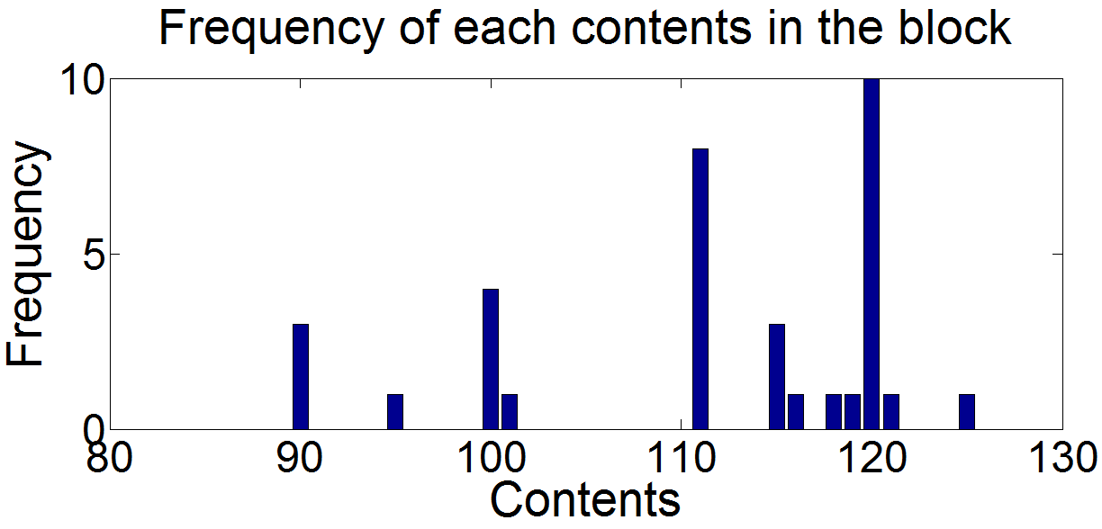
Embedding contents in reversible schemes
Overview
Reversible scheme
Image Block
In this example embeddable contents are 111 and 120
100 | 90 | 120 | 121 | 111
120 | 111 | 110 | 119 | 120
120 | 115 | 120 | 110 | 116
90 | 120 | 111 | 111 | 118
101 | 111 | 115 | 120 | 120
90 | 125 | 120 | 115 | 111
95 | 100 | 111 | 120 | 111
Reversible schemes embeds into only a few different valued contents in the embedding space, i.e., not into all the contents.
To implant more data bits these embeddable contents should be the most frequency ones.
Histogram provides the statistics of most appeared contents.
Histogram

Slide 6
Comparing different embedding space by their Histogram
Overview
Hist. of pixel values
Hist. of DCT coefficients
Hist. of prediction errors, e_{i,j}
Hist. of pixel differences, D_{i,j}
D_{i,j} = I_{i,j} - I_{i,j-1}
e_{i,j} = I_{i,j} - P_{i,j-1}

Slide 7
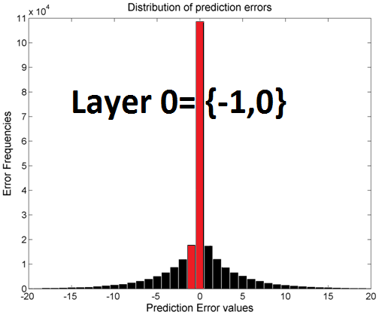
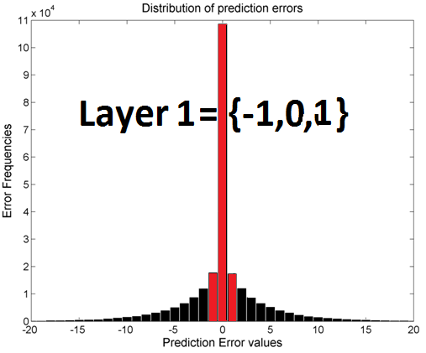
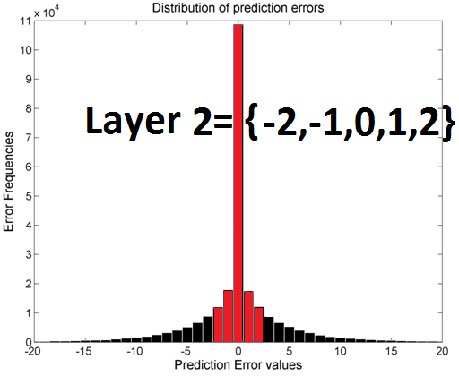
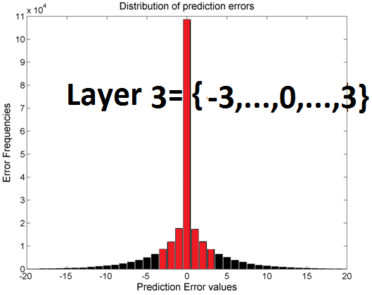
Embedding Layers in the Histogram
Overview
What is happening?
Embedding is done into
Two
Or
several contents
Which are
appeared most
In the histogram.
Embedding Layer 0
Embedding Layer 1
Embedding Layer 2
Embedding Layer 3

Slide 8
Reversible Embedding Process in the Error Histogram
Overview
Single layer embedding process
Multi-layer embedding process
Here, {(2e+1)-e}<<L. i.e., amount of changes in the non-embeddable errors are larger than the amount for embeddable errors
No change for conceiving 0 bit
0
S_{i,j} = P_{i,j} + ẽ_{i,j}
-1
1
-2
2
-3
3
…
-1
0
1
…
-2(L+1)
-2(L+1)+1
-L-3
-L-2
-L-1
-L
…
-1
0
1
…
L
L+1
L+2
L+3
L+4
2(L+1)
2(L+1)+1
b=0
-1
b=0
0
-1
0
When error e<0
When error e>=0
-2
b=1
1
b=0
2e+1
b=0
2e
b=1
e
Embeddable errors:
–L, -L+1, …, -1, 0, 1, …, L-1, L
1. Prediction errors histogram
2e
e
2e+1
b=1
b=1
2. Shift non-embeddable errors
1. Prediction error histogram
4. Embed each bit b shifting histogram
3. Embed each bit b shifting errors
2. Select embedding layer L
3. Shift non-embeddable errors by L places

Slide 9
Reversible Extraction Process in the Stego Errors
Overview
Single layer extraction process
Multi-layer extraction process
b=1
b=1
b=1
b=1
b=0
b=0
b=0
b=0
I_{i,j} = P_{i,j} + e_{i,j}
…
-1
0
1
…
-2(L+1)
-2(L+1)+1
-L-3
-L-2
-L-1
-L
…
-1
0
1
…
L
L+1
L+2
L+3
L+4
2(L+1)
2(L+1)+1
1. Generate stego errors histogram
1. Generate stego errors histogram
2. Extract message and reconstruct conceived errors
2. Extract message and reconstruct conceived errors

Slide 10

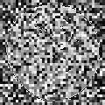
Reversible data embedment schemes
Overview
Schemes which manage the stego image quality
Xiaoxiao et al. in 2015; Kamal and Islam in 2015;
Kamal and Islam in 2016;
Cover
Stego
Reversible Data Embedment Schemes
Ong et al. in 2014;
X. Zhang et al. in 2014;
Liao and Shu in 2015 ;
Retrieved Cover
Cover
Stego
Schemes which Intentionally destroy the stego image quality
Performed at Sender Side
Performed at Receiver Side

Slide 11


Performance Measuring Parameters
,
Overview
,
and
Performance measuring parameters:
1. Volume of embedded bits:
2. Stego image quality:
Cover
Stego

Slide 12
Performance Measuring Parameters
,
Overview
,
and
Performance measuring parameters:
1. Volume of embedded bits:
2. Stego image quality:
Cover C
Stego S
MSE and PSNR:
SSIM:
More latest and provide structural similarity index value.
: Mean of cover block
: Mean of stego block
: Variance in cover block
: Variance in stego block
: Covariance between cover and stego block
Structural dissimilarity index (SDIM) is:

Slide 13
Performance Measuring Parameters
,
Overview
,
and
Performance measuring parameters:
1. Volume of embedded bits:
2. Stego image quality:
Quality Preservation Based Schemes
To increase
To increase
Cover
Stego
Quality Destruction Based Schemes
To increase
To decrease
What are the research Questions?

Slide 14

Reviewed Reversible Schemes
R e v e r s i b l e
S c h e m e s
Quality Preservation Based Schemes
Improve the prediction accuracy
Histogram translation
Quality destruction Based Schemes
This Thesis
Embed into SL and ML
Encrypting Image pixels
Overview |
Literature Review |
Contributions |
Proposals |
Conclusion

Slide 15
Weighted Average Predictor
Reviews
I-II
Repeatedly predicting (Ou et al., 2013)
Pixel prediction: This scheme repeatedly predicts each pixel until the predictor goes to stable state.
Time complexity is higher.
How many repetitions? => Not defined.
Weighting neighbors by Gradient responses (Yang et al., 2013)
Ignored diagonal gradient responses.
Less performance for smaller sized filters.
Higher time complexity for larger sized
filters.
Pixel prediction: From weighted average of four neighbors. Weights are allotted based on horizontal and vertical gradient responses.
 | W_{t}
W_{l} |  | W_{r}
 | W_{b}
Apply convolution filter for averaging
 | I_{t}
I_{l} | I_{c} | I_{r}
 | I_{b}
Allotting weights based on gradient response
Weight
Pixels
Horizontal Gradient
Vertical Gradient
Gradient: Changes of intensities in a direction.

Slide 16

Neighbors Reference Predictors
Reviews
III-IV
Median biased predictor, (Hong W., 2012)
 | LT | T
 | L | i
T: Top
LT
L
T
P=max (T, L)
L: Left
When LT smaller, which one is bigger?
LT: Left-Top
LT
L
T
P=min (T, L)
I: Processing pixel
When LT bigger, which one is smaller?
Else
P=(T+ L-LT)
Fully biased by a single diagonal pixel, LT.
Neighbor pixel as prediction (Tai et al. 2009)
Measure neighbor reference distance.
D_{i}= I_{i,j} - I_{i-1,j}
I_{i,j}
Immediate neighbor
Processing pixel
Image Data
This concentrates fewer values around ‘0’ than the ones in the prediction errors.

Slide 17

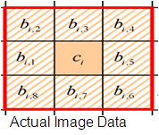
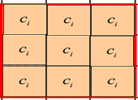
Block Centre Reference Predictor
Reviews
V
Predicting from block centre (Tsai et al, 2009)
Use block centre as a reference pixel
r_{i,2}
r_{i,3}
r_{i,4}
=
c_{i}
-
c_{i}
c_{i}
c_{i}
c_{i}
c_{i}
c_{i}
c_{i}
c_{i}
r_{i,1}
r_{i,5}
c_{i}
Measure distance with reference value
r_{i,8}
r_{i,7}
r_{i,6}
Basic Pixel Reference Errors
Block centre as a reference pixel
Data bits are embedded into these distances. The reference pixels are remained unchanged.
Higher valued r_{i,j} increases in a bigger block.
Cannot detect any deep hill of sharp valley around the centre.

Slide 18
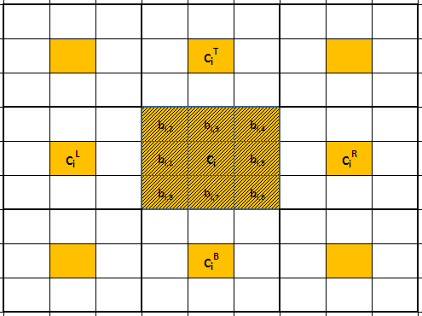



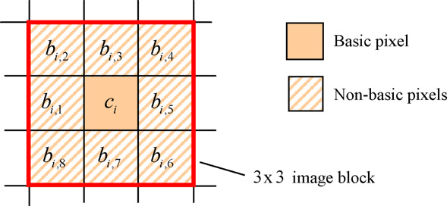

Block Centre Reference Predictor
Reviews
VI
Predicting from centre of multiple blocks, (Hong et al, 2010)
Prediction Rules
Predicting b_{i,j}
Predicting by rules
Centre of blocks
p_{i,2}
p_{i,3}
p_{i,4}
Working block
Pixels used in the prediction rules
p_{i,1}
p_{i,5}
c_{i} : Basic pixel
c_{i}^{T}, c_{i}^{R}, c_{i}^{B}, c_{i}^{L}: Satellite pixels
p_{i,8}
p_{i,7}
p_{i,6}
Predicted block

Slide 19
Block Centre Reference Predictor
Reviews
VI
Predicting from centre of multiple blocks, (Hong W et al, 2010)
Prediction Rules
Predicting b_{i,j}
Predicting by rules
Centre of blocks
Used rules during the prediction of corner pixels
p_{i,2}
p_{i,3}
p_{i,4}
p_{i,1}
p_{i,5}
c_{i} more close to b_{i,j}
Block size is fixed to 3x3
c_{i} more close to b_{i,j} but weighted equally.
Reference pixels are not used to embed bits
p_{i,8}
p_{i,7}
p_{i,6}
Predicted block

Slide 20
Block Median Reference Predictor
Reviews
VII
Block median as reference value (Leung et al. 2013)
b_{i,1} | b_{i,2} | b_{i,3}
b_{i,8} | b_{i,9} | b_{i,4}
b_{i,7} | b_{i,6} | b_{i,5}
b_{i,5} | b_{i,3} | b_{i,2} | b_{i,9} | b_{i,8} | b_{i,6} | b_{i,7} | b_{i,1} | b_{i,4}
Sort
Median: m_{i}=b_{i,8}
Image block
e_{i,1} | e_{i,2} | e_{i,3}
e_{i,8} | e_{i,9} | e_{i,4}
e_{i,7} | e_{i,6} | e_{i,5}
b_{i,1} | b_{i,2} | b_{i,3}
b_{i,8} | b_{i,9} | b_{i,4}
b_{i,7} | b_{i,6} | b_{i,5}
m_{i} | m_{i} | m_{i}
m_{i} | m_{i} | m_{i}
m_{i} | m_{i} | m_{i}
Errors
Image block
Block with median value
Applied both single and multi layers to meet smaller and higher embedding capacity respectively.
Embedding space
Prediction accuracy deteriorates for larger block size
Median pixel does not accept any message bit.

Slide 21
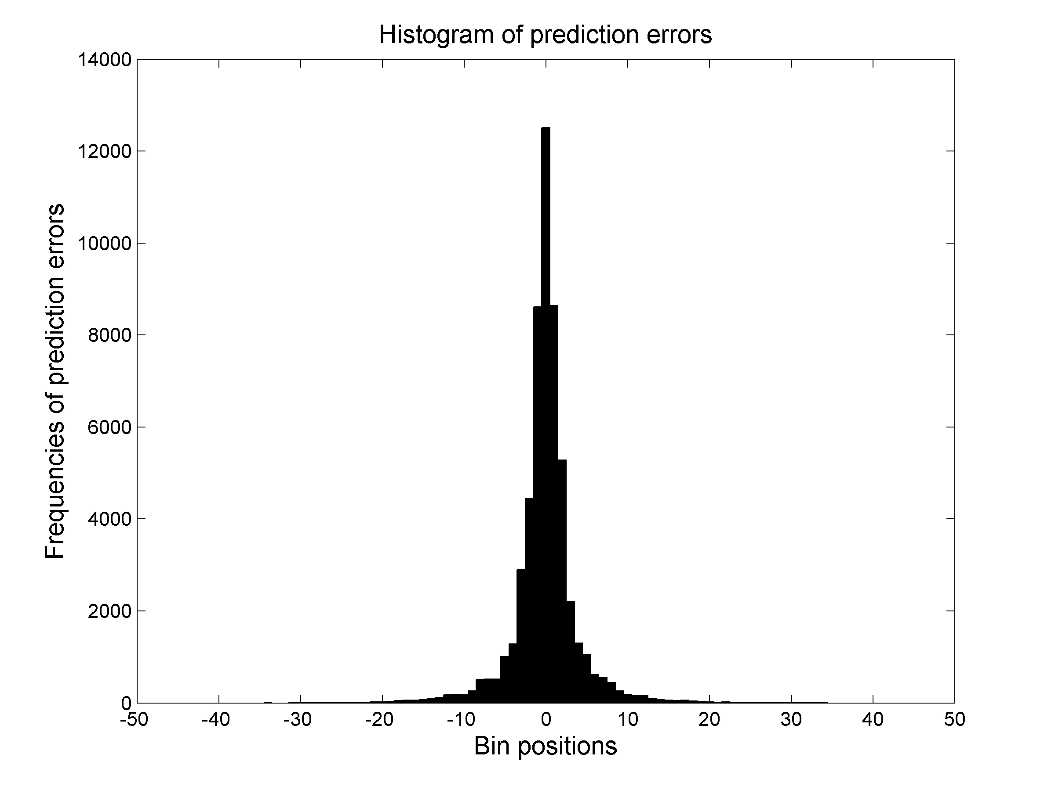
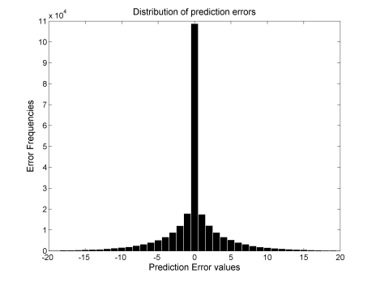
Multi Predictor Based Scheme
Reviews
VIII
Two asymmetric predictors (Chen et al., 2013)
Embed into
Embed into
Predict on Cover
Draw Hist.
Form Stego
Predict on Stego
Draw Hist.
Two predictors are applied.
Predictors should be asymmetric.
Embeds only into a single error point.
Shift
Shift

Slide 22

Multi Predictors Based Scheme
Reviews
IX
Multi-predictor based optimal predictor (Ma et al., 2015)
Predict a pixel I_{i,j}
by n predictors
Sort predicted values and say these are: p_{i,j}, q_{i,j}, r_{i,j} for 3 predictors
Image
0
p_{1,5}
q_{1,5}
r_{1,5}
255
Position of predicted values in the gray scale
Which of p_{i,j}, q_{i,j}, r_{i,j} is optimal?
Big circle => Optimal predicted value.
Type 1:
0
p_{1,5}=q_{1,5}=r_{1,5}
255
I_{i,j}
Type 2:
0
I_{i,j}<p_{i,j}
p_{1,5}
q_{1,5}
r_{1,5}
255
I_{i,j}
Type 3:
0
p_{1,5}
q_{1,5}
r_{1,5}
I_{i,j}>r_{i,j}
255
Type 4:
0
p_{1,5}
q_{1,5}
I_{i,j}
r_{1,5}
255
Type 4 pixels are about 1/3 of total pixels
Quantity of Type 4 pixel increases with the increment of applied predictors.
p_{i,j}<I_{i,j} <r_{i,j}
Skip and mark as non-embeddable

Slide 23

Distortion Based Steganographic Schemes
(Distortion by Embedding)
Reviews
X
Histogram association and mapping (HAM) (Ong et al., 2014)
b_{i,1} | b_{i,2} | b_{i,3}
b_{i,8} | b_{i,9} | b_{i,4}
b_{i,7} | b_{i,6} | b_{i,5}
Histogram of block pixels
0
255
Image Block
Gray range
Draw a histogram.

Slide 24
Distortion Based Steganographic Schemes
(Distortion by Embedding)
Reviews
X
Histogram association and mapping (HAM) (Ong et al., 2014)
b_{i,1} | b_{i,2} | b_{i,3}
b_{i,8} | b_{i,9} | b_{i,4}
b_{i,7} | b_{i,6} | b_{i,5}
0
64
128
192
255
Image Block
Range, R
Draw a histogram.
Measure range and partition the gray scale into P parts by
Let P=4

Slide 25
Distortion Based Steganographic Schemes
(Distortion by Embedding)
Reviews
X
Histogram association and mapping (HAM) (Ong et al., 2014)
Reflect
b_{i,1} | b_{i,2} | b_{i,3}
b_{i,8} | b_{i,9} | b_{i,4}
b_{i,7} | b_{i,6} | b_{i,5}
11
00
01
10
0
64
128
192
255
e.g., If message chunk is 10
Image Block
Range, R
Draw a histogram.
Measure range and partition the gray scale into P parts by
Let P=4
Number of embeddable bits b,
Here b=2,
Message chunk {00, 01, 10, 11}
Shifting Histogram by the pattern of message chunk
{00, 01, 10, 11}
Number of embedded bits depends on the partition P, (i.e., on range, R)

Slide 26



Distortion Based Steganographic Schemes
(First Distortion Then Embedding)
Reviews
XI
Block encryption and flipping LSBs (Liao and Shu, 2015)
Partition the image into blocks
Divide encrypted values into two equal parts
Embed message bits 0 and 1
XOR
If bit =0
Else if bit =1
Encrypted block
Encryption Key
Image block
Cover Image
Flip 3 LSBs
Flip 3 LSBs
Embed only 1 bit per block.

Slide 27

Distortion Based Steganographic Schemes
(First Distortions Then Embedding)
Reviews
XII
Image encryption and 4th LSB replacement (Zhang et al., 2014)
Encrypt the image
Divide encrypted values into black and white parts
Separate white pixels
XOR
Encrypted block
Cover Image
Encryption Key
Convert to binary
Collect 4th LSB of white pixel.
Collect all 4th LSBs of white pixels.
Data
LSBs
Compress and concatenate these with data.
Embed these compressed data into 4th LSBs of white pixels.
50% of image data does not accept message bits (the black pixels only).

Slide 28
Contributions of the Thesis
Contributions
Thesis Approaches
Review the existing works
Understand their motivations towards their achievements
Find their limitations, put criticisms and provide guidelines as a solutions of these limitations
Design models
We
Do numerical analysis
Do experiment and analyze the results
Publish seven articles
Write the thesis book
Develop presentation slides
Overview |
Literature Review |
Contributions |
Proposals |
Conclusion

Slide 29

Contributions of the Thesis
Contributions
The thesis improves embedding performance by
1.
Enhancing prediction accuracy
2.
Embedding for multi times in multi layer schemes
3.
Generating embeddable code for every pixel
4.
Applying prediction process in the image distortion based schemes
5.
Embedding 8 bits per pixel in the distortion based schemes
Publications:
[1]
[2]
[3]
[4]
[5]
[6]
[7]
Kamal A. H. M. and Islam M. M., “Capacity improvement of reversible data hiding scheme through better prediction and double cycle embedding process”, in Proceedings of IEEE International Conference on Advance Networks and Telecommunication Systems (ANTS), Kolkata, India, 16-18 December 2015.
Kamal A. H. M. and Islam M. M., "Enhancing embedding capacity and stego image quality by employing multi predictors", Journal of Information Security and Applications, 32: 59-74, February 2017.
Kamal A. H. M. and Islam M. M., "Boosting up the data hiding rate multi cycle embedment process", Journal of Visual Communication and Image Representation, 40: 574-588, July 2016.
Kamal A. H. M. and Islam M. M., "Enhancing the performance of the data embedment process through encoding errors", Journal of Electronics, 5(4): 79-95, November 2016.
Kamal A. H. M. and Islam M. M., “Enhancing the embedding payload by handling the affair of association and mapping of block pixels through prediction errors histogram”, in Proceedings of International Conference on Networks Systems and Security (NSysS), BUET, Dhaka, 5-8 January, 2016.
Habiba S., Kamal A. H. M. and Islam M. M., "Enhancing the robustness of visual degradation based HAM reversible data hiding", Journal of Computer Science, 12(2): 88-97, March 2016.
Kamal A. H. M. and Islam M. M., "Facilitating and securing offline e-medicine service through image steganography", Healthcare Technology Letters, 1(2): 74-79, June 2014.
Overview |
Literature Review |
Contributions |
Proposals |
Conclusion

Slide 30
Proposed Multi Predictors for Enhancing Embedding Capacity and Image Quality¹
Proposed Work 1
Generating optimal errors from the errors of multiple predictors
b_{1,1} | b_{1,2} | b_{1,3} | b_{1,4} | b_{1,5} | b_{1,6} | b_{1,7} | b_{1,8} | b_{1,9}
Number of Predictors n
When k^{th} predictor at (i,j): prediction p_{k,i,j}.
Predictor P₁
Calculate prediction errors for n
predictors
Predictor P_{k}
Predictor P_{n}
p_{1,i,j}
p_{k,i,j}
p_{n,i,j}
E_{k,i,j}=b_{i,j}-p_{k,i,j}
E_{1,i,j}=b_{i,j}-p_{1,i,j}
E_{n,i,j}=b_{i,j}-p_{n,i,j}
¹Published in the Elsevier Journal of Information Security and Applications
Overview |
Literature Review |
Contributions |
Proposals |
Conclusion

Slide 31
Proposed Multi Predictors for Enhancing Embedding Capacity and Image Quality¹
Proposed Work 1
Generating optimal errors from the errors of multiple predictors
b_{1,1} | b_{1,2} | b_{1,3} | b_{1,4} | b_{1,5} | b_{1,6} | b_{1,7} | b_{1,8} | b_{1,9}
Number of Predictors n
When k^{th} predictor at (i,j): prediction p_{k,i,j}.
Predictor P₁
Calculate prediction errors for n
predictors
Predictor P_{k}
Predictor P_{n}
Generate m Hybrid Errors:
p_{1,i,j}
p_{k,i,j}
p_{n,i,j}
E_{k,i,j}=b_{i,j}-p_{k,i,j}
E_{1,i,j}=b_{i,j}-p_{1,i,j}
E_{n,i,j}=b_{i,j}-p_{n,i,j}
β_{k,m}ϵ{-1, 1} and
B_{k,m} ϵ{1, 2}
Objective:
¹Published in the Elsevier Journal of Information Security and Applications

Slide 32
Proposed Multi Predictors for Enhancing Embedding Capacity and Image Quality¹
Proposed Work 1
Generating optimal errors from the errors of multiple predictors
Possible Hybrid Errors, E_{n+1,m}
Number of Predictors n
When k^{th} predictor at (i,j): prediction p_{k,i,j}.
b_{1,1} | b_{1,2} | b_{1,3} | b_{1,4} | b_{1,5} | b_{1,6} | b_{1,7} | b_{1,8} | b_{1,9}
m | Values of for
 | n=3 | n=4 | n=5
1 | E₁-E₂+E₃ | 2E₁+ E₂- E₃-E₄ | E₁+ E₂+E₃-E₄-E₅
2 | E₁+E₂-E₃ | E₁+ 2E₂-E₃- E₄ | E₁+ E₂-E₃+E₄-E₅
3 | -E₁+E₂+E₃ | 2E₁-E₂+E₃-E₄ | E₁+E₂-E₃-E₄+E₅
4 |  | E₁-E₂+ 2E₃- E₄ | E₁-E₂+ E₃+E₄-E₅
5 |  | 2E₁- E₂-E₃+E₄ | E₁- E₂+E₃-E₄+E₅
6 |  | E₁- E₂-E₃+2E₄ | E₁- E₂-E₃+E₄+E₅
7 |  | -E₁- E₂+2E₃+ E₄ | -E₁+ E₂+E₃+ E₄-E₅
8 |  | -E₁- E₂+E₃+ 2E₄ | -E₁+ E₂+E₃- E₄+E₅
9 |  | -E₁+ 2E₂+E₃- E₄ | -E₁-+E₂-E₃+ E₄+E₅
10 |  | -E₁+ E₂+2E₃- E₄ | -E₁- E₂+E₃+ E₄+E₅
11 |  | -E₁+ 2E₂-E₃+E₄
12 |  | -E₁+ E₂-E₃+2E₄
Predictor P₁
Calculate prediction errors for n
predictors
Predictor P_{k}
Predictor P_{n}
Generate m Hybrid Errors:
p_{1,i,j}
p_{k,i,j}
p_{n,i,j}
E_{k,i,j}=b_{i,j}-p_{k,i,j}
E_{1,i,j}=b_{i,j}-p_{1,i,j}
E_{2,i,j}=b_{i,j}-p_{2,i,j}
β_{k,m}ϵ{-1, 1} and
B_{k,m} ϵ{1, 2}
¹Published in the Elsevier Journal of Information Security and Applications

Slide 33
Proposed Multi Predictors for Enhancing Embedding Capacity and Image Quality¹
Proposed Work 1
Generating optimal errors from the errors of multiple predictors
b_{1,1} | b_{1,2} | b_{1,3} | b_{1,4} | b_{1,5} | b_{1,6} | b_{1,7} | b_{1,8} | b_{1,9}
Number of Predictors n
When k^{th} predictor at (i,j): prediction p_{k,i,j}.
Predictor P₁
Calculate prediction errors for n
predictors
Predictor P_{k}
Predictor P_{n}
Generate m Hybrid Errors:
p_{1,i,j}
p_{k,i,j}
p_{n,i,j}
E_{k,i,j}=b_{i,j}-p_{k,i,j}
E_{1,i,j}=b_{i,j}-p_{1,i,j}
E_{n,i,j}=b_{i,j}-p_{n,i,j}
Producing the optimal Errors, e_{i,j}
Errors
1 2 … .
n+1 n+2 … .
n+m+1 .
If E₁ =0 or -1
e_{i,j}=E₁ and AP=1
Elseif E₂=0 or -1
e_{i,j}=E₂ and AP=2
Elseif E_{n,1}=0 or -1
e_{i,j}=E_{n,1} and AP=3
…
Else
e_{i,j}=min (E_{n,1},…,E_{n,m}) and AP=respective
…
Elseif E_{n,2}=0 or -1
e_{i,j}=E_{n,2} and AP=4
Prediction errors E₁ to E_{n}
Hybrid errors E_{n,1} to E_{n,m}
Hybrid E_{n,1} to E_{n,m}
¹Published in the Elsevier Journal of Information Security and Applications

Slide 34

Proposed Multi Predictors for Enhancing Embedding Capacity and Image Quality¹
Proposed Work 1
Embedding process
Compute prediction errors histogram
Shift non-embeddable errors
Embed message bits by shifting
embeddable errors
-1
b=0
0
b=0
-1
0
…
-1
0
1
…
-2
1
Ẽ₃
b=1
b=1
E₃
Stego Image generation
¹Published in the Elsevier Journal of Information Security and Applications

Slide 35
Proposed Multi Predictors for Enhancing Embedding Capacity and Image Quality¹
Proposed Work 1
Message extraction and cover reconstruction
Apply same predictors
Measure predicted values
Compute stego and hybrid prediction errors
b̃_{1,1} | b̃_{1,2} | b̃_{1,3} | b̃_{1,4} | b̃_{1,5} | b͂_{1,6} | b̃_{1,7} | b̃_{1,8} | b̃_{1,9}
Predictor P₁
Predictor P_{k}
Predictor P_{n}
p_{1,i,j}
p_{k,i,j}
p_{n,i,j}
Ẽ_{k,i,j}=b̃_{i,j}-p_{k,i,j}
Ẽ_{1,i,j}=b̃_{i,j}-p_{1,i,j}
Ẽ_{k,i,j}=b̃_{i,j}-p_{n,i,j}
¹Published in the Elsevier Journal of Information Security and Applications

Slide 36
Proposed Multi Predictors for Enhancing Embedding Capacity and Image Quality¹
Proposed Work 1
Message extraction and cover reconstruction
Generating AP and optimal stego errors
Hybrid Errors
Stego Errors
Ẽ_{n1} … Ẽ_{nk} … Ẽ_{nm}
Ẽ₁ … Ẽ_{k} … Ẽ_{n}
Find first encountered E͂_{t}
E͂_{t} ϵ{Ẽ₁ … Ẽ_{k} … Ẽ_{n}}
and
E͂_{t} ϵ{-1, 0}
Check for {-1, 0}
Ẽ₁ … Ẽ_{k} … Ẽ_{n}
If ‘0’ bit were implanted
-1 => -1
0 => 0
Sequentially
Yes
Yes
Bit is not found in the stego errors. Check this in the hybrid errors.
Ẽ_{k}
E͂_{t} = E͂_{k}
Is it {-1, 0}
No
No
Find first encountered E͂_{t}
E͂_{t} ϵ{Ẽ₁ … Ẽ_{k} … Ẽ_{n}}
and
E͂_{t} ϵ{-2, 1}
Check for {-2, 1}
{Ẽ₁ … Ẽ_{k} … Ẽ_{n}}
Yes
Sequentially
e.g., E͂_{k} ={-2 or 1}
E͂_{t} = E͂_{k}
No
If ‘1’ were implanted
-1 => -2
0 => 1
No (Nothing implanted)
Yes
E͂_{n+1} = E͂_{t}
AP_{i,j} =t
E͂_{t} =min(Ẽ₁ … Ẽ_{k} … Ẽ_{n})
E͂_{n+1} = E͂_{t}
AP_{i,j} =t
¹Published in the Elsevier Journal of Information Security and Applications

Slide 37

Proposed Multi Predictors for Enhancing Embedding Capacity and Image Quality¹
Proposed Work 1
Message extraction and cover reconstruction
Now all AP and optimal stego errors ẽ_{i,j} are in hand.
Extraction of message bit m
1
m=1
-2
m=1
ẽ_{i,j}
ẽ_{i,j}
0
m=0
-1
m=0
Reconstruction of cover errors:
…
…
ẽ_{i,j}
… -2 -1
e_{i,j}=ẽ_{i,j} +1
ẽ_{i,j}
0 1 2 …
e_{i,j}=ẽ_{i,j} -1
ẽ_{i,j} <=-2
ẽ_{i,j} >=1
Cover Image generation
¹Published in the Elsevier Journal of Information Security and Applications

Slide 38
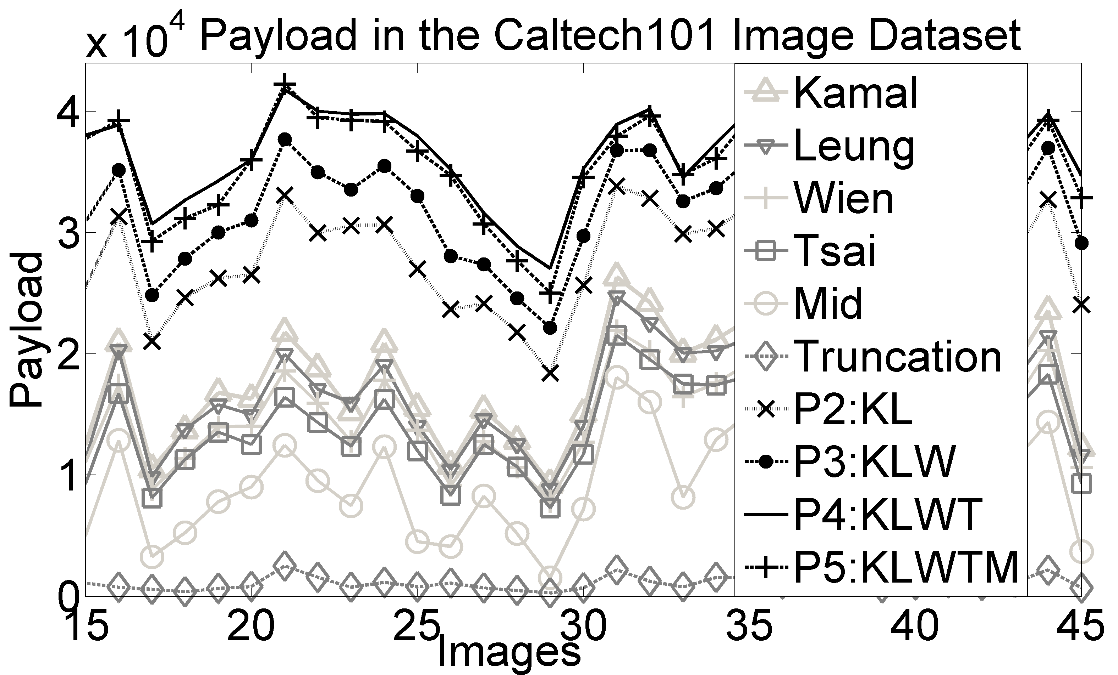
Proposed Multi Predictors for Enhancing Embedding Capacity and Image Quality¹
Proposed Work 1
Experimented Results
Prediction errors
Amount of error per pixel
Payload
Payloads per PSNR
Payloads per SDIM
¹Published in the Elsevier Journal of Information Security and Applications

Slide 39
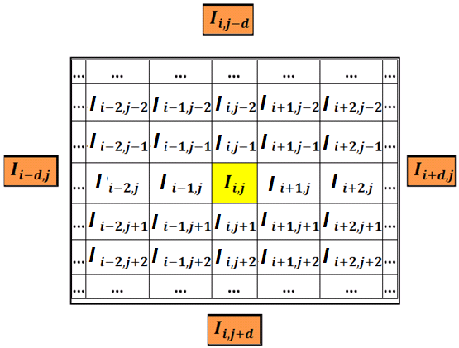

Proposed Improved Prediction and Multi Cycle Data Embedment Process²
Proposed Work 2
Partition image into blocks of dxd pixels, where d= {1,2,..}
I_{u,v}
Divide block in 4 quadrants
Consider 1st quadrant
Q4
Q1
Define baseline and non-baseline pixels
P i x e l s
Q3
d
Baseline pixels
Q2
I_{x,y}
Non baseline pixels
P i x e l s
d
²Published in the Proceedings of IEEE ANTS, 2015
Prediction for each I_{m,n}

Slide 40
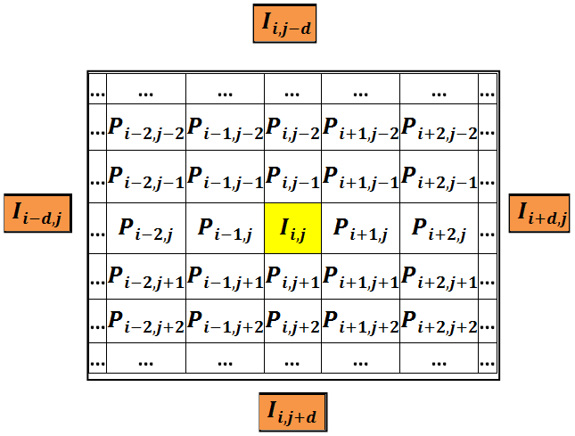
Proposed Improved Prediction and Multi Cycle Data Embedment Process²
Proposed Work 2
Reference Pixels:
Partition image into blocks of dxd pixels, where d= {1,2,..}
Euclidean Distance, D
I_{u,v}
Divide block in 4 quadrants
Consider 1st quadrant
Define baseline and non-baseline pixels
Measure Euclidean distances
P i x e l s
Prediction of Baseline Pixels
I_{x,y}
i.e., Weighted average where weight is 1/ D
P i x e l s
Prediction of non-baseline pixels
²Published in the Proceedings of IEEE ANTS, 2015
Prediction for each I_{m,n}

Slide 41
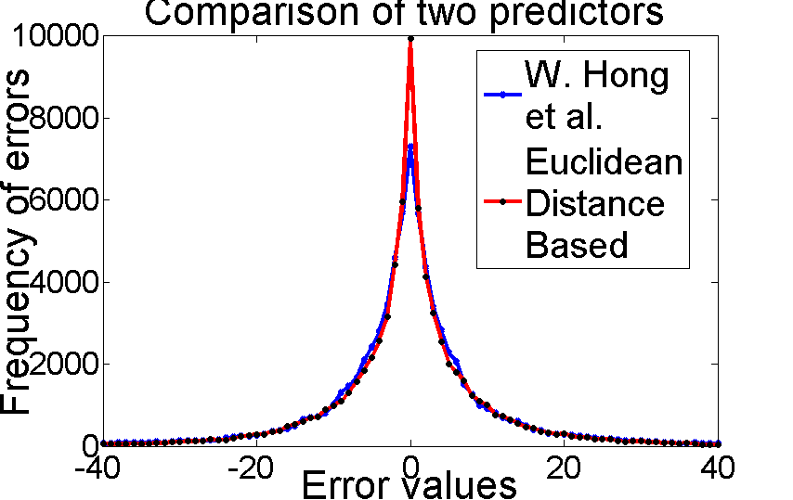
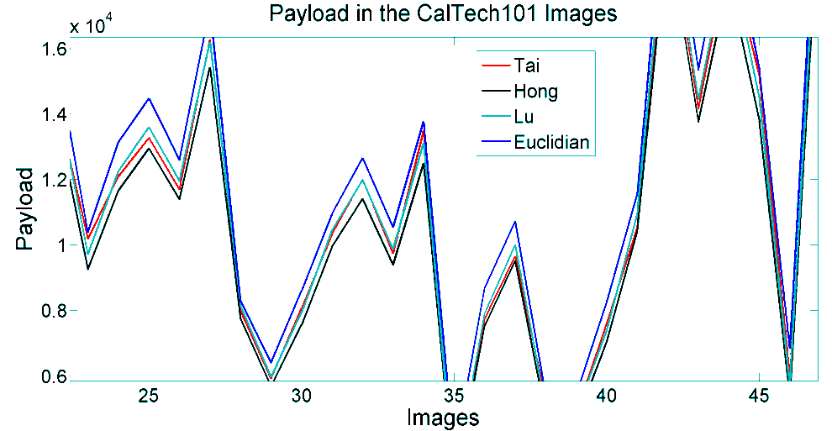
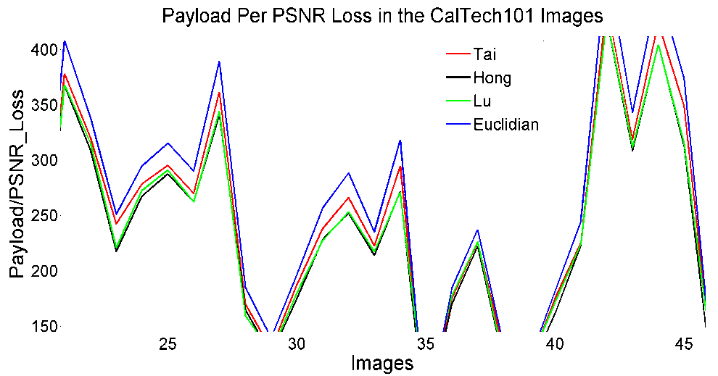
Proposed Improved Prediction and Multi Cycle Data Embedment Process²
Proposed Work 2
Measure prediction errors
Fig. : Comparison of predictors
Apply single layer data embedment process into the errors of e_{i,j}. The modified errors are ẽ_{i,j}.
Results
²Published in the Proceedings of IEEE ANTS, 2015

Slide 42
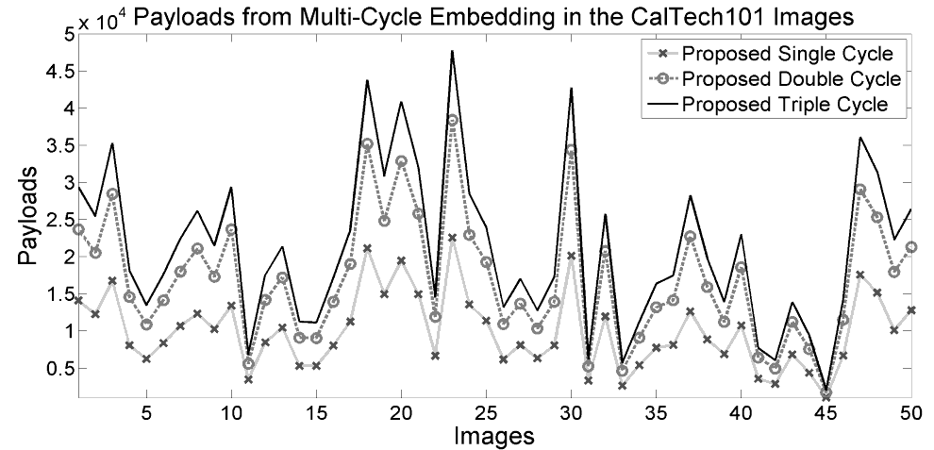
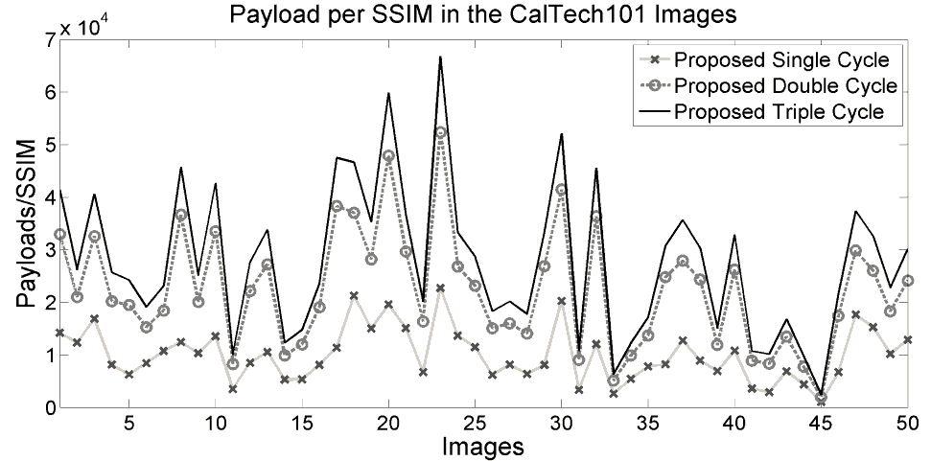
Proposed Improved Prediction and Multi Cycle Data Embedment Process²
Proposed Work 2
Single Layer Multi Cycle Process
ẽ_{i,j}
More bits to embed?
Embed bits into e_{i,j}
Generate Stego values from ẽ_{i,j}
No
Yes, e_{i,j} = ẽ_{i,j}
Results
²Published in the Proceedings of IEEE ANTS, 2015

Slide 43
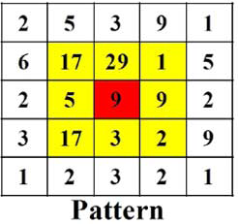
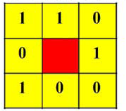
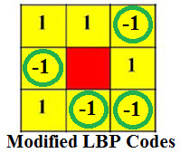
Proposed Local Pattern Based Embedding Scheme for Achieving 1bpp Capacity³
Proposed Work 3
Objective: Apply single layer embedment process but achieve the capacity of 1bit per pixel
Demand: Should generate embeddable code for every pixel
f_{b}
f_{a}
Achieved: By applying local binary pattern (LBP) matching operator
f_{x}: Frequency of x
What is LBP?
a b
LBP (Murala et al. 2012)
>9
N_{p} : Neighbor pixel
C : Reference pixel
If N_{p}>C
pattern code =1
Else
pattern code =0
End
Pattern Code (PC)
0
-1
Here,
a=-1
b=1
³Published in the Elsevier Journal of Electronics

Slide 44


Proposed Local Pattern Based Embedding Scheme for Achieving 1bpp Capacity³
Proposed Work 3
 | b_{i,1} | b_{i,2} | b_{i,3}
 | b_{i,4} | r_{i} | b_{i,5}
 | b_{i,6} | b_{i,7} | b_{i,8}
 | Image Block
Defining and arranging pixels in a block:
Reference pixel r_{i}: Centre pixel/any one in a block/a set of negotiated value
Neighbor pixels b_{i,j}: Other than the reference pixel
Arrange these block pixels in a raw
2. Apply odd-even conversion function:
b_{i,1} | b_{i,2} | b_{i,3} | b_{i,4} | b_{i,5} | b_{i,6} | b_{i,7} | b_{i,8} | r_{i}
r_{i}
Make odd
Make even
0 1 2 3 4 5 6 7 8 9 10
0 1 2 3 4 5 6 7 8 9 10
If b_{i,j}<r_{i} Then
b̃_{i,j}=b_{i,j}-modulus(b_{i,j}, 2)
i.e. make them even
If b_{i,j}>=r_{i} Then
b̃_{i,j}=b_{i,j}-modulus(b_{i,j}, 2)+1
i.e. make them odd
Example:
255 | 250 | 100 | 121 | 170 | 131 | 221 | 240 | 200
b_{i,,j} : Part of image
255 | 251 | 100 | 120 | 170 | 130 | 221 | 241 | 200
b̃_{i,j}: Processed block
Meaning of color in the cell
0 | 1 | 0 | 1 | 0 | 1 | 0 | 1
S_{i,j} : Shift Trace Matrix
³Published in the Elsevier Journal of Electronics

Slide 45
Proposed Local Pattern Based Embedding Scheme for Achieving 1bpp Capacity³
Proposed Work 3
3. Generating LBP code:
255 | 251 | 100 | 120 | 170 | 130 | 221 | 241 | 200
b̃_{i,j}
1 | 1 | -1 | -1 | -1 | -1 | 1 | 1
e_{i,,j} : Encoded errors
4. Generating LBP encoded values:
p_{i,j}=b̃_{i,j} – e_{i,j}
0 1 2 3 4 5 6 7 8 9 10
e_{i,j}=-1
e_{i,j}=1
254 | 250 | 101 | 121 | 171 | 131 | 220 | 240 | 200
p_{i,j} : Predictions
255 | 251 | 100 | 120 | 170 | 130 | 221 | 241 | 200
b̃_{i,j}: Part of image (Processed block)
1 | 1 | -1 | -1 | -1 | -1 | 1 | 1
e_{i,,j} : Encoded errors
5. Embedding message bit m into LBPs:
Message stream M=0110100
Embedded bits | x | 0 | 1 | 1 | 0 | 1 | 0 | 0
ẽ_{i,j} =e_{i,j} If b̃_{i,j}=255 or b̃_{i,j}=0
ẽ_{i,j} =e_{i,j} Else if m=1
ẽ_{i,j} =2*e_{i,j} Else if m=0
1 | 2 | -1 | -1 | -2 | -1 | 2 | 2
ẽ_{i,,j} : Stego encoded errors
6. Calculating Stego Pixels:
Error modification only for m=0
254 | 250 | 101 | 121 | 171 | 131 | 220 | 240 | 200
p_{i,j} : Encoded values
255 | 252 | 100 | 120 | 169 | 130 | 222 | 242 | 200
b̃̃_{i,j} : Stego Block
Embedding is done!
³Published in the Elsevier Journal of Electronics

Slide 46
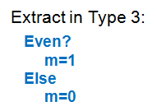
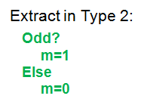
Proposed Local Pattern Based Embedding Scheme for Achieving 1bpp Capacity³
Proposed Work 3
Extraction process
Categorizing Pixels as
m=(mod(b̃̃_{ij}, 2) XOR 1)
Type | Meaning
1 | b̃_{i,j}=255 or b̃_{i,j}=0
2 | b̃_{i,j}≥r_{i}
3 | b̃_{i,j}<r_{i}
0 1 2 3 4 5 6 7 8 9 10
m=mod(b̃̃_{ij}, 2)
255 | 252 | 100 | 120 | 169 | 130 | 222 | 242 | 200
b̃̃̃_{i,j} : Stego Block
1 | 2 | 3 | 3 | 3 | 3 | 2 | 2 | 200
Matching Type No.
Meaning of color in the cell
 | 0 | 1 | 1 | 0 | 1 | 0 | 0 | 200
Message
M=0110100
³Published in the Elsevier Journal of Electronics

Slide 47
Proposed Local Pattern Based Embedding Scheme for Achieving 1bpp Capacity³
Proposed Work 3
Recovery process
1. Generate LBPs:
1 | 1 | -1 | -1 | -1 | -1 | 1 | 1
e_{i,,j} : Encoded errors
255 | 252 | 100 | 120 | 169 | 130 | 222 | 242 | 200
b̃̃_{i,j} : Stego Block
2. Generate stego encoded errors ẽ_{i,j} from pixel histogram
1 | 2 | -1 | -1 | -2 | -1 | 2 | 2
ẽ_{i,,j} : Stego encoded errors
Pixel value histogram
0 1 2 3 4 5 6 7 8 9 10
If odd
ẽ_{i,j}=-2
Else
ẽ_{i,j}=-1
If even
ẽ_{i,j}=2
Else
ẽ_{i,j}=1
³Published in the Elsevier Journal of Electronics

Slide 48
Proposed Local Pattern Based Embedding Scheme for Achieving 1bpp Capacity³
Proposed Work 3
Recovery process
3. Generate LBP encoded values
255 | 252 | 100 | 120 | 169 | 130 | 222 | 242 | 200
b̃̃_{i,j} : Stego Block
1 | 2 | -1 | -1 | -2 | -1 | 2 | 2
ẽ_{i,,j} : Stego encoded errors
( )
4. Generate the results produced by odd-even conversion function at the sender side
254 | 250 | 101 | 121 | 171 | 131 | 220 | 240 | 200
p_{i,j} : Encoded values
( )
1 | 1 | -1 | -1 | -1 | -1 | 1 | 1
e_{i,,j} : Encoded errors
255 | 251 | 100 | 120 | 170 | 130 | 221 | 241 | 200
b̃_{i,j}: Shifted block
5. Finding cover pixels
b_{ij}=b̃_{ij}-S_{ij} if b̃_{ij}≥c_{i}
b_{ij}=b̃_{ij}+S_{ij} if b̃_{ij}<c_{i}
0 1 2 3 4 5 6 7 8 9 10
0 | 1 | 0 | 1 | 0 | 1 | 0 | 1
S_{i,j} : Shift Trace Matrix
255 | 250 | 100 | 121 | 170 | 131 | 221 | 240 | 200
b_{i,j}: Cover Image Block
0 1 2 3 4 5 6 7 8 9 10
³Published in the Elsevier Journal of Electronics

Slide 49
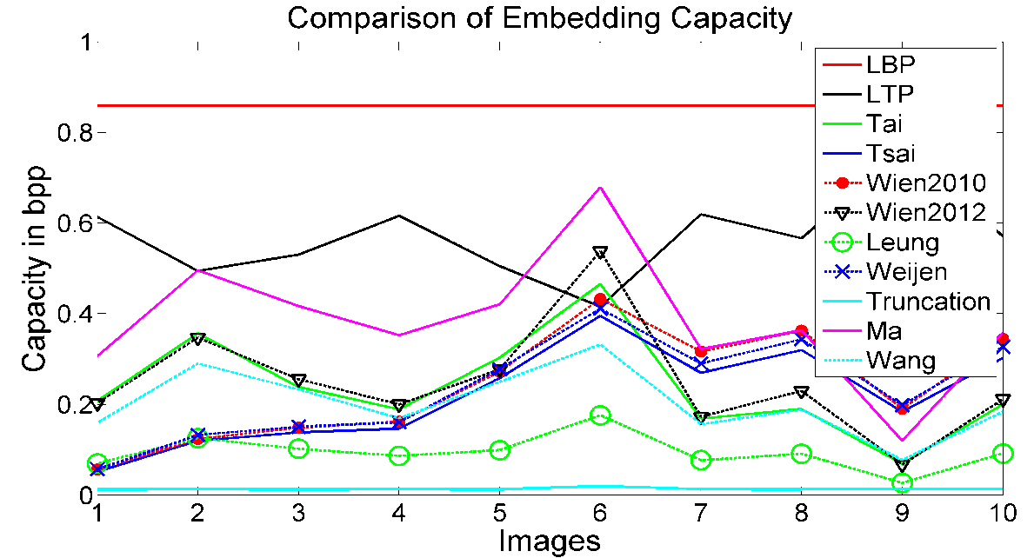
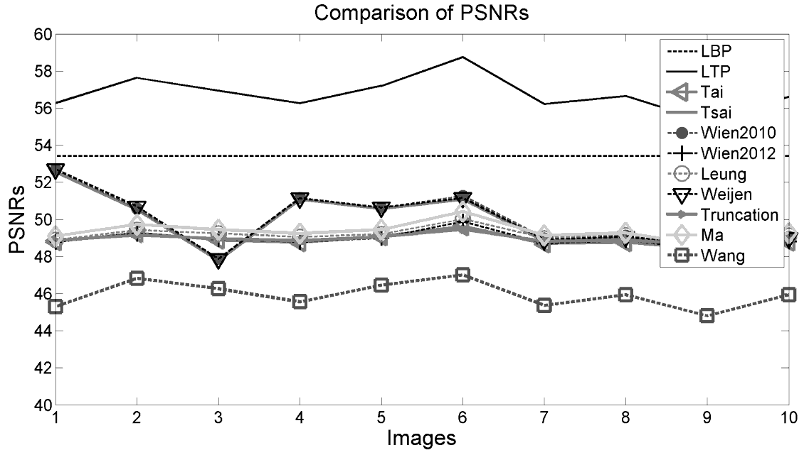
Proposed Local Pattern Based Embedding Scheme for Achieving 1bpp Capacity³
Proposed Work 3
Results:
³Published in the Elsevier Journal of Electronics

Slide 50
Proposed Local Pattern Based Embedding Scheme for Enhancing Stego Quality
Proposed Work 4
Research Question: If the embedding payload P is small,
Why will we generate embeddable code for each pixel?
Proposal: Rather it is better to generate three codes a, b and c such that
      a>b>c
      (f_{a} + f_{c}) ≥P where f_{x} : frequency of x
      a will be modified in left direction
      c will be modified in right direction
      b will be remained as unchanged.
f_{b}
f_{c}
f_{a}
a b c
Benefit: This will meet the demanded capacity, however, improve the stego quality.
Achieved: By applying local ternary pattern (LTP) matching operator.

Slide 51
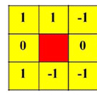
Proposed Local Pattern Based Embedding Scheme for Enhancing Stego Quality
Proposed Work 4
What is LTP?
LTP (Murala et al. 2012)
N_{p} : Neighbor pixel
C : Reference pixel
If N_{p}≥C+t
pattern code =1
Else if |N_{p}-C|<t
pattern code =0
Else if N_{p}≤ C-t
pattern code =-1
If we relate it with the immediate previous slide
a=-1
b=0
c=1
N_{p}
N_{p}
C
N_{p}
0
t
t
Code=1
255
Code=-1
Code=0
LTP Codes

Slide 52
Proposed Local Pattern Based Embedding Scheme for Enhancing Stego Quality
Proposed Work 4
Process of applying LTP method:
Set a small value to t, where r+t<255 and r-t>0
f_{a}+f_{c} < P
No
Measure LTP codes a, b and c.
Provide LTP code to data hider
t=t+1
Yes
3. Embedment process
  Embed into LTP codes a and c using the embedding rules that were applied in LBP based schemes
  Avoid the code b while implanting bits.

Slide 53
Proposed Local Pattern Based Embedding Scheme for Enhancing Stego Quality
Proposed Work 4
Result:

Slide 54

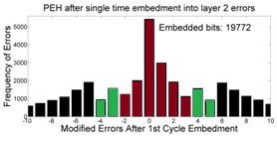
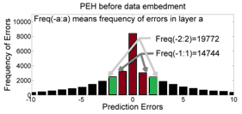
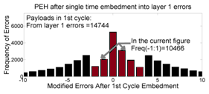
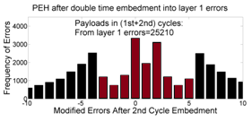
Proposed Multi-Layer Multi-Cycle Embedding for Improved Payload and Image Quality⁴
Proposed Work 5
nE: number of embeddable errors
Extracted Message
nE=5
We propose
Step 3 and 4
nE=3
nE=3
e_{i,j} =I_{i,j} - P_{i,j}
Step 3 and 4
Step 2
I_{i,j} =P_{i,j} + e_{i,j}
Extracted Message
ẽ_{i,j} =Ĩ_{i,j} - P_{i,j}
Histogram of original errors
After 1st Cycle
After 2nd Cycle
Retrieving Phase
Given L and k where L=nE/k
Compute stego errors
Extract message
Reconstruct errors
Repeat 3-4 steps for k-times
Payload by embedding for 1-time into 5 errors=19772 bits
Payload by embedding for 2-times into 3 errors=25210 bits
Let PL₁=Payload by embedding for 1-time into nE errors
Let PL_{k}=Payload by embedding for k-times into L=nE/k errors
Then PL_{k}>PL₁
⁴Published in the Elsevier Journal of Visual Communications and Image Representations

Slide 55
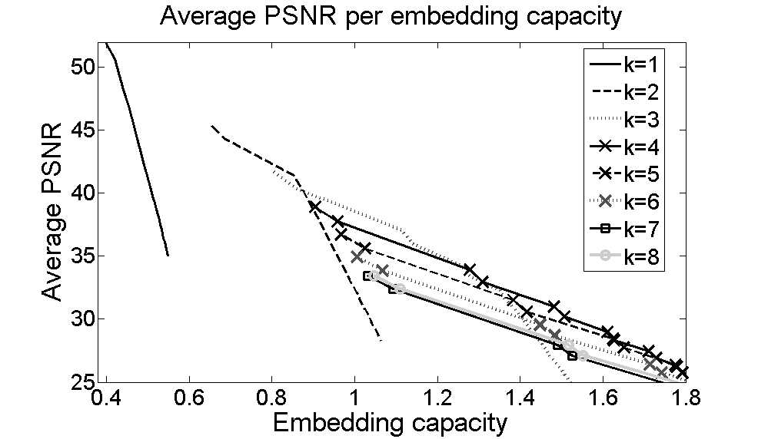
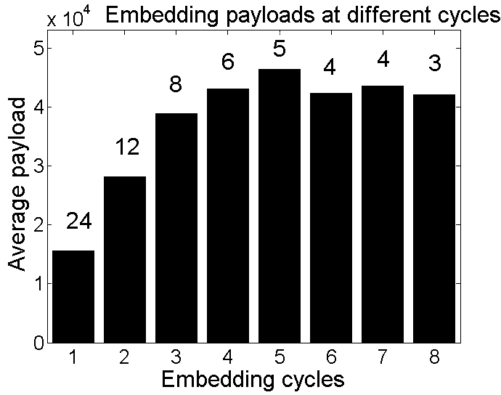
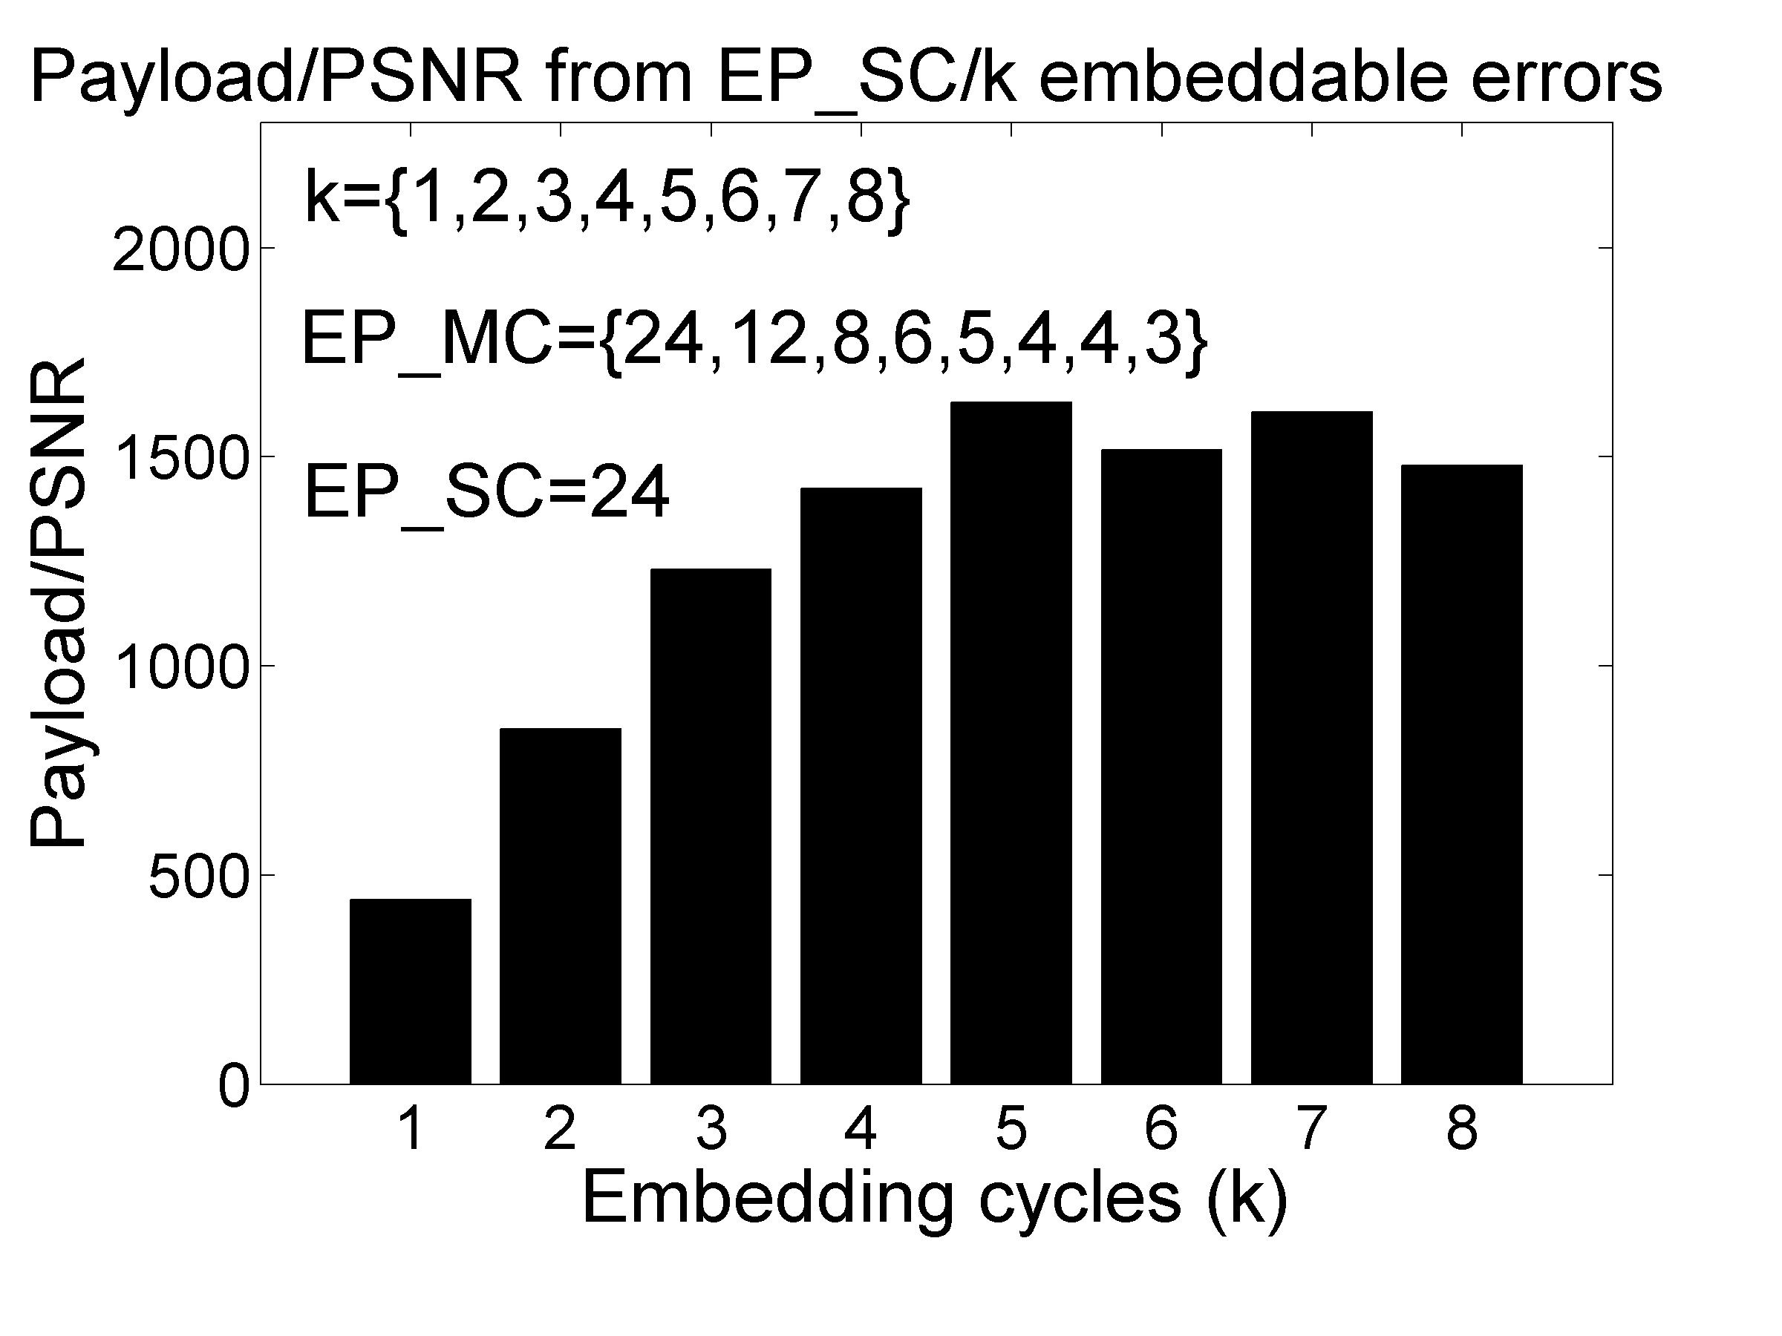
Proposed Multi-Layer Multi-Cycle Embedding for Improved Payload and Image Quality⁴
Proposed Work 5
Results: Three snapshoot out of 9 different results
If required embedding capacity is more than 0.45bpp, proposed multi-cycle scheme ensure better image quality.
Fig. 1: Payload in each embedding cycle
Fig. 2: Payload per PSNR in each embedding cycle
Fig. 3: PSNR per embedding capacity
⁴Published in the Elsevier Journal of Visual Communications and Image Representations

Slide 56
Embedding by Association and Mapping of Prediction Error Histogram⁵
Proposed Work 6
Histogram association Mapping (HAM)
Motivation from Flash Back: Ong et al. in 2015
Capacity depends on the number of partitions
Partition number depends on the range of block pixels
R
01
10
11
00
0
64
128
192
255
3
0
1
2
Partition No.
⁵Published in the Proceedings of NSysS, 2016

Slide 57
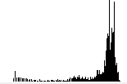



Embedding by Association and Mapping of Prediction Error Histogram⁵
Proposed Work 6
Divide the cover image into blocks
2. Predict each pixel using any scheme. e.g. Tsai et al.’s scheme
Cover Block B^{k}
3. Measure P
Pixel’s Histogram
4. Quantity of embeddable bits
Predict
R
5. Consider the secret message is
0110… … … … … … … ..010
Cover Image
… … ....
Stego Image
b-bits
b-bits
b-bits
Prediction Errors
(PE)
R_{p}<R
d=decimal(b-bits)
6. Shift block pixels by
ABS(PE)
R_{e}
⁵Published in the Proceedings of NSysS, 2016

Slide 58
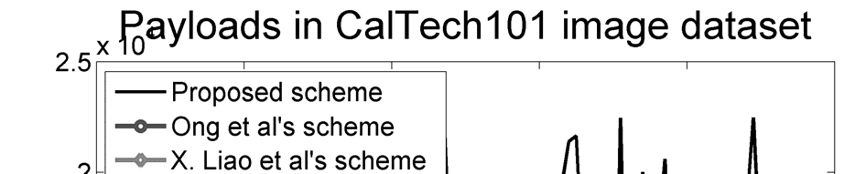
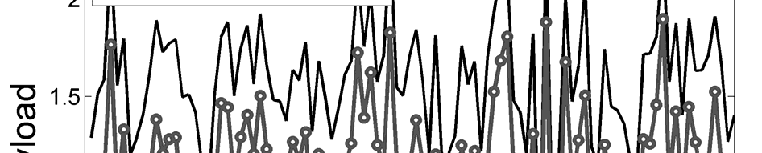
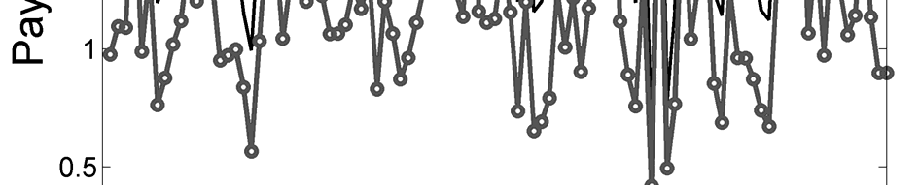
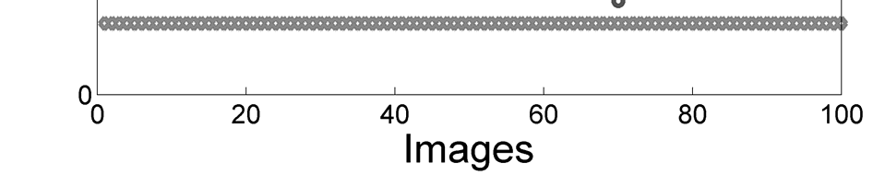
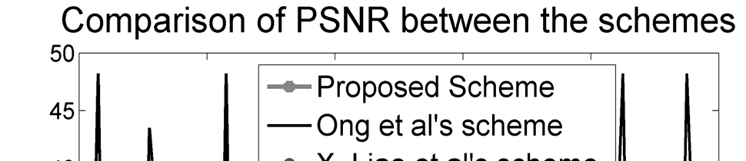
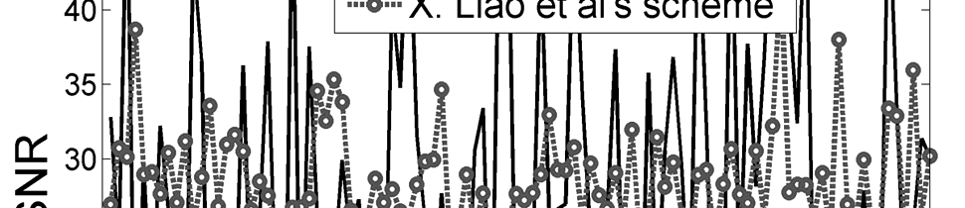
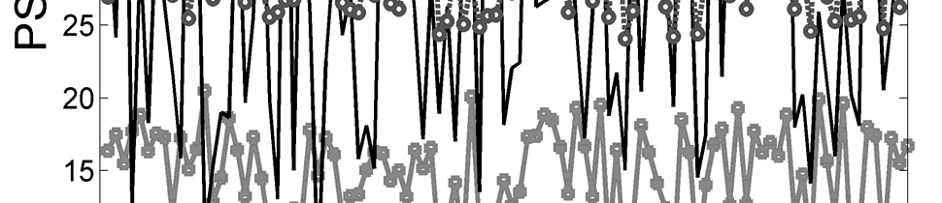
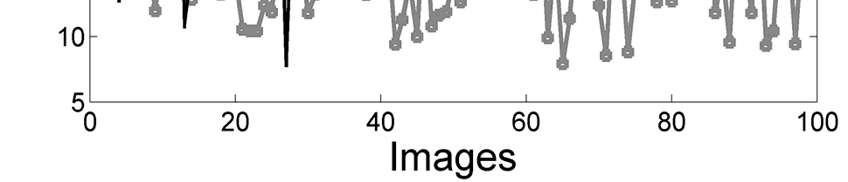
Embedding by Association and Mapping of Prediction Error Histogram⁵
Proposed Work 6
Results:
⁵Published in the Proceedings of NSysS, 2016

Slide 59
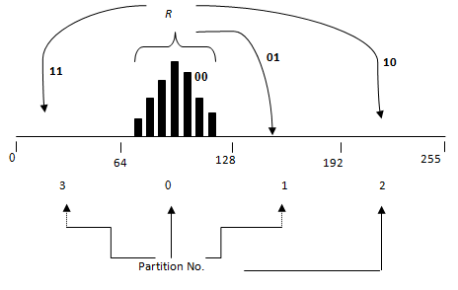
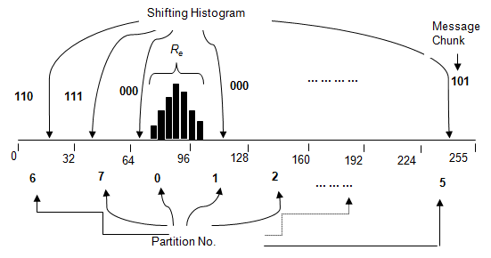
Proposed k-times Predictions for Enhancing Capacity of HAM Schemes
Proposed Work 7
Motivation:
Partitioning by pixel value’s range
Partitioning by prediction error’s range

Slide 60


Proposed k-times Predictions for Enhancing Capacity of HAM Schemes
Proposed Work 7
An image block
Absolute errors E₁
Absolute errors E₂
1
3
…
2
4
Predicted values
Prediction from E₁
Hist of E₁
2nd times predict
3rd
Times
predict
Range value decreases for repeated predictions

Slide 61
Proposed k-times Predictions for Enhancing Capacity of HAM Schemes
Proposed Work 7
1. Predict corner pixel by the average of two vertical and horizontal neighbors
a | b | g | m | n
c |  | h |  | o
 | k | i | l
u |  | j |  | z
v | w |  | x | y
2. Predict edge pixels by the average of three neighbors.
3. Predict middle pixels by the average of four neighbors.
An image block
4. Measure the prediction errors in absolute value.

Slide 62
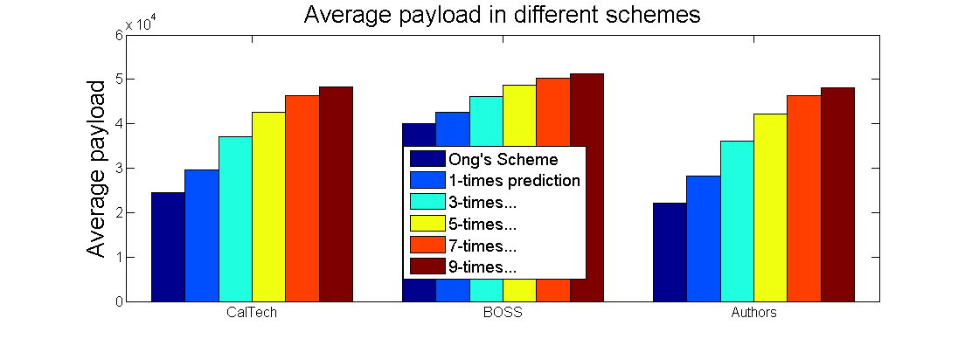
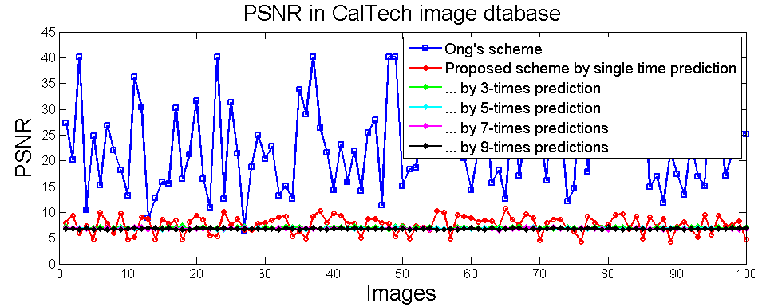
Proposed k-times Predictions for Enhancing Capacity of HAM Schemes
Proposed Work 7
Proposal
3/8

Slide 63
Improving the Embedding Capacity and Data Security of Distortion Based Scheme
Proposed Work 8
Negotiate for two encryption keys K and R
C_{1,1} | C_{1,2} | … | … | … | … | C_{1,y}
… | … | … | … | … | … | …
… | … | … | … | … | … | …
… | … | …. | … | … | … | …
C_{x,1} | C_{x,2} | …. |  |  | C_{x,y-1} | C_{x,y}
XOR
Encrypted Image C
Encryption Key R
Encrypt the Image by R (Say this is C)
D_{1,1} | D_{1,2} | … | … | … | … | D_{1,y}
… | … | … | … | … | … | …
… | … | … | … | … | … | …
… | … | …. | … | … | … | …
D_{x,1} | D_{x,2} | …. | … | … | … | D_{x,y}
How bits are distributed?
D=C
Embeds into D by bit distribution process
Encrypt D by another key K
Embed Secret

Slide 64
Improving the Embedding Capacity and Data Security of Distortion Based Scheme
Proposed Work 8
Measure the average value d of lastly accessed t number of pixels in D.
If d ≥ 6 then
n=8
Else if d ≥ 4 but d<6 then
n=4
Else if d ≥ 2 but d<4 then
n=2
Else
n=1
End
C_{1,1} | C_{1,2} | … | … | … | … | C_{1,y}
… | … | … | … | … | … | …
… | … | … | … | … | … | …
… | … | …. | … | … | … | …
C_{x,1} | C_{x,2} | …. |  |  | C_{x,y-1} | C_{x,y}
… | … | … | … | … | … | …
Binaries of a contents of D
… | … | … | … | … | … | …
Select bit when n=1
D_{1,1} | D_{1,2} | … | … | … | … | D_{1,y}
… | … | … | … | … | … | …
… | … | … | … | … | … | …
… | … | …. | … | … | … | …
D_{x,1} | D_{x,2} | …. | … | … | … | D_{x,y}
… | … | … | … | … | … | …
Select bits when n=2
… | … | … | … | … | … | …
Select bits when n=4
Embed Secret
… | … | … | … | … | … | …
Select bits when n=8

Slide 65
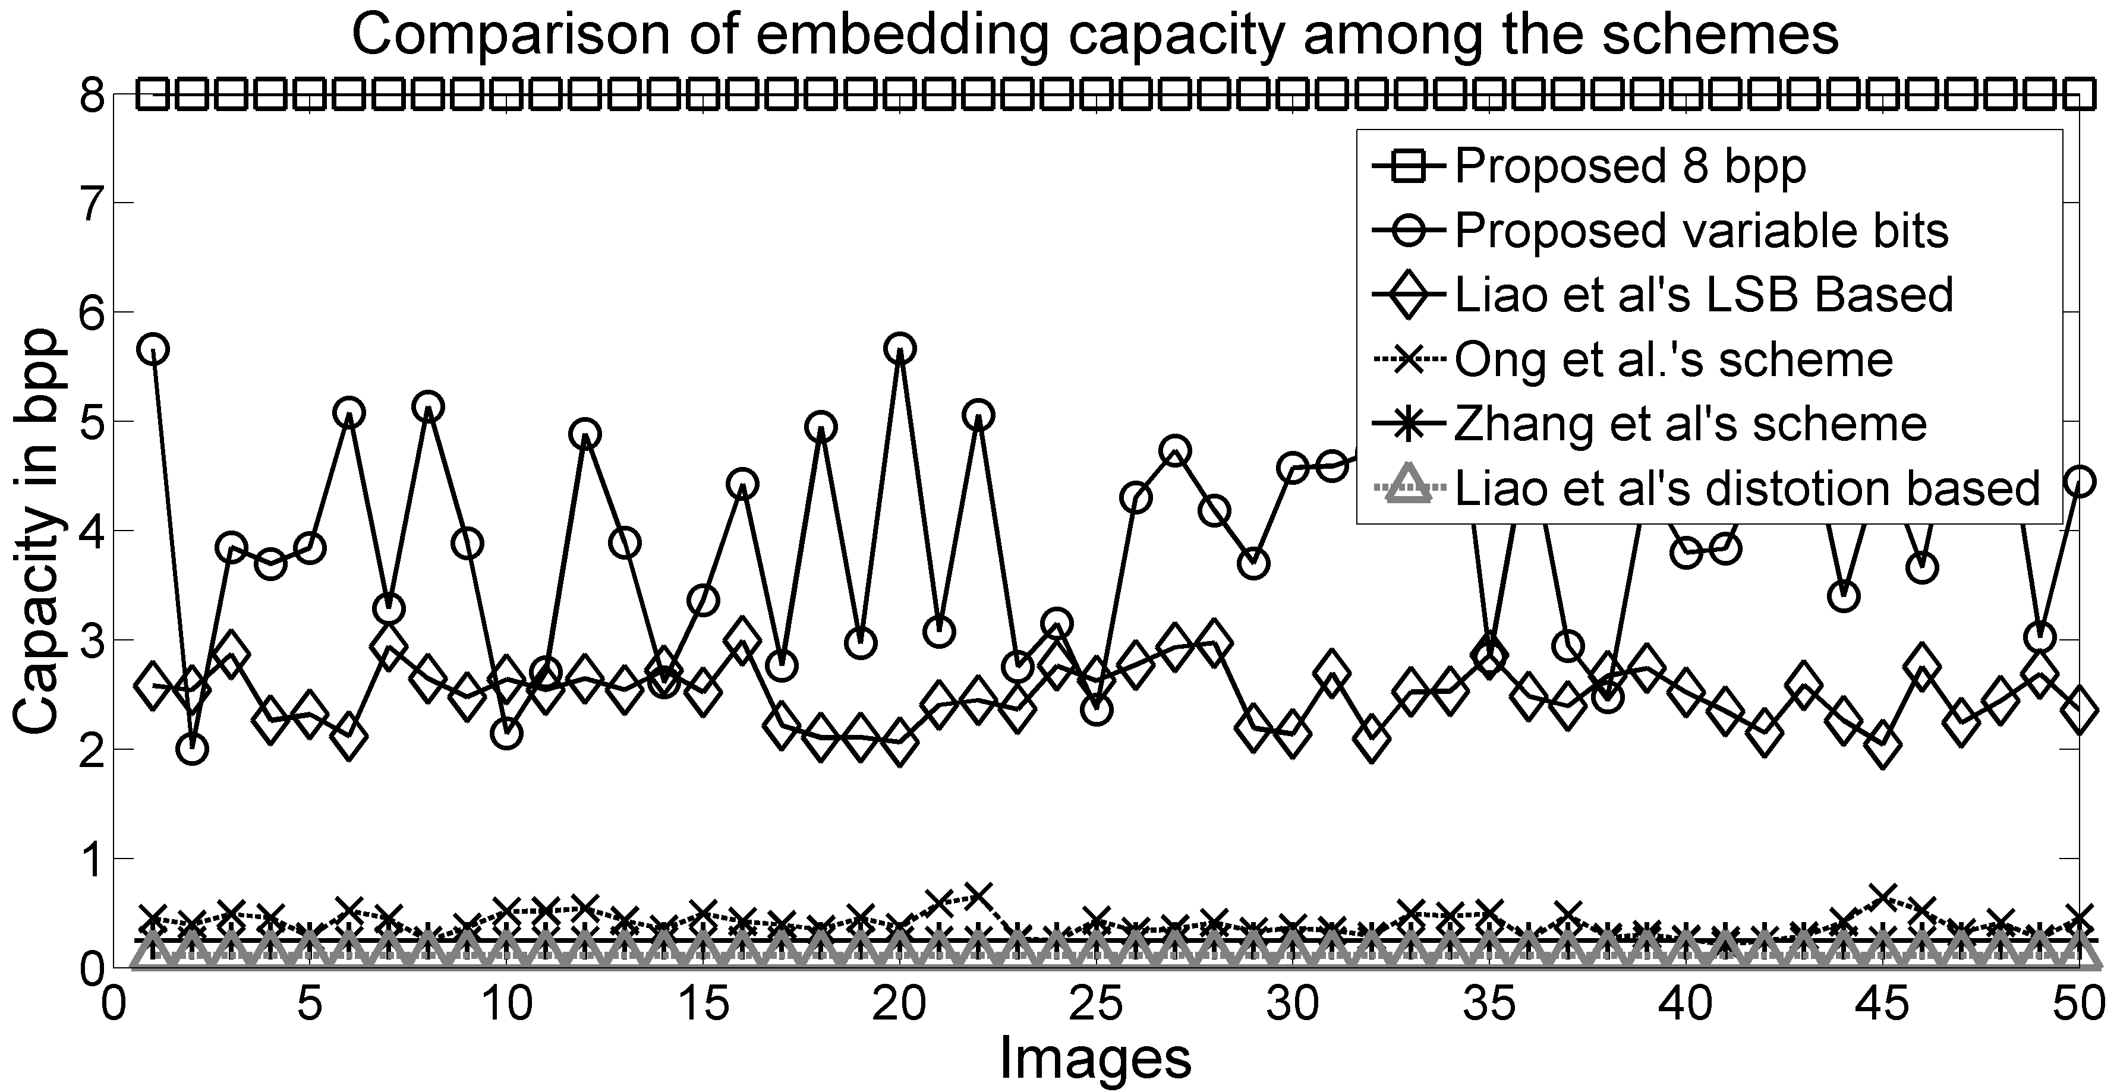
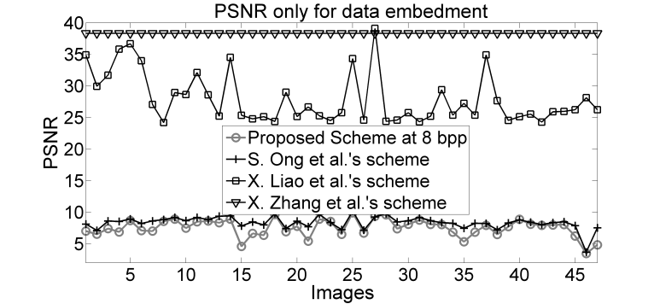
Improving the Embedding Capacity and Data Security of Distortion Based Scheme
Proposed Work 8
C_{1,1} | D_{1,1} | C_{1,2} | … | … | … | C_{1,y} | D_{1,y}
D_{2,1} | C_{2,1} | D_{2,2} | … | … | … | D_{2,y} | C_{2,y}
… | … | … | … | … | … | … | …
… | … | … | … | … | … | … | …
… | … | … | … | … | … | … | …
… | … | … | … | … | … | … | …
C_{x,1} | D_{x,1} | … | … | … | … | C_{x,y} | D_{x,y}
Shuffle the pixels of C and D to make the stego image dimensionally dissimilar.
Results:

Slide 66
Conclusion
Last words
Our contributions are on-
Embedding capacity improvement:
  Maintaining image quality
  Purposely destroying image quality
Embedding capacity and stego image quality improvement:
  Single layer data embedment
  Multi layer data embedment
Embeddable error quantity improvement:
  Applying multi predictors
  Applying LBP and LTP codes
Overview |
Literature Review |
Contributions |
Proposals |
Conclusion

Slide 67
Conclusion
Last words
Remaining Tasks-
  One article is written on the presented 8th proposal. That will be submitted to a journal.
  Another article will be written on LBP and LTP based schemes, that is presented in the 3rd and 4th proposal, owing to be submitted in an IEEE/Elsevier journal.
Future Works-
Demolishing the necessity of side information
To apply LTP codes in multi layer approach
To embed bits in a block by modifying a single pixel only
To apply steganography in authenticating smartcard users and to operate
various control devices.
Overview |
Literature Review |
Contributions |
Proposals |
Conclusion

Slide 68
References
Ref.
[1] Hong, Wien, (2012), "Adaptive reversible data hiding method based on error energy control and histogram shifting.", Optics Communications, 285.2, 101-108.
[2] Leung, Hon Yin, et al., (2013), "Adaptive reversible data hiding based on block median preservation and modification of prediction errors.", Journal of Systems and Software, 86.8, 2204-2219.
[3] Ong, SimYing, Koksheik Wong, and Kiyoshi Tanaka., (2014), A Scalable Reversible Data Embedding Method with progressive quality degradation functionality., Signal Processing: Image Communication, 29 (1), 135-149.
[4] Ou, Bo, et al., (2013), "Reversible data hiding based on PDE predictor.", Journal of Systems and Software, 86.10, 2700-2709
[5] Yang, Wei-Jen, et al, (2013), "Efficient reversible data hiding algorithm based on gradient-based edge direction prediction.", Journal of Systems and Software, 86.2, 567-580
[6] Ma, Xiaoxiao, et al., (2015), "High-fidelity reversible data hiding scheme based on multi-predictor sorting and selecting mechanism.", Journal of Visual Communication and Image Representation, 28, 71-82
[7] Kamal, A. H. M., and M. Mahfuzul Islam, (2014), "Facilitating and securing offline e-medicine service through image steganography.", Healthcare Technology Letters, 1.2, 74-79
[8] Hong, Wien, and Tung-Shou Chen, "A local variance-controlled reversible data hiding method using prediction and histogram-shifting.", Journal of Systems and Software, vol. 83, no. 12, pp. 2653-2663, 2010
[9] Tai, Wei-Liang, Chia-Ming Yeh, and Chin-Chen Chang, "Reversible data hiding based on histogram modification of pixel differences.", Circuits and Systems for Video Technology, IEEE Transactions on, vol. 19, no. 6, pp. 906-910, 2009
[10] Kamal A H M, Islam M M, “Capacity Improvement of Reversible Data Hiding Scheme through Better Prediction and Double Cycle Embedding Process”, Proc. of IEEE Int Conference on Advance Networks and Telecommunication Systems, 2015, pp 7-12
[11] Kamal A H M, Islam M M, “Enhancing the Embedding Payload by Handling the Affair of Association and Mapping of Block Pixels through Prediction Errors Histogram”, Proc. of Int Conference on Networks Systems and Security, January, 2016.
[12] Chen, Xianyi, et al., "Reversible watermarking method based on asymmetric-histogram shifting of prediction errors.", Journal of Systems and Software, vol. 86, no. 10, pp. 2620-2626, 2013
[13] Lu, Yuh-Yih, and Hsiang-Cheh Huang, "Adaptive reversible data hiding with pyramidal structure.", Vietnam Journal of Computer Science, pp. 1-13, 2014
[14] Liao, Xin, and Changwen Shu., "Reversible Data Hiding in Encrypted Images Based on Absolute Mean Difference of Multiple Neighboring Pixels.", Journal of Visual Communication and Image Representation, vol. 28, pp. 21-27, 2015.
[15] Zhang, Xinpeng, et al., "Efficient reversible data hiding in encrypted images.", Journal of Visual Communication and Image Representation, vol. 25, no. 2, pp. 322-328, 2014.
[16] Tsai, Piyu, Yu-Chen Hu, and Hsiu-Lien Yeh, "Reversible image hiding scheme using predictive coding and histogram shifting.", Signal Processing, vol. 89, no. 6, pp. 1129-1143, 2009
[17] Kamal, A. H. M., and M. Mahfuzul Islam, (2016), "Enhancing the robustness of visual degradation based HAM reversible data hiding ", journal of computer science, online version

Slide 69

Acknowledgements
Ack.
I am grateful to :
Prof. Dr. Mohammad Mahfuzul Islam, Supervisor of this thesis
My parents
Wife and children
My teachers of CSE, BUET and
Department of CSE, BUET
69

Slide 70
Acknowledgements
Ack.
The research is supported by the Fellowship of ICT division,
the Ministry of
Post, Telecommunication and Information Technology,
the Government of Bangladesh.
I am grateful to my working university, Jatiya Kabi Kazi Nazrul Islam University, for granting me a study leave.
70

Slide 71
The End
End
Thanks.
Any question?

