Slide 1
CSE 101:Computer Programming
Start up
Structure
A structure is a convenient tool for handling a list of logically related data items.
The concept of structure is analogous to record.
Example: To select for the gold medalist, the administrator will create record of:
Sr
Name:
Roll:
CGPA:
Session:
Dept:
Sr | Name | Roll | CGPA | Session | Dept
1 | A | 1 | 3.8 | 2012 | EEE
2 | B | 30 | 3.89 | 2013 | EEE
3 | C | 20 | 3.76 | 2014 | EEE
--- | --- | --- | --- | --- | ---
Structure help us to that

Slide 2

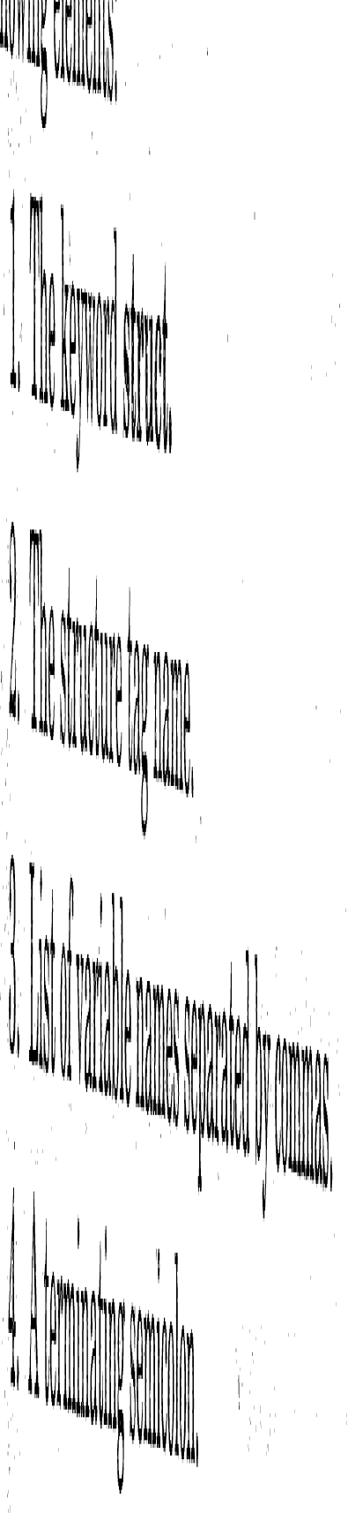
CSE 101:Computer Programming
Start up
Structure
Sr | Name | Roll | CGPA | Session | Dept
1 | A | 1 | 3.8 | 2012 | EEE
2 | B | 30 | 3.89 | 2013 | EEE
3 | C | 20 | 3.76 | 2014 | EEE
--- | --- | --- | --- | --- | ---
struct GoldMedal
{
int Sr;
char Name[30];
int Roll;
float CGPA;
int Session;
char Dept[5];
};
Struct GoldMedal Std1, Std2, Std3
Now declare variable std1, std2, std3 of type struct GoldMedal.

Slide 3
CSE 101:Computer Programming
Start up
Structure
Sr | Name | Roll | CGPA | Session | Dept
1 | A | 1 | 3.8 | 2012 | EEE
2 | B | 30 | 3.89 | 2013 | EEE
3 | C | 20 | 3.76 | 2014 | EEE
--- | --- | --- | --- | --- | ---
struct GoldMedal
{
int Sr;
char Name[30];
int Roll;
float CGPA;
int Session;
char Dept[5];
};
main()
{
Struct GoMedal Std1, Std2;
printf(“Enter Sr. Name, Roll, CGPA, Seesion and Dept of a student”);
scanf(“%d%s%d%f%d%s”,
&Std1.Sr, Std1.Name, &Std1.Roll,
&Std1.Session, Std1.Dept);
printf(“Enter Sr. Name, Roll, CGPA, Seesion and Dept of a student”);
scanf(“%d%s%d%f%d%s”,
&Std2.Sr, Std2.Name, &Std2.Roll,
&Std2.Session, Std2.Dept);
printf(“Sr.\tName\tRoll\tCGPA\tSession\tDept);
printf(“%d\t%s\t%d\t%f\t%d\t%s”,
Std1.Sr, Std1.Name, Std1.Roll, Std1.CGPA,
Std1.Session, Std1.Dept);
printf(“%d\t%s\t%d\t%f\t%d\t%s”,
Std2.Sr, Std2.Name, Std2.Roll, Std2.CGPA,
Std2.Session, Std2.Dept);
}

Slide 4
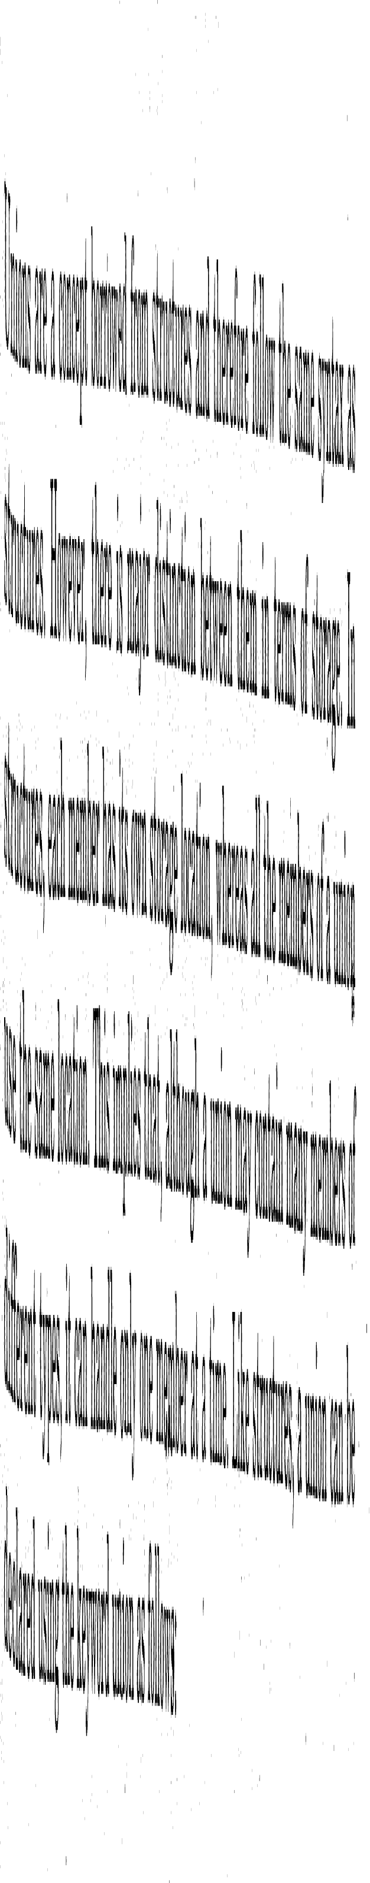
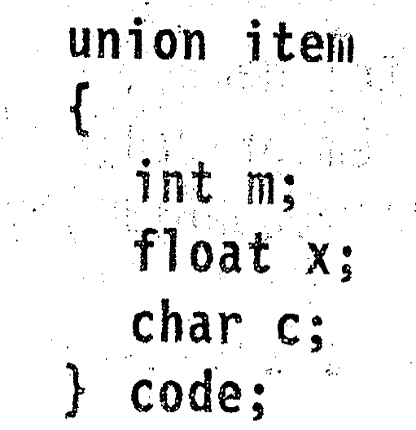
CSE 101:Computer Programming
Start up
Union

