Slide 1


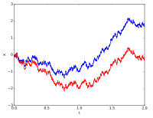
Stochastic Process for MS
CSE 5403: Stochastic Process Cr. 3.00
Course Teacher: Dr. A H M Kamal
Course Leaner: 2nd semester of MS 2015-16

Slide 2
Stochastic Process for MS
Kalman Filter:
The purpose of filtering is to extract the required information from a signal, ignoring everything else.
How well a filter performs this task can be measured using a cost or loss function. Indeed we may define the goal of the filter to be the minimization of this loss function.
A Kalman filter is an optimal estimator – i.e., it infers parameters of interest from
indirect, inaccurate and uncertain observations. It is recursive so that new
measurements can be processed as they arrive.
Use it when you are in uncertain about the information of a dynamic system.
You can make an educated guess about what the system is going to do next.
Ideal for system which are continuously changing.
They are light on memory
They are fast
Easy to understand
The filter is constructed as a mean squared error minimizing system, as like Wiener filter.
But an alternative derivation of the filter is also provided showing how the filter relates to maximum likelihood statistics

Slide 3
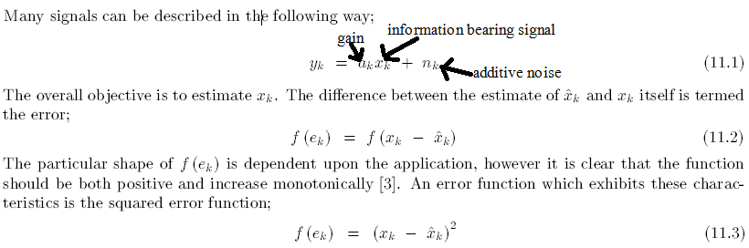
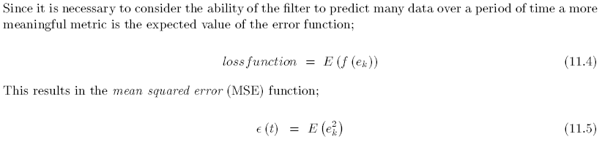
Stochastic Process for MS
Kalman Filter:
Mean Square Errors

Slide 4
Stochastic Process for MS
Kalman Filter:
Maximum Likelihood
The above derivation of mean squared error, although intuitive is somewhat heuristic. A more rigorous derivation can be developed using maximum likelihood statistics. This is achieved by redefining the goal of the filter to finding the x̂ which maximises the probability or likelihood of y. That is;
Assuming that the additive random noise is Gaussian distributed with a standard deviation of σ_{k} gives;
Which leads to;

Slide 5

Stochastic Process for MS
Kalman Filter:
Maximum Likelihood

