Slide 1


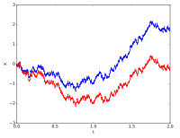
Stochastic Process for MS
CSE 5403: Stochastic Process Cr. 3.00
Course Teacher: Dr. A H M Kamal
Course Leaner: 2nd semester of MS 2015-16

Slide 2

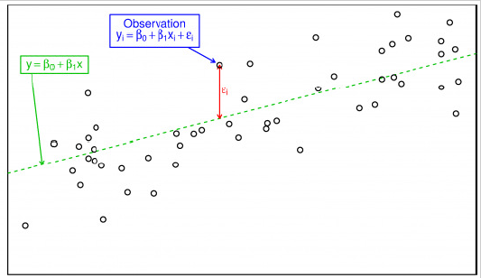
Stochastic Process for MS
Regression Analysis:
Regression analysis is used to describe the relationships between a set of independent variables and the dependent variable. Regression analysis produces a regression equation where the coefficients represent the relationship between each independent variable and the dependent variable.
Simple linear model:
A simple linear model to relate the forecasted and predictor variable is as follows:
Where the regression line is:
β₀ , β₁ are variable that can be analyzed to minimize the sum of ε.
These two variable are estimated.
When x=0, ε =0, then y= β₀.

Slide 3
Stochastic Process for MS
Regression Analysis:
β₀ , β₁ are variable that can be analyzed to minimize the sum of ε.
These two variable are estimated.
When x=0, ε =0, y= β₀.
These errors:
Have mean zero.
Are not auto correlated
Are unrelated to the predicting variables.

Slide 4

Stochastic Process for MS
Regression Analysis:
β₀ , β₁ are variable that can be analyzed to minimize the sum of ε.
These two variable are estimated.
When x=0, ε =0, y= β₀.
Choose the value of β₀ , β₁ are to minimize error’s sum

Slide 5
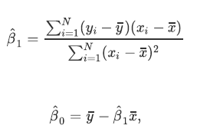
Stochastic Process for MS
Regression Analysis:
Choose the value of β₀ , β₁ are to minimize error’s sum
Least square errors:

Slide 6
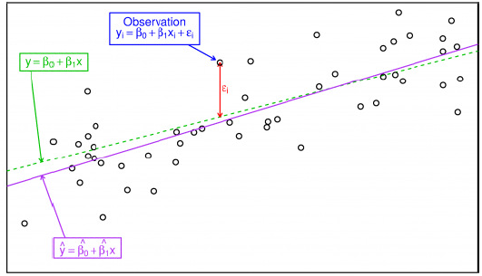

Stochastic Process for MS
Regression Analysis:
Least square errors:
Estimated regression line (of red color),
The green is true line.
Observed values:
True line:
Estimated regression line:

Slide 7



Stochastic Process for MS
Regression Analysis:
Least square errors:
Estimated regression line (of red color),
The green is true line.
Observed values:
True line:
The forecast values of y obtain from the observed values of x. Also known as fitted values.
The difference between observed values and the forecasted values are called residues.
Estimated regression line:
Target:

