Slide 1
CSE 101:Computer Programming
Start up
Decision making and looping
Start
Input
Test Condition
No
Yes
Do different task
Do this task
Do this task
End
Do this task

Slide 2


CSE 101:Computer Programming
Start up
Decision making and looping

Slide 3
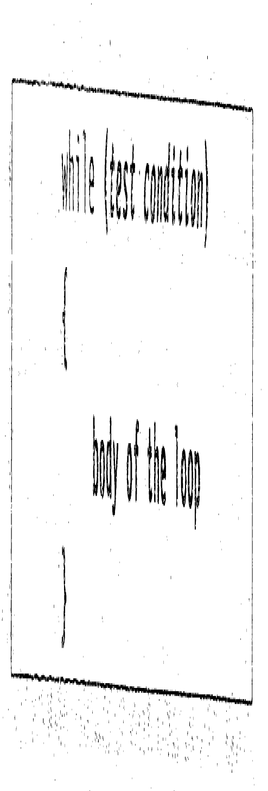
CSE 101:Computer Programming
Start up
Decision making and looping:-
The while statement:
====
sum=0;
n=1; /* initialize test variable*/
while(n<=10) /*Testing Condition */
{
sum=sum+n*n;
n=n+1; /* Incrementing */
}
printf(“sum=%d\n”, sum);
===
A program to do:
sum=1²+2²+3²+….+n²
A Solution:
sum=0;
sum=sum+1*1;
sum=sum+2*2;
sum=sum+3*3;
…
…
sum=sum+(n-1)*(n-1);
sum=sum+n*n;
means sum=1²
means sum=1²+2²
means sum=1²+2²+3²
loop
Problem: If n is unknown and large.

Slide 4
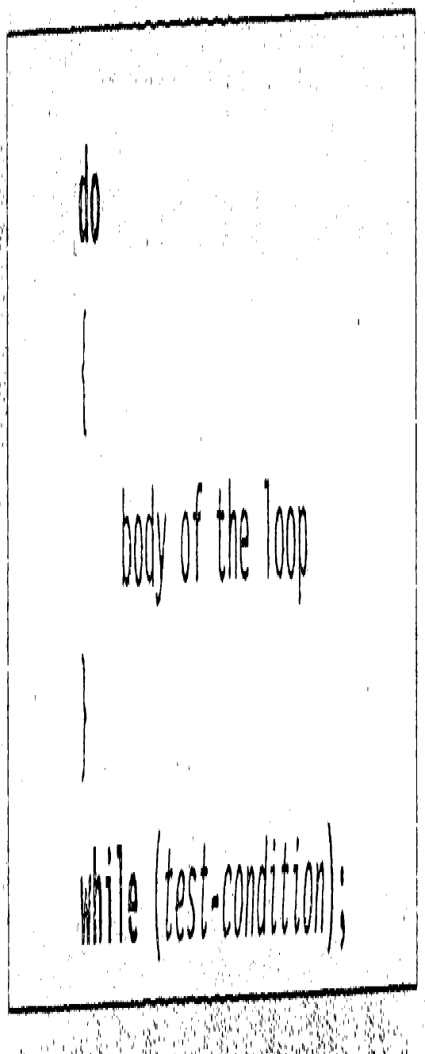
CSE 101:Computer Programming
Start up
Decision making and looping:-
The do statement:
====
sum=0;
n=1; /* initialize test variable*/
while(n<=10) /*Testing Condition */
{
sum=sum+n*n;
n=n+1; /* Incrementing */
}
printf(“sum=%d\n”, sum);
===
====
sum=0;
n=1; /* initialize test variable*/
do
{
sum=sum+n*n;
n=n+1; /* Incrementing */
}
while(n<=10);/*Testing Condition */
printf(“sum=%d\n”, sum);
===

Slide 5

CSE 101:Computer Programming
Start up
Decision making and looping:-
The for statement:
====
sum=0;
n=1; /* initialize test variable*/
while(n<=10) /*Testing Condition */
{
sum=sum+n*n;
n=n+1; /* Incrementing */
}
printf(“sum=%d\n”, sum);
===
====
sum=0;
n=1; /* initialize test variable*/
do
{
sum=sum+n*n;
n=n+1; /* Incrementing */
}
while(n<=10);/*Testing Condition */
printf(“sum=%d\n”, sum);
===
====
sum=0;
/* initialize test variable*/
for(n=1; n<=10; n++)
{
sum=sum+n*n;
}
printf(“sum=%d\n”, sum);
===

Slide 6
CSE 101:Computer Programming
Start up
Decision making and looping:-
Write a program to do: Y=X^{n}
Y=X;
Y=Y*X;
Y=Y*X;
Y=Y*X;
…
…
Y=Y*X;
A Solution:
means Y=X
means Y=X²
means Y=X³
means Y=X⁴
means Y=X^{n}
Using for loop:
====
Y=X;
for(i=1; i<n; i++)
{
Y=Y*X;
}
printf(“Result=%d\n”, Y);
===
Problem: If n is unknown and large.
Solution: Use a loop construct.

Slide 7
CSE 101:Computer Programming
Start up
Decision making and looping:-
Write a program to do: Y=X^{n}
Using do loop:
Using for loop:
====
i=1
Y=X; /* initialize test variable*/
do
{
Y=Y*X;
i=i+1; /* Incrementing */
}
while(i<n);/*Testing Condition */
printf(“Result=%d\n”, Y);
===
====
Y=X;
for(i=1; i<n; i++)
{
Y=Y*X;
}
printf(“Result=%d\n”, Y);
===

Slide 8
CSE 101:Computer Programming
Start up
Decision making and looping:-
Write a program to do: Y=X^{n}
Using while loop:
Using do loop:
Using for loop:
====
Y=X;
i=1; /* initialize test variable*/
while(i<n) /*Testing Condition */
{
Y=Y*X;
i=i+1; /* Incrementing */
}
printf(“Result=%d\n”, Y);
===
====
i=1
Y=X; /* initialize test variable*/
do
{
Y=Y*X;
i=i+1; /* Incrementing */
}
while(i<n);/*Testing Condition */
printf(“Result=%d\n”, Y);
===
====
Y=X;
for(i=1; i<n; i++)
{
Y=Y*X;
}
printf(“Result=%d\n”, Y);
===

Slide 9
CSE 101:Computer Programming
Start up
Decision making and looping:-
Processing the mid term results of 10 students.
#include<stdio.h>
#include<conio.h>
main()
{
int roll, mid1, mid2, mid3, total, i, n;
n=10
i=1;
while(i<=n) /*Testing Condition */
{
printf(“Enter Roll, and marks of Mid Term1, Mid Term 2, Mid Term 3 for the student %d\n”, i);
scanf(“%d %d %d %d”, &roll, &mid1, &mid2, &mid3);
total=mid1+mid2+mid3;
printf(“\n%d obtains %d in mid terms\n”, roll, total);
i=i+1;
}
getch();
}
If I want to do the same using for loop, how to do?
Bring these in a single statement as
for(i=1; i<=n; i=i+1)

Slide 10
CSE 101:Computer Programming
Start up
Decision making and looping:-
Processing the mid term results of 10 students.
#include<stdio.h>
#include<conio.h>
main()
{
int roll, mid1, mid2, mid3, total, i, n;
n=10;
for(i=1; i<=n; i++)
{
printf(“Enter Roll, and marks of Mid Term1, Mid Term 2, Mid Term 3 for the student %d\n”, i);
scanf(“%d %d %d %d”, &roll, &mid1, &mid2, &mid3);
total=mid1+mid2+mid3;
printf(“\n%d obtains %d in mid terms\n”, roll, total);
}
getch();
}
If I want to do the same using for loop, how to do?

Slide 11
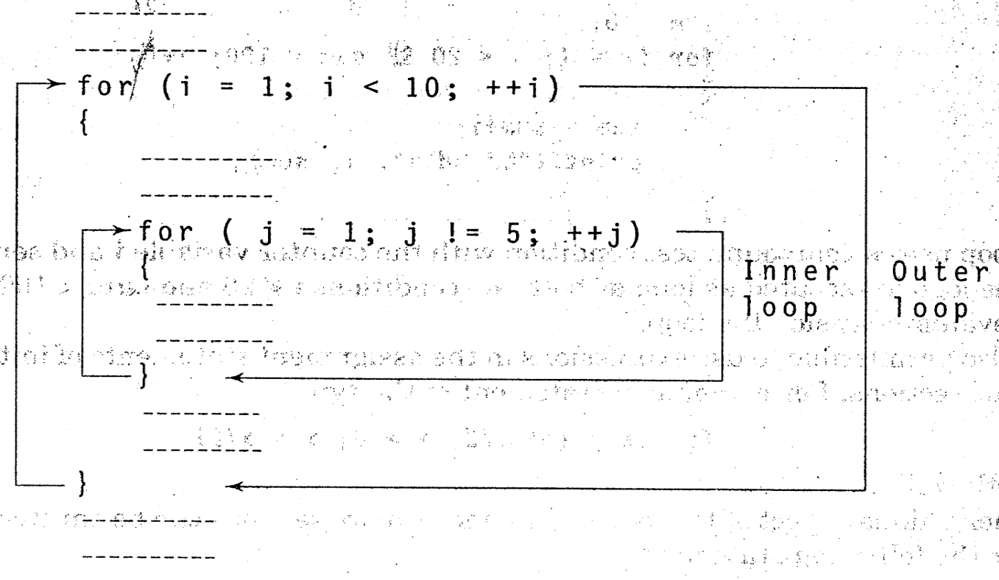
CSE 101:Computer Programming
Start up
Decision making and looping:-
Nesting of for loop

Slide 12
CSE 101:Computer Programming
Start up
Decision making and looping:-
Nesting of for loop
main()
{
int roll, midTerm, total, I, j, n=10;
for(i=1; i<=n; i++)
{
total=0;
printf(“Enter Roll No\n”);
scanf(“%d”, &roll);
printf(“\nEnter marks of three mid terms\n”);
for(j=1;j<=3;j++)
{
scanf(“%d “, &midTerm);
total=total+midTerm;
}
printf(“\n%d obtains %d in mid terms\n”, roll, total);
}
getch();
}
Outer loop
Inner loop

Slide 13
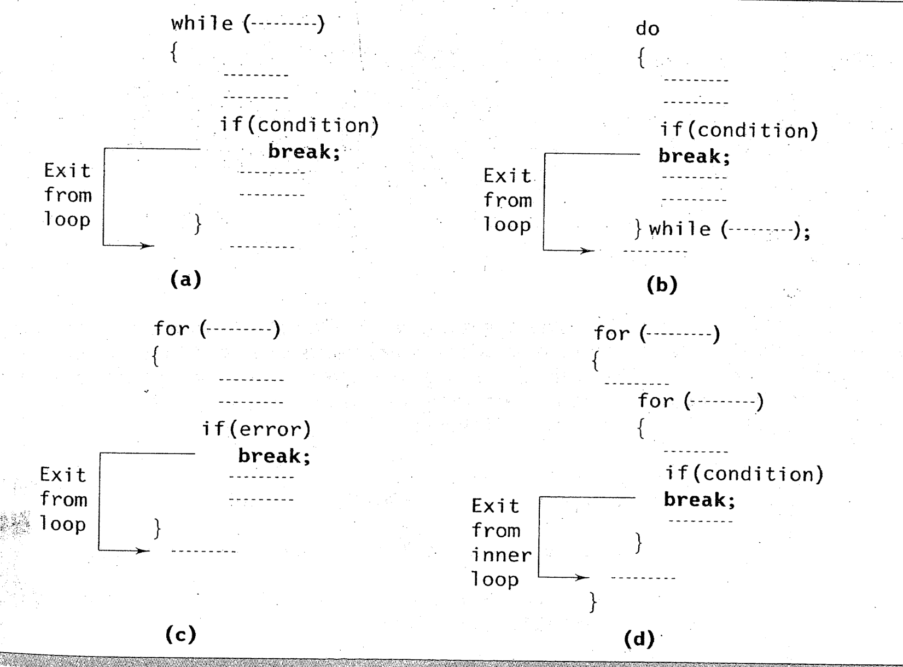
CSE 101:Computer Programming
Start up
Decision making and looping:-
Jumping from loop

Slide 14
CSE 101:Computer Programming
Start up
Decision making and looping:-
Jumping from loop
main()
{
int roll, midTerm, total, I, j, n=10;
for(i=1; i<=n; i++)
{
total=0;
printf(“Enter Roll No\n”);
scanf(“%d”, &roll);
printf(“\nEnter marks of three mid terms\n”);
for(j=1;j<=3;j++)
{
scanf(“%d “, &midTerm);
total=total+midTerm;
}
printf(“\n%d obtains %d in mid terms\n”, roll, total);
if(i>5) break;
}
getch();
}

Slide 15
CSE 101:Computer Programming
Start up
Decision making and looping:-
Jumping from loop
main()
{
int roll, midTerm, total, I, j, n=10;
for(i=1; i<=n; i++)
{
total=0;
printf(“Enter Roll No\n”);
scanf(“%d”, &roll);
printf(“\nEnter marks of three mid terms\n”);
for(j=1;j<=3;j++)
{
if(i==5) break;
scanf(“%d “, &midTerm);
total=total+midTerm;
}
printf(“\n%d obtains %d in mid terms\n”, roll, total);
}
getch();
}

Slide 16
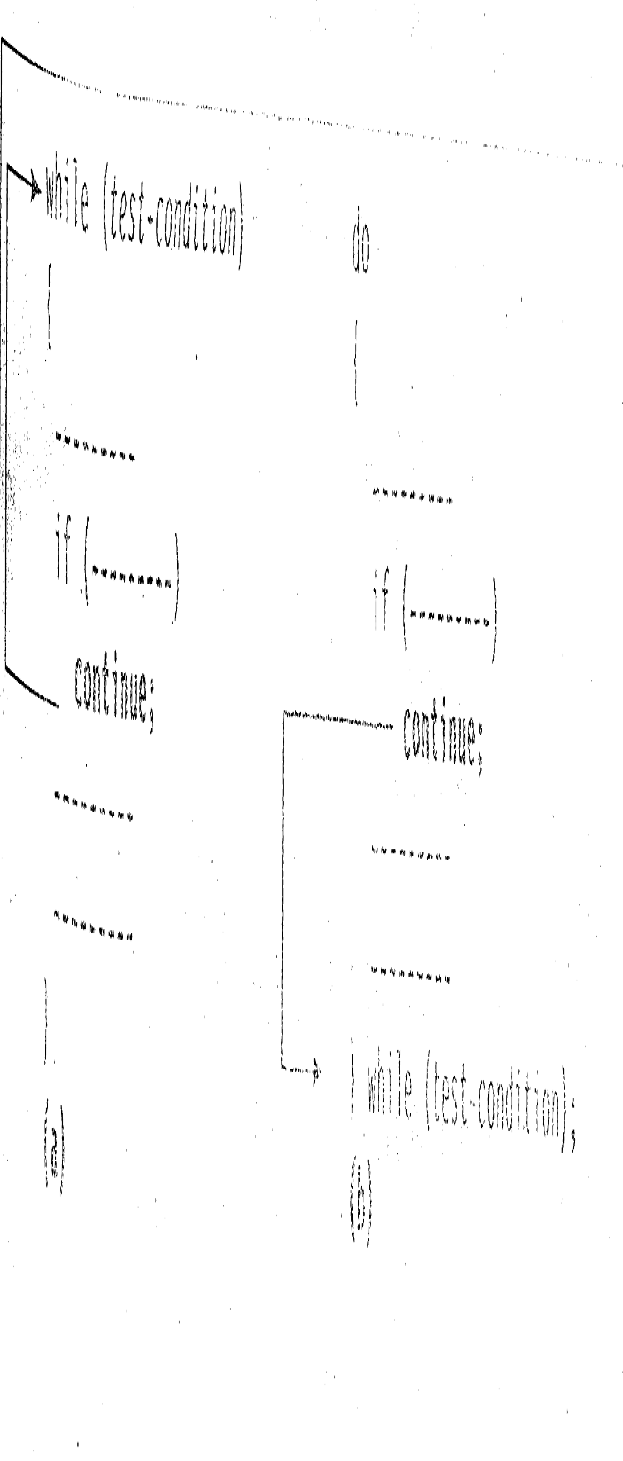
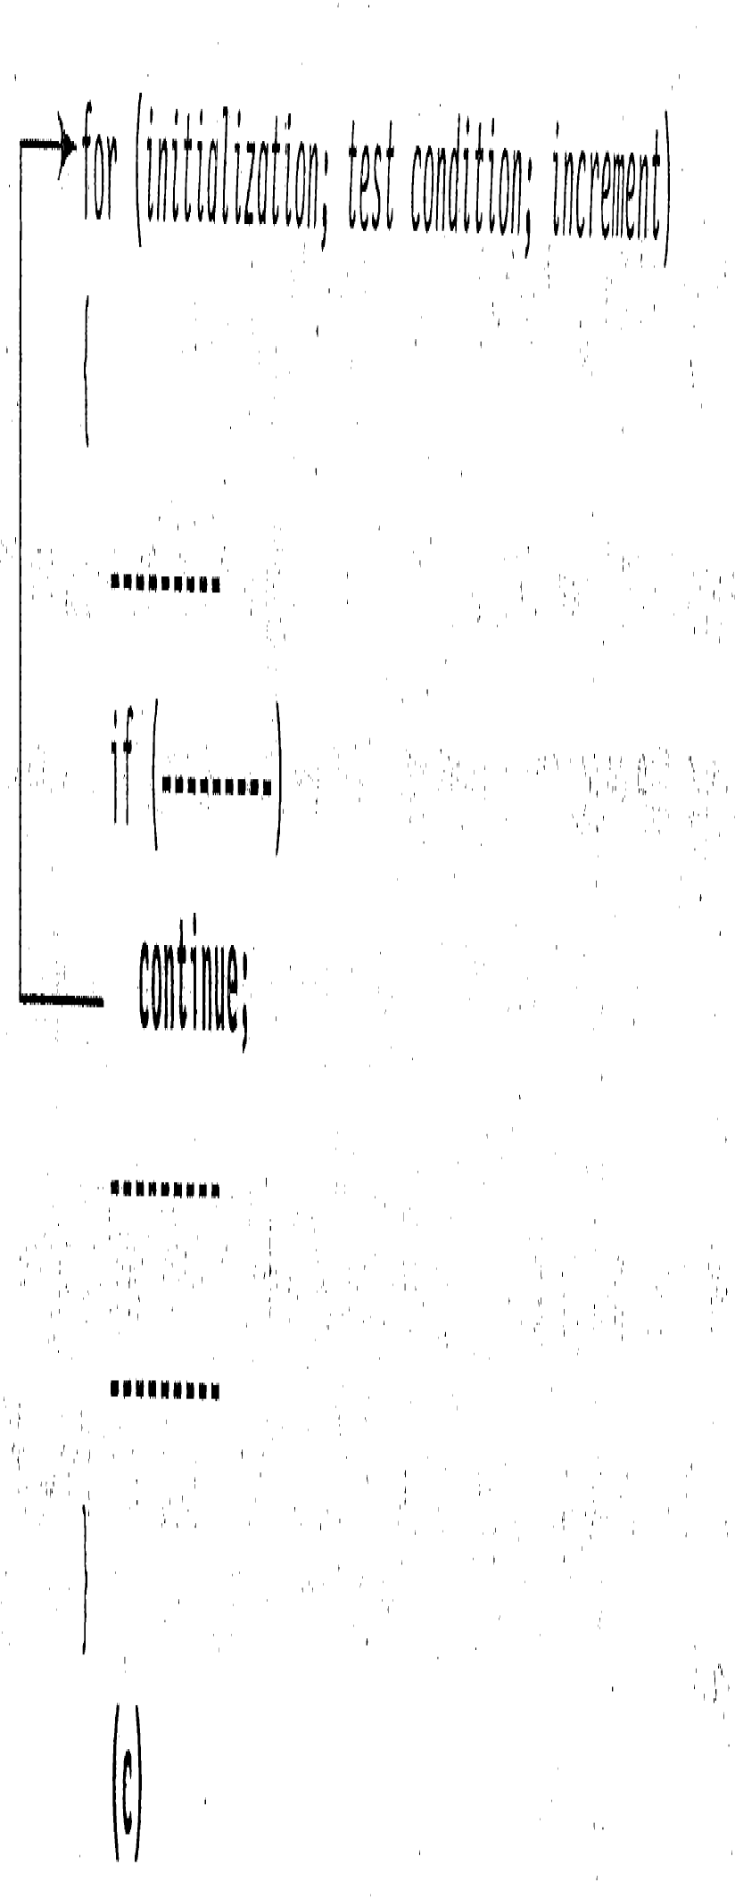
CSE 101:Computer Programming
Start up
Decision making and looping:-
Skipping a part of the loop

Slide 17
CSE 101:Computer Programming
Start up
Decision making and looping:-
Skipping a part of the loop
main()
{
int roll, midTerm, total, I, j, n=10;
for(i=1; i<=n; i++)
{
total=0;
printf(“Enter Roll No\n”);
scanf(“%d”, &roll);
printf(“\nEnter marks of three mid terms\n”);
for(j=1;j<=3;j++)
{
if(i==5) break;
scanf(“%d “, &midTerm);
total=total+midTerm;
}
printf(“\n%d obtains %d in mid terms\n”, roll, total);
}
getch();
}
Inner loop skips for student 5, but it is done by break statement.

Slide 18
CSE 101:Computer Programming
Start up
Decision making and looping:-
Skipping a part of the loop
main()
{
int roll, midTerm, total, I, j, n=10;
for(i=1; i<=n; i++)
{
if(i==5) continue;
total=0;
printf(“Enter Roll No\n”);
scanf(“%d”, &roll);
printf(“\nEnter marks of three mid terms\n”);
for(j=1;j<=3;j++)
{
scanf(“%d “, &midTerm);
total=total+midTerm;
}
printf(“\n%d obtains %d in mid terms\n”, roll, total);
}
getch();
}
Continue statement to skip for student 5

