Slide 1


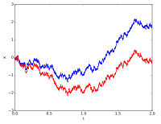
Stochastic Process for MS
CSE 5403: Stochastic Process Cr. 3.00
Course Teacher: A H M Kamal
Course Leaner: 2nd semester of MS 2015-16

Slide 2
Stochastic Process for MS
Point Estimation:
We know that before the data is collected,
the observations are considered to be random variables, say X₁, X₂, …, X_{n}.
Therefore, a random variable could be
any function of the observation, or
any statistic,
For example, the sample mean M̅ and the sample variance S² are statistics and they
are also random variables.

Slide 3
Stochastic Process for MS
Point Estimation:
A numerical value of a sample statistic will be used as the point estimate.
The objective of point estimation is to select a single number, based on sample data, that is the most plausible value for a parameter of interest, say θ.
if
X is a random variable with probability distribution f(x),
characterized by the unknown parameter θ,
and if
X₁, X₂, …, X_{n} is a random sample of size n from X,
=> the statistic Θ̂=h(X₁, X₂, …, X_{n})is called a point estimator of θ.
Note that:
Θ̂ is a random variable because it is a function of random variables.
After the sample has been selected, Θ̂ takes on a particular numerical value θ̂ called the point estimate of θ.

Slide 4
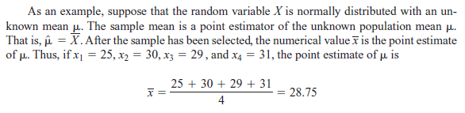
Stochastic Process for MS
Point Estimation:

Slide 5
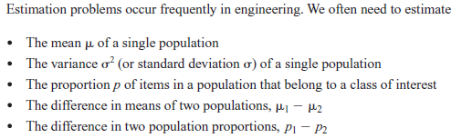
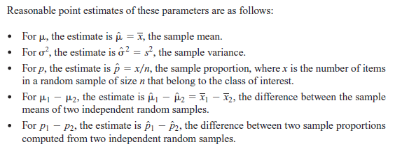
Stochastic Process for MS
Point Estimation:

Slide 6

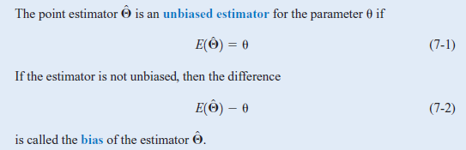
Stochastic Process for MS
Point Estimation: Unbiased Estimator

Slide 7
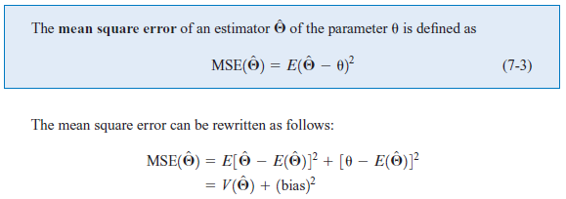
Stochastic Process for MS
Point Estimation:

Slide 8
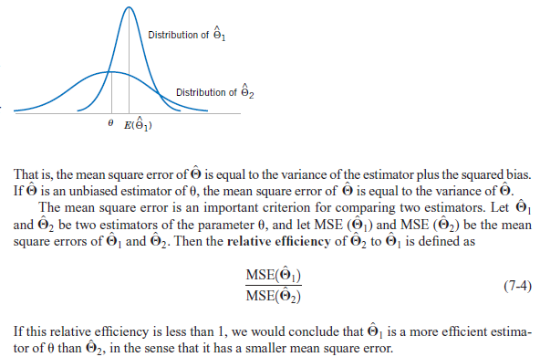
Stochastic Process for MS
Point Estimation:

Slide 9
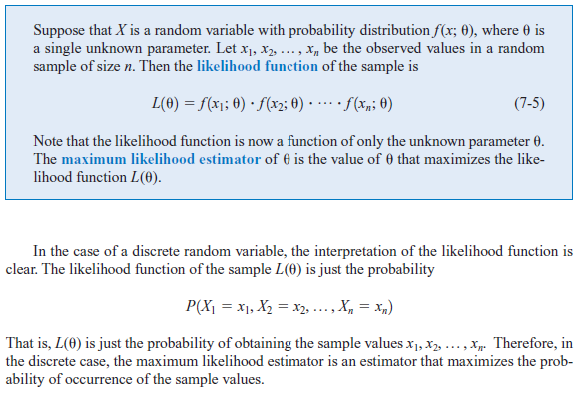
Stochastic Process for MS
Point Estimation: Maximum Likelihood
One of the best methods of obtaining a point estimator of a parameter is the method of maximum likelihood.

Slide 10
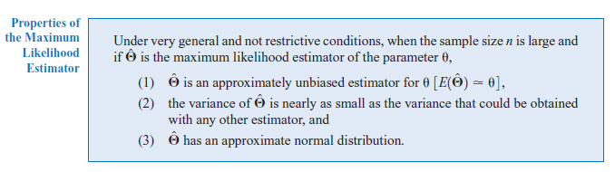
Stochastic Process for MS
Point Estimation:

Slide 11
Stochastic Process for MS
Point Estimation:

