Slide 1
CSE 101:Computer Programming
Start up
Course Teacher: Dr. A. H. M. Kamal
To Session: 2017-18
Year : 1 Semester: 1
Date of class commencement: 07/03/2018 Class termination: 31/07/2018
Evaluation method:
Early evaluation
Mid Term I 10
Mid Term II 10
Mid Term III (A project) 10
Class attendance 10
Early evaluation total 40
Final exam 60
Total 100

Slide 2
CSE 101:Computer Programming
Start up
Chapter: Managing Input and Output Operations
Reading a character:
Variable_name=getchar();
For example
char Grade;
Grade=getchar();
The same can also be performed by:
scanf(“%c”, Grade);

Slide 3
CSE 101:Computer Programming
Start up
Chapter: Managing Input and Output Operations
Reading a character: Checking whether the typed character is digit or alphabet
char Grade;
Grade=getchar();
int Flag;
Flag=isalpha(Grade);
The value of Flag is non-zero if Grade contains an alphabet.
Flag=isdigit(Grade);
The value of Flag is non-zero if Grade contains a digit.

Slide 4
CSE 101:Computer Programming
Start up
Chapter: Managing Input and Output Operations
Reading a character: Checking whether the typed character is digit or alphabet
char Grade, changedCase;
Grade=getchar();
int Flag;
Flag=isalpha(Grade);
The value of Flag is non-zero if Grade contains an alphabet.
Flag=isdigit(Grade);
The value of Flag is non-zero if Grade contains a digit.
changedCase=toupper(Grade);
It will convert Grade value to upper case letter.
changedCase=tolower(Grade);
It will convert Grade value to lower case letter.

Slide 5
CSE 101:Computer Programming
Start up
Chapter: Managing Input and Output Operations
Writing a character:
char Grade, changedCase;
Grade=getchar();
putchar(variable_Name);
For example:
1. Grade=‘A’;
putchar(Grade);
2. Grade=‘A’;
char cCase;
cCase=tolower(Grade);
putcharCase);
3. Grade=‘a’;
char cCase=toupper(Grade);
putchar(cCase);
output
A
output
a
output
A

Slide 6
CSE 101:Computer Programming
Start up
Chapter: Managing Input and Output Operations
Data inputing
scanf(“control string”, &arg1, &arg2, …);

Slide 7
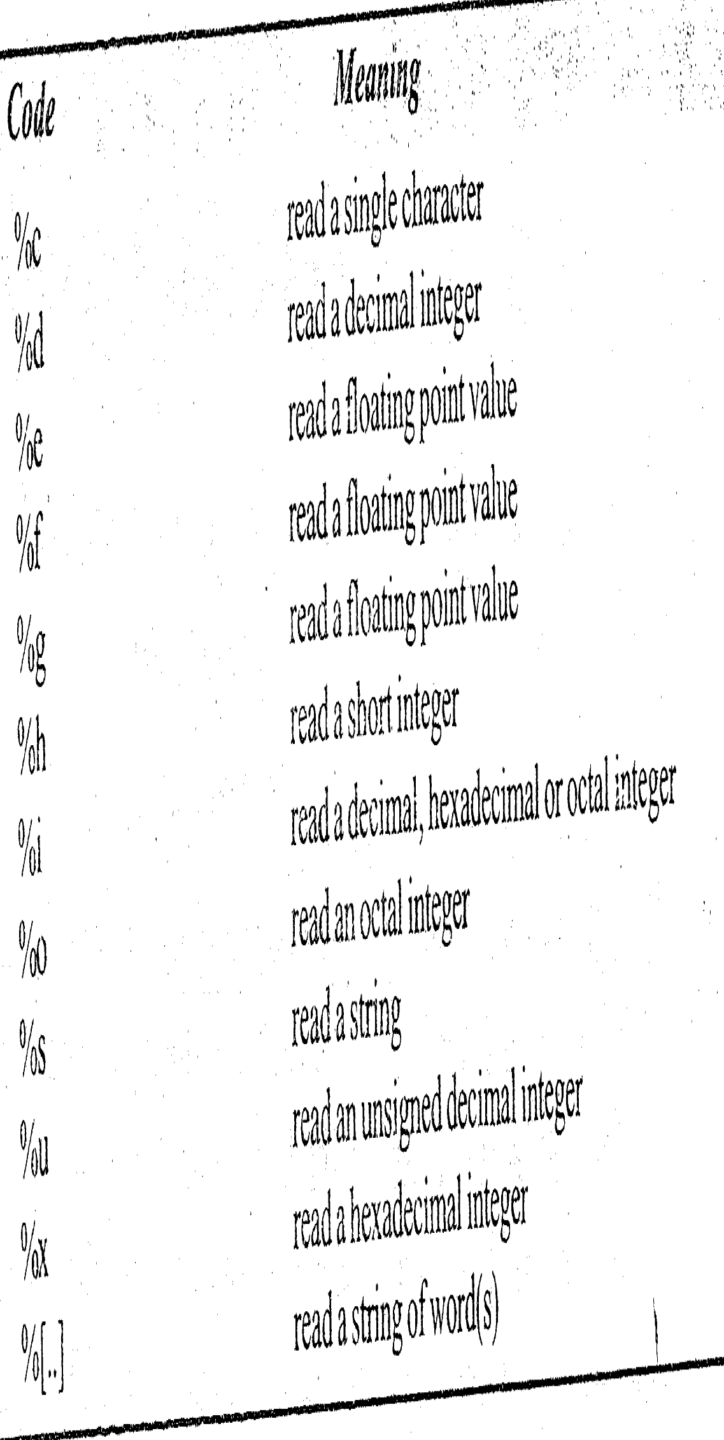
CSE 101:Computer Programming
Start up
Chapter: Managing Input and Output Operations
Data inputing
scanf(“control string”, &arg1, &arg2, …);
scanf(“%d”, &a);
scanf(“%f”, &b);
scanf(“%s”, &c);
scanf(“%c”, d);

Slide 8
CSE 101:Computer Programming
Start up
Chapter: Managing Input and Output Operations
Mixed data inputing
scanf(“%d %f %s %c”, &a, &b, &c, d);

Slide 9
CSE 101:Computer Programming
Start up
Chapter: Managing Input and Output Operations
Mixed data output
printf(“%d”, a);
printf(“%f”, b);
printf(“%s”, c);
printf(“%c”, d);
In a mixed manner
printf(“%d %f %s %c”, a, b, c, d);

Slide 10
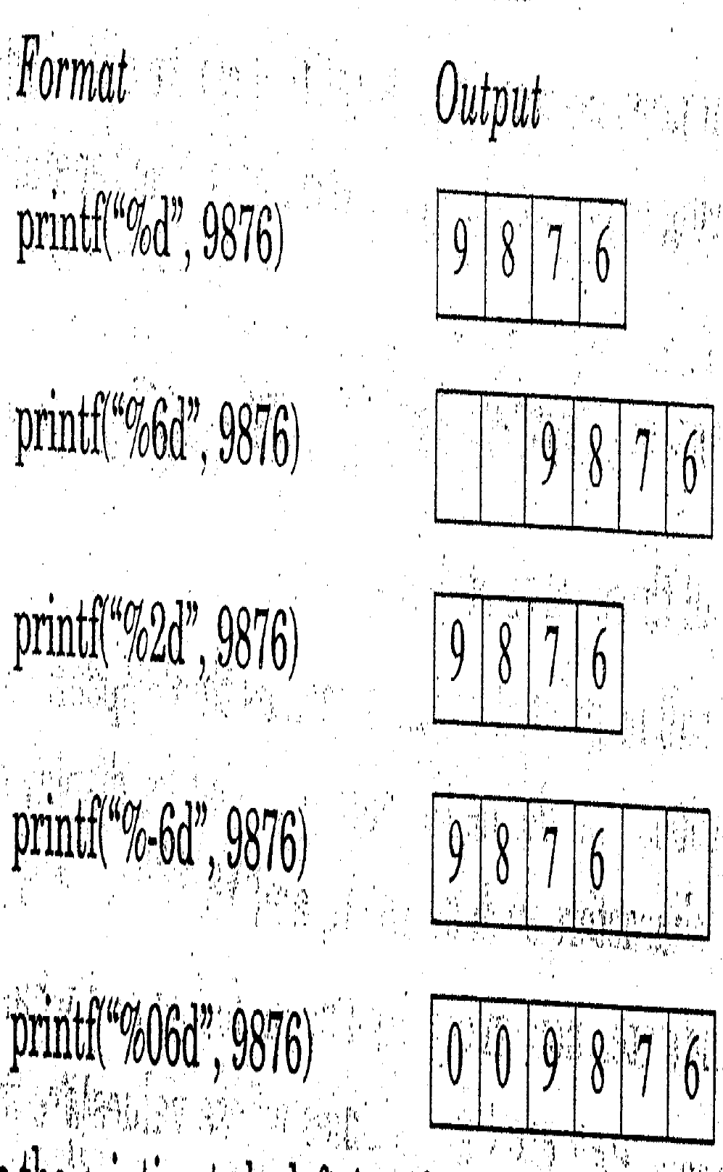
CSE 101:Computer Programming
Start up
Chapter: Managing Input and Output Operations
Data Types: Formating Integer Number
Example:
Void main()
{
int Roll;
printf(“Enter your roll no\n”);
scanf(“%d”, &Roll);
printf(“Your roll is %d\n”, Roll);
}

Slide 11
CSE 101:Computer Programming
Start up
Chapter: Managing Input and Output Operations
Data Types: Formating Integer Number
Example:
Void main()
{
int Number;
Number=9876
printf(“%d\n”, Number);
printf(“%6d\n”, Number);
printf(“%2d\n”, Number);
printf(“%-6d\n”, Number);
printf(“%06d\n”, Number);
}

Slide 12
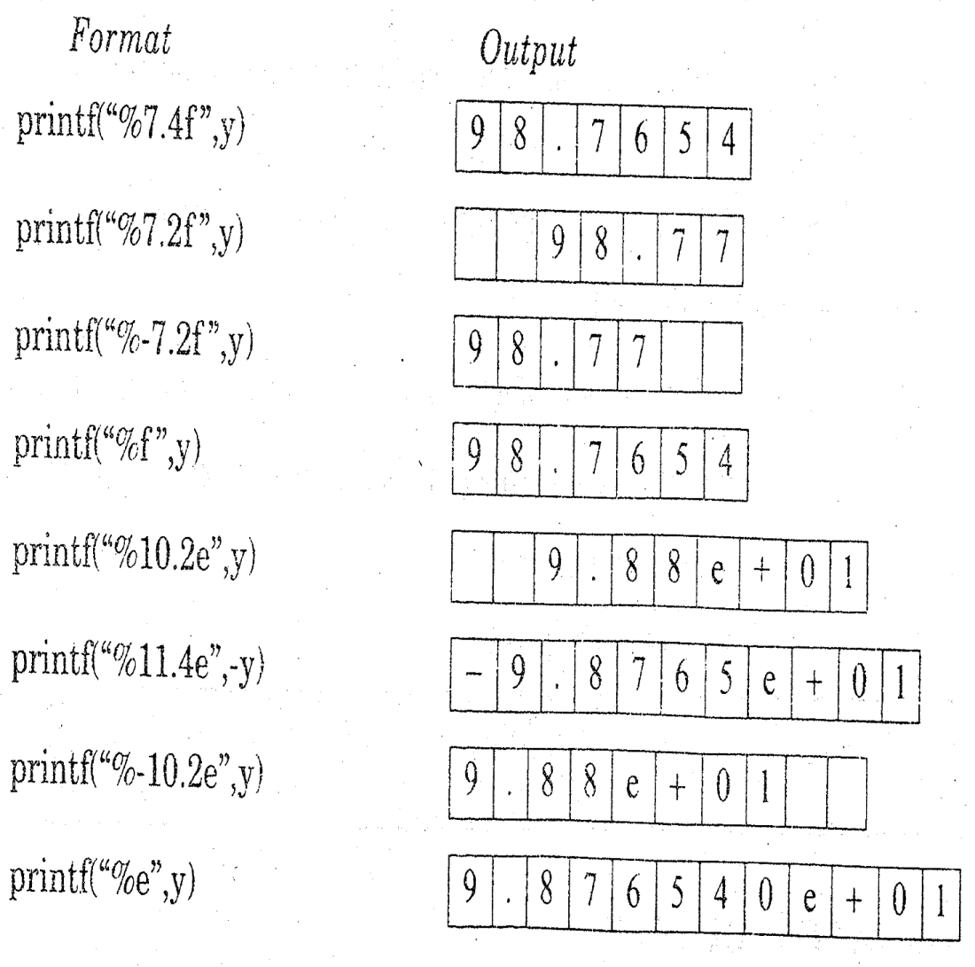
CSE 101:Computer Programming
Start up
Chapter: Managing Input and Output Operations
Data Types: Formating Real Number
Example:
Void main()
{
float Number;
y=98.7654
printf(“%7.4f\n”, y);
printf(“%7.2f\n”, y);
printf(“%-7.2f\n”, y);
printf(“%f\n”, y);
printf(“%10.2e\n”, y);
}

Slide 13
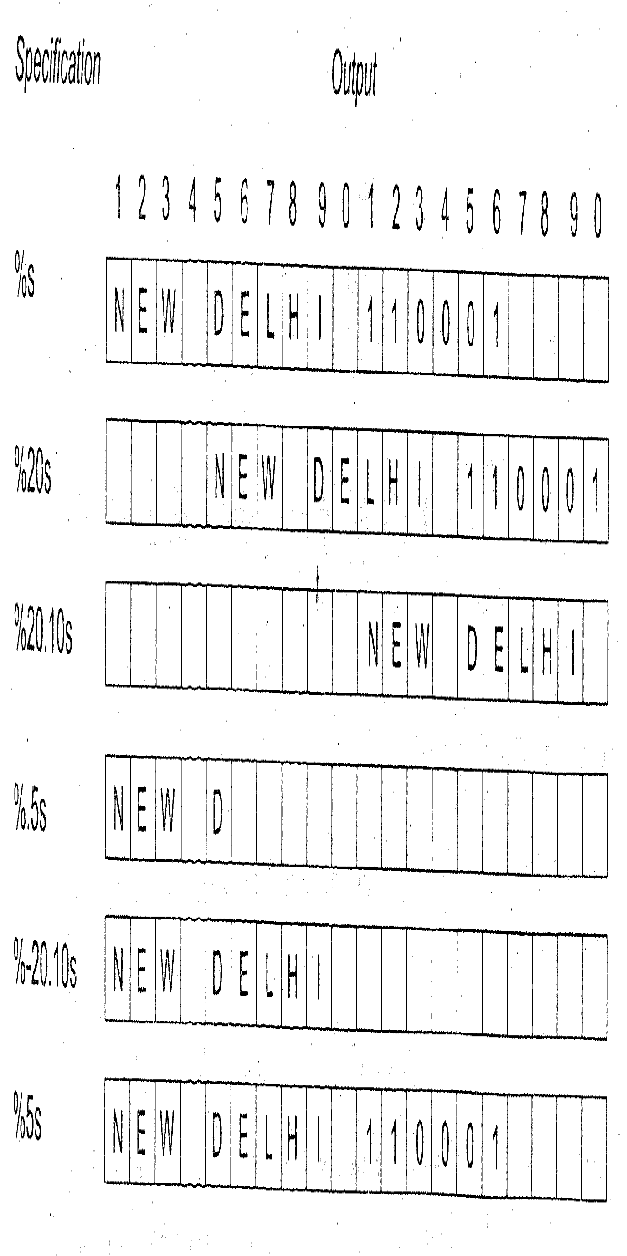
CSE 101:Computer Programming
Start up
Chapter: Managing Input and Output Operations
Data Types: Formating String

Slide 14
CSE 101:Computer Programming
Start up
Chapter: Managing Input and Output Operations
Data Types: Enhancing the readability of output
Tab \t
New line \n
printf(“%d /t %f/n %s /t %c”, a, b, c, d);

Slide 15
CSE 101:Computer Programming
Start up
Chapter: Managing Input and Output Operations
Data Types: Enhancing the readability of output
Example: We want to design this Inventory:
Sr | Qty | Rate
1 | 15 | 500
2 | 20 | 1000
3 | 12 | 700
Line 1
Line 2
Line 3
Line 4
main(){
int Sr, Qty1, Rate1 , Qty2, Rate2 , Qty3, Rate3;
printf(“Enter Quantity and Rate);
scanf(“%d%d”,&Qty1, &Rate1);
sanf(“%d%d”,&Qty2, &Rate2);
scanf(“%d%d”,&Qty3, &Rate3);
Sr=1;
printf(“Sr \t Qty \t Rate\n”);
printf(“%d \t %d \t%d\n”, Sr, Qty1, Rate1);
Sr=Sr+1;
printf(“\n%d \t %d \t%d\n”, Sr, Qty2, Rate2);
Sr=Sr+1;
printf(“\n%d \t %d \t%d\n”, Sr, Qty3, Rate3);
}
Read Values
Program for the Inventory:
Output: First line of Inventory
Output: Second line of Inventory
Print Values
Output: Third line of Inventory
Output: Fourth line of Inventory

Slide 16
CSE 101:Computer Programming
Start up
Chapter: Managing Input and Output Operations
Data Types: Primary Data Types
Example
Program:
#include<stdio.h>
#include<conio.h>
void main()
{
printf(“**********\n”);
printf(“*******\n”);
printf(“****\n”);
printf(“*”);
getch();
}
Demanded Output
**********
*******
****
*

Slide 17
CSE 101:Computer Programming
Start up
Chapter: Managing Input and Output Operations
Data Types: Primary Data Types
Example
Program:
#include<stdio.h>
#include<conio.h>
void main()
{
printf(“**********\n”);
printf(“ *******\n”);
printf(“ ****\n”);
printf(“ *”);
getch();
}
Demanded Output
**********
*******
****
*

Slide 18
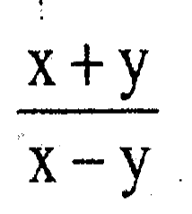
CSE 101:Computer Programming
Start up
Write a program to read the values of x and y and to write the values of
Program:
#include<stdio.h>
#include<conio.h>
void main()
{
float x, y, sum, sub, div;
printf(“Enter the value of x and y”);
scanf(“%f %f”, &x, &y);
sum=x+y;
sub=x-y;
div=sum/sub;
printf(“\n”);
printf(“x+y\n”);
printf(“ ------=%f\n”, div);
printf(“x-y\n”);
getch();
}
Output
Enter the value of x and y
While executing

Slide 19
CSE 101:Computer Programming
Start up
Write a program to read the values of x and y and to write the values of
Program:
#include<stdio.h>
#include<conio.h>
void main()
{
float x, y, sum, sub, div;
printf(“Enter the value of x and y”);
scanf(“%f %f”, &x, &y);
sum=x+y;
sub=x-y;
div=sum/sub;
printf(“\n”);
printf(“x+y\n”);
printf(“ ------=%f\n”, div);
printf(“x-y\n”);
getch();
}
Output
Enter the value of x and y
While executing

Slide 20
CSE 101:Computer Programming
Start up
Write a program to read the values of x and y and to write the values of
X=50
Program:
#include<stdio.h>
#include<conio.h>
void main()
{
float x, y, sum, sub, div;
printf(“Enter the value of x and y”);
scanf(“%f %f”, &x, &y);
sum=x+y;
sub=x-y;
div=sum/sub;
printf(“\n”);
printf(“x+y\n”);
printf(“ ------=%f\n”, div);
printf(“x-y\n”);
getch();
}
Output
Enter the value of x and y 50
While executing

Slide 21
CSE 101:Computer Programming
Start up
Write a program to read the values of x and y and to write the values of
X=50
Y=40
Program:
#include<stdio.h>
#include<conio.h>
void main()
{
float x, y, sum, sub, div;
printf(“Enter the value of x and y”);
scanf(“%f %f”, &x, &y);
sum=x+y;
sub=x-y;
div=sum/sub;
printf(“\n”);
printf(“x+y\n”);
printf(“ -----=%f\n”, div);
printf(“x-y\n”);
getch();
}
Output
Enter the value of x and y 50 40
While executing

Slide 22
CSE 101:Computer Programming
Start up
Write a program to read the values of x and y and to write the values of
X=50
Y=40
sum=50+40=90
Program:
#include<stdio.h>
#include<conio.h>
void main()
{
float x, y, sum, sub, div;
printf(“Enter the value of x and y”);
scanf(“%f %f”, &x, &y);
sum=x+y;
sub=x-y;
div=sum/sub;
printf(“\n”);
printf(“x+y\n”);
printf(“ -----=%f\n”, div);
printf(“x-y\n”);
getch();
}
Output
Enter the value of x and y 50 40
While executing

Slide 23
CSE 101:Computer Programming
Start up
Write a program to read the values of x and y and to write the values of
X=50
Y=40
sum=50+40=90
sub=50-40=10
Program:
#include<stdio.h>
#include<conio.h>
void main()
{
float x, y, sum, sub, div;
printf(“Enter the value of x and y”);
scanf(“%f %f”, &x, &y);
sum=x+y;
sub=x-y;
div=sum/sub;
printf(“\n”);
printf(“x+y\n”);
printf(“ -----=%f\n”, div);
printf(“x-y\n”);
getch();
}
Output
Enter the value of x and y 50 40
While executing

Slide 24
CSE 101:Computer Programming
Start up
Write a program to read the values of x and y and to write the values of
X=50
Y=40
sum=50+40=90
sub=50-40=10
div=90/10=9
Program:
#include<stdio.h>
#include<conio.h>
void main()
{
float x, y, sum, sub, div;
printf(“Enter the value of x and y”);
scanf(“%f %f”, &x, &y);
sum=x+y;
sub=x-y;
div=sum/sub;
printf(“\n”);
printf(“x+y\n”);
printf(“ ------=%f\n”, div);
printf(“x-y\n”);
getch();
}
Output
Enter the value of x and y 50 40
While executing

Slide 25
CSE 101:Computer Programming
Start up
Write a program to read the values of x and y and to write the values of
X=50
Y=40
sum=50+40=90
sub=50-40=10
div=90/10=9
Program:
#include<stdio.h>
#include<conio.h>
void main()
{
float x, y, sum, sub, div;
printf(“Enter the value of x and y”);
scanf(“%f %f”, &x, &y);
sum=x+y;
sub=x-y;
div=sum/sub;
printf(“\n”);
printf(“x+y\n”);
printf(“ ------=%f\n”, div);
printf(“x-y\n”);
getch();
}
Output
Enter the value of x and y 50 40
While executing

Slide 26
CSE 101:Computer Programming
Start up
Write a program to read the values of x and y and to write the values of
X=50
Y=40
sum=50+40=90
sub=50-40=10
div=90/10=9
Program:
#include<stdio.h>
#include<conio.h>
void main()
{
float x, y, sum, sub, div;
printf(“Enter the value of x and y”);
scanf(“%f %f”, &x, &y);
sum=x+y;
sub=x-y;
div=sum/sub;
printf(“\n”);
printf(“x+y\n”);
printf(“ ------=%f\n”, div);
printf(“x-y\n”);
getch();
}
Output
Enter the value of x and y 50 40
x+y
While executing

Slide 27
CSE 101:Computer Programming
Start up
Write a program to read the values of x and y and to write the values of
X=50
Y=40
sum=50+40=90
sub=50-40=10
div=90/10=9
Program:
#include<stdio.h>
#include<conio.h>
void main()
{
float x, y, sum, sub, div;
printf(“Enter the value of x and y”);
scanf(“%f %f”, &x, &y);
sum=x+y;
sub=x-y;
div=sum/sub;
printf(“\n”);
printf(“x+y\n”);
printf(“ ------=%f\n”, div);
printf(“x-y\n”);
getch();
}
Output
Enter the value of x and y 50 40
x+y
------=9
While executing

Slide 28
CSE 101:Computer Programming
Start up
Write a program to read the values of x and y and to write the values of
X=50
Y=40
sum=50+40=90
sub=50-40=10
div=90/10=9
Program:
#include<stdio.h>
#include<conio.h>
void main()
{
float x, y, sum, sub, div;
printf(“Enter the value of x and y”);
scanf(“%f %f”, &x, &y);
sum=x+y;
sub=x-y;
div=sum/sub;
printf(“\n”);
printf(“x+y\n”);
printf(“ ------=%f\n”, div);
printf(“x-y\n”);
getch();
}
Output
Enter the value of x and y 50 40
x+y
------=9
x-y
While executing

Slide 29
CSE 101:Computer Programming
Start up
Decision
End of Chapter 4
Next Chapter 5
Decision making and branching

