Slide 1
CSE 101:Computer Programming
Operators
Operators in C

Slide 2
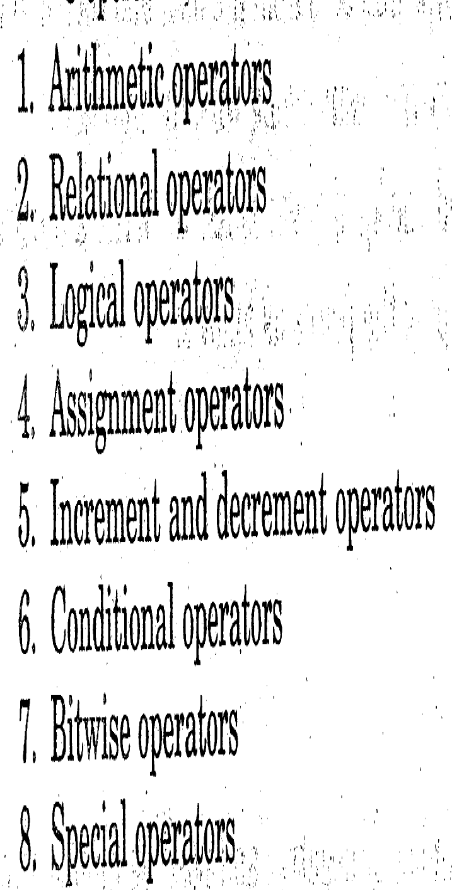
CSE 101:Computer Programming
Operators
Operator:
Arithmetic Operator
Addition +
Subtraction -
Division /
Multiplication *
Modulus division %
Relational Operator
< Less than
> Greater than
== Equal
>= Greater or equal
<= Less or equal
!= Not equal
Output: Number
Output: True or False
Output: True or False
Logical Operator
&& Logical AND
|| Logical OR
! Logical NOT
Output: Number
Assignment Operator
= var op=exp
Means var=var op exp
Incr and Decr Operator
++ var var=var+1;
var++ var=var+1;
--var var=var-1;
var-- var=var-1;
Output: Number
Conditional Operator
? : var= exp1? Exp2 : exp3
Output: Value
if(x>10) y=1;
else y=2;
y=x>10 ? 1:2
Bitwise Operator
& bitwise AND
| bitwise OR
^ bitwise exclusive OR
<< shift left
>> shift right
Bitwise Operator
, comma
Sizeof
& and * pointer
. And -> member selection
Output: Number

Slide 3
CSE 101:Computer Programming
Operators
Operator:
Precedence of operator:
S=a-b/2-c*3+2;
High priority *, /, %
Low priority +, -

Slide 4
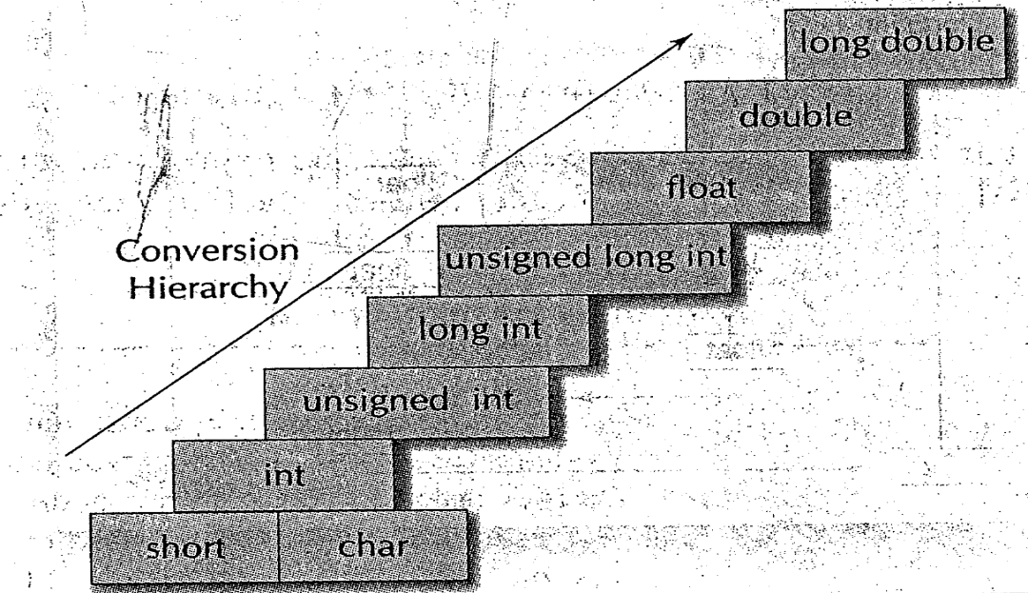
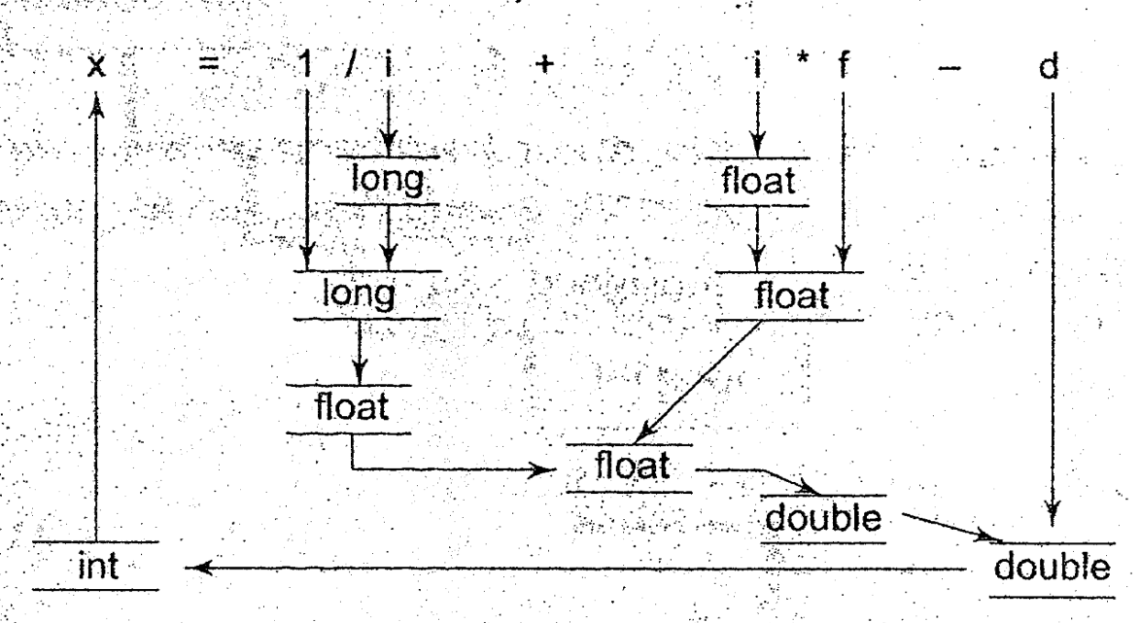
CSE 101:Computer Programming
Operators
Type Conversion:
Type Conversion:
Implicit:
During evaluation, lower type is converted to upper type automatically.
int i, x;
float f;
double d;
long int l;
x=l/i+i*f-d;

Slide 5

CSE 101:Computer Programming
Operators
Type Conversion:
Type Conversion:
Implicit:
During evaluation, lower type is converted to upper type automatically.
(2) Explicit :
Changing type manually.
int a, b;
float c;
c=a/b;
Solution:
int i, a, b;
float c;
c=(float) (a/b);

Slide 6
CSE 101:Computer Programming
Operators
End of Type Conversion

