Slide 1


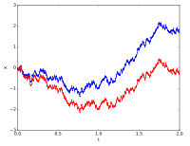
Stochastic Process for MS
CSE 5403: Stochastic Process Cr. 3.00
Course Teacher: A H M Kamal
Course Leaner: 2nd semester of MS 2015-16

Slide 2
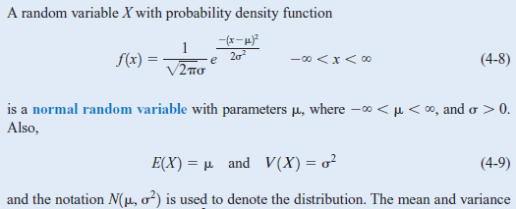
Stochastic Process for MS
Normal Distribution:
In probability theory, the normal (or Gaussian or Gauss or Laplace-Gauss) distribution is a very common continuous probability distribution.
A random variable with a Gaussian distribution is said to be normally distributed.

Slide 3
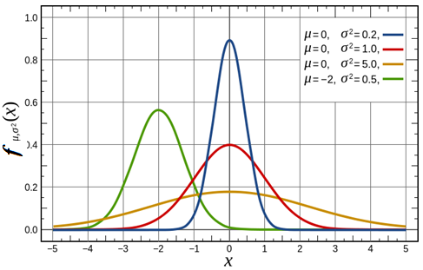

Stochastic Process for MS
Normal Distribution:

Slide 4
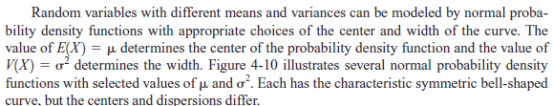
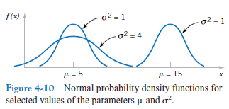
Stochastic Process for MS
Normal Distribution:

Slide 5
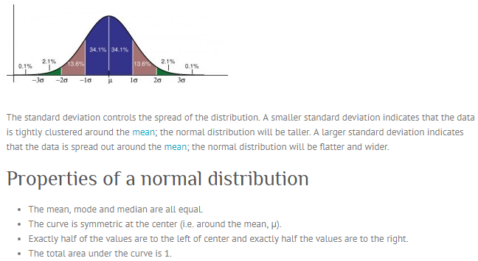
Stochastic Process for MS
Normal Distribution:
The standard Gaussian distribution has a mean of 0 and a standard deviation of 1.

Slide 6

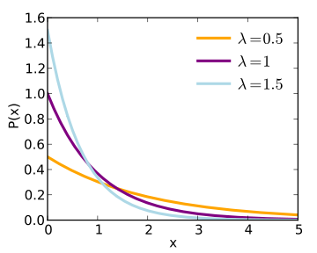

Stochastic Process for MS
Probability Density Function of an Exponential Random Variable:
The mean or expected value of an exponentially distributed random variable X with rate parameter λ is given by

Slide 7
Stochastic Process for MS
Joint Probability:
What is a 'Joint Probability‘?
A joint probability is a statistical measure where the likelihood of two events occurring together and at the same point in time are calculated. Joint probability is the probability of event Y occurring at the same time event X occurs.
Notation for joint probability takes the form:
P(X∩Y) or P(X and Y) or P(XY), which reads as the joint probability of X and Y.
Joint Probability vs. Conditional Probability
Joint probability should not be confused with conditional probability - the probability that one event will happen given that another action or event happens. The conditional probability form is P(X, given Y) or P(X│Y) – that is, the chance of one event happening is conditional on another event happening.
Joint probability only factors the likelihood of both events occurring. Conditional probability can be used to calculate joint probability, as seen in this formula: P(X ∩ Y) = P(X│Y) x P(Y).
Statisticians and analysts use joint probability as a tool when two or more observable events can occur simultaneously.

Slide 8
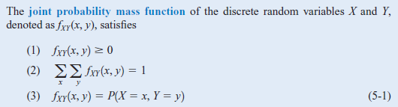
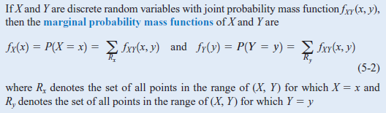
Stochastic Process for MS
Joint Probability:
The individual probability distribution of a random variable is referred
to as its marginal probability distribution.

Slide 9


Stochastic Process for MS
Joint Probability:
For Multiple Random Variable

Slide 10
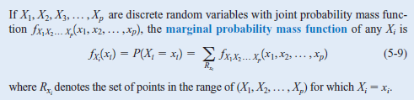
Stochastic Process for MS
Joint Probability:
For Multiple Random Variable

Slide 11
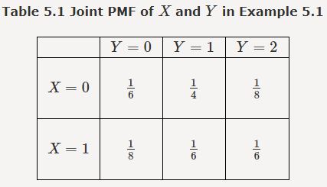
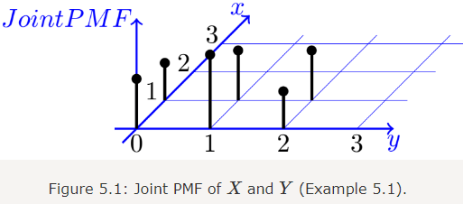
Stochastic Process for MS
Joint Probability:
Marginal Probability

Slide 12

Stochastic Process for MS
Joint Probability:
Marginal Probability
Find P(X=0,Y≤1)P(X=0,Y≤1).
Find the marginal PMFs of X and Y.
Find P(Y=1|X=0)P(Y=1|X=0).
Are X and Y independent?

Slide 13
Stochastic Process for MS
Joint Probability:
Marginal Probability
a. Find P(X=0,Y≤1)P(X=0,Y≤1).
b. Find the marginal PMFs of X and Y.
Find P(Y=1|X=0)P(Y=1|X=0).
Are X and Y independent?

Slide 14
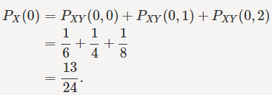
Stochastic Process for MS
Joint Probability:
Marginal Probability
a. Find P(X=0,Y≤1)P(X=0,Y≤1).
b. Find the marginal PMFs of X and Y.
Find P(Y=1|X=0)P(Y=1|X=0).
Are X and Y independent?

Slide 15

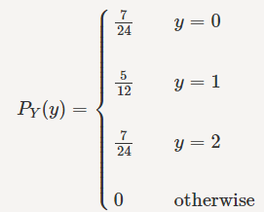
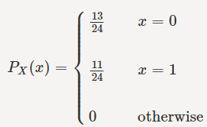
Stochastic Process for MS
Joint Probability:
Marginal Probability
a. Find P(X=0,Y≤1)P(X=0,Y≤1).
b. Find the marginal PMFs of X and Y.
Find P(Y=1|X=0)P(Y=1|X=0).
Are X and Y independent?
P_{y}(0)=P_{XY}(0,0)+ P_{XY}(0,1)=1/6+1/8=7/24

Slide 16
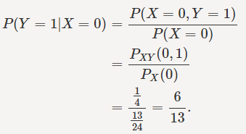
Stochastic Process for MS
Joint Probability:
Marginal Probability
a. Find P(X=0,Y≤1)P(X=0,Y≤1).
b. Find the marginal PMFs of X and Y.
Find P(Y=1|X=0)P(Y=1|X=0).
Are X and Y independent?
Conditional Probability Mass Function:

Slide 17



Stochastic Process for MS
Joint Probability:
Marginal Probability
a. Find P(X=0,Y≤1)P(X=0,Y≤1).
b. Find the marginal PMFs of X and Y.
Find P(Y=1|X=0)P(Y=1|X=0).
Are X and Y independent?
Conditional Probability Mass Function:

Slide 18
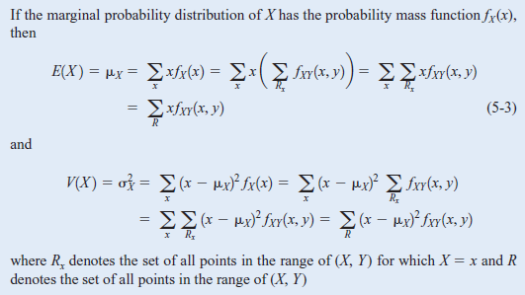
Stochastic Process for MS
Joint Probability:

Slide 19
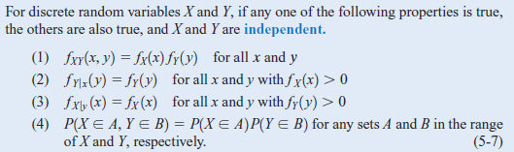
Stochastic Process for MS
Joint Probability:
Independent:

Slide 20
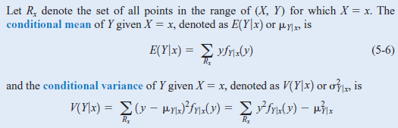
Stochastic Process for MS
Joint Probability:
Conditional:

Slide 21
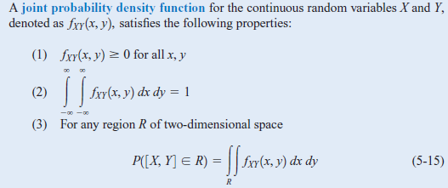
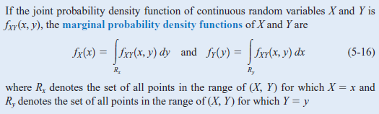
Stochastic Process for MS
Joint Probability:
Continuous:

Slide 22
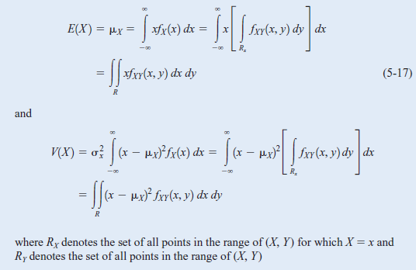
Stochastic Process for MS
Joint Probability:
Continuous:

Slide 23

Stochastic Process for MS
Joint Probability:
COVARIANCE:
When two or more random variables are defined on a probability space, it is useful to describe how they vary together; that is, it is useful to measure the relationship between the variables. A common measure of the relationship between two random variables is the covariance.
Because E[(X- u_{x})(Y- u_{y})]
=E[XY-Xu_{y} – Yu_{x} + u_{x}u_{y}]=E(XY)-u_{y}E(X)- u_{x}E(Y)+ u_{x}u_{y}
=E(XY)- u_{x}u_{y} - u_{x}u_{y} +u_{x}u_{y}

Slide 24

Stochastic Process for MS
Joint Probability:
COVARIANCE:
Because E[(X- u_{x})(Y- u_{y})]
=E[XY-Xu_{y} – Yu_{x} + u_{x}u_{y}]=E(XY)-u_{y}E(X)- u_{x}E(Y)+ u_{x}u_{y}
=E(XY)- u_{x}u_{y} - u_{x}u_{y} +u_{x}u_{y}
We know that E(XY) =
When X and Y are dependent.
If X and Y are independent, then E(XY)=E(X)E(Y)= u_{x}u_{y}
Then E[(X- u_{x})(Y- u_{y})]=E(XY)- u_{x}u_{y} = u_{x}u_{y} - u_{x}u_{y} =0

Slide 25
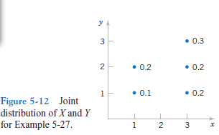



Stochastic Process for MS
Joint Probability:
COVARIANCE:
We know that E(XY) =
=1*1*0.1+3*1*0.2+ , for y=1
1*2*0.2+3*2*0.2+ , for y=2
3*3*0.3 , for y=3
-2.4*2.0
=5-4.8

Slide 26




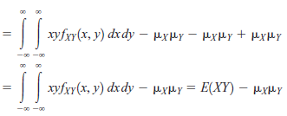
Stochastic Process for MS
Joint Probability:
COVARIANCE:
For continuous
random variables
Hence,

Slide 27

Stochastic Process for MS
Joint Probability:
COVARIANCE:
For continuous
random variables
If X and Y are dependent
If X and Y are independent

Slide 28


Stochastic Process for MS
Joint Probability:
Correlations:

Slide 29
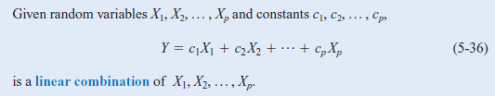
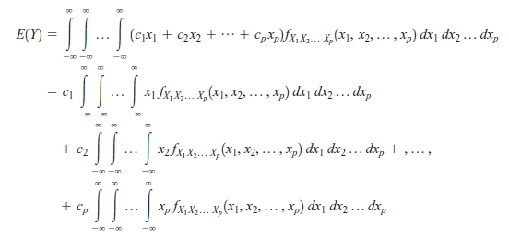

Stochastic Process for MS
Joint Probability:

Slide 30
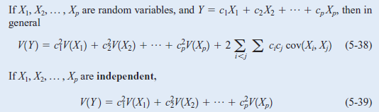
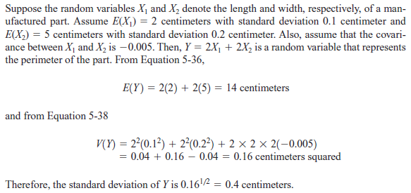
Stochastic Process for MS
Joint Probability:

Slide 31
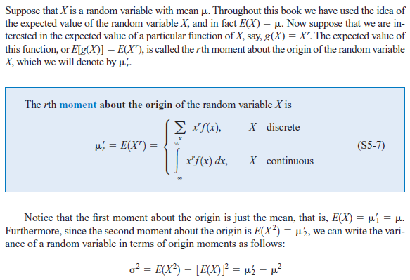
Stochastic Process for MS
Moment:

