Slide 1
CSE 101:Computer Programming
Start up
Course Teacher: Dr. A. H. M. Kamal
To Session: 2017-18
Year : 1 Semester: 1
Date of class commencement: 07/03/2018 Class termination: 31/07/2018
Evaluation method:
Early evaluation
Mid Term I 10
Mid Term II 10
Mid Term III (A project) 10
Class attendance 10
Early evaluation total 40
Final exam 60
Total 100

Slide 2
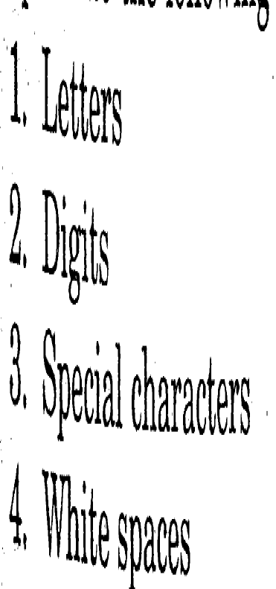
CSE 101:Computer Programming
Start up
Chapter: Constant, Variable and Data Types
Character Set:
a, b, …, z, A, B, …, Z
0, 1, 2, …, 9
@, $, #, *,

Slide 3
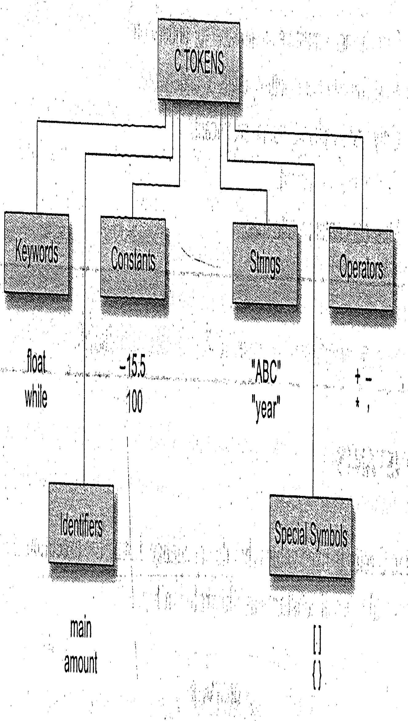
CSE 101:Computer Programming
Start up
Chapter: Constant, Variable and Data Types
Token:
Individual words and punctuation marks are called token.
Individual units of C program are called C token

Slide 4
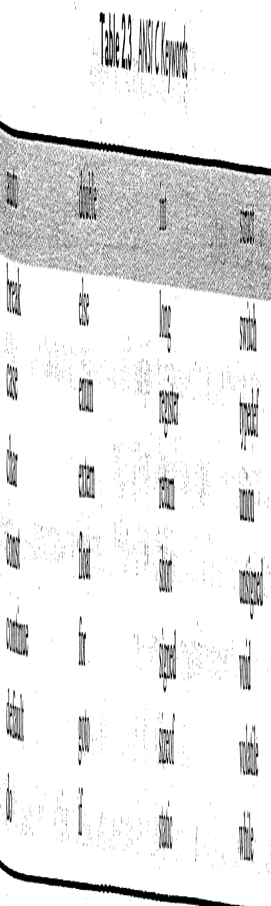
CSE 101:Computer Programming
Start up
Chapter: Constant, Variable and Data Types
Keywords:
Keywords have fixed meaning and these cannot be changed
These serve as basic building block for program statement

Slide 5
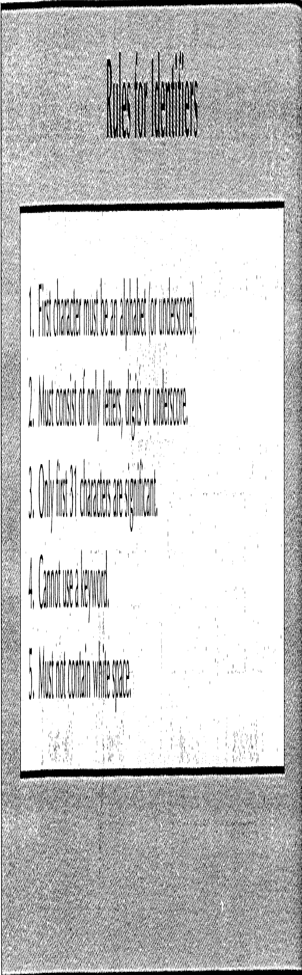
CSE 101:Computer Programming
Start up
Chapter: Constant, Variable and Data Types
Identifier:
Identifier refers to a name of a variable, function or array.
These are user define name.
Consisted of sequence of letter and digits starting with a letter.
Both lower case and upper case letter are permitted.
Example: Marks1, maks2, _Marks3, _marks4, marksOf5

Slide 6
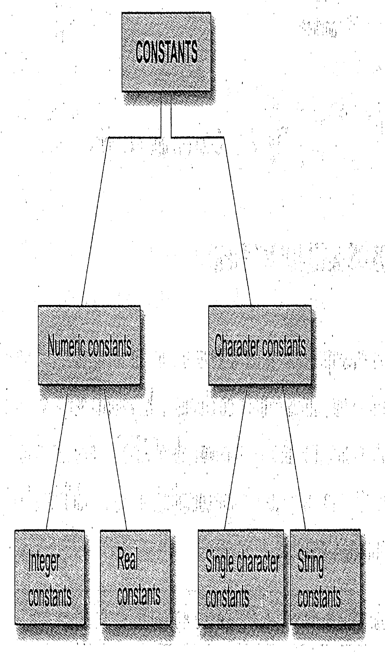
CSE 101:Computer Programming
Start up
Chapter: Constant, Variable and Data Types
Constant:
Refers to fixed values that do not change during the execution of a program
124, -234
0.05, -23.4
‘a’, ‘z’
“CSE”, “EEE”

Slide 7
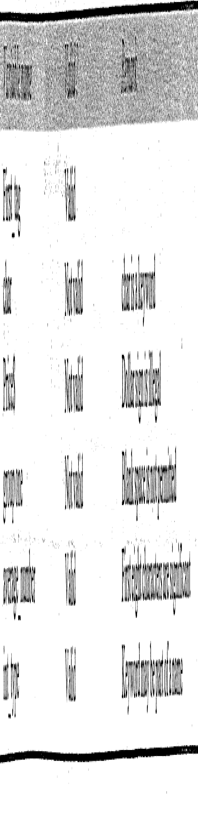
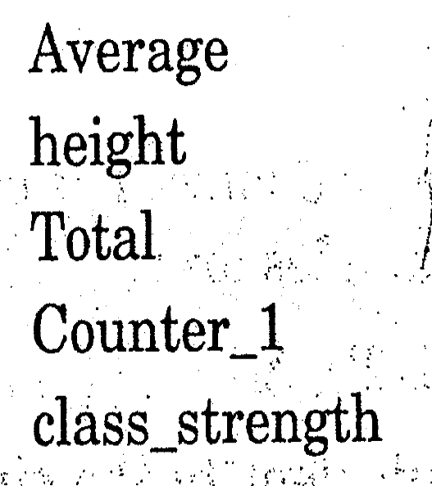
CSE 101:Computer Programming
Start up
Chapter: Constant, Variable and Data Types
Variable:
A variable is a data name that may be used to store a data value
A variable may take different value at different time during the execution

Slide 8
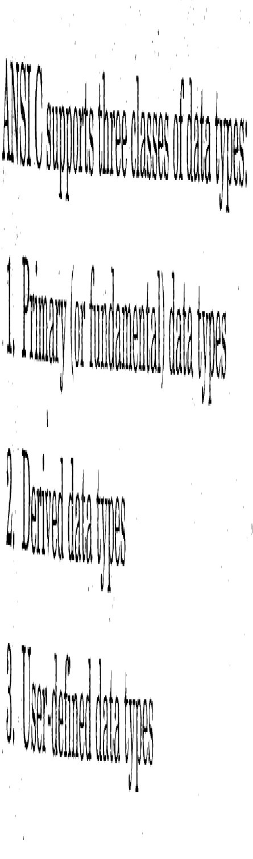
CSE 101:Computer Programming
Start up
Chapter: Constant, Variable and Data Types
Data Types:

Slide 9
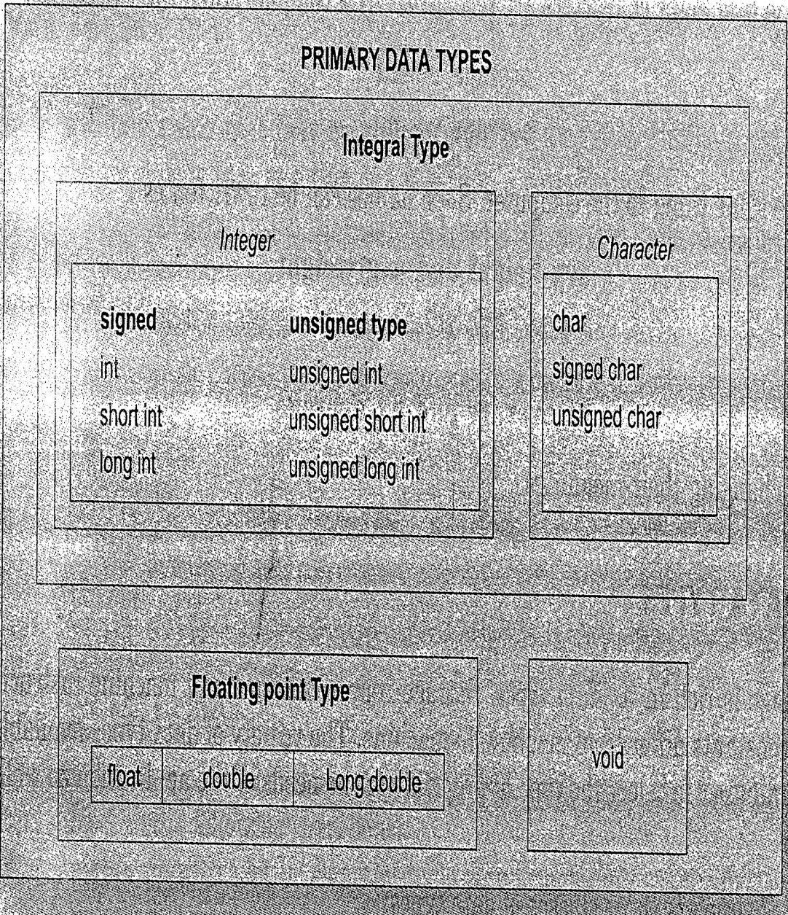
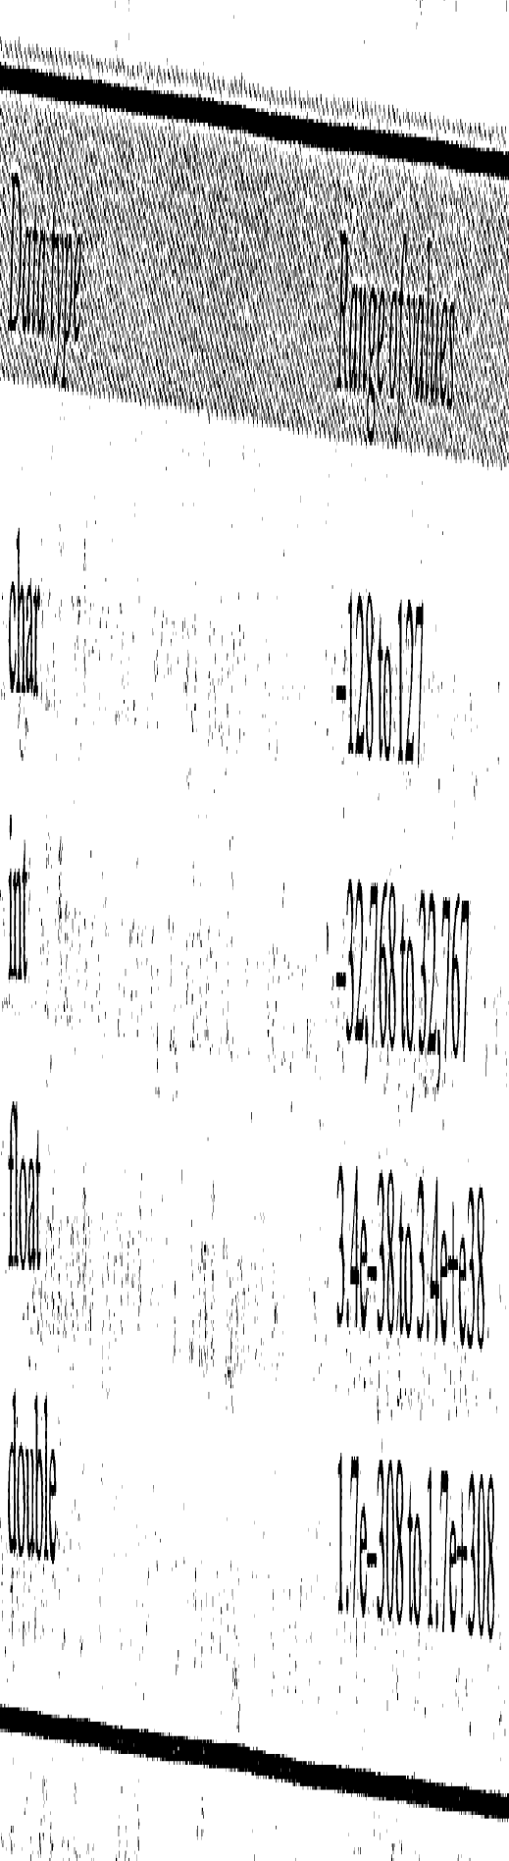
CSE 101:Computer Programming
Start up
Chapter: Constant, Variable and Data Types
Data Types: Primary Data Types

Slide 10
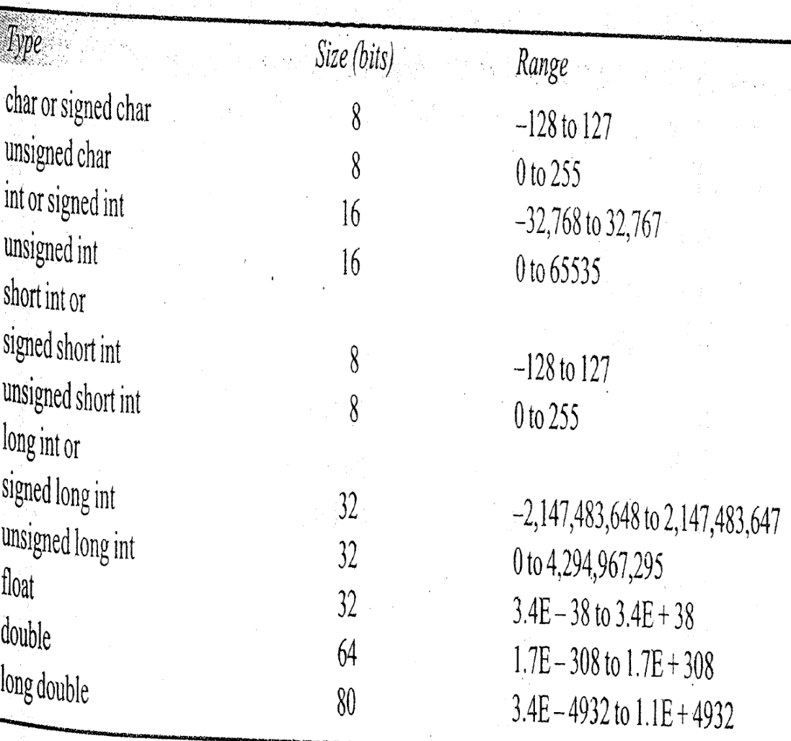
CSE 101:Computer Programming
Start up
Chapter: Constant, Variable and Data Types
Data Types: Primary Data Types

Slide 11
CSE 101:Computer Programming
Start up
Chapter: Constant, Variable and Data Types
Data Types:
It tells the compiler what the variable name is.
It specifies what type of data the variable will hold.
Declaration in C:
 | 1st part | 2nd part | 3rd part | 4th part
For single variable | Data type | Al least one space | Variable name For example, Roll | ;
For multiple variable | Data Type Ex. int | At least one space | First variable, second, …, nth variable Example roll1, roll2 | ;
Int Roll;
Int Roll1, Roll2, Roll4;

Slide 12
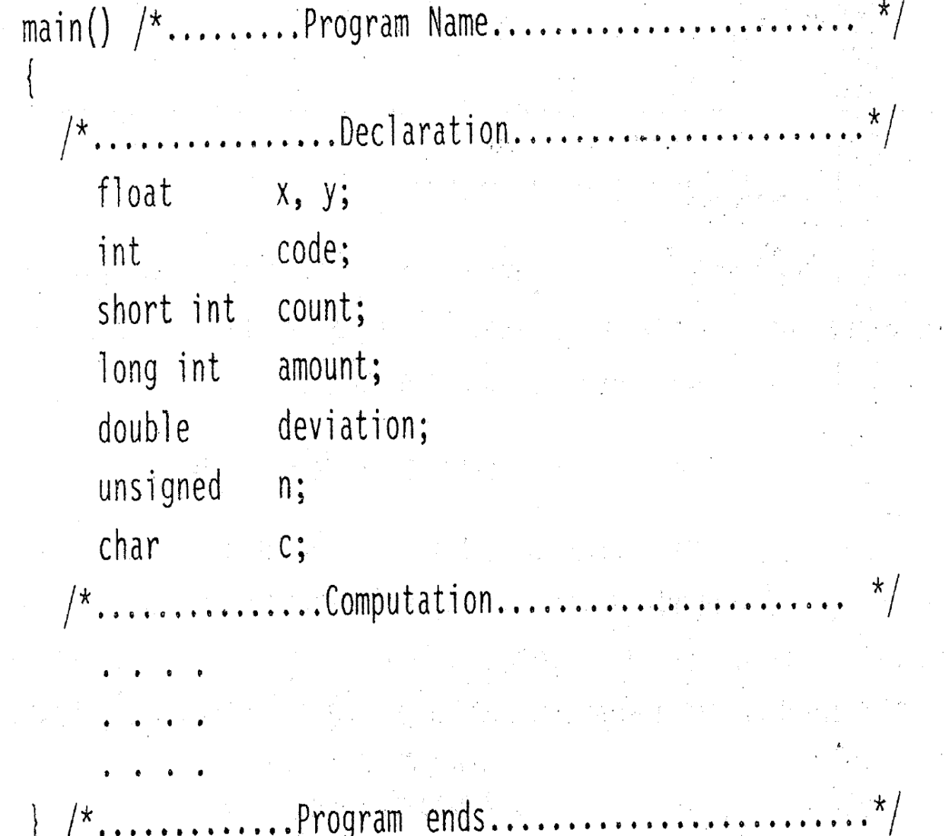
CSE 101:Computer Programming
Start up
Chapter: Constant, Variable and Data Types
Data Types: Variables in a program

Slide 13
CSE 101:Computer Programming
Start up
Chapter: Constant, Variable and Data Types
Data Types: Assigning values to variables
#include<stdio.h>
#include<stdlib.h>
Void main()
{
int a, b, c, total;
float avg;
total=a+b+c;
avg=total/3;
printf(“Total is %d”, total);
printf(“Average of three is %f”, avg);
}
Still problem, because a, b, c do not have any values. Hence, how and what the compute for total and avg.

Slide 14
CSE 101:Computer Programming
Start up
Chapter: Constant, Variable and Data Types
Data Types: Assigning values to variables
#include<stdio.h>
#include<stdlib.h>
Void main()
{
int a=10, b=15, c=20, total;
float avg;
total=a+b+c;
avg=total/3;
printf(“Total is %d”, total);
printf(“Average of three is %f”, avg);
}
#include<stdio.h>
#include<stdlib.h>
Void main()
{
int a, b, c, total;
float avg;
total=a+b+c;
avg=total/3;
printf(“Total is %d”, total);
printf(“Average of three is %f”, avg);
}
Assigning values to variable.

Slide 15
CSE 101:Computer Programming
Start up
Chapter: Constant, Variable and Data Types
Data Types: Assigning values to variables
#include<stdio.h>
#include<stdlib.h>
Void main()
{
int a, b, c, total;
a= 10;
b=15;
c=20;
float avg;
total=a+b+c;
avg=total/3;
printf(“Total is %d”, total);
printf(“Average of three is %f”, avg);
}
#include<stdio.h>
#include<stdlib.h>
Void main()
{
int a=10, b=15, c=20, total;
float avg;
total=a+b+c;
avg=total/3;
printf(“Total is %d”, total);
printf(“Average of three is %f”, avg);
}
Way of assigning values to variable.

Slide 16
CSE 101:Computer Programming
Start up
Chapter: Constant, Variable and Data Types
Data Types: Assigning values to variables
#include<stdio.h>
#include<stdlib.h>
Void main()
{
int a, b, c, total;
a= 10;
b=15;
c=20;
float avg;
total=a+b+c;
avg=total/3;
printf(“Total is %d”, total);
printf(“Average of three is %f”, avg);
}
#include<stdio.h>
#include<stdlib.h>
Void main()
{
int a=10, b=15, c=20, total;
float avg;
total=a+b+c;
avg=total/3;
printf(“Total is %d”, total);
printf(“Average of three is %f”, avg);
}
#include<stdio.h>
#include<stdlib.h>
Void main()
{
int a, b, c, total;
a= 10; b=15; c=20;
float avg;
total=a+b+c;
avg=total/3;
printf(“Total is %d”, total);
printf(“Average of three is %f”, avg);
}
Way of assigning values to variable.

Slide 17
CSE 101:Computer Programming
Start up
Chapter: Constant, Variable and Data Types
Data Types: Assigning values to variables
#include<stdio.h>
#include<stdlib.h>
Void main()
{
int a, b, c, total;
a= 10;
b=15;
c=20;
float avg;
total=a+b+c;
avg=total/3;
printf(“Total is %d”, total);
printf(“Average of three is %f”, avg);
}
#include<stdio.h>
#include<stdlib.h>
Void main()
{
int a=10, b=15, c=20, total;
float avg;
total=a+b+c;
avg=total/3;
printf(“Total= %d, Avg=%f”, total, avg);
}
#include<stdio.h>
#include<stdlib.h>
Void main()
{
int a, b, c, total;
a= 10; b=15; c=20;
float avg;
total=a+b+c;
avg=total/3;
printf(“Total is %d”, total);
printf(“Average of three is %f”, avg);
}
printf for same task
Way of assigning values to variable.

Slide 18
CSE 101:Computer Programming
Start up
Chapter: Constant, Variable and Data Types
Data Types: Assigning values to variables
#include<stdio.h>
#include<stdlib.h>
void main()
{
int a=10, b=15, c=20, total; float avg;
total=a+b+c;
avg=total/3;
printf(“Total= %d, Avg=%f”, total, avg);
}
Multiple statements in a same line
#include<stdio.h>
#include<stdlib.h>
void main(){ int a=10, b=15, c=20, total; float avg; total=a+b+c; avg=total/3;
printf(“Total= %d, Avg=%f”, total, avg);}

Slide 19
CSE 101:Computer Programming
Start up
Chapter: Constant, Variable and Data Types
Data Types: Assigning values to variables
Initialization:
The process of giving initial values to variables is called initialization.
Example:
int AgeOfStd1, AgeOfStd2, AgeOfStd3=18;
char Grade=‘A’, Group;
AgeOfStd1=17;
AgeOfStd2=17;
Group=‘B’;
C permits the initialization of more than one variables in a single statement using multiple assignment operator.
Example:
int AgeOfStd1, AgeOfStd2, AgeOfStd3;
AgeOfStd1=AgeOfStd2=AgeOfStd3=17;

Slide 20
CSE 101:Computer Programming
Start up
Chapter: Constant, Variable and Data Types
Data Types: Readingn data from keyboard to a variable
Scanf(“Control string”, &variable1, &variable2, …);
Control String:
%c for character data (char)
%d for integer data (int)
%ld for ling integer (long int)
%f for float data (float)
%.12f => to specify 12 digits after point
%lf for double data (double)
%.12lf => to specify 12 digit after the point
%u for unsigned data (unsigned)
Example:
Int a;
flat b;
char c;
scanf(“%d”, &a);
scanf(“%f”, &b);
scanf(“%c”, &c);
Through a single statement:
scanf(“%d%f%c”, &a,&b,&c);

Slide 21
CSE 101:Computer Programming
Start up
Chapter: Constant, Variable and Data Types
Data Types: Sending the value of a variable to monitor/output
printf(“Any srting+Control string+ string”, variable1, variable2, …);
Control String:
%c for character data (char)
%d for integer data (int)
%ld for ling integer (long int)
%f for float data (float)
%.12f => to specify 12 digits after point
%lf for double data (double)
%.12lf => to specify 12 digit after the point
%u for unsigned data (unsigned)
Example:
Int a=10;
flat b=12.5;
char c=‘A’;
printf(“The value of a is %d”, a);
printf(“b=%f”, b);
printf(“The letter =%c”, c);
Through a single statement:
printf(“a=%d; b=%f; c=%c”, a, b, c);

Slide 22
CSE 101:Computer Programming
Start up
Chapter: Constant, Variable and Data Types
Data Types: Readingn data from keyboard to a variable
Scanf(“Control string”, &variable1, &variable2, …);
Control String:
%c for character data (char)
%d for integer data (int)
%ld for ling integer (long int)
%f for float data (float)
%.12f => to specify 12 digits after point
%lf for double data (double)
%.12lf => to specify 12 digit after the point
%u for unsigned data (unsigned)
Example:
Void main()
{
int Roll;
printf(“Enter your roll no”);
scanf(“%d”, &Roll);
printf(“Your roll is %d”, Roll);
}

Slide 23
CSE 101:Computer Programming
Start up
Chapter: Constant, Variable and Data Types
Data Types: Readingn data from keyboard to a variable
Scanf(“Control string”, &variable1, &variable2, …);
Output Window:
Example:
Void main()
{
int Roll;
scanf(“%d”, &Roll);
printf(“Your roll is %d”, Roll);
}
Execution Pointer

Slide 24
CSE 101:Computer Programming
Start up
Chapter: Constant, Variable and Data Types
Data Types: Readingn data from keyboard to a variable
Scanf(“Control string”, &variable1, &variable2, …);
Output Window:
But we do not understand about what to do.
Example:
Void main()
{
int Roll;
scanf(“%d”, &Roll);
printf(“Your roll is %d”, Roll);
}
Execution Pointer

Slide 25
CSE 101:Computer Programming
Start up
Chapter: Constant, Variable and Data Types
Data Types: Readingn data from keyboard to a variable
Scanf(“Control string”, &variable1, &variable2, …);
Output Window:
Example:
Void main()
{
int Roll;
printf(“Enter your roll no”);
scanf(“%d”, &Roll);
printf(“Your roll is %d”, Roll);
}
Enter your roll no
Execution Pointer
Look at the cursor. It is at the end of the sentence.

Slide 26
CSE 101:Computer Programming
Start up
Chapter: Constant, Variable and Data Types
Data Types: Readingn data from keyboard to a variable
Scanf(“Control string”, &variable1, &variable2, …);
Output Window:
Example:
Void main()
{
int Roll;
printf(“Enter your roll no\n”);
scanf(“%d”, &Roll);
printf(“Your roll is %d”, Roll);
}
Enter your roll no
Execution Pointer
Apply ‘\n’ to send cursor to a the new line.

Slide 27
CSE 101:Computer Programming
Start up
Chapter: Constant, Variable and Data Types
Data Types: Readingn data from keyboard to a variable
Scanf(“Control string”, &variable1, &variable2, …);
Output Window:
Example:
Void main()
{
int Roll;
printf(“Enter your roll no\n”);
scanf(“%d”, &Roll);
printf(“Your roll is %d”, Roll);
}
Enter your roll no
4
Execution Pointer

Slide 28
CSE 101:Computer Programming
Start up
Chapter: Constant, Variable and Data Types
Data Types: Readingn data from keyboard to a variable
Scanf(“Control string”, &variable1, &variable2, …);
Output Window:
Example:
Void main()
{
int Roll;
printf(“Enter your roll no\n”);
scanf(“%d”, &Roll);
printf(“Your roll is %d”, Roll);
}
Enter your roll no
45
Execution Pointer

Slide 29
CSE 101:Computer Programming
Start up
Chapter: Constant, Variable and Data Types
Data Types: Readingn data from keyboard to a variable
Scanf(“Control string”, &variable1, &variable2, …);
Output Window:
Example:
Void main()
{
int Roll;
printf(“Enter your roll no\n”);
scanf(“%d”, &Roll);
printf(“Your roll is %d”, Roll);
}
Enter your roll no
45
Your roll no is 45
Execution Pointer
Look at the cursor. It is at the end of the sentence.

Slide 30
CSE 101:Computer Programming
Start up
Chapter: Constant, Variable and Data Types
Data Types: Readingn data from keyboard to a variable
Scanf(“Control string”, &variable1, &variable2, …);
Output Window:
Example:
Void main()
{
int Roll;
printf(“Enter your roll no\n”);
scanf(“%d”, &Roll);
printf(“Your roll is %d\n”, Roll);
}
Enter your roll no
45
Your roll no is 45
Execution Pointer

Slide 31
CSE 101:Computer Programming
Start up
End of slide

