Slide 1


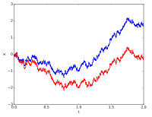
Stochastic Process for MS
CSE 5403: Stochastic Process Cr. 3.00
Course Teacher: A H M Kamal
Course Leaner: 2nd semester of MS 2015-16

Slide 2
Stochastic Process for MS
A stochastic process is a probabilistic (non-deterministic) system that evolves with time via random changes to a collection of variables. A finite stochastic process consists of a finite number of stages in which the outcomes and associated probabilities at each stage depend on the outcomes and associated probabilities of the preceding stages.
One type of finite stochastic process is called a Random Walk. A Random Walk process is "memoryless": the next state depends only on the current state and not on the sequence of events that preceded it.
Input
Outcome and probabilities of Stage 1
Outcome of Stage n
Stage 1
Stage 2
Stage n

Slide 3
Stochastic Process for MS
Aim of the course:
The object of this course is to lead to a good understanding of stochastic processes, their most commonly used models and their properties, as well as the derivation of some of the most commonly used estimators for such processes : Wiener and Kalman filters, predictors and smoothers
At the end of this course, the students will be able to :
-- Have a good understanding of and familiarity with random variables and stochastic processes ;
-- Characterize and use stable processes and their spectral properties;
-- Use the major estimators, and characterize their performances ;
-- Synthetize predictors, filters and smoothers, in both Wiener or Kalman frameworks.

Slide 4
Stochastic Process for MS
The course is subdivided into four parts/chapters:
-- Probabilities, random variables, moments, change of variables.
-- Stochastic processes, independence, stability, ergodicity, spectral representation, classical models of stochastic processes.
-- Estimation (for random variables) : biais, variance, bounds, convergence, asymptotic properties, classical estimators.
-- Estimation (for random processes) : filtering, prediction, smoothing, Wiener and Kalman estimators.
However, we will learn few more topics in this course if we can manage time.

Slide 5
Stochastic Process for MS
Is Stochastic Process useful for Computer Science Students?
Stochastic processes underlie many ideas in statistics such as time series, markov chains, markov processes, bayesian estimation algorithms, etc. Thus, a study of stochastic processes will be useful in two ways:
Enable you to develop models for situations of interest to you.
Enable you to better understand the nuances of the statistical methodology that uses stochastic processes.
The short answer probably is that all observable processes, which we may want to analyze with statistical tools, are stochastic processes, that is, they contain some element of randomness

Slide 6
Stochastic Process for MS
CSE 5403: Stochastic Process Cr. 3.00
Course Teacher: A H M Kamal
Evaluation Method:
One mid Term 10%
One presentation 10%
Assignment to solve in MATLAB 10%
Attendance 10%
Final exam 60%

Slide 7
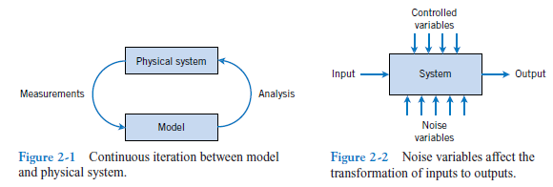
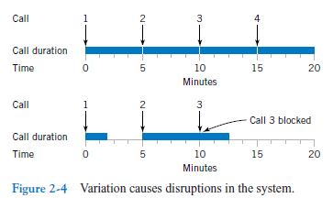
Stochastic Process for MS
Why Randomness?

Slide 8



Stochastic Process for MS
Randomness
Key point: Outcomes
22}
Adult suffrage
Continuous
17
Office hours
Days temperature
Discrete
Are you liking stochastic process course?

Slide 9
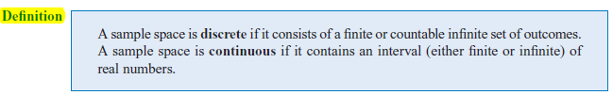
Stochastic Process for MS
Randomness
Key point: Outcomes
Key point: Continuous and Discrete Sample Space

Slide 10
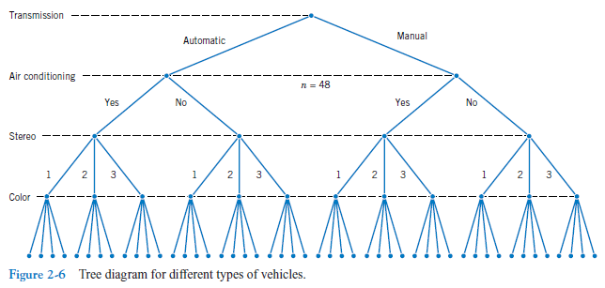
Stochastic Process for MS
Why Randomness?

Slide 11
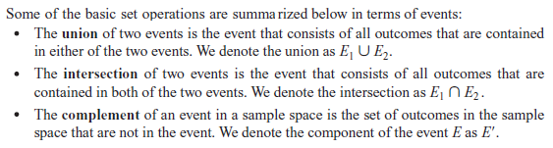
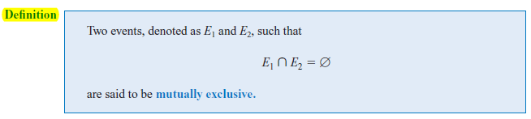
Stochastic Process for MS
Event
Often we are interested in a collection of related outcomes from a random experiment.
An event is a subset of the sample space of a random experiment.

Slide 12

Stochastic Process for MS
Event

Slide 13
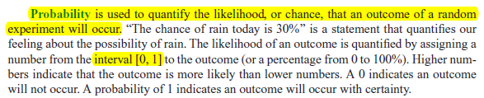


Stochastic Process for MS
Probability

Slide 14

Stochastic Process for MS
Probability

Slide 15
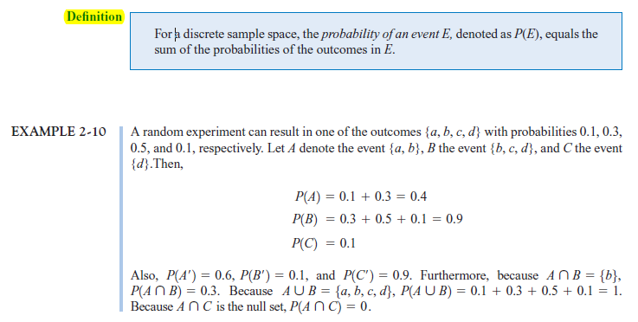
Stochastic Process for MS
Probability

Slide 16
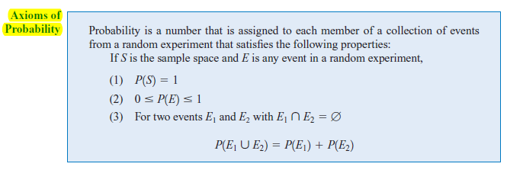
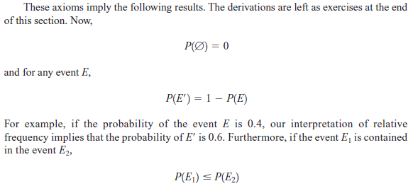
Stochastic Process for MS
Probability

Slide 17



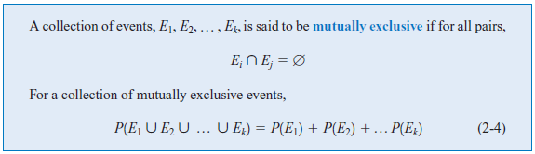
Stochastic Process for MS
Probability
Additional Rules:
Two events:
More events:

Slide 18


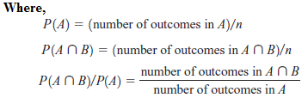
Stochastic Process for MS
Probability
Conditional Probability:
When two events A, B are dependent it is important to know the probability
that the event B will occur, given that A has already happened. We define this to
be conditional probability, denoted by P(B|A).

Slide 19

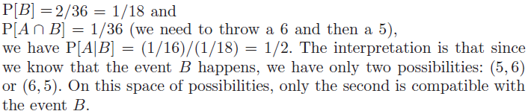

Stochastic Process for MS
Probability
Conditional Probability:
When two events A, B are dependent it is important to know the probability
that the event B will occur, given that A has already happened. We define this to
be conditional probability, denoted by P(B|A).
Multiplication rule:

Slide 20
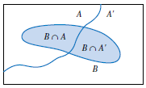


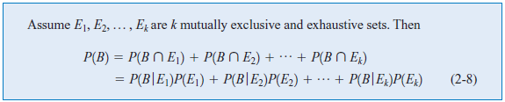
Stochastic Process for MS
Probability
Total Probability:
Total Probability of B:
As A and A’ are mutually exclusive:

Slide 21
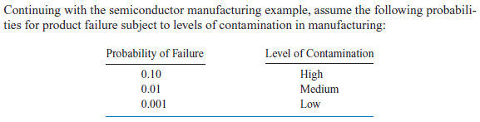

Stochastic Process for MS
Probability
Total Probability:

Slide 22
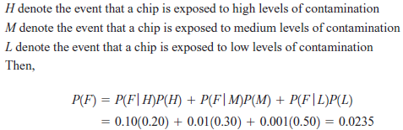
Stochastic Process for MS
Probability
Total Probability:

Slide 23
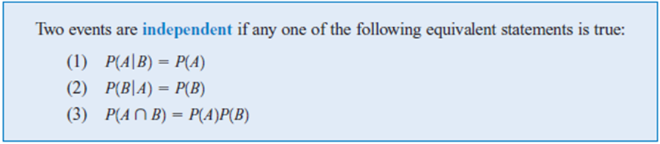
Stochastic Process for MS
Probability: Independence

Slide 24
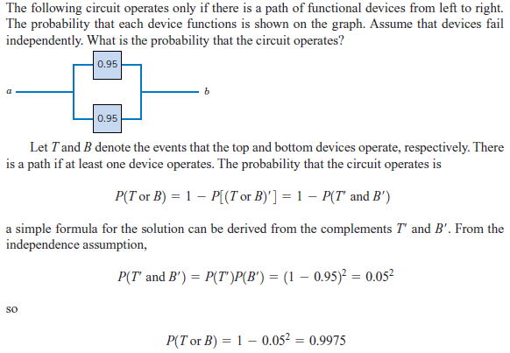
Stochastic Process for MS
Probability: Independence

Slide 25
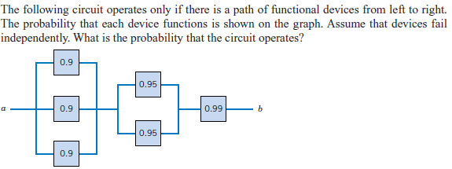
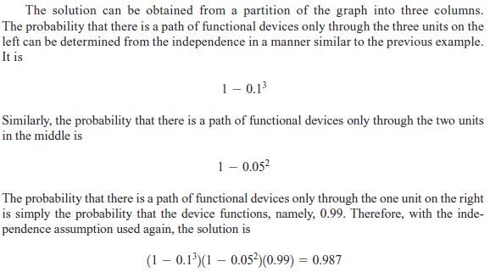
Stochastic Process for MS
Probability: Independence

Slide 26

Stochastic Process for MS
Probability: Bayes’ Theorem
Deduced by:
According to the law of conditional probability:
According to multiplication law:

Slide 27
Stochastic Process for MS
=
Probability: Bayes’ Theorem
You are asked to submit a project proposal in a group where the group consists of two members. If a person of the group named StochasticCSE is a boy, what is the probability that the other member of this group is a girl?
Is it ½?
Let b and g represent the sample of a boy and girl, respectively.
Then, the sample space is {bb, bg, gb, gg}. Let A={bb, bg, gb} and B={bg, gb, gg}, where every sample in A consisted of at least a boy and the sample of B consists of at least a girl.
The P[A]=P[A]=3/4. Again, P[B|A]=2/3 because P[B|A]=

Slide 28
Stochastic Process for MS
Probability: Bayes’ Theorem
When boys and girls fall in love either the boy or the girl first proposes. In an experiment, it is observed that 30% of the boys and 10% of girls fall in love. Then, if a person is identified as a lover, what is the probability that the person is a boy?
Ans: Let the event of love is E and assume two letter B and G to denote boy and girl, respectively.
Here, P(B)=P(G)=0.5
P(E|B)=0.3 and P(E|G)=0.1.
According to Bayes' law

Slide 29
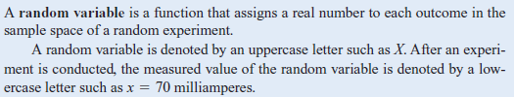

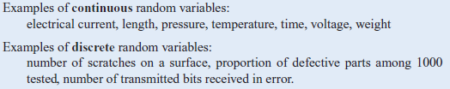
Stochastic Process for MS
Random Variable:

Slide 30


Stochastic Process for MS
Random Variable:

Slide 31

Stochastic Process for MS
Probability Distribution:
The probability distribution of a random variable X is a description of the probabilities associated with the possible values of X. For a discrete random variable, the distribution is often specified by just a list of the possible values along with the probability of each.
There is a chance that a bit transmitted through a digital transmission channel is received in error. Let X equal the number of bits in error in the next four bits transmitted. The possible values for X are {0, 1, 2, 3, 4}. Based on a model for the errors that is presented in the following section, probabilities for these values will be determined. Suppose that the probabilities are
The probability distribution of X is specified by the possible values along with the probability of each. A graphical description of the probability distribution of X is shown in Fig. 3-1.

Slide 32
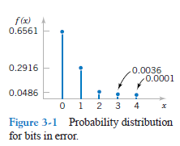
Stochastic Process for MS
Probability Distribution:
There is a chance that a bit transmitted through a digital transmission channel is received in error. Let X equal the number of bits in error in the next four bits transmitted. The possible values for X are {0, 1, 2, 3, 4}. Based on a model for the errors that is presented in the following section, probabilities for these values will be determined. Suppose that the probabilities are
The probability distribution of X is specified by the possible values along with the probability of each. A graphical description of the probability distribution of X is shown in Fig. 3-1.

Slide 33
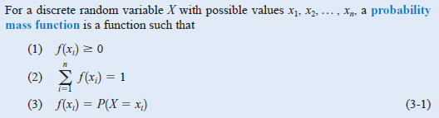
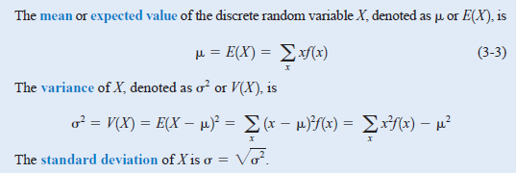
Stochastic Process for MS
Probability Mass Function:
A probability mass function (pmf) is a function that gives the probability that a discrete random variable is exactly equal to some value.

Slide 34
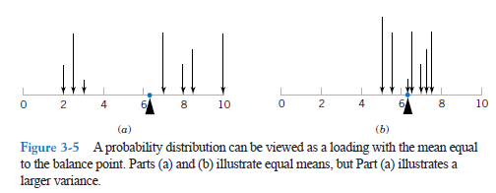
Stochastic Process for MS
Probability Mass Function:

Slide 35
Stochastic Process for MS
Probability Mass Function:
The mean of a discrete random variable X is a weighted average of the possible values of X, with weights equal to the probabilities. If is the probability mass function of a loading on a long, thin beam, is the point at which the beam balances. Consequently, describes the “center’’ of the distribution of X in a manner similar to the balance point of a loading.

Slide 36

Stochastic Process for MS
Probability Mass Function:
The variance of a random variable X is a measure of dispersion or scatter in the possible values for X. The variance of X uses weight f(x) as the multiplier of each possible squared deviation (x-μ)². Figure 3-5 illustrates probability distributions with equal means but different variances.

Slide 37
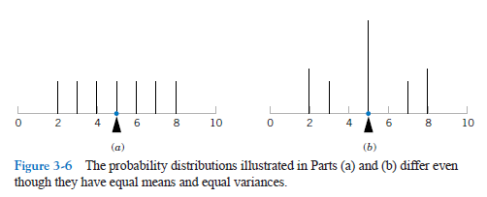
Stochastic Process for MS
Probability Mass Function:

Slide 38
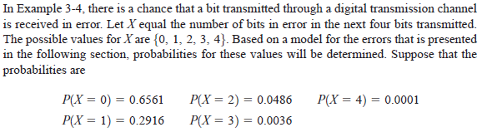

Stochastic Process for MS
Probability Mass Function:

Slide 39
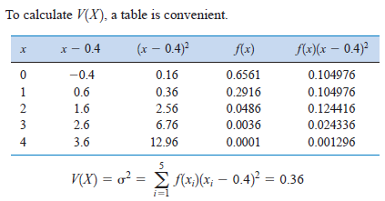

Stochastic Process for MS
Probability Mass Function:
We can also compute
V(X) by:

Slide 40
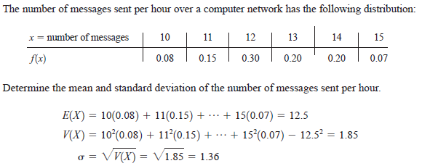
Stochastic Process for MS
Probability Mass Function:

Slide 41


Stochastic Process for MS
Probability Mass Function:

Slide 42
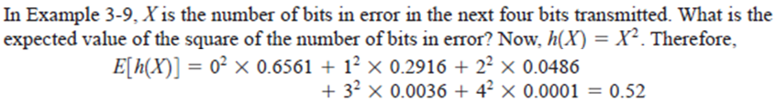
Stochastic Process for MS
Probability Mass Function:

Slide 43

Stochastic Process for MS
Probability Mass Function:

Slide 44
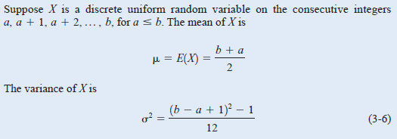
Stochastic Process for MS
Probability Mass Function:

Slide 45
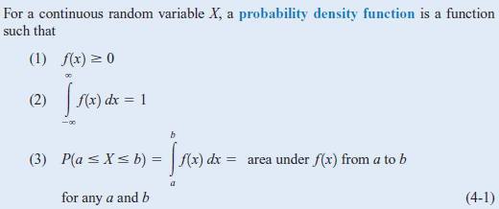
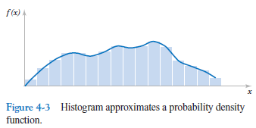

Stochastic Process for MS
Probability Density Function:
A probability density function f(x) can be used to describe the probability distribution of a continuous random variable X.
A histogram is an approximation to a
probability density function.

Slide 46
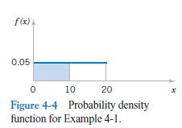
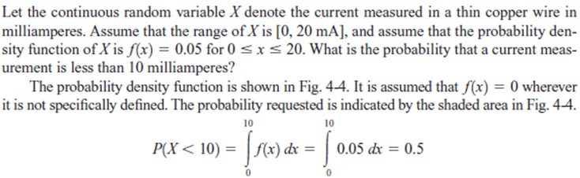
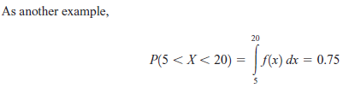
Stochastic Process for MS
Probability Distribution Function:

Slide 47
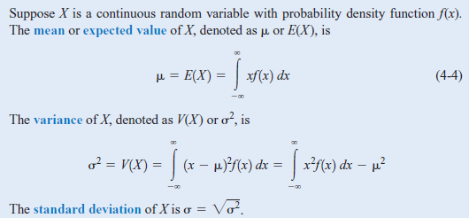
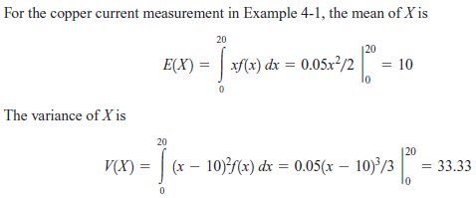
Stochastic Process for MS
Probability Distribution Function:

Slide 48
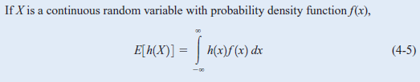
Stochastic Process for MS
Probability Distribution Function:

Slide 49
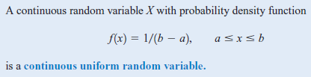
Stochastic Process for MS
Probability Distribution Function:

Slide 50
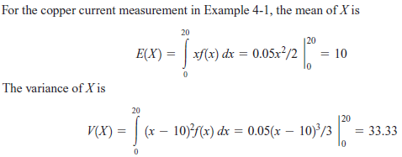
Stochastic Process for MS
Probability Distribution Function:

Slide 51

Stochastic Process for MS
Probability Distribution Function:

Slide 52
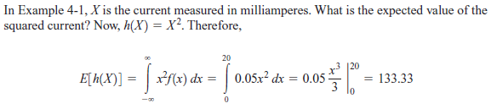
Stochastic Process for MS
Probability Distribution Function:

Slide 53
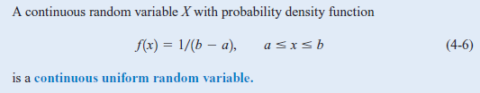
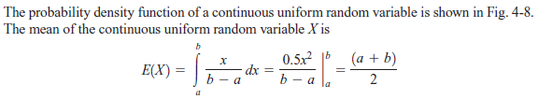

Stochastic Process for MS
Probability Distribution Function:

Slide 54
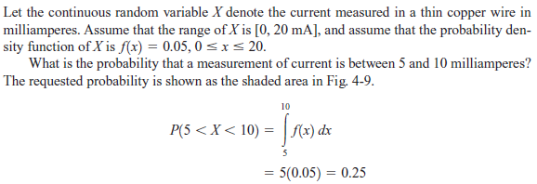
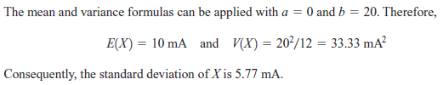
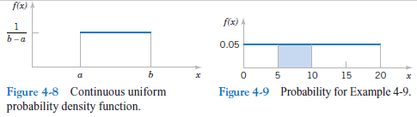
Stochastic Process for MS
Probability Distribution Function:

Slide 55

Stochastic Process for MS
Normal Distribution:
In probability theory, the normal (or Gaussian or Gauss or Laplace-Gauss) distribution is a very common continuous probability distribution.
A random variable with a Gaussian distribution is said to be normally distributed.

Slide 56


Stochastic Process for MS
Normal Distribution:

Slide 57


Stochastic Process for MS
Normal Distribution:

Slide 58

Stochastic Process for MS
Normal Distribution:
The standard Gaussian distribution has a mean of 0 and a standard deviation of 1.

Slide 59



Stochastic Process for MS
Probability Density Function of an Exponential Random Variable:
The mean or expected value of an exponentially distributed random variable X with rate parameter λ is given by

Slide 60
Stochastic Process for MS
Joint Probability:
What is a 'Joint Probability‘?
A joint probability is a statistical measure where the likelihood of two events occurring together and at the same point in time are calculated. Joint probability is the probability of event Y occurring at the same time event X occurs.
Notation for joint probability takes the form:
P(X∩Y) or P(X and Y) or P(XY), which reads as the joint probability of X and Y.
Joint Probability vs. Conditional Probability
Joint probability should not be confused with conditional probability - the probability that one event will happen given that another action or event happens. The conditional probability form is P(X, given Y) or P(X│Y) – that is, the chance of one event happening is conditional on another event happening.
Joint probability only factors the likelihood of both events occurring. Conditional probability can be used to calculate joint probability, as seen in this formula: P(X ∩ Y) = P(X│Y) x P(Y).
Statisticians and analysts use joint probability as a tool when two or more observable events can occur simultaneously.

Slide 61


Stochastic Process for MS
Joint Probability:
The individual probability distribution of a random variable is referred
to as its marginal probability distribution.

Slide 62


Stochastic Process for MS
Joint Probability:
For Multiple Random Variable

Slide 63

Stochastic Process for MS
Joint Probability:
For Multiple Random Variable

Slide 64

Stochastic Process for MS
Joint Probability:

