Slide 1
CSE 101:Computer Programming
Start up
Course Teacher: Dr. A. H. M. Kamal
To Session: 2017-18
Year : 1 Semester: 1
Date of class commencement: 07/03/2018 Class termination: 31/07/2018
Evaluation method:
Early evaluation
Mid Term I 10
Mid Term II 10
Mid Term III (A project) 10
Class attendance 10
Early evaluation total 40
Final exam 60
Total 100

Slide 2
CSE 101:Computer Programming
Start up
Course Teacher: Dr. A. H. M. Kamal
To Session: 2017-18
Year : 1 Semester: 1
Date of class commencement: 07/03/2018 Class termination: 31/07/2018
One Mid Term will be boosted up. How?
Let the mark of a Mid Term is M.
Let L=log10(M)*10
Let Integer_of_L=ceiling(L,1)
Boosted_UP=max(M, Integer_of_L)

Slide 3
CSE 101:Computer Programming
Start up
Course Teacher: Dr. A. H. M. Kamal
To Session: 2017-18
Year : 1 Semester: 1
Date of class commencement: 07/03/2018 Class termination: 31/07/2018
What about the project?
You will be assigned a work to perform one of the following:
to design a game
to solve a mathematical problem
to develop an educational apps
any thing you can propose relating the theme of the course

Slide 4
CSE 101:Computer Programming
Start up
Course Teacher: Dr. A. H. M. Kamal
To Session: 2017-18
Year : 1 Semester: 1
Date of class commencement: 07/03/2018 Class termination: 31/07/2018
Another padding course, CSE 102: Computer Programming Lab
Total class 14
Evaluation during class:
Have to submit one report 10
Attendance 10
Early evaluation 20
Final Evaluation:
Viva 30
Script writing 15
Experiment 35
Final evaluation Total 80
-------------------------------------------------------------------------------------------------------------
Total 100

Slide 5
CSE 101:Computer Programming
Start up
Academic Offences
Academic Offences include, but are not limited to:
Infringing unreasonably on the work of other members
E.g., disrupting classes
Cheating
Plagiarism
Misrepresentations
Copying from unauthorized documents or from side person(s) during the examination

Slide 6
CSE 101:Computer Programming
Start up
Plagiarism
All projects must be done individually:
You may not copy code directly from any other source
If you viewed another code (from books or lecture notes), you must include a reference in your project
You may not share code with any other students by transmitting completed functions to your peers
This restriction includes—but is not limited to—electronic and hard-copy sharing
You may discuss projects together and help another student debug his or her code; however, you cannot dictate or give the exact solution

Slide 7
CSE 101:Computer Programming
Start up
Plagiarism
Collaboration with other students must be limited to
Discussions
High-level pseudocode
Assistance with debugging (only through the offering of advice)
Sharing test files
All such collaborations must be documented in your source code

Slide 8
CSE 101:Computer Programming
Start up
Plagiarism
When one student copies from another student, both students are responsible
Exceptions are made for outright theft
The penalty for plagiarism on a Project is a mark of 0 on the project in question

Slide 9
CSE 101:Computer Programming
Start up
Plagiarism
One student cannot accept “full responsibility”
For example, A, B, and C worked together sharing the ideas of each other (Good)
They each did their own work, however, they shared code to comment on each others programming (may create problem).
B gave A’s code to D who copied it for his project and submitted it
A and D received a 0.

Slide 10
CSE 101:Computer Programming
Start up
Covered Topics
What is programming?
History of C
Structured Programming Concept
Basic Concept of Compiler
Algorithms
Program Creation
Data Types and Variable
Decision Making Statements
Looping Statements
Formatting Input and Output
Functions
Concept of OOP

Slide 11
CSE 101:Computer Programming
Start up
Referred Books
Any book and web on
Structured Programming in C
A reference one is :
Programming in ANSI C
4th Edition
-by E Balagurusamy
Tata McGraw-Hill Publishing Company Limited

Slide 12
CSE 101:Computer Programming
Start up
Language
Why programming language?
- To develop software/program
- The program is written by and executed in a language
Language are of three types:
Low level.
Example, machine level language, assembly language
Mid level
C
High level
Visual Basic

Slide 13
CSE 101:Computer Programming
Start up
Language
Language are of three types:
Low level.
Example, machine level language, assembly language
Mid level
C
High level
Visual Basic
Computer do not understand mid level or high level language
Hence, to make it functioning these mid or high level language codes should be converted to machine level language so that the computer can understand.

Slide 14
CSE 101:Computer Programming
Start up
Language
Translator
takes a source program as input and converts
it into an object or target program.
Source Program
object program
Translator
Assembler
converts assembly language program into
machine language.
Source Program
machine code
Assembler

Slide 15
CSE 101:Computer Programming
Start up
Language
Compiler
translate a high-level language such as FORTRAN,
PASCAL,COBOL into a particular computer’s machine
or assembly language
the conversion time from source program to object
program is called compiled time
object program’s execution time is called run time
Data
Executing Computer
Source Program
Object Program
Compiler
Result
Compile time
Run time

Slide 16
CSE 101:Computer Programming
Start up
Language
Interpreter
processes an internal form of the source program and
data at the same time
interpretation of the internal source form occurs
at run time
no object program is created
no compile time
Data
Source Program
Interpreter
Result

Slide 17
CSE 101:Computer Programming
Start up
History of Structured Programming:
ALGOL in the early of 1960s
First computer language
To use block structure
Gave the concept of structured programming
Basic Combine Programming Language (BCPL) in 1967
by Martin Richards
For writing system software
B in 1970
by Ken Thompson
to create early version of UNIX operating system
C in 1972
uses the concepts of all above
added the concept of data types
other powerful features

Slide 18
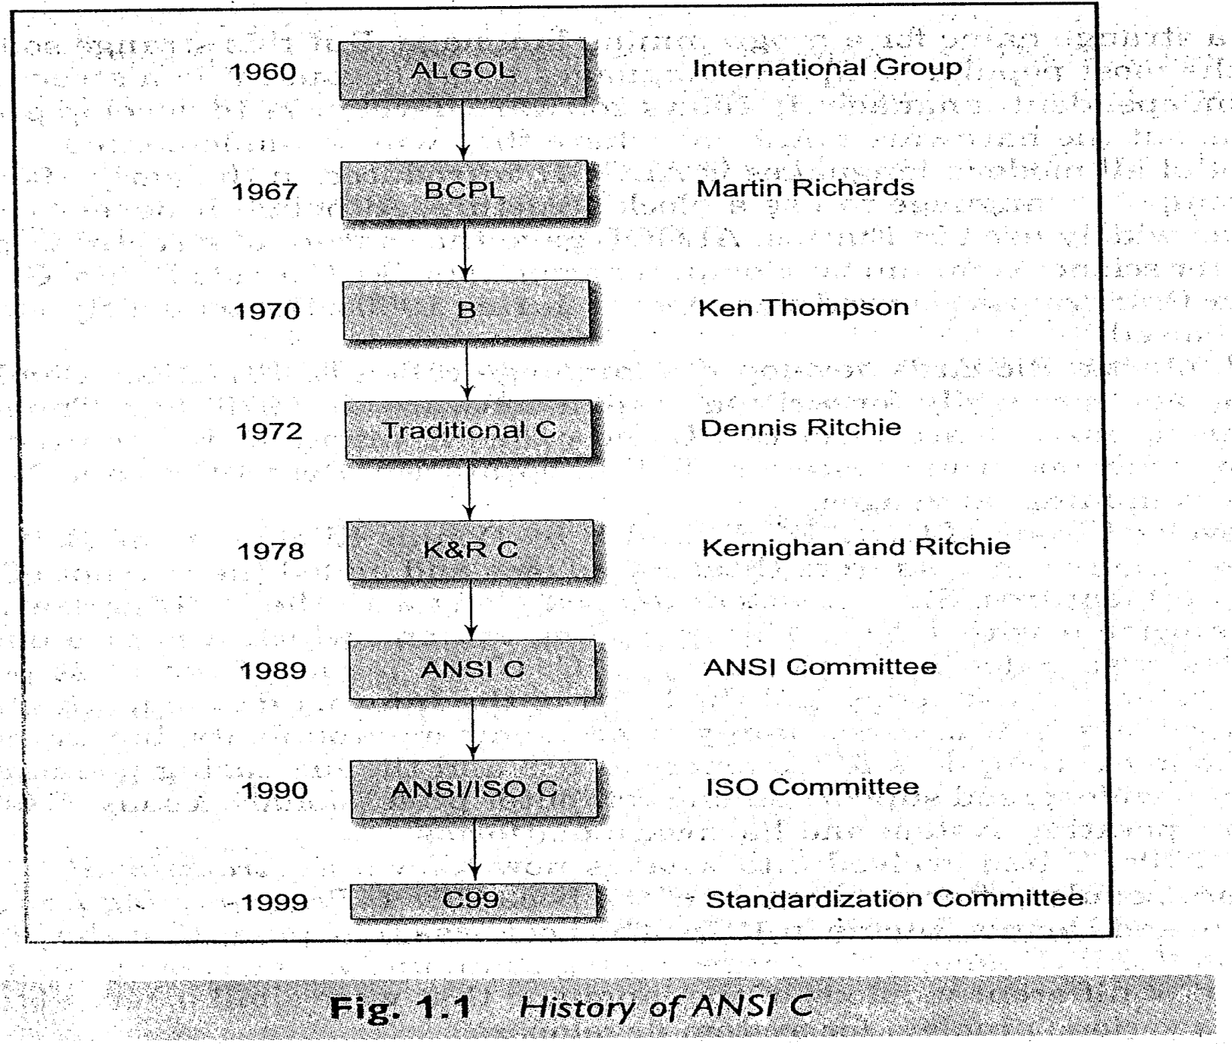
CSE 101:Computer Programming
Start up
History of Structured Programming:

Slide 19
CSE 101:Computer Programming
Start up
Objective of Programming in C?
Given a problem: Add 5 and 3.
Write a program to solve the problem for me by a machine.
Challenge:
To make the program understandable to the machine.
Because:
5+3=8 5+3=7 Which one is correct?
+5+3=+8 +5++3=+8
Method: (Are those correct?)
1 2 3 4
--------------------------------------------------------
5+3=8 5,3+=8 +5, 3=8 5
+3
----------
8
C has these defined structures.
Now let the program is written:
Is it correctly written?
C has this ability to check
Again let the program is correctly written:
It requires to
execute the program
send the outcomes to the output
C has this ability.

Slide 20

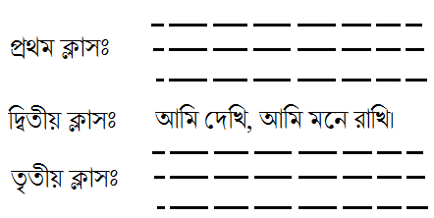
CSE 101:Computer Programming
Start up
C programming should have a structure:
দাড়ি, কমা্র ব্যাবহার ও বানান শুদ্ধ কিনা জানার জন্য বাংলা গ্রামারকে মেমরিতে লোড করা প্রয়োজন।
শুরু
শেষ

Slide 21
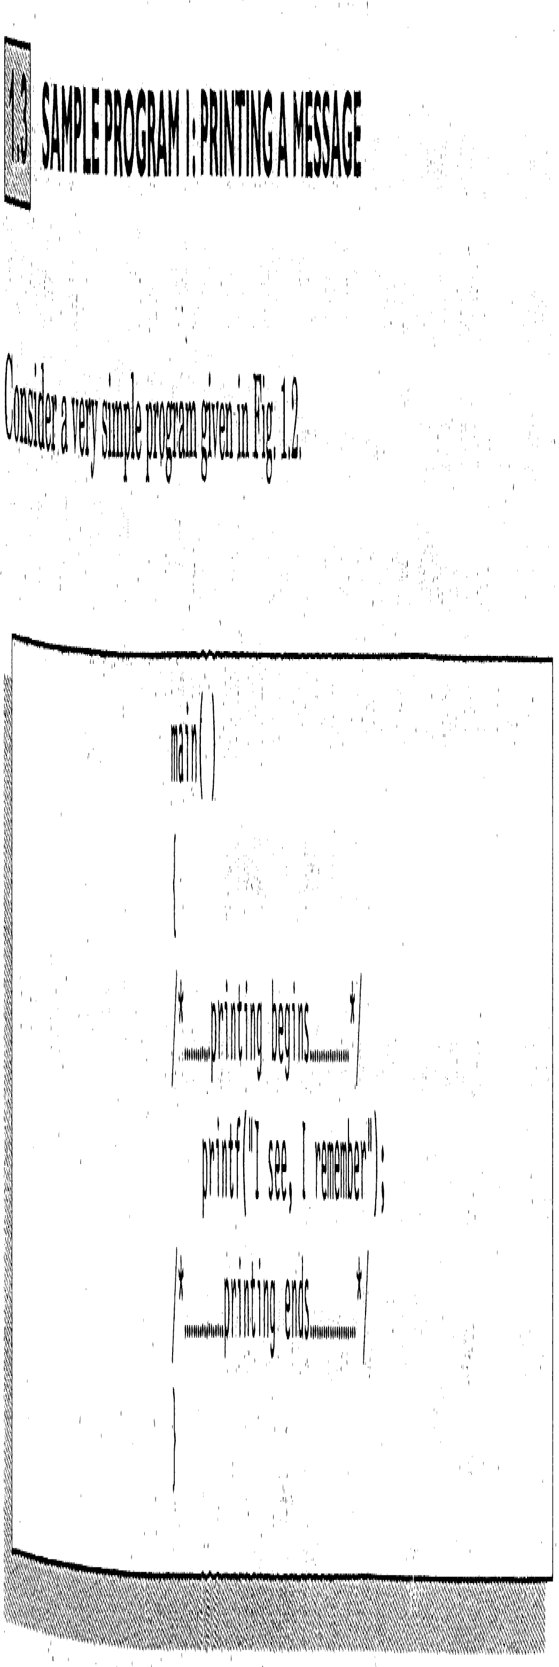
CSE 101:Computer Programming
Start up
History of Structured Programming:
Starting point to execute
Start of the main module
Write your program here
End of the main module

Slide 22
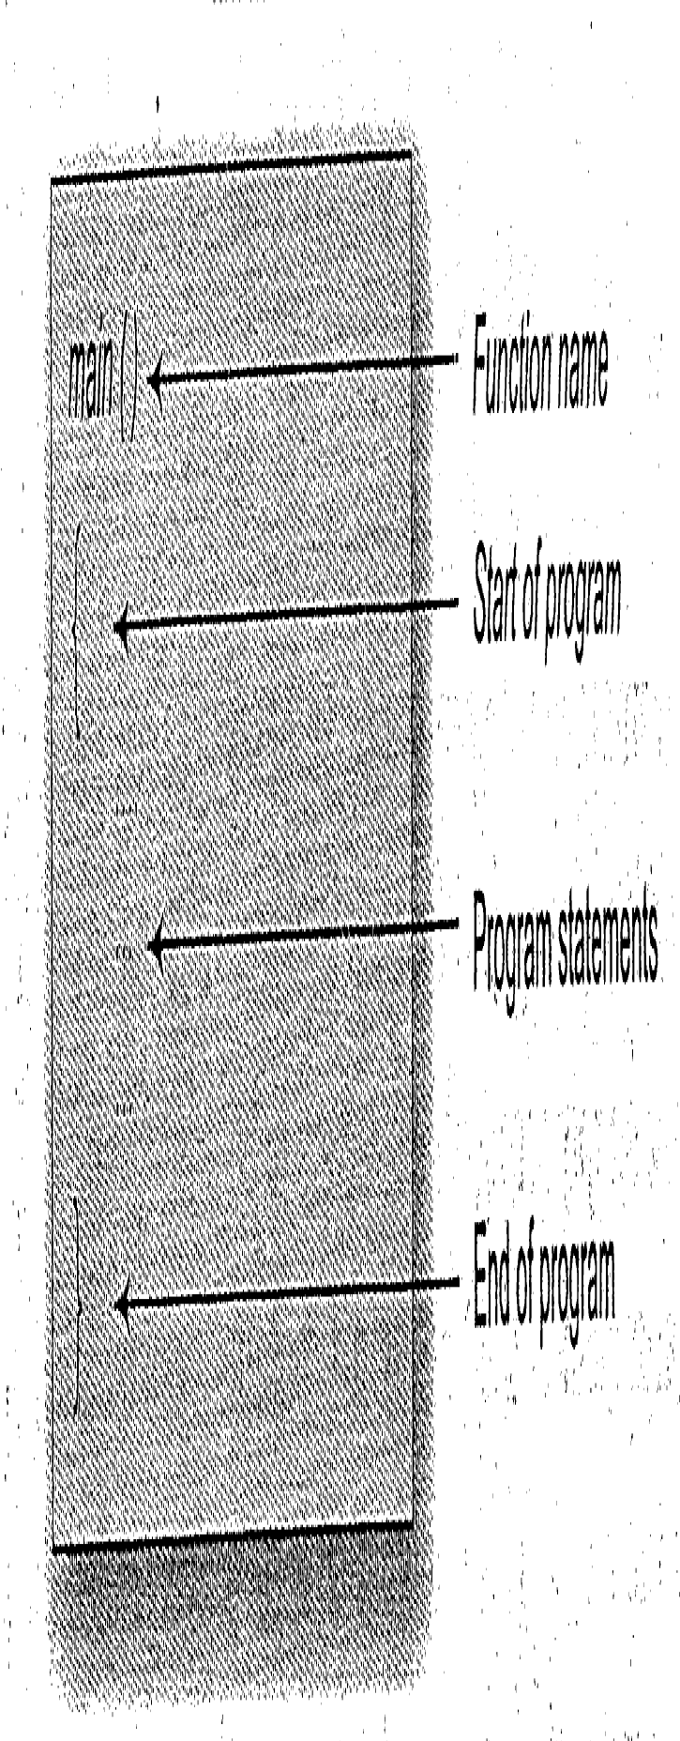
CSE 101:Computer Programming
Start up

Slide 23
CSE 101:Computer Programming
Start up
History of Structured Programming:

Slide 24
CSE 101:Computer Programming
Start up
History of Structured Programming:
Starting point to execute
Start of the main module
Comments
Sending to output
Comments
End of the main module

Slide 25
CSE 101:Computer Programming
Start up
History of Structured Programming:
main()
{
printf(“I see, I remember”);
}

Slide 26
CSE 101:Computer Programming
Start up
History of Structured Programming:
Only executable statement is printf.
Format of printf:
printf তারপর ( তারপর দাও ” এরপর Write any sentence that you want to sent at the output বাক্য লিখা শেষ হলে দাও ” ঠিক পরই দাও ) সর্বশেষ দিতে হবে ;

Slide 27
CSE 101:Computer Programming
Start up
History of Structured Programming:
Structure:
main( )
{
---
---
}
Only executable statement is printf.
Format of printf:
Hence, not changeable part is: printf(“ “);
Write sentence with the double quotations.
Example: printf(“We are in class”);

Slide 28
CSE 101:Computer Programming
Start up
History of Structured Programming:
main()
{
printf(“I see,”)
printf(“ I remember”);
}

Slide 29
CSE 101:Computer Programming
Start up
History of Structured Programming:
main()
{
printf(“I see,”)
printf(“ I remember”);
}
Execution pointer

Slide 30
CSE 101:Computer Programming
Start up
History of Structured Programming:
main()
{
printf(“I see,”)
printf(“ I remember”);
}
Execution pointer

Slide 31
CSE 101:Computer Programming
Start up
History of Structured Programming:
main()
{
printf(“I see,”)
printf(“ I remember”);
}
Execution pointer
After execution of first printf
I see,
Output cursor

Slide 32
CSE 101:Computer Programming
Start up
History of Structured Programming:
main()
{
printf(“I see,”)
printf(“ I remember”);
}
Execution pointer
After execution of first printf
I see,
Output cursor

Slide 33
CSE 101:Computer Programming
Start up
History of Structured Programming:
main()
{
printf(“I see,”)
printf(“ I remember”);
}
Execution pointer
After execution of second printf
I see, I remember !
Output cursor

Slide 34
CSE 101:Computer Programming
Start up
History of Structured Programming:
main()
{
printf(“I see,”)
printf(“ I remember”);
}
main()
{
printf(“I see”)
printf(“, I remember”);
}
main()
{
printf(“I ”)
printf(“see, I remember”);
}
main()
{
printf(“I s”)
printf(“ee, I remember”);
}
Output:
I see, I remember
Output:
I see, I remember
Output:
I see, I remember

Slide 35

CSE 101:Computer Programming
Start up
Now, we want to print the sentence in two lines.
printf(“I see,”);
printf(“I remember !”);
What will be the output:
I see, I remember !
I see,I remember !
I see,
I remember !

Slide 36
CSE 101:Computer Programming
Start up
Now, we want to print the sentence in two lines.
Method:
Print first line to output
I see,
Output cursor
2. Send output cursor to second line
I see,
Output cursor
I see,
I remember !
3. Print second line

Slide 37


CSE 101:Computer Programming
Start up
Program:
new line command \n
\n is used to send cursor to a new line.
\n is used in printf function and inside into “ “.
Same but different:
printf(“I see,”);
printf(“\n”);
printf(“I remember !”);
Do the same in another way:
printf(“I see,”);
printf(“\n”);
printf(“I “);
printf(“remember !”);

Slide 38
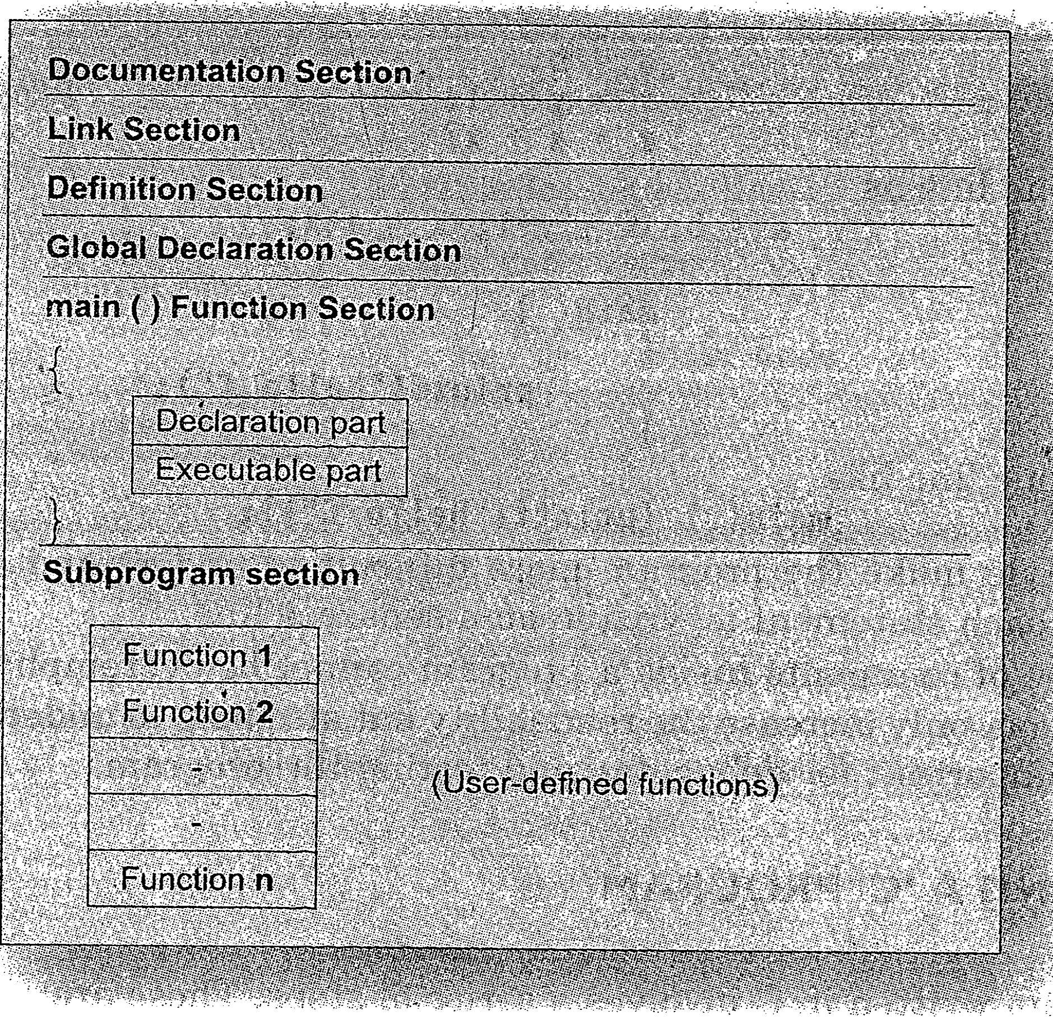
CSE 101:Computer Programming
Start up
Program:

Slide 39
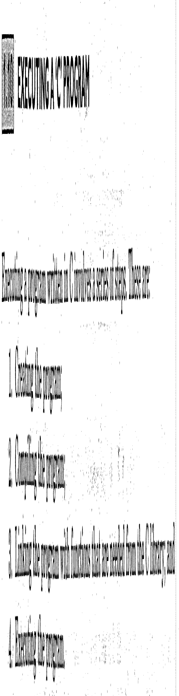
CSE 101:Computer Programming
Start up
Program:

Slide 40
CSE 101:Computer Programming
Start up
Program:

Slide 41
CSE 101:Computer Programming
Start up

Slide 42
CSE 101:Computer Programming
Start up
History of Structured Programming:

