Slide 1

CSE 325:Computer Peripherals and Interfacing
Sheikh Sujan Ali
Associate Professor
Dept. of Computer Science and Engineering
Jatiya Kabi Kazi Nazrul Islam University
Mymensingh, Bangladesh

Slide 2
Introduction
Computer Peripherals
A computer peripheral is any external device that provides input and output for the computer.
For example, a keyboard and mouse are input peripherals, while a monitor and printer are output peripherals.
Computer peripherals, or peripheral devices, are sometimes called I/O devices because they provide input and output for the computer.
Some peripherals, such as external hard drives, USB flash drive and memory card provide both input and output for the computer.

Slide 3

Introduction
Computer Interfacing
In computing, an interface is an art of connecting computers and peripherals by which two or more separate components of a computer system can exchange information.
The exchange can be between software, computer hardware, peripheral devices, humans and combinations of these.
The goal of this course is to introduce hardware and software design techniques and issues for interfacing computers and peripheral devices

Slide 4
Basic I/O Interface
A microprocessor is great at solving problem, but can not communicate with the outside world.
This chapter outlines some of the basic methods of communications, both serial and parallel, between humans or machines and the microprocessor.
First introduces the basic I/O interface and discuss decoding for I/O devices.
Then, provides detail on parallel and serial interfacing, both of which have a variety of applications.

Slide 5
Basic I/O Interfaces
The basic input device is a set of three-state buffers.
The basic output device is a set of data latches.
The term IN refers to moving data from the I/O device into the microprocessor and
The term OUT refers to moving data out of the microprocessor to the I/O device.

Slide 6
Chapter Objectives
Upon completion of this chapter, you will be able to:
Explain the operation of the basic input and output interfaces.
Decode an 8-, 16-, and 32-bit I/O device so that they can be used at any I/O port address.
Define handshaking and explain how to use it with I/O devices.
Interface and program the 82C55 programmable parallel interface.
Interface LCD displays, LED displays, keyboards, ADC, DAC, and various other devices to the 82C55.
Interface an analog-to-digital converter and a digital-to-analog converter to the microprocessor.
Interface both DC and stepper motors to the microprocessor.

Slide 7
The I/O Instructions
One type of instruction* transfers information to an I/O device (OUT). [*In computer science, an instruction is a single operation of a processor defined by the processor instruction set.]
Another reads from an I/O device (IN).
Instructions are also provided to transfer strings of data between memory and I/O.
Instructions that transfer data between an I/O device and the microprocessor’s accumulator (AL, AX, or EAX) are called IN and OUT.

Slide 8
The I/O Instructions
The I/O address is stored in register DX as a 16-bit address or as an 8-bit address.
Intel calls the 8-bit form (p8) a fixed address
The 16-bit address is called a variable address because it is stored in a DX, and then used to address the I/O device.
Other instructions that use DX to address I/O are the INS and OUTS instructions.
I/O ports are 8 bits in width.
a 16-bit port is actually two consecutive 8-bit ports being addressed
a 32-bit I/O port is actually four 8-bit ports

Slide 9
The I/O Instructions
When data are transferred using IN or OUT, the I/O address, (port number or simply port), appears on the address bus.
External I/O interface decodes the port number in the same manner as a memory address.
the 8-bit fixed port number (p8) appears on address bus connections A₇–A₀ with bits A₁₅–A₈ equal to 00000000₂
The 16-bit variable port number (DX) appears on address connections A₁₅–A₀.

Slide 10
The I/O Instructions
INS and OUTS instructions address an I/O device using the DX register.
but do not transfer data between accumulator and I/O device as do the IN/OUT instructions
Instead, they transfer data between memory and the I/O device

Slide 11
Isolated and Memory-Mapped I/O
Two different methods of interfacing I/O:
- isolated I/O and
- memory-mapped I/O.
In isolated I/O, the IN, INS, OUT, and OUTS transfer data between the microprocessor’s accumulator or memory and the I/O device.
In memory-mapped I/O, any instruction that references memory can accomplish the transfer.

Slide 12
Isolated I/O
The most common I/O transfer technique used in the Intel-based system is isolated I/O.
isolated describes how I/O locations are isolated from memory in a separate I/O address space
Addresses for isolated I/O devices, called ports, are separate from memory.
Because the ports are separate, the user can expand the memory to its full size without using any of memory space for I/O devices.

Slide 13
Isolated I/O
A disadvantage of isolated I/O is that data transferred between I/O and microprocessor must be accessed by the IN, INS, OUT, and OUTS instructions.
Separate control signals for the I/O space are developed (using M/IO and W/R ), which indicate an I/O read (IORC) or an I/O write (RD) operation.
These signals indicate an I/O port address, which appears on the address bus, is used to select the I/O device.

Slide 14
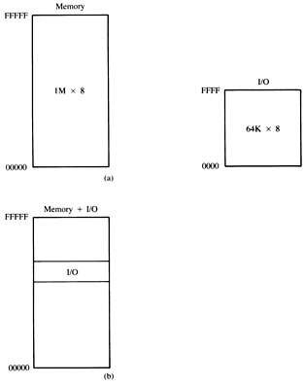
Memory and I/O Maps
in the PC, isolated I/O ports are used to control peripheral devices
an 8-bit port address is used to access devices located on the system board, such as the timer and keyboard interface
a 16-bit port is used to access serial and parallel ports, video and disk drive systems
Figure: The memory and I/O maps for the 8086/8088 microprocessors. (a) Isolated I/O. (b) Memory-mapped I/O.

Slide 15
Memory-Mapped I/O
Memory-mapped I/O does not use the IN, INS, OUT, or OUTS instructions.
It uses any instruction that transfers data between the microprocessor and memory.
treated as a memory location in memory map
Advantage is any memory transfer instruction can access the I/O device.
Disadvantage is a portion of memory system is used as the I/O map.
reduces memory available to applications

Slide 16
The Basic Input Interface
Three-state buffers are used to construct the 8-bit input port depicted in Figure 2.
External TTL data are connected to the inputs of the buffers.
buffer outputs connect to the data bus
The circuit of allows the processor to read the contents of the eight switches that connect to any 8-bit section of the data bus when the select signal becomes a logic 0.

Slide 17
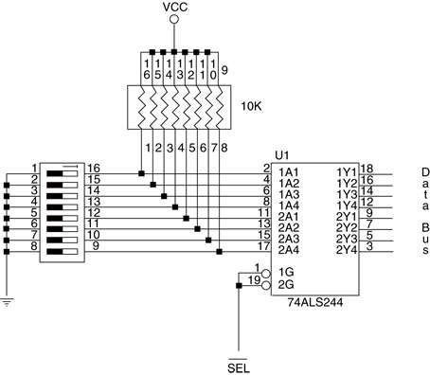
Figure 2 The basic input interface illustrating the connection of eight switches. Note that the 74ALS244 is a three-state buffer that controls the application of the switch data to the data bus.

Slide 18
The Basic Input Interface
When the IN instruction executes, contents of the switches copy to the AL register.
To interface 16-bit of data, the circuit in Figure 2 is doubled to include to 74ALS244 buffers that connect 16 bits of input data to 16-bit data bus.
To interface 32 bits of data, the circuit is expanded by a factor of 4.

Slide 19
The Basic Output Interface
Receives data from the processor and usually must hold it for some external device.
latches or flip-flops, like buffers in the input device, are often built into the I/O device
Fig 3 shows how eight light-emitting diodes (LEDs) connect to the processor through a set of eight data latches.
The latch stores the number output by the microprocessor from the data bus so that the LEDs can be lit with any 8-bit binary number.

Slide 20
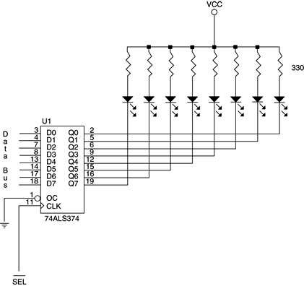
Figure 3 The basic output interface connected to a set of LED displays.

Slide 21
The Basic Output Interface
Latches hold the data because when the processor executes an OUT, data are only present on the data bus for less than 1.0 µs.
the viewer would never see the LEDs illuminate
When the OUT executes, data from AL, AX, or EAX transfer to the latch via the data bus.
Each time the OUT executes, the SEL signal activates, capturing data to the latch.
data are held until the next OUT
When the output instruction is executed, data from the AL register appear on the LEDs.

Slide 22
Handshaking
Many I/O devices accept or release information slower than the microprocessor.
A method of I/O control called handshaking or polling, synchronizes the I/O device with the microprocessor.
An example is a parallel printer that prints a few hundred characters per second (CPS).
The processor can send data much faster.
a way to slow the microprocessor down to match speeds with the printer must be developed

Slide 23
Handshaking
Fig 4 illustrates typical input and output connections found on a printer.
data transfers via data connections (D₇–D₀)
ASCII data are placed on D₇–D₀, and a pulse is then applied to the STB connection.
BUSY indicates the printer is busy
STB is a clock pulse used to send data to printer
The strobe signal sends or clocks the data into the printer so that they can be printed.
as the printer receives data, it places logic 1 on the BUSY pin, indicating it is printing data

Slide 24
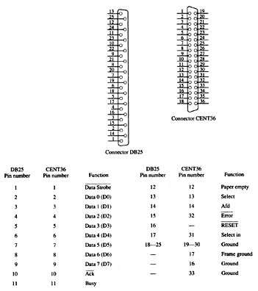
Figure 4 The DB25 connector found on computers and the Centronics 36-pin connector found on printers for the Centronics parallel printer interface.

Slide 25
Handshaking
The software polls or tests the BUSY pin to decide whether the printer is busy.
If the printer is busy, the processor waits
if not, the next ASCII character goes to the printer
This process of interrogating the printer, or any asynchronous device like a printer, is called handshaking or polling.

Slide 26
Input Devices
Input devices are already TTL and compatible, and can be connected to the microprocessor and its interfacing components.
or they are switch-based
Switch-based devices are either open or connected; These are not TTL levels.
TTL levels are a logic 0 (0.0 V–0.8 V)
or a logic 1 (2.0 V–5.0 V)
Using switch-based device as TTL-compatible input requires conditioning applied.

Slide 27
Input Devices
Fig 5 shows a toggle switch properly connected to function as an input device.
A pull-up resistor ensures when the switch is open, the output signal is a logic 1.
when the switch is closed, it connects to ground, producing a valid logic 0 level
A standard range of values for pull-up resistors is between 1K Ohm and 10K Ohm.

Slide 28
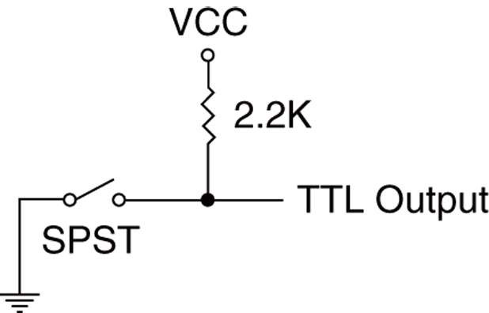
Input Devices
Figure 5 A single-pole, single-throw switch interfaced as a TTL device.

Slide 29
Input Devices
Mechanical switch contacts physically bounce when they are closed,
which can create a problem if a switch is used as a clocking signal for a digital circuit
To prevent problems with bounces, one of the circuits shown in Fig 7 can be used.
the first is a classic textbook bounce eliminator
second is a more practical version of the same
The first version costs more to construct
the second costs requires no pull-up resistors and two inverters instead of two NAND gates

Slide 30
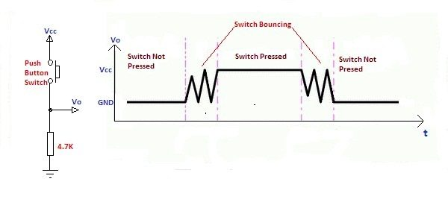
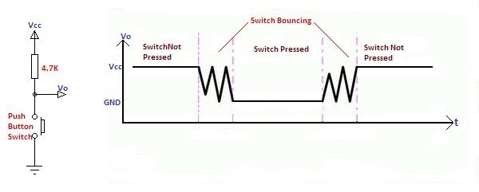
Bouncing Problem
Switch Bouncing in Pull Down Connection
Switch Bouncing in Pull Up Connection

Slide 31
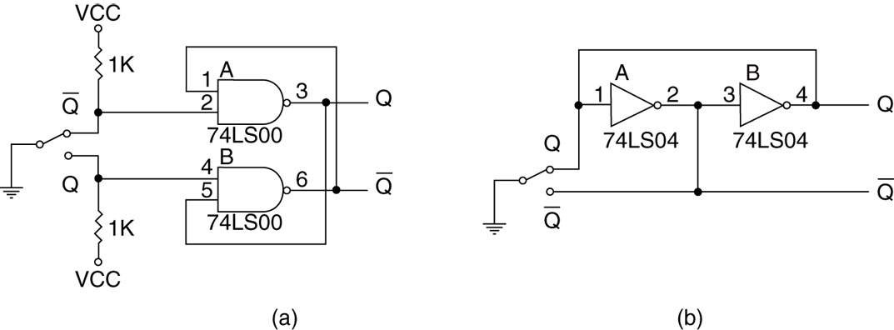
Figure 6 Debouncing switch contacts: (a) conventional debouncing and (b) practical debouncing.
as the Q input from the switch becomes a logic 0, it changes the state of the flip-flop
if the contact bounces away from the Q input, the flip-flop remembers, no change occurs, and thus no bounce

Slide 32
Output Devices
Output devices are more diverse than input devices, but many are interfaced in a uniform manner.
Before an output device can be interfaced, we must understand voltages and currents from the microprocessor or TTL interface.
Voltages are TTL-compatible from the microprocessor of the interfacing element.
logic 0 = 0.0 V to 0.4 V
logic 1 = 2.4 V to 5.0 V

Slide 33
Output Devices
Currents for a processor and many interfacing components are less than for standard TTL.
Logic 0 = 0.0 to 2.0 mA
logic 1 = 0.0 to 400 µA
Fig 8 shows how to interface a simple LED to a microprocessor peripheral pin.
a transistor driver is used in 8

Slide 34
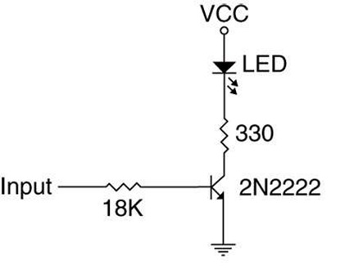
Output Devices
Figure 8 Interfacing an LED: using a transistor and.

Slide 35
Output Devices
TTL input signal has minimum value of 2.4 V
Drop across emitter-base junction is 0.7 V.
The difference is 1.7 V
the voltage drop across the resistor
The value of the resistor is 1.7 V ÷ 0.1 mA or 17K W.
as 17K W is not a standard value, an 18K W resistor is chosen

Slide 36
Output Devices
In 8, we elected to use a switching transistor in place of the TTL buffer.
2N2222 is a good low-cost, general-purpose switching transistor with a minimum gain of 100
collector current is 10 mA; so base current will be 1/100 of collector current of 0.1 mA
To determine the value of the base current–limiting resistor, use the 0.1 mA base current and a voltage drop of 1.7 V across the base current–limiting resistor.

Slide 37
Output Devices
Fig 9 illustrates a motor connected to the Darlington-pair with a minimum current gain of 7000 and a maximum current of 4A.
Value of the bias resistor is calculated exactly the same as the one used in the LED driver.
The current through the resistor is 1.0 A ÷ 7000, or about 0.143 mA.
Voltage drop is 0.9 V because of the two diode drops (base/emitter junctions).
The value of the bias resistor is 0.9 V ÷ 0.143 mA or 6.29K W.

Slide 38
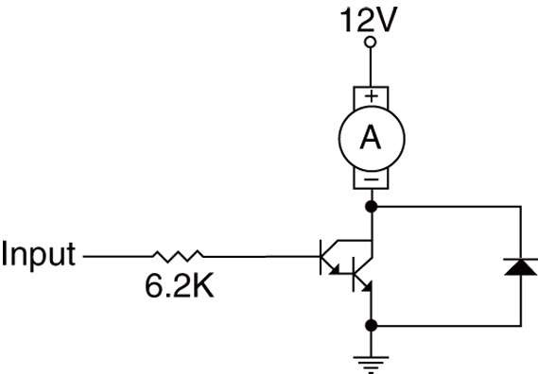
Figure 9 A DC motor interfaced to a system by using a Darlington-pair.
The Darlington-pair must use a heat sink because of the amount of current
the diode must be present to prevent the Darlington-pair from being destroyed by inductive kickback

Slide 39
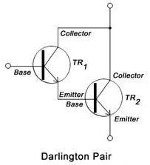
Darlington pair
Darlington pair/transistor is a compound structure of a particular design made by two bipolar transistors connected in such a way that the current amplified by the first transistor is amplified further by the second one.
Darlington transistors can be used in high-current circuits, such as those involving computer control of motors or relays.

Slide 40
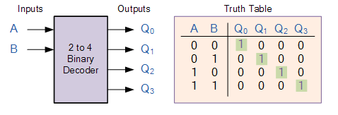
Decoder
In digital electronics, a binary decoder is a combinational logic circuit that converts binary information from the n coded inputs to a maximum of 2^{n} unique outputs.

Slide 41
Decoding 8-Bit I/O Port Addresses
Fixed I/O instruction uses an 8-bit I/O port address that on A₁₅–A₀ as 0000H–00FFH.
we often decode only address connections A₇–A₀ for an 8-bit I/O port address
The DX register can also address I/O ports 00H–FFH.
If the address is decoded as an 8-bit address, we can never include I/O devices using a 16-bit address.
the PC never uses or decodes an 8-bit address

Slide 42
Decoding 8-Bit I/O Port Addresses
Figure 10 shows a 74ALS138 decoder that decodes 8-bit I/O ports F0H - F7H.
identical to a memory address decoder except we only connect address bits A₇–A₀ to the inputs of the decoder
Figure 11 shows the PLD version, using a GAL22V10 (a low-cost device) for this decoder.
The PLD is a better decoder circuit because the number of integrated circuits has been reduced to one device.

Slide 43
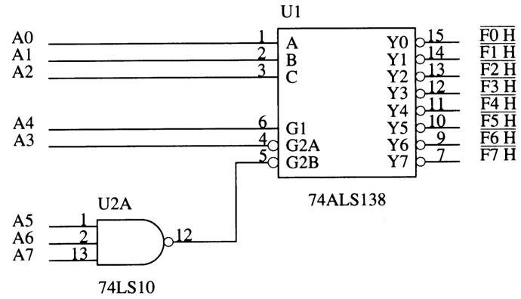
Figure 10 A port decoder that decodes 8-bit I/O ports. This decoder generates active low outputs for ports F0H–F7H.

Slide 44
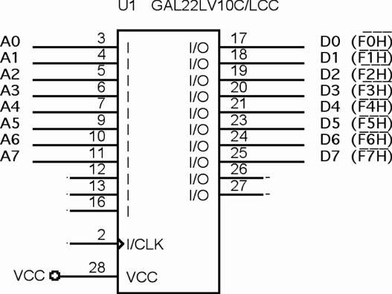
Figure 11 A PLD that generates port selection signals

Slide 45
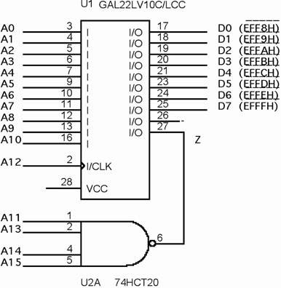
Figure 12 A PLD that decodes 16-bit I/O ports EFF8H through EFFFH.

Slide 46
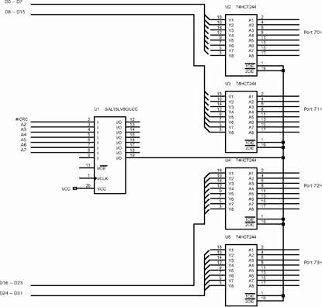
Figure 13 A 32-bit-wide port decoded at 70H through 73H for the 80486DX microprocessor.
I/O ports decoded by this interface are the 8-bit ports 70H–73H
When writing to access this port, it is crucial to use the address 70H for 32-bit input
as instruction IN EAX, 70H

Slide 47
THE PROGRAMMABLE PERIPHERAL
82C55 programmable peripheral interface (PPI) is a popular, low-cost interface component found in many applications.
The PPI has 24 pins for I/O, programmable in groups of 12 pins and groups that operate in three distinct modes of operation.
82C55 can interface any TTL-compatible I/O device to the microprocessor.

Slide 48
THE PROGRAMMABLE PERIPHERAL
The 82C55 (CMOS version) requires wait states if operated with a processor using higher than an 8 MHz clock.
also provides at least 2.5 mA of sink (logic 0) current at each output, a maximum of 4.0 mA
Because I/O devices are inherently slow, wait
states used during I/O transfers do not impact significantly upon the speed of the system.
The 82C55 still finds application even in the latest Core2-based computer system.

Slide 49
THE PROGRAMMABLE PERIPHERAL
82C55 is used for interface to the keyboard and parallel printer port in many PCs.
found as a function within an interfacing chip set
also controls the timer and reads data from the keyboard interface
An experimentation board is available that plugs into the parallel port of a PC, to allow access to an 8255 located on the board.
The 8255 is programmed in either assembly language or Visual C++ through drivers available with the board.

Slide 50
Basic Description of the 82C55
Fig 14 shows pin-outs of the 82C55 in DIP and surface mount (flat pack) format.
The three I/O ports (labeled A, B, and C) are programmed as groups.
group A connections consist of port A (PA₇–PA₀) and the upper half of port C (PC₇–PC₄)
group B consists of port B (PB₇–PB₀) and the lower half of port C (PC₃–PC₀)
82C55 is selected by its CS pin for programming and reading/writing to a port.

Slide 51
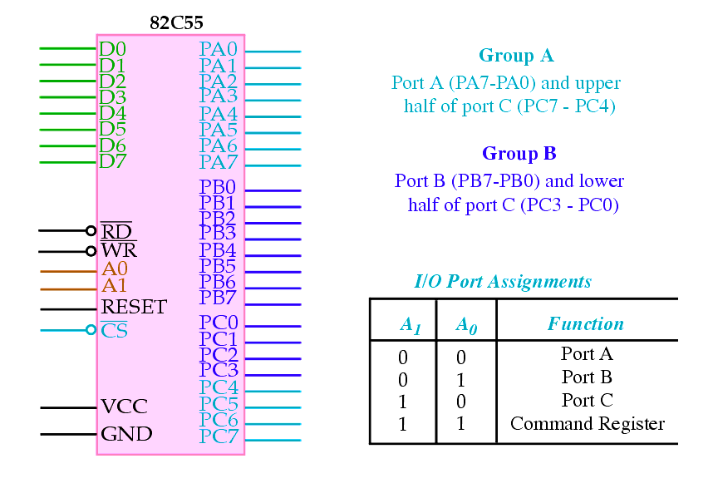
Figure 14 The pin-out of the 82C55 peripheral interface adapter (PPI).

Slide 52
Basic Description of the 82C55
Table 1 shows I/O port assignments used for programming and access to the I/O ports.
In the PC, a pair of 82C55s, or equivalents, are decoded at I/O ports 60H–63H and also at ports 378H–37BH.
The 82C55 is a fairly simple device to interface to the microprocessor and program.
For 82C55 to be read or written, the CS input must be logic 0 and the correct I/O address must be applied to the A₁ and A₀ pins.
Remaining port address pins are don’t cares

Slide 53
Basic Description of the 82C55
Fig 15 shows an 82C55 connected to the 80386SX so it functions at 8-bit addresses C0H (port A), C2H (port B), C4H (port C), and C6H (command register).
this interface uses the low bank of the I/O map
All 82C55 pins are direct connections to the 80386SX, except the CS pin. The pin is decoded/selected by a 74ALS138 decoder.
A RESET to 82C55 sets up all ports as simple input ports using mode 0 operation.
initializes the device when the processor is reset

Slide 54
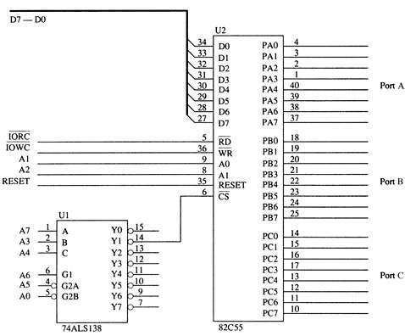
Figure 15 The 82C55 interfaced to the 80386SX microprocessor.

Slide 55
Basic Description of the 82C55
After a RESET, no other commands are needed, as long as it is used as an input device for all three ports.
82C55 is interfaced to the PC at port addresses 60H–63H for keyboard control.
also for controlling the speaker, timer, and other internal devices such as memory expansion
It is also used for the parallel printer port at I/O ports 378H–37BH.

Slide 56
Programming the 82C55
82C55 is programmed through two internal command registers shown in Figure 16.
Bit position 7 selects either command byte A or command byte B.
command byte A programs functions of group A and B
byte B sets (1) or resets (0) bits of port C only if the 82C55 is programmed in mode 1 or 2
Group B (port B and the lower part of port C) are programmed as input or output pins.

Slide 57
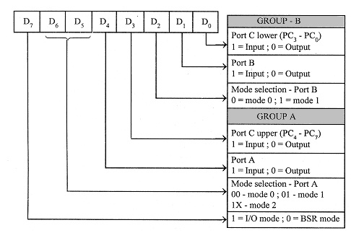
Figure 16 The command byte of the command register in the 82C55.

Slide 58
Programming the 82C55
Mode 0 : Simple Input or Output
In this mode, Port A and Port B are used as two simple 8-bit I/O ports and Port C as two 4-bit I/O ports.
Each port (or half-port, in case of Port C) can be programmed to function as simply an input port or an output port.
The input/output features in mode 0 are :Outputs are latched, Inputs are not latched (?).
Ports do not have handshake or interrupt capability.

Slide 59
Programming the 82C55
Mode 1 : Input or Output with handshake
In mode 1, handshake signals are exchanged between the microprocessor and peripherals prior to data transfer.
The ports (A and B) function as 8-bit I/O ports.
They can be configured either as input or output ports.
Each port (Port A and Port B) uses 3 lines from port C as handshake signals.
The remaining two lines of port C can be used for simple I/O functions.
Input and output data are latched and Interrupt logic is supported.

Slide 60
Programming the 82C55
Mode 2 : Bidirectional Data Transfer
This mode is used primarily in applications such as data transfer between the two computers or floppy disk controller interface.
Port A can be configured as the bidirectional port and Port B either in mode 0 or mode 1.
Port A uses five signals from Port C as handshake signals for data transfer.
The remaining three lines from Port C can be used either as simple I/O or as handshake signals for Port B.

Slide 61
Programming the 82C55
Group A (port A and the upper part of port C) are programmed as input or output pins.
Group A can operate in modes 0, 1, and 2.
mode 2 operation is a bidirectional mode of operation for port A
If a 0 is placed in bit position 7 of the command byte, command byte B is selected
This allows any bit of port C to be set (1) or reset (0), if the 82C55 is operated in either mode 1 or 2.
otherwise, this byte is not used for programming

Slide 62
Mode 0 Operation
Mode 0 operation causes 82C55 to function:
as a buffered input device
as a latched output device
Fig 17 shows 82C55 connected to a set of eight seven-segment LED displays.
These are standard LEDs.
the interface can be modified with a change in resistor values for an organic LED (OLED) display or high-brightness LEDs

Slide 63
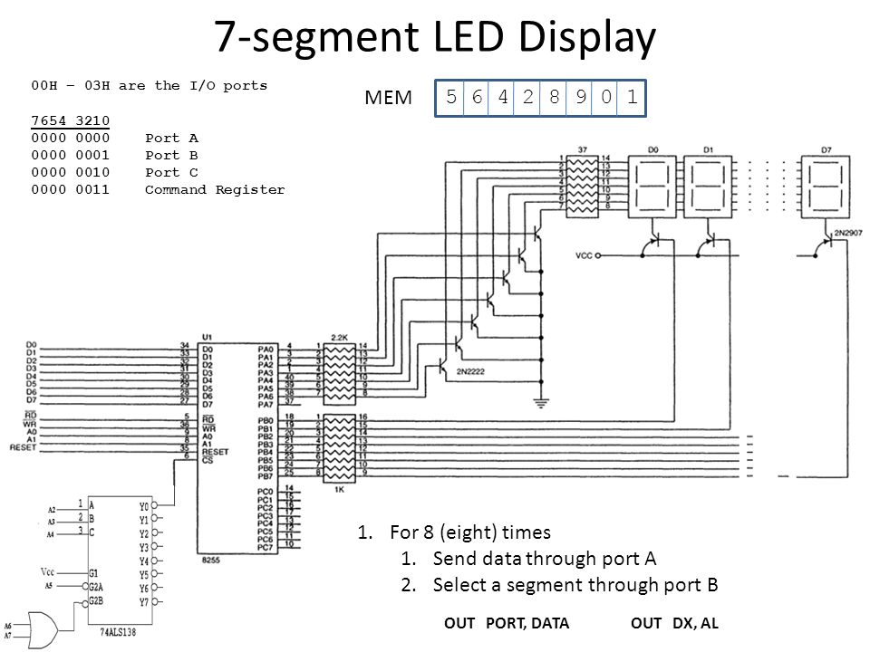
Figure 17 An 8-digit LED display interfaced to the 8088 microprocessor through an 82C55 PIA

Slide 64
An 8-digit LED display
ports A & B are programmed as (mode 0) simple latched output ports
port A provides segment data inputs port B provides a means of selecting one display position at a time for multiplexing the displays
the 82C55 is interfaced to an 8088 through a PLD so it functions at I/O port numbers 0700H–0703H
PLD decodes the I/O address and develops the write strobe for the WR pin of the 82C55

Slide 65
A Stepper Motor Interfaced to the 82C55.
Another device often interfaced to a computer system is the stepper motor.
a digital motor because it is moved in discrete steps as it traverses through 360°
An inexpensive stepper motor is geared to move perhaps 15° per step
A more costly, high-precision stepper motor can be geared to 1° per step.

Slide 66
A Stepper Motor Interfaced to the 82C55.
In all cases, these steps are gained through many magnetic poles and/or gearing.
Figure 18 shows a four-coil stepper motor that uses an armature with a single pole.
two coils are energized
If less power is required, one coil may be energized at a time, causing the motor to step at 45°, 135°, 225°, and 315°.
The motor is shown with the armature rotated to four discrete places, called full stepping.
accomplished by energizing the coils, as shown

Slide 67
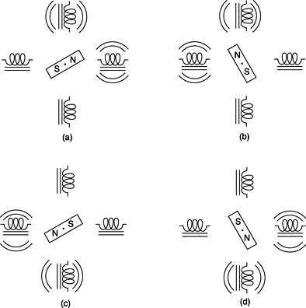
Figure 18 The stepper motor showing full-step operation: (a) 45° (b) 135° (c) 225° (d) 315°.

Slide 68
A Stepper Motor Interfaced to the 82C55.
The motor is driven by NPN Darlington amp pairs to provide a large current to each coil.
A circuit that can drive this stepper motor is illustrated in Fig 19.
with the four coils shown in place
This circuit uses the 82C55 to provide drive signals used to rotate the motor armature in either the right- or left-hand direction.

Slide 69
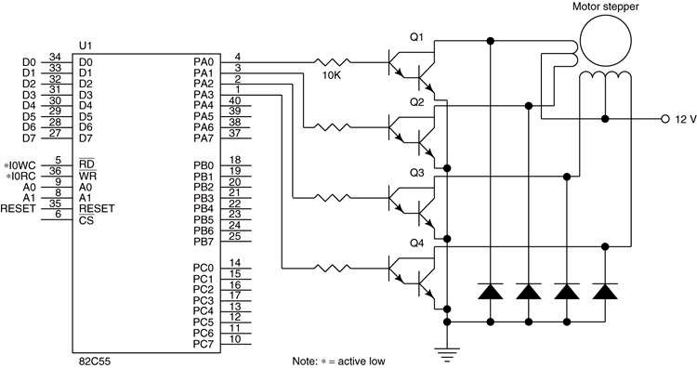
Figure 19 A stepper motor interfaced to the 82C55. This illustration does not show the decoder.

Slide 70
Key Matrix Interface
Keyboards come in a variety of sizes, from standard 101-key QWERTY keyboards to special keyboards that contain 4 to 16 keys.
Fig 20 is a key matrix with 16 switches interfaced to ports A and B of an 82C55.
the switches are formed into a 4 × 4 matrix, but any matrix could be used, such as a 2 × 8
The keys are organized into four rows and columns: (ROW₀–ROW₃) (COL₀–COL₃)

Slide 71
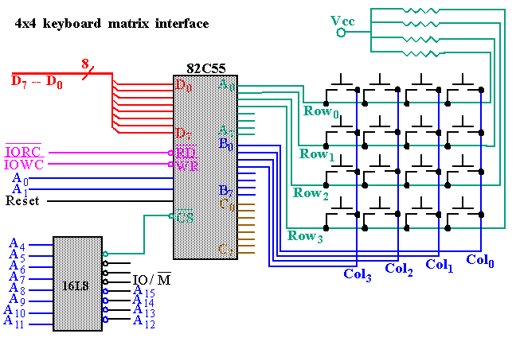
Figure 20 A 4 × 4 keyboard matrix connected to an 8088 microprocessor through the 82C55 PIA.

Slide 72
Mode 1 Strobed Input
In computer or memory technology, a strobe is a signal that is sent that validates data or other signals on adjacent parallel lines.
Causes port A and/or port B to function as latching input devices.
allows external data to be stored to the port until the microprocessor is ready to retrieve it
Port C is used in mode 1 operation—not for data, but for control or handshaking signals.
to help operate either or both port A and B as strobed input ports
Fig 21 shows how both ports are structured for mode 1 strobed input operation.

Slide 73
Signal Definitions for Mode 1 Strobed Input
STB - The strobe input loads data to the port latch, which holds the information until it is input to the microprocessor via the IN instruction.
IBF - Input buffer full is an output indicating that the input latch contains information.
INTR - Interrupt request is an output that requests an interrupt. The INTR pin becomes a logic 1 when STB returns to a logic 1. Cleared when data are input from the port by the processor.
INTE - Interrupt enable signal is neither input nor output; it is an internal bit programmed via port PC₄ (port A) or PC₂ (port B) bit position.

Slide 74
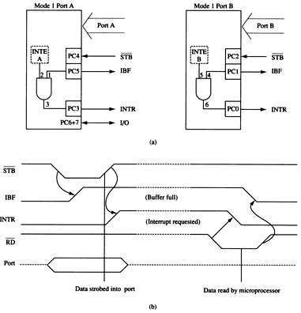
Figure 21 Strobed input operation (mode 1) of the 82C55. (a) Internal structure and (b) timing diagram.

Slide 75
Strobed Input Example
An example of a strobed input device is a keyboard.
The keyboard encoder debounces the key switches and provides a strobe signal whenever a key is depressed.
the data output contains ASCII-coded key code
Figure 22 illustrates a keyboard connected to strobed input port A.

Slide 76
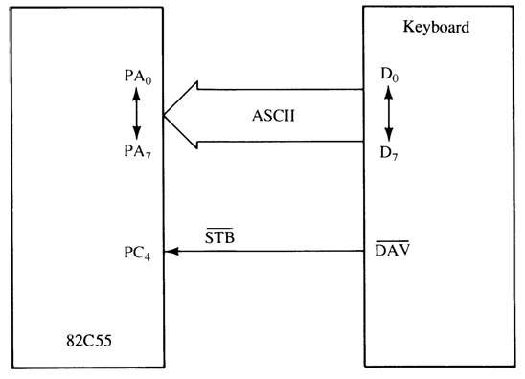
Figure 22 Using the 82C55 for strobed input operation of a keyboard.

Slide 77
Mode 1 Strobed Output
Fig 23 shows the internal configuration and timing diagram of 82C55 when operated as a strobed output device under mode 1.
Strobed output operation is similar to mode 0 output operation.
except control signals are included to provide handshaking
When data are written to a strobed output port, the output buffer full signal becomes logic 0 to indicate data are present in the port latch.

Slide 78
Signal Definitions for Mode 1 Strobed Output
OBF - Output buffer full goes low whenever data are output (OUT) to the port A or B latch. The signal is set to logic 1 when the ACK pulse returns from the external device.
ACK - The acknowledge signal causes the OBF pin to return to logic 1. The ACK signal is a response from an external device, indicating that it has received data from the 82C55 port.
INTR - Interrupt request often interrupts the processor when the external device receives the data via the ACK signal. Qualified by the internal INTE (interrupt enable) bit.
INTE - Interrupt enable is neither input nor output; it is an internal bit programmed to enable or disable the INTR pin. INTE A is programmed using PC₆ bit. INTE B is programmed using the PC₂ bit.

Slide 79
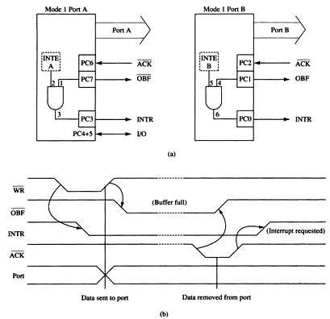
Figure 23 Strobed output operation (mode 1) of the 82C55. (a) Internal structure and (b) timing diagram

Slide 80
Strobed Output Example
The printer interface demonstrates how to achieve strobed output synchronization between the printer and the 82C55.
Figure 24 illustrates port B connected to a parallel printer, with eight data inputs for receiving ASCII-coded data, a DS (data strobe) input to strobe data into the printer, and an ACK output to acknowledge the receipt of the ASCII character.

Slide 81
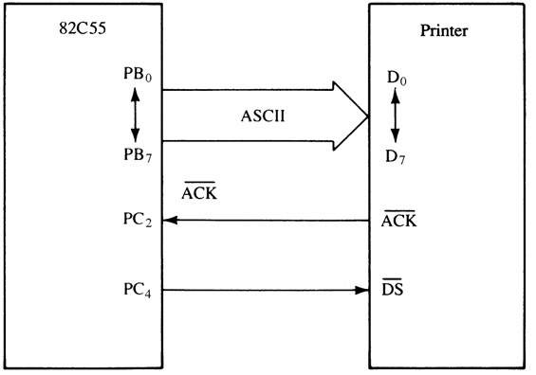
Figure 24 The 82C55 connected to a parallel printer interface that illustrates the strobed output mode of operation for the 82C55.

Slide 82
Mode 2 Bidirectional Operation
Mode 2 is allowed with group A only.
Port A becomes bidirectional, allowing data transmit/receive over the same eight wires.
useful when interfacing two computers
Also used for IEEE-488 parallel high-speed GPIB (general- purpose instrumentation bus) interface standard.
Figure 11-30 shows internal structure and timing for mode 2 bidirectional operation.

Slide 83
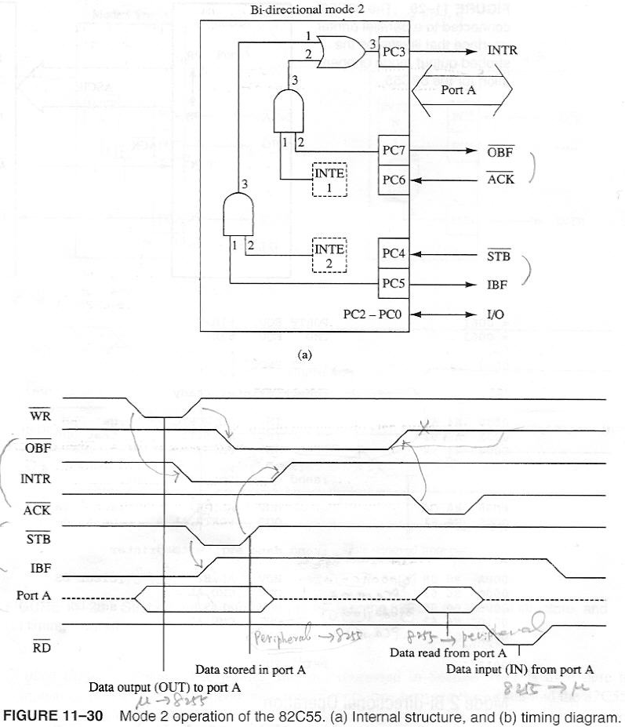
Figure 11-30 Mode 2 operation of the 82C55. (a) Internal structure and (b) timing diagram.

Slide 84
82C55 Mode Summary
Figure 26 shows a graphical summary of the three modes of operation for the 82C55.
Mode 0 provides simple I/O.
Mode 1 provides strobed I/O.
Mode 2 provides bidirectional I/O.
These modes are selected through the command register of the 82C55.

Slide 85
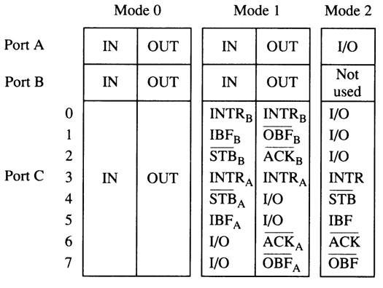
Figure 26 A summary of the port connections for the 82C55 PIA.

Slide 86
8254 PROGRAMMABLE INTERVAL TIMER
The 8254 consists of three independent 16-bit programmable counters (timers).
Each counter is capable of counting in binary or binary-coded decimal (BCD).
maximum allowable input frequency to any counter is 10 MHz
Useful where the microprocessor must control real-time events.
Usage includes real-time clocks, event counters, and motor speed/direction control.

Slide 87
8254 Functional Description
Figure 27 shows the pin-out of the 8254, a higher-speed version of the 8253, and a diagram of one of the three counters.
Each timer contains:
a CLK input which provides the basic operating frequency to the timer
a gate input pin which controls the timer in some modes
an output (OUT) connection to obtain the output of the timer

Slide 88
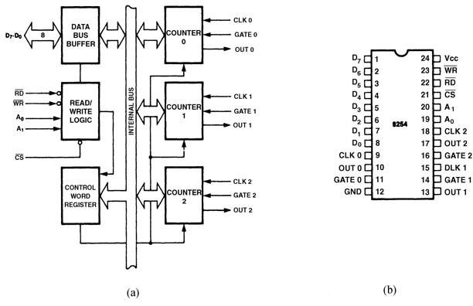
Figure 27 The 8254 programmable interval timer. (a) Internal structure and (b) pin-out. (Courtesy of Intel Corporation.)

Slide 89
8254 Functional Description
The signals that connect to the processor are the data bus pins (D₇–D₀), RD, WR, CS, and address inputs A₁ and A₀.
Address inputs are present to select any of the four internal registers.
used for programming, reading, or writing to a counter
Timer zero generates an 18.2 Hz signal that interrupts the microprocessor at interrupt vector 8 for a clock tick.
often used to time programs and events in DOS
Timer 1 is programmed for 15 µs, used on the PC to request a DMA action used to refresh the dynamic RAM.
Timer 2 is programmed to generate a tone on the PC speaker.

Slide 90
Pin Definitions for 8254
-The address inputs select one of four internal registers within the 8254. See Table 11–4 for the function of the A₁ and A₀ address bits.
CLK-The clock input is the timing source for each of the internal counters. This input is often connected to the PCLK signal from the microprocessor system bus controller.
CS - Chip select enables 8254 for programming and reading or writing a counter.
G - The gate input controls the operation of the counter in some modes of operation
GND - Ground connects to the system ground bus.

Slide 91
Pin Definitions for 8254
OUT - A counter output is where the waveform generated by the timer is available.
RD - Read causes data to be read from the 8254 and often connects to the IORC signal.
VCC - Power connects to the +5.0 V power supply.
WR - Write causes data to be written to the 8254 and often connects to write strobe IOWC.

Slide 92
Programming the 8254
Each counter is programmed by writing a control word, followed by the initial count.
fig 28 lists the program control word structure
The control word allows the programmer to select the counter, mode of operation, and type of operation (read/write).
also selects either a binary or BCD count

Slide 93
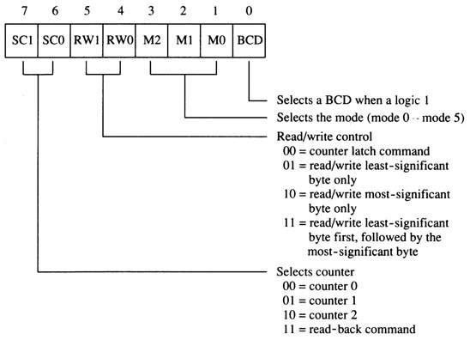
Figure 28 The control word for the 8254-2 timer.

Slide 94
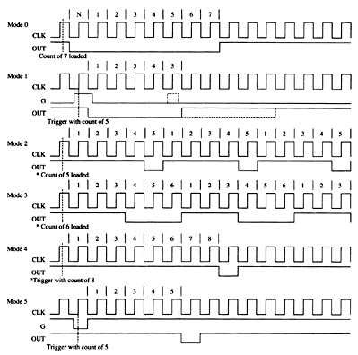
Modes of Operation
six modes (0–5) of available to each of the 8254 counters
each mode functions with the CLK input, the gate (G) control signal, and OUT signal
Figure 29 The six modes of operation for the 8254-2 programmable interval timer. The G input stops the count when 0 in modes 2, 3, and 4.

Slide 95
Mode 0
Allows 8254 to be used as an events counter.
Output becomes logic 0 when the control word is written and remains until N plus the number of programmed counts.
For example, if a count of 5 is programmed, the output will remain a logic 0 for 6 count beginning with N.
Note that gate (G) input must be logic 1 to allow the counter to count.
If G becomes logic 0 in the middle of the count, the counter will stop until G again becomes logic 1.

Slide 96
Mode 1
Causes function as a retriggerable, monostable multivibrator (one-shot).
G input triggers the counter so it develops a pulse at the OUT connection that becomes logic 0 for the duration of the count.
if the count is 10, the OUT connection goes low for 10 clocking periods when triggered
If G input occurs within the output pulse, the counter is reloaded and the OUT connection continues for the total length of the count.

Slide 97
Mode 2
Allows the counter to generate a series of continuous pulses one clock pulse wide.
pulse separation is determined by the count
For a count of 10, output is logic 1 for nine clock periods and low for one clock period.
The cycle is repeated until the counter is programmed with a new count or until the G pin is placed at logic 0.
G input must be logic 1 for this mode to generate a continuous series of pulses

Slide 98
Mode 3
Generates a continuous square wave at the OUT connection, provided the G pin is logic 1.
If the count is even, output is high for one half of the count and low for one half of the count.
If the count is odd, output is high for one clocking period longer than it is low.
if the counter is programmed for a count of 5, the output is high for three clocks and low for two clocks

Slide 99
Mode 4
Allows a single pulse at the output.
If count is programmed as 10, output is high for 10 clocking periods and low for one period.
the cycle does not begin until the counter is loaded with its complete count
Operates as a software triggered one-shot.
As with modes 2 and 3, this mode also uses the G input to enable the counter.
G input must be logic 1 for the counter to operate for these three modes

Slide 100
Mode 5
A hardware triggered one-shot that functions as mode 4.
except it is started by a trigger pulse on the G pin instead of by software
This mode is also similar to mode 1 because it is retriggerable.

Slide 101
DC Motor Speed and Direction Control
An application of 8254 is as a motor speed controller for a DC motor.
Fig 11-45 shows the schematic diagram of the motor and associated driver circuitry.
It also illustrates the interconnection of the 8254, a flip-flop, and the motor and its driver.
Fig 11–46 shows some timing diagrams and effects on the speed/direction of the motor.
Each counter generates pulses at different positions to vary the duty cycle at the Q output of the flip-flop.

Slide 102
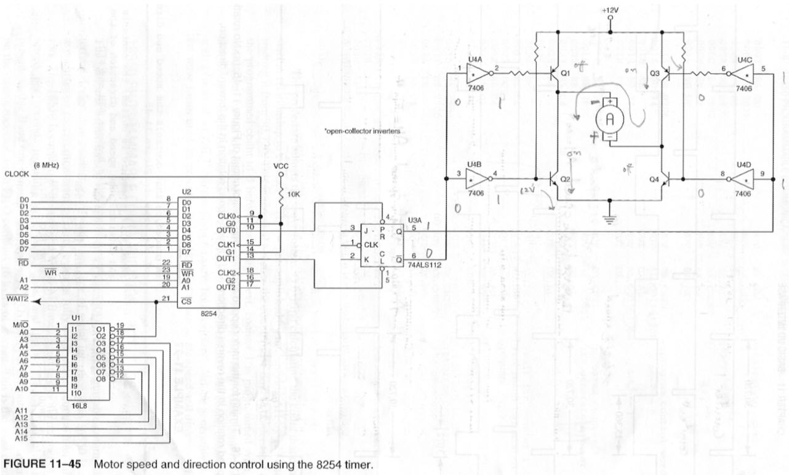
DC Motor Speed and Direction Control

Slide 103
DC Motor Speed and Direction Control
if Q output of the 74ALS112 is logic 1, the motor spins in its forward direction
if logic 0, the motor spins in reverse
if flip-flop output alternates between logic 1 and 0, the motor spins in either direction at various speeds
if the duty cycle of the Q output is 50%, the motor will not spin at all and exhibits some holding torque

Slide 104
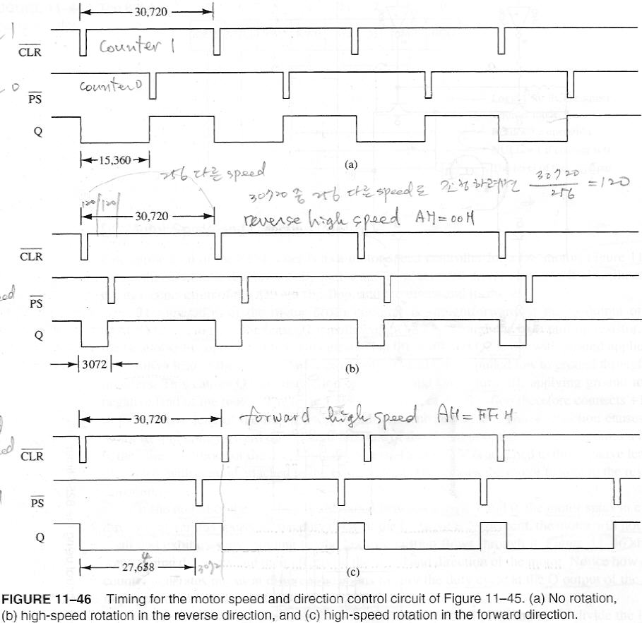

Slide 105
ANALOG-TO-DIGITAL (ADC) & DIGITAL-TO-ANALOG (DAC) CONVERTERS
These devices are used to interface the microprocessor to the analog world.
Many events monitored and controlled by the microprocessor are analog events.
These range from monitoring all forms of events, even speech, to controlling motors and like devices.

Slide 106
The DAC0830 Digital-to-Analog Converter
A fairly common and low-cost digital-to-analog converter is the DAC0830.
a product of National Semiconductor Corp
An 8-bit converter that transforms an 8-bit binary number into an analog voltage.
Other converters are available that convert from 10-, 12-, or 16-bit binary numbers into analog voltages.

Slide 107
The DAC0830 Digital-to-Analog Converter
The number of voltage steps generated by the converter is equal to the number of binary input combinations.
an 8-bit converter generates 256 voltage levels
a 10-bit converter generates 1024 levels
The DAC0830 is a medium-speed converter that transforms a digital input to an analog output in approximately 1.0 µs.

Slide 108
The DAC0830 Digital-to-Analog Converter
Figure 11–48 shows pin-outs of a DAC0830.
The device has eight data bus connections for the application of the digital input code.
Analog outputs labeled IOUT1 & IOUT2 are inputs to an external operational amplifier.
Because this is an 8-bit converter, its output step voltage is defined as –V_{REF} (reference voltage), divided by 255.
the step voltage is often called the resolution of the converter

Slide 109
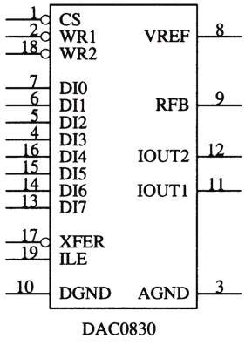
Figure 11–48 The pin-out of the DAC0830 digital-to-analog converter.

Slide 110
Internal Structure of the DAC0830
Fig 11–49 shows the internal structure.
This device contains two internal registers.
the first is a holding register
the second connects to the R–2R internal ladder converter
The two latches allow one byte to be held while another is converted.
The first latch is often disabled and the second for entering data into the converter.

Slide 111
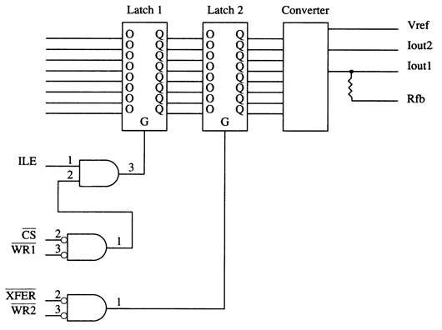
Figure 11–49 The internal structure of the DAC0830.

Slide 112
Both latches within the DAC0830 are transparent latches.
when G input is logic 1, data pass through
when G input becomes logic 0, data are latched
The output of the R–2R ladder within the converter appears at IOUT1 and IOUT2.
These outputs are designed to be applied to an operational amplifier such as a 741 or similar device.

Slide 113
Connecting the DAC0830 to the Microprocessor.
A PLD is used to decode the DAC0830 at I/O port address 20H.
when an OUT 20H,AL instruction is executed, contents of data bus connections AD₀–AD₇ are passed to the converter in the DAC0830
The 741 operational amplifier, along with the –12 V zener reference voltage, causes the full-scale output voltage to equal +12 V.
See Fig 11–50.

Slide 114
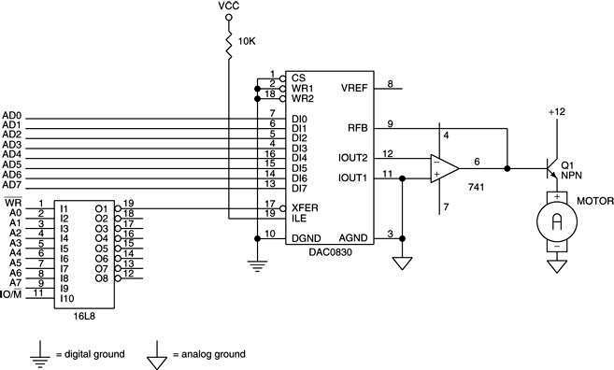
Figure 11–50 A DAC0830 interfaced to the 8086 microprocessor at 8-bit I/O location 20H.

Slide 115
The ADC080X Analog-to-Digital Converter
A common, low-cost ADC, compatible with a wide range of microprocessors.
while there are faster ADCs available with more resolution, this device is ideal for applications that do not require a high degree of accuracy
ADC080X requires up to 100 µs to convert an analog input voltage into a digital output code.
Figure 11–51 shows the pin-out of the ADC0804 converter.

Slide 116
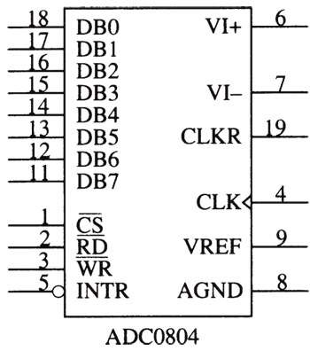
Figure 11–51 The pin-out of the ADC0804 analog-to-digital converter.

Slide 117
To operate the converter, the WR pin is pulsed with CS grounded to start the conversion process.
See Fig 11–52 for a timing diagram that shows the interaction of the control signals.
If a time delay is used that allows at least 100 µs of time, there is no need to test INTR pin.
Another option is to connect the INTR pin to an interrupt input, so when the conversion is complete, an interrupt occurs.

Slide 118
Connecting the ADC0804 to the Microprocessor
ADC0804 interfaced to an 8086 is illustrated in Figure 11–55.
V_{REF} is not attached to anything, which is normal
Suppose ADC0804 is decoded at I/O port address 40H for the data and address 42H for INTR.
The procedure to read data is listed in Example 11–29.

Slide 119
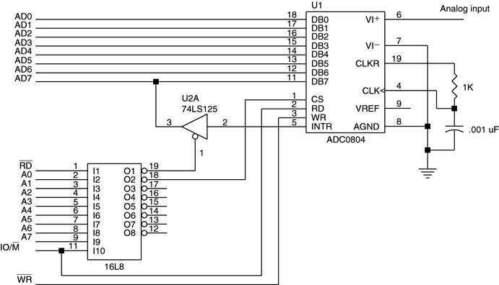
Figure 11–55 The ADC0804 interfaced to the 8086 microprocessor.

Slide 120
Using the ADC0804 and the DAC0830
This illustrates an example using an ADC0804 and a DAC0830 to capture and replay audio signals or speech.
a speech synthesizer has been used in the past to generate speech, but quality was poor
For human quality speech, we can use an ADC0804 to capture an audio signal and store it for later playback through a DAC0830.

Slide 121
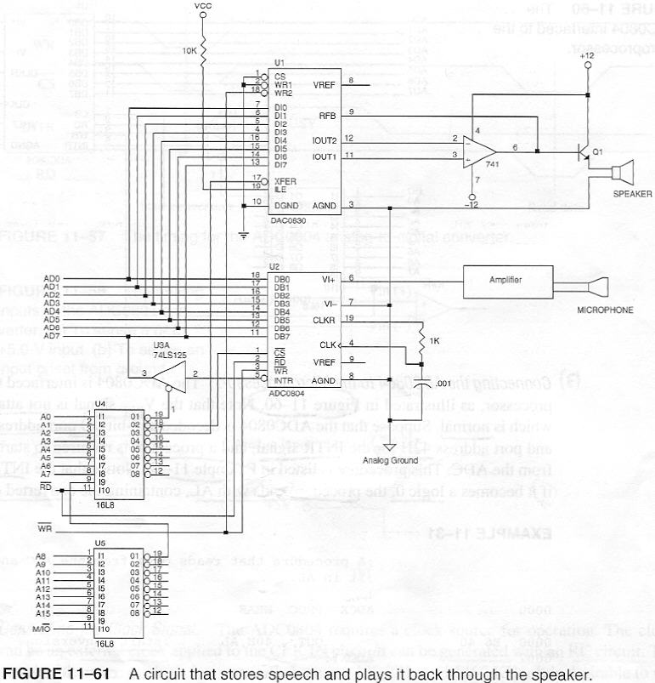
Figure 11–61 A circuit that stores speech and plays it back through the speaker.

Slide 122
A procedure called READS reads the speech.
A second, PLAYS, plays it back.
The speech is sampled and stored in a section of memory called WORDS.
The sample rate is chosen at 2048 samples per second, which renders acceptable-sounding speech.

