Slide 1

CSE 203: Data Structure
Data Structure
QUEUE:
A scenario of waiting in front of a public toilet.
How the people are taking place?
Ans: at the backend / last position.
This also called rear.
Who has entered in the toilet?
Ans: First person / the person at the front.
First in First Out (FIFO)
Two pointer: REAR, FRONT

Slide 2
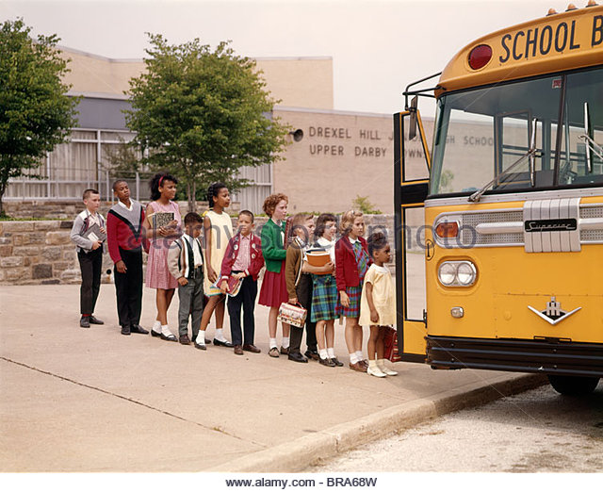
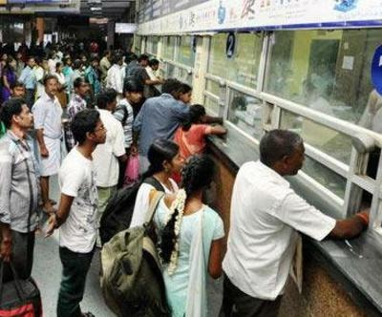
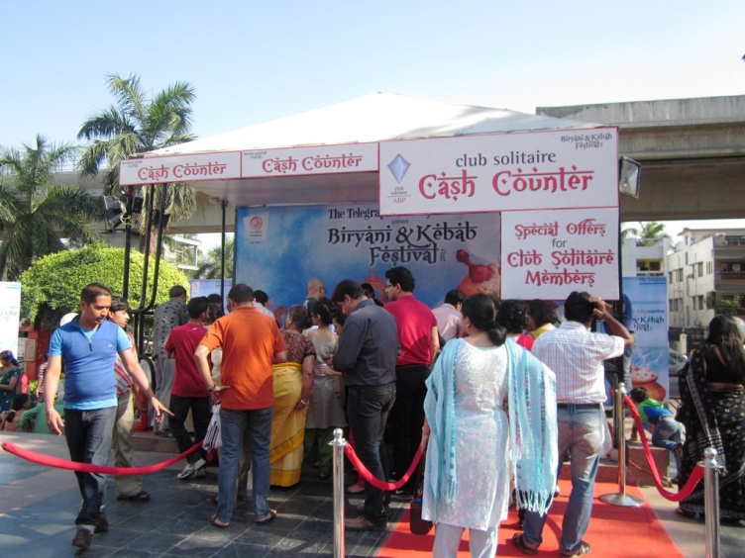
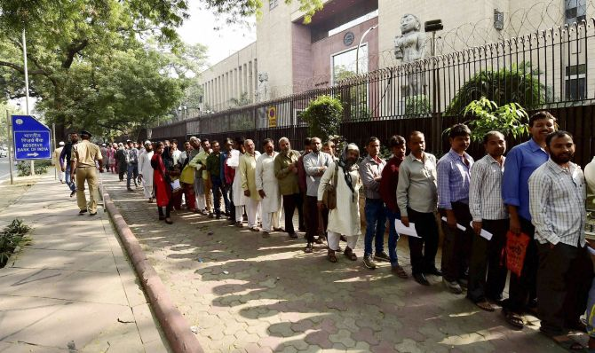

CSE 203: Data Structure
Data Structure
QUEUE:
First In First Out (FIFO)
EXAMPLE
Waiting to get into bus.
Waiting in a ticket counter.
Waiting in cash counter.
Waiting for voting.
Waiting for doctor.
Now say,
Who will be first to meet the doctor?
Solution: This is maintained by a list. Called QUEUE.

Slide 3
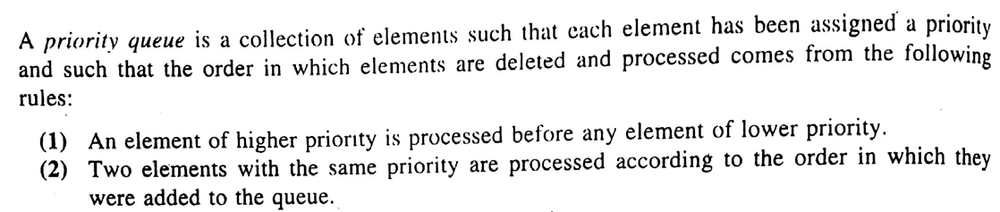
CSE 203: Data Structure
Data Structure
DEQUE:
Element can be added or removed at either end but not in the middle.
AAA | BBB | CCC
1 | 2 | 3 | 4 | 5 | 6 | 7 | 8 | 9 | 10 | 11
Priority QUEUE:

Slide 4
CSE 203: Data Structure
Data Structure
Queue:
First In First Out (FIFO)
AAA | BBB | CCC
1 | 2 | 3 | 4 | 5 | 6 | 7 | 8 | 9 | 10 | 11
INSERT: DDD
(where?)
AAA | BBB | CCC | DDD
1 | 2 | 3 | 4 | 5 | 6 | 7 | 8 | 9 | 10 | 11
DELETE:
(Which one?)
 | BBB | CCC | DDD
1 | 2 | 3 | 4 | 5 | 6 | 7 | 8 | 9 | 10 | 11
DELETE:
(Which one?)
 |  | CCC | DDD
1 | 2 | 3 | 4 | 5 | 6 | 7 | 8 | 9 | 10 | 11
It require two pointers:
FRONT to Insert REAR to delete

