Slide 1
CSE 203: Data Structure
Data Structure
STACK:
A pole is placed on a plane.
D
Disk A is placed in the pole.
C
Disk B is placed on disk A.
B
Disk C is placed on disk B.
A
Disk D is placed on disk C.
This type of operation is called push instead of insert.
Where to push?
At TOP
Is it possible to another disk E?
If there is no space to push in STACK, the situation is called overflow.

Slide 2
CSE 203: Data Structure
Data Structure
STACK:
A pole is placed on a plane.
D
Disk A is placed in the pole.
C
Disk B is placed on disk A.
B
Disk C is placed on disk B.
A
Disk D is placed on disk C.
This type of operation is called push instead of insert.
Where to push?
At TOP
Now remove disk D.
Removing/deleting process is known as POP.
Now remove disk C.
Is it possible to POP more?
Now remove disk B.
Ans: No, because the pole is empty. When the STACK is empty but one tries to perform POP, the situation is called underflow.
Now remove disk A.

Slide 3
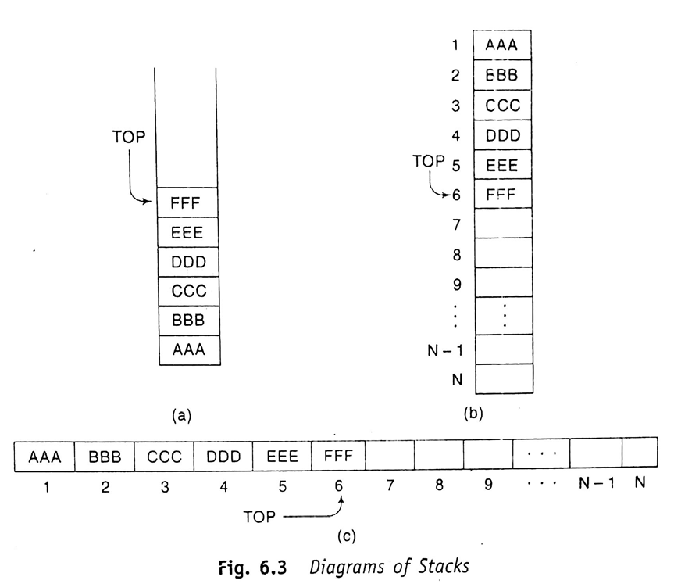
CSE 203: Data Structure
Data Structure
STACK:
Elements are
AAA, BBB, CCC, DDD, EEE, FFF.
Sequentially pushed in an array of STACK.

Slide 4
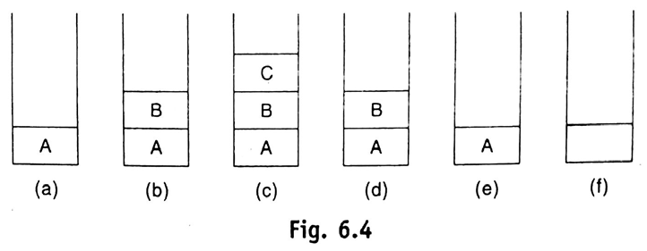
CSE 203: Data Structure
Data Structure
STACK:
Elements are
A, B, C.
Sequentially pushed in an array of STACK.

Slide 5
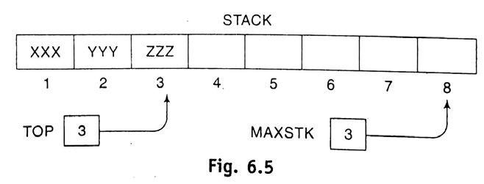
CSE 203: Data Structure
Data Structure
STACK: Array representation
Elements are
XXX, YYY, ZZZ.
Sequentially pushed in an array of STACK.
8

Slide 6

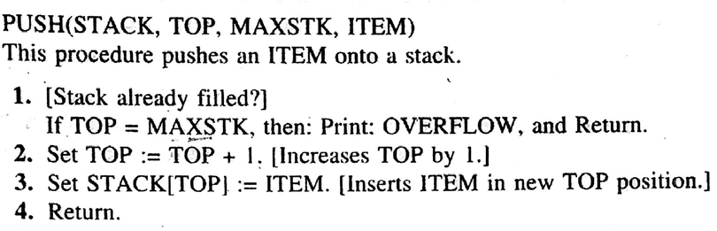
CSE 203: Data Structure
Data Structure
STACK: Array representation
Let, ITEM=“WWW”
Here,
MAXSTK=11
TOP=3
Step 2. TOP=TOP+1=3+1=4
Step 3. STACK[TOP]=STACK[4]=WWW
Array of STACK:
AAA | BBB | CCC
1 | 2 | 3 | 4 | 5 | 6 | 7 | 8 | 9 | 10 | 11

Slide 7
CSE 203: Data Structure
Data Structure
STACK: Array representation
Let, ITEM=“WWW”
Here,
MAXSTK=11
TOP=3
Step 2. TOP=TOP+1=3+1=4
Step 3. STACK[TOP]=STACK[4]=WWW
Array of STACK:
AAA | BBB | CCC | WWW
1 | 2 | 3 | 4 | 5 | 6 | 7 | 8 | 9 | 10 | 11

Slide 8
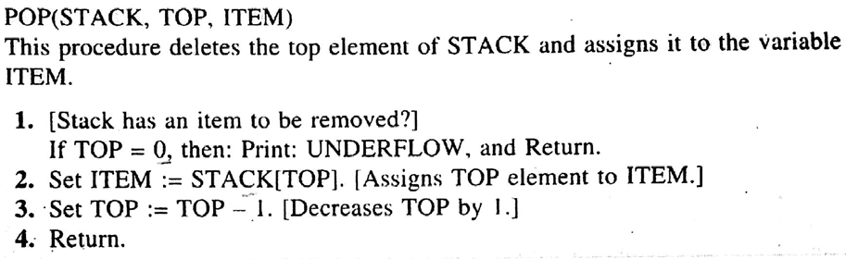
CSE 203: Data Structure
Data Structure
STACK: Array representation
Here,
MAXSTK=11
TOP=4
Step 2. ITEM=STACK[TOP]=STACK[4]=WWW
Step 3. TOP=TOP-1=3
Array of STACK:
AAA | BBB | CCC | WWW
1 | 2 | 3 | 4 | 5 | 6 | 7 | 8 | 9 | 10 | 11

Slide 9
CSE 203: Data Structure
Data Structure
STACK: Performing Arithmetic Operation
Notations:
Infix
Polish (Prefix)
Reverse Polish (Postfix)

Slide 10
CSE 203: Data Structure
Data Structure
STACK: Performing Arithmetic Operation
Notations:
Infix
Polish (Prefix)
Reverse Polish (Postfix)
(A+B)*C

Slide 11
CSE 203: Data Structure
Data Structure
STACK: Performing Arithmetic Operation
Notations:
Infix
Polish (Prefix)
Reverse Polish (Postfix)
Operator symbol is placed before its two operand:
In Infix: (A+B)*C
In Polish: *+ABC
Infix: 12/(7-3)+2*(1+5)
In Polish: 12/[-, 7, 3]+2*[+, 1, 5]
: [/12,-,7,3]+[*, 2, +, 1, 5]
:+, /, 12, -, 7, 3, *, 2, +, 1, 5

Slide 12

CSE 203: Data Structure
Data Structure
STACK: Performing Arithmetic Operation
Notations:
Infix
Polish (Prefix)
Reverse Polish (Postfix)
Operator symbol is placed before its two operand:
In Infix: (A+B)*C
In Polish: *+ABC
P: +, /, 12, -, 7, 3, *, 2, +, 1, 5
P: +, /, 12, 4, *, 2, +, 1, 5
P: +, 3, *, 2, +, 1, 5
P: +, 3, *, 2, 6
P: +, 3, 12
P: 15

Slide 13
CSE 203: Data Structure
Data Structure
STACK: Performing Arithmetic Operation
Notations:
Infix
Polish (Prefix)
Reverse Polish (Postfix)
Operator symbol is placed after its two operand:
In Infix: (A+B)*C
In Postfix: AB+C*
P= 5, 6, 2, +, *, 12, 4, /, -
P= 5, 8, *, 12, 4, /, -
P= 40, 12, 4, /, -
P= 40, 3, -
P= 37

Slide 14
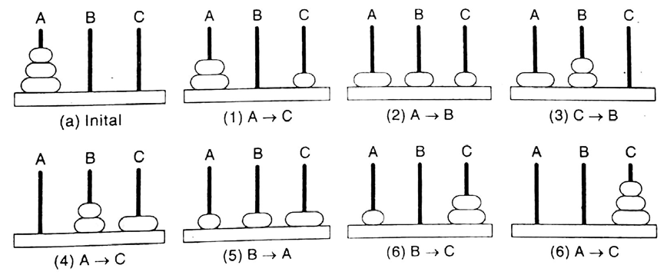
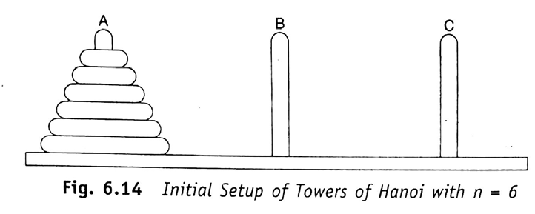
CSE 203: Data Structure
Data Structure
STACK: Performing Arithmetic Operation
Recursion:
Calling itself.
Factorial
Fibonacci Sequence
Tower of Hanoi:

