Slide 1
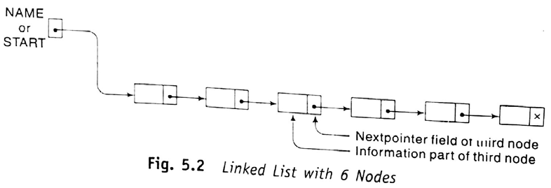
CSE 203: Data Structure
Data Structure
Pointer/Link List
A link list:
is a one way list
is a linear collection of data elements, called nodes
What happens if START .
What does means? .
Where the linear order is given by means of pointers. Each node is divided into two parts:
First part that contains information of element
Second part that contains the address of next node. It is also known as link field, nextpointer field.
The pointer of the last node contains a special value, called null pointer.
There is a list pointer variable, called START, that contains the address of first node

Slide 2

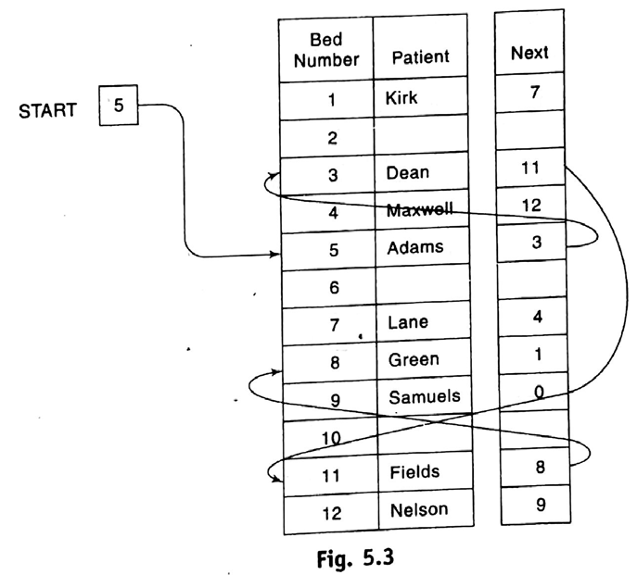
CSE 203: Data Structure
Data Structure
Pointer
/Link List

Slide 3
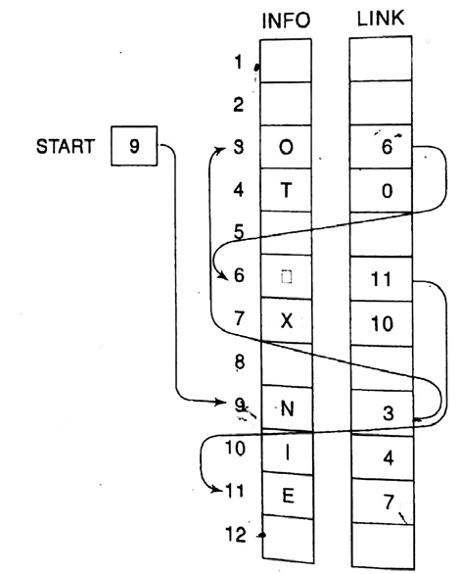

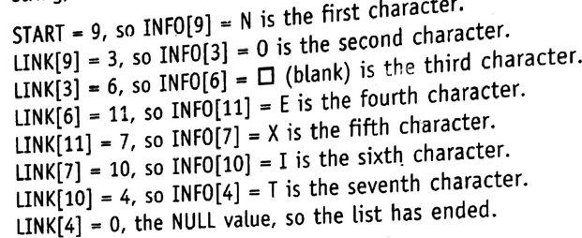
CSE 203: Data Structure
Data Structure
Representation of Link List in memory
A link list for:

Slide 4
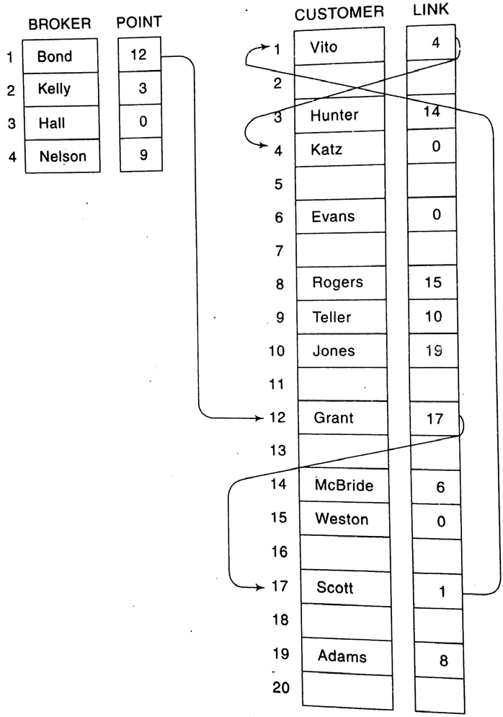







CSE 203: Data Structure
Data Structure
Representation of Link List in memory
A link list for multiple start nodes:

Slide 5
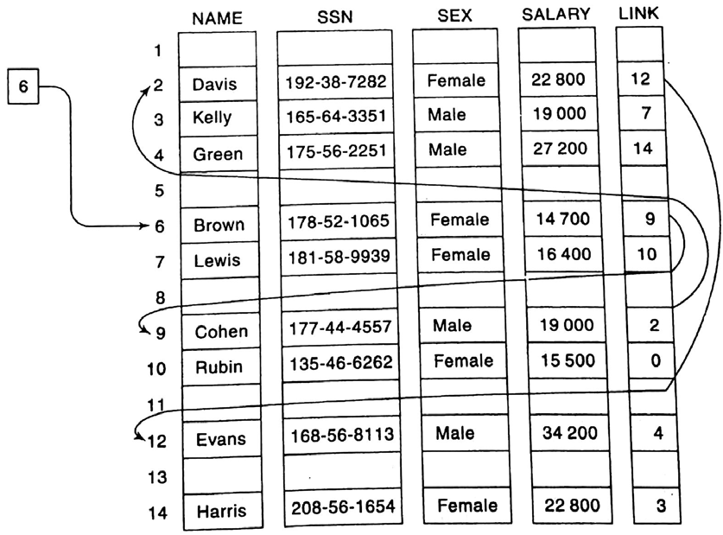
CSE 203: Data Structure
Data Structure
Representation of Link List in memory
Link list of multiple values:

Slide 6
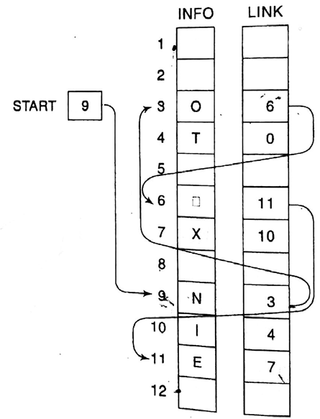
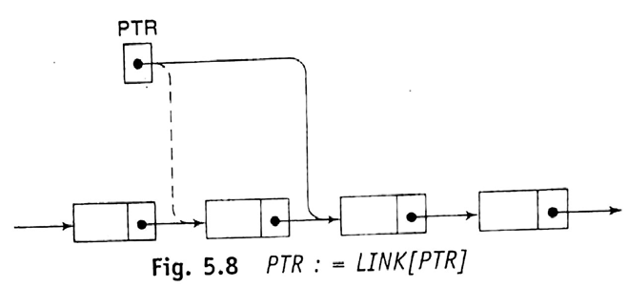
CSE 203: Data Structure
Data Structure
Traversing elements of a Link List

Slide 7
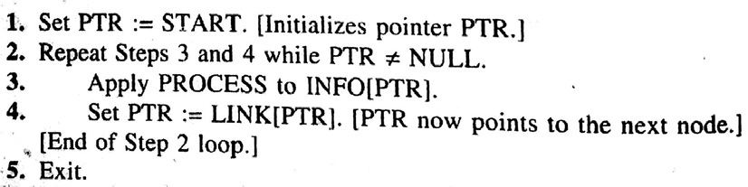
CSE 203: Data Structure
Data Structure
Traversing elements of a Link List

Slide 8
CSE 203: Data Structure
Data Structure
Traversing elements of a Link List
While Executing
PTR=9

Slide 9
CSE 203: Data Structure
Data Structure
Traversing elements of a Link List
PTR=9
While Executing

Slide 10
CSE 203: Data Structure
Data Structure
Traversing elements of a Link List
PTR=9
While Executing

Slide 11
CSE 203: Data Structure
Data Structure
Traversing elements of a Link List
PTR=3
While Executing

Slide 12
CSE 203: Data Structure
Data Structure
Traversing elements of a Link List
PTR=3
While Executing

Slide 13
CSE 203: Data Structure
Data Structure
Traversing elements of a Link List
PTR=3
While Executing

Slide 14
CSE 203: Data Structure
Data Structure
Traversing elements of a Link List
PTR=6
While Executing

Slide 15
CSE 203: Data Structure
Data Structure
Traversing elements of a Link List
PTR=6
While Executing

Slide 16
CSE 203: Data Structure
Data Structure
Traversing elements of a Link List
PTR=6
While Executing

Slide 17
CSE 203: Data Structure
Data Structure
Traversing elements of a Link List
PTR=11
While Executing

Slide 18
CSE 203: Data Structure
Data Structure
Traversing elements of a Link List
After several executions………Let PTR=4
While Executing

Slide 19
CSE 203: Data Structure
Data Structure
Traversing elements of a Link List
PTR=4
While Executing

Slide 20
CSE 203: Data Structure
Data Structure
Traversing elements of a Link List
PTR=0
While Executing

Slide 21
CSE 203: Data Structure
Data Structure
Traversing elements of a Link List
PTR=0
While Executing

Slide 22
CSE 203: Data Structure
Data Structure
Traversing elements of a Link List
While Executing

Slide 23
CSE 203: Data Structure
Data Structure
Traversing elements of a Link List
Code window
Implementing in C

Slide 24
CSE 203: Data Structure
Data Structure
Traversing elements of a Link List
Identify the variables, their types and the necessary data structures.
Implementing in C

Slide 25
CSE 203: Data Structure
Data Structure
Traversing elements of a Link List
Identify the variables, their types and the necessary data structures.
Here,
There are four variables.
Three of integer type and one of character type.
Two of single valued and two of array types.
Now declare them accordingly.
Implementing in C

Slide 26
CSE 203: Data Structure
Data Structure
Traversing elements of a Link List
void main()
{ int START, PTR, LINK[12]={-2, -2, 6, -1, -2, 11, 10, -2, 3, 4, 7, -2};
char INFO[12]={“ OT X NIE “};
Two space
Single space
Implementing in C

Slide 27
CSE 203: Data Structure
Data Structure
Traversing elements of a Link List
void main()
{ int START, PTR, LINK[12]={-2, -2, 6, -1, -2, 11, 10, -2, 3, 4, 7, -2};
char INFO[12]={“ OT X NIE “};
PTR=START;

Slide 28
CSE 203: Data Structure
Data Structure
Traversing elements of a Link List
void main()
{ int START, PTR, LINK[12]={-2, -2, 6, -1, -2, 11, 10, -2, 3, 4, 7, -2};
char INFO[12]={“ OT X NIE “};
PTR=START;
while(PTR!=-1)
{

Slide 29
CSE 203: Data Structure
Data Structure
Traversing elements of a Link List
void main()
{ int START, PTR, LINK[12]={-2, -2, 6, -1, -2, 11, 10, -2, 3, 4, 7, -2};
char INFO[12]={“ OT X NIE “};
PTR=START;
while(PTR!=-1)
{
printf(“%d, ”, INFO[PTR]);

Slide 30
CSE 203: Data Structure
Data Structure
Traversing elements of a Link List
void main()
{ int START, PTR, LINK[12]={-2, -2, 6, -1, -2, 11, 10, -2, 3, 4, 7, -2};
char INFO[12]={“ OT X NIE “};
PTR=START;
while(PTR!=-1)
{
printf(“%d, ”, INFO[PTR]);
PTR=LINK[PTR];
}
}
Additional operations:
Counting elements
Printing elements

Slide 31
CSE 203: Data Structure
Data Structure
Searching an element in a Link List
What to do?

Slide 32
CSE 203: Data Structure
Data Structure
Searching an element in a Link List
If INFO[PTR]==ITEM then print PTR and stop.

Slide 33
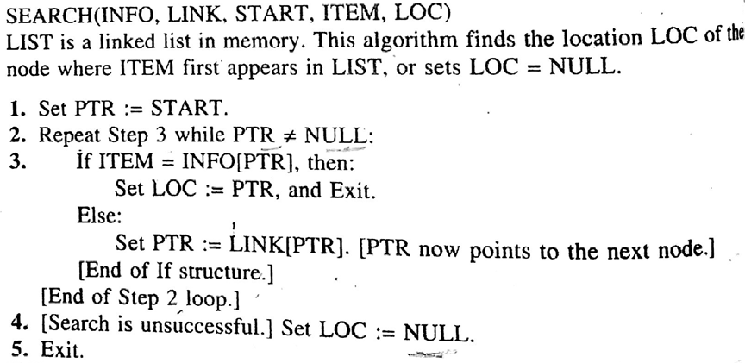
CSE 203: Data Structure
Data Structure
Searching an element in a Link List
If INFO[PTR]==ITEM then print PTR and stop.
For searching

Slide 34
CSE 203: Data Structure
Data Structure
Searching an element in a Link List
void main()
{ int START, PTR, LOC, LINK[12]={-2, -2, 6, -1, -2, 11, 10, -2, 3, 4, 7, -2};
char INFO[12]={“ OT X NIE “}, ITEM=‘X’;
PTR=START;
while(PTR!=-1)
{ if (ITEM==INFO[PTR])
{LOC=PTR; printf(“%d, ”,LOC); return;}
else PTR=LINK[PTR];
} printf(“Item is not found in the array”);
}

Slide 35
CSE 203: Data Structure
Data Structure
Deleting an element from the Link List
Deleting first element
Deleting last element
Deleting a given ITEM
Deleting First element
Set START=LINK[START]
2. Deleting Last element
Set PTR=START
Repeat while LINK[LINK[PTR]]≠NULL
PTR=LINK[PTR]
Set LINK[PTR]=NULL

Slide 36
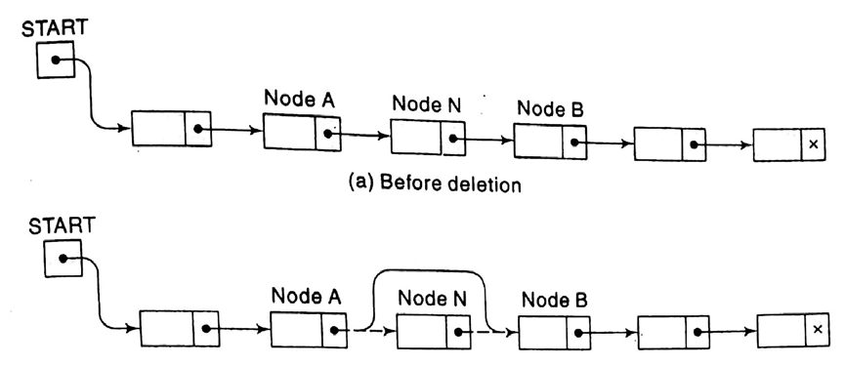
CSE 203: Data Structure
Data Structure
Deleting an element from the Link List
3. Given an ITEM to delete

Slide 37
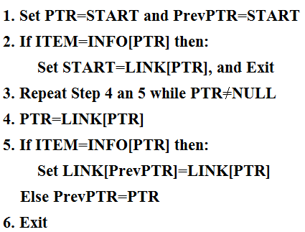
CSE 203: Data Structure
Data Structure
Deleting an element from the Link List
3. Given an ITEM

Slide 38
CSE 203: Data Structure
Data Structure
Deleting an element from the Link List
While Executing
ITEM=‘E’
PTR=9
PrevPTR=9

Slide 39
CSE 203: Data Structure
Data Structure
Deleting an element from the Link List
While Executing
ITEM=‘E’
PTR=9
PrevPTR=9
INFO[9] is ‘N’

Slide 40
CSE 203: Data Structure
Data Structure
Deleting an element from the Link List
While Executing
ITEM=‘E’
PTR=9
PrevPTR=9
INFO[9] is ‘N’

Slide 41
CSE 203: Data Structure
Data Structure
Deleting an element from the Link List
While Executing
ITEM=‘E’
PTR=3 because LINK[PTR] is 3.
PrevPTR=9
INFO[9] is ‘N’

Slide 42
CSE 203: Data Structure
Data Structure
Deleting an element from the Link List
While Executing
ITEM=‘E’
PTR=3 because LINK[PTR] is 3.
PrevPTR=9
INFO[3] is ‘O’

Slide 43
CSE 203: Data Structure
Data Structure
Deleting an element from the Link List
While Executing
ITEM=‘E’
PTR=3 because LINK[PTR] is 3.
PrevPTR=3
INFO[3] is ‘O’

Slide 44
CSE 203: Data Structure
Data Structure
Deleting an element from the Link List
While Executing
ITEM=‘E’
PTR=3 because LINK[PTR] is 3.
PrevPTR=3
INFO[3] is ‘O’

Slide 45
CSE 203: Data Structure
Data Structure
Deleting an element from the Link List
While Executing
ITEM=‘E’
PTR=6 because LINK[3] is 6.
PrevPTR=3
INFO[3] is ‘O’

Slide 46
CSE 203: Data Structure
Data Structure
Deleting an element from the Link List
While Executing
ITEM=‘E’
PTR=6 because LINK[3] is 6.
PrevPTR=3
INFO[6] is ‘ ’

Slide 47
CSE 203: Data Structure
Data Structure
Deleting an element from the Link List
While Executing
ITEM=‘E’
PTR=6 because LINK[3] is 6.
PrevPTR=6
INFO[6] is ‘ ’

Slide 48
CSE 203: Data Structure
Data Structure
Deleting an element from the Link List
While Executing
ITEM=‘E’
PTR=6 because LINK[3] is 6.
PrevPTR=6
INFO[6] is ‘ ’

Slide 49
CSE 203: Data Structure
Data Structure
Deleting an element from the Link List
While Executing
ITEM=‘E’
PTR=11 because LINK[6] is 11.
PrevPTR=6
INFO[6] is ‘ ’

Slide 50
CSE 203: Data Structure
Data Structure
Deleting an element from the Link List
While Executing
ITEM=‘E’
PTR=11 because LINK[6] is 11.
PrevPTR=6
INFO[11] is ‘E’

Slide 51
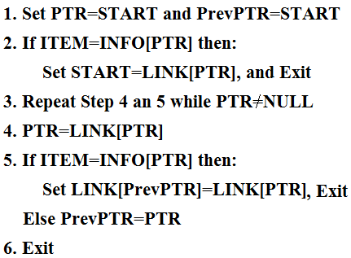
CSE 203: Data Structure
Data Structure
Deleting an element from the Link List
While Executing
ITEM=‘E’
PTR=11 because LINK[6] is 11.
PrevPTR=6
LINK[6]=LINK[11], that is, LINK[6]=7
INFO[11] is ‘E’

Slide 52
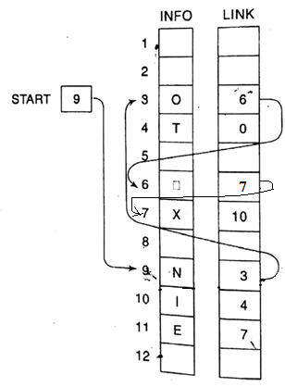
CSE 203: Data Structure
Data Structure
Deleting an element from the Link List
After Deletion
ITEM=‘E’
PTR=11 because LINK[6] is 11.
PrevPTR=6
LINK[6]=LINK[11], that is, LINK[6]=7
INFO[11] is ‘E’

Slide 53
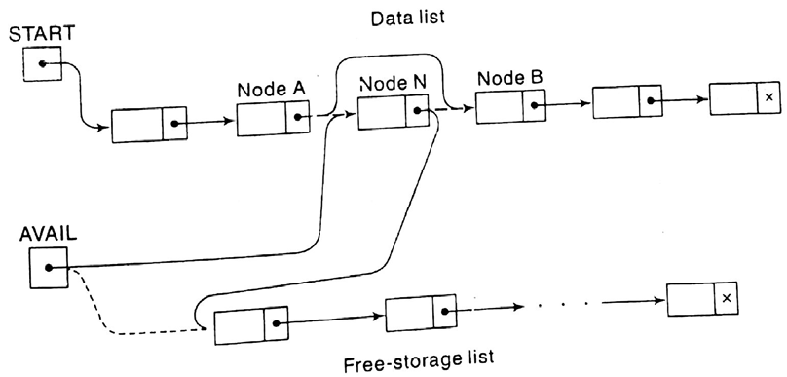
CSE 203: Data Structure
Data Structure
Deleting an element from the Link List
What to about AVAIL List?

Slide 54
CSE 203: Data Structure
Data Structure
Memory allocation and garbage collection of a Link List

Slide 55
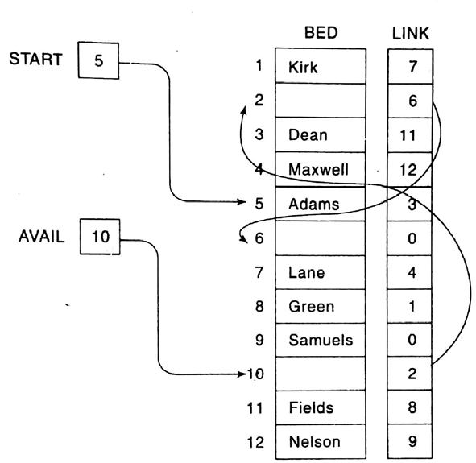
CSE 203: Data Structure
Data Structure
Memory allocation and garbage collection of a Link List

Slide 56
CSE 203: Data Structure
Data Structure
Memory allocation and garbage collection of a Link List
If an item is deleted from the list, how to collect the space for the purpose of future reuse?
What is OVERFLOW and UNDERFLOW?
When do these two operations happen?

Slide 57
CSE 203: Data Structure
Data Structure
Inserting an element from the Link List
Inserting in an empty list
Inserting as a first element
Inserting at the last
Inserting ITEM at a given position

Slide 58
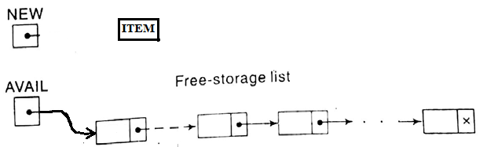
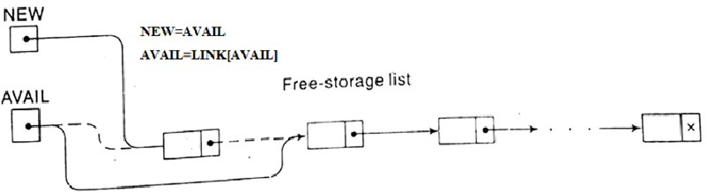
CSE 203: Data Structure
Data Structure
Inserting an element from the Link List
Inserting in an empty list

Slide 59

CSE 203: Data Structure
Data Structure
Inserting an element from the Link List
Inserting in an empty list
After removing dash lines, it looks like the left figure

Slide 60
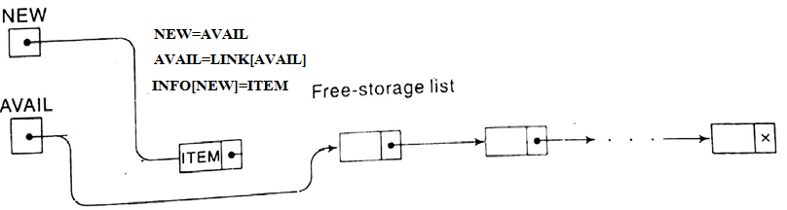
CSE 203: Data Structure
Data Structure
Inserting an element from the Link List
Inserting in an empty list

Slide 61
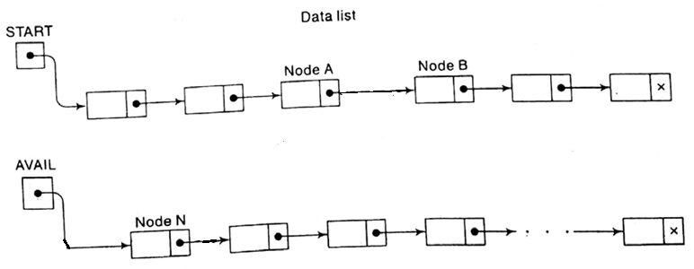
CSE 203: Data Structure
Data Structure
Inserting an element from the Link List
4. Inserting an ITEM to a given position
Now we want to insert a node after A and before B.

Slide 62
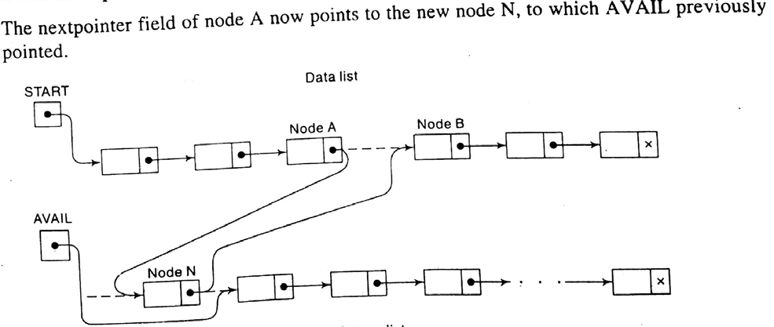
CSE 203: Data Structure
Data Structure
Inserting an element from the Link List
4. Inserting an ITEM to a given position

Slide 63
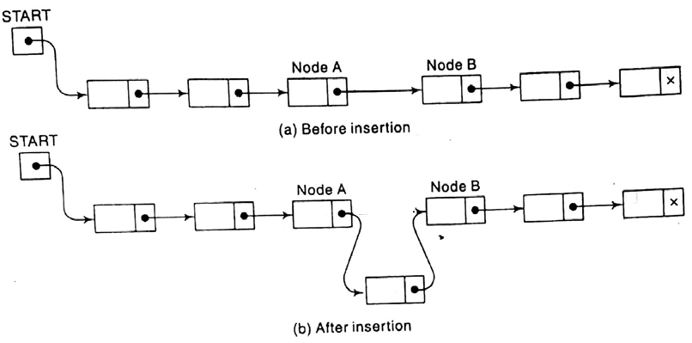
CSE 203: Data Structure
Data Structure
Inserting an element from the Link List
4. Inserting an ITEM to a given position

Slide 64
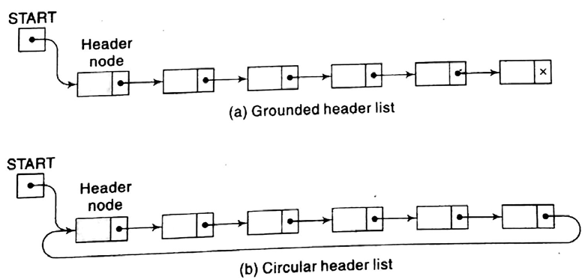
CSE 203: Data Structure
Data Structure
Header Link List
Contain a special node called header node at the beginning
Grounded header list
Circular header list

Slide 65
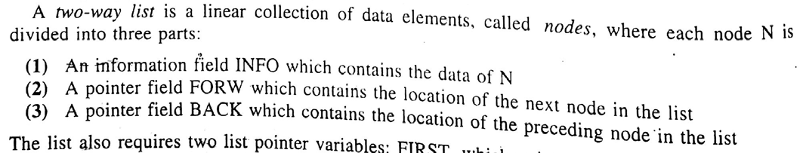
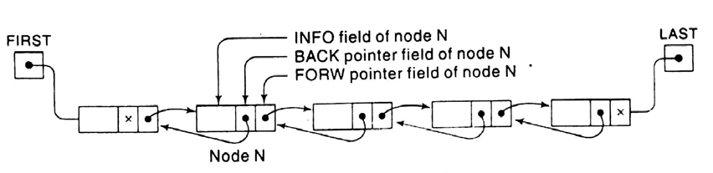
CSE 203: Data Structure
Data Structure
Two-way List

