Slide 1
CSE 403: Computer Graphics
HIDDEN SURFACE:
When we view a picture containing non-transparent objects and surfaces, then we cannot see those objects from view which are behind from objects closer to eye. We must remove these hidden surfaces to get a realistic screen image. The identification and removal of these surfaces is called Hidden-surface problem.
When we want to display a 3D object on a 2D screen, we need to identify those parts of a screen that are visible from a chosen viewing position.
Front non-transparent object
Front transparent object
Prof. Dr. A. H. M. Kamal, CSE, JKKNIU

Slide 2
CSE 403: Computer Graphics
HIDDEN SURFACE:
There are two approaches for removing hidden surface problems −
Object-Space method: It is implemented in physical coordinate system.
Image-space method: Image-space method is implemented in screen coordinate system.
Front non-transparent object
Front transparent object
Prof. Dr. A. H. M. Kamal, CSE, JKKNIU

Slide 3
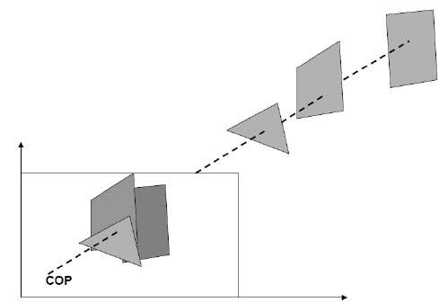
CSE 403: Computer Graphics
HIDDEN SURFACE:
Depth Buffer (Z-Buffer) Method of hidden surface removal:
This method is developed by Cutmull. It is an image-space approach. The basic idea is to test the Z-depth of each surface to determine the closest (visible) surface.
In this method each surface is processed separately one pixel position at a time across the surface. The depth values for a pixel are compared and the closest (smallest z) surface determines the color to be displayed in the frame buffer.
Prof. Dr. A. H. M. Kamal, CSE, JKKNIU

Slide 4
CSE 403: Computer Graphics
HIDDEN SURFACE:
Depth Buffer (Z-Buffer) Method of hidden surface removal:
Depth buffer is used to store depth values for (x, y) position, as surfaces are processed (0 ≤ depth ≤ 1).
The frame buffer is used to store the intensity value of color value at each position (x, y).
The z-coordinates are usually normalized to the range [0, 1]. The 0 value for z-coordinate indicates back clipping pane and 1 value for z-coordinates indicates front clipping pane.
Prof. Dr. A. H. M. Kamal, CSE, JKKNIU

Slide 5
CSE 403: Computer Graphics
HIDDEN SURFACE:
Depth Buffer (Z-Buffer) Method of hidden surface removal:
Algorithm
Step-1 − Set the buffer values −
Depthbuffer (x, y) = 0
Framebuffer (x, y) = background color
Figure 1: Example 1
Step-2 − Process each polygon (One at a time)
For each projected (x, y) pixel position of a polygon, calculate depth z.
If z > depthbuffer (x, y)
Compute surface color,
set depthbuffer (x, y) = z,
framebuffer (x, y) = surfacecolor (x, y)
Figure 2: Example 2
Advantages
It is easy to implement.
It processes one object at a time.
Disadvantages
It requires large memory.
It is time consuming process.
Prof. Dr. A. H. M. Kamal, CSE, JKKNIU

Slide 6
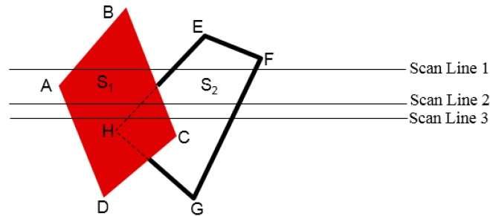
CSE 403: Computer Graphics
HIDDEN SURFACE:
Scan-Line Method of hidden surface removal:
It is an image-space method to identify visible surface. This method has a depth information for only single scan-line. In order to require one scan-line of depth values, we must group and process all polygons intersecting a given scan-line at the same time before processing the next scan-line. Two important tables, edge table and polygon table, are maintained for this.
Prof. Dr. A. H. M. Kamal, CSE, JKKNIU

Slide 7
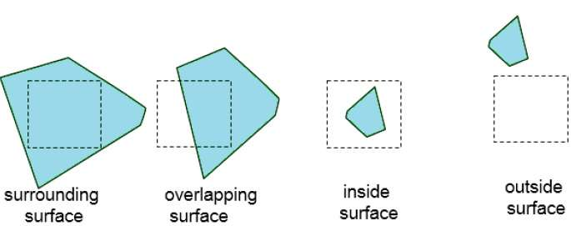
CSE 403: Computer Graphics
HIDDEN SURFACE:
Area-Subdivision Method of hidden surface removal:
Divide the total viewing area into smaller and smaller rectangles until each small area is the projection of part of a single visible surface or no surface at all.
Surrounding surface − One that completely encloses the area.
Overlapping surface − One that is partly inside and partly outside the area.
Inside surface − One that is completely inside the area.
Outside surface − One that is completely outside the area.
Prof. Dr. A. H. M. Kamal, CSE, JKKNIU

Slide 8
CSE 403: Computer Graphics
HIDDEN SURFACE:
Area-Subdivision Method of hidden surface removal:
Divide the total viewing area into smaller and smaller rectangles until each small area is the projection of part of a single visible surface or no surface at all.
No further subdivisions of a specified area are needed if one of the following conditions is true −
All surfaces are outside surfaces with respect to the area.
Only one inside, overlapping or surrounding surface is in the area.
A surrounding surface obscures all other surfaces within the area boundaries.
Prof. Dr. A. H. M. Kamal, CSE, JKKNIU

Slide 9
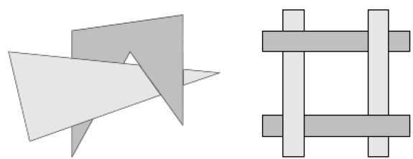
CSE 403: Computer Graphics
HIDDEN SURFACE:
Depth Sorting Method of hidden surface removal:
Depth sorting method uses both image space and object-space operations. The depth-sorting method performs two basic functions −
First, the surfaces are sorted in order of decreasing depth.
Second, the surfaces are scan-converted in order, starting with the surface of greatest depth.
The scan conversion of the polygon surfaces is performed in image space. This method for solving the hidden-surface problem is often referred to as the painter's algorithm.
Prof. Dr. A. H. M. Kamal, CSE, JKKNIU

Slide 10
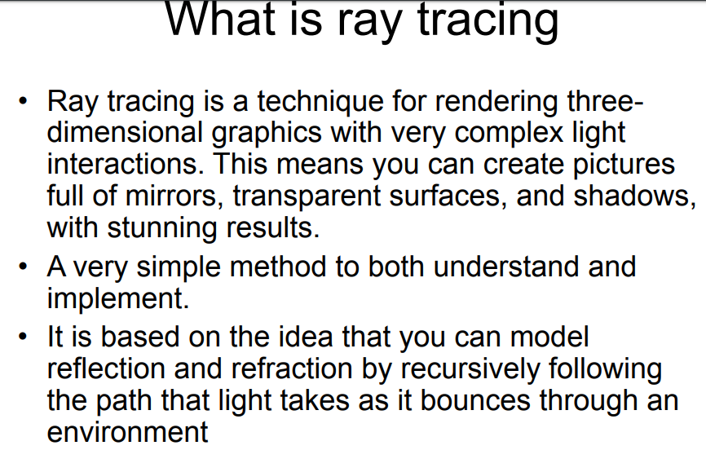
CSE 403: Computer Graphics
RAY TRACING:
Prof. Dr. A. H. M. Kamal, CSE, JKKNIU

Slide 11
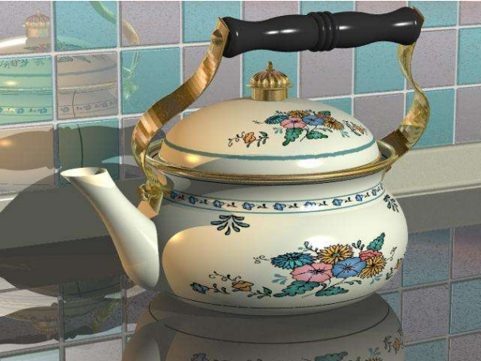
CSE 403: Computer Graphics
RAY TRACING:
Ray Traced Image
Prof. Dr. A. H. M. Kamal, CSE, JKKNIU

Slide 12
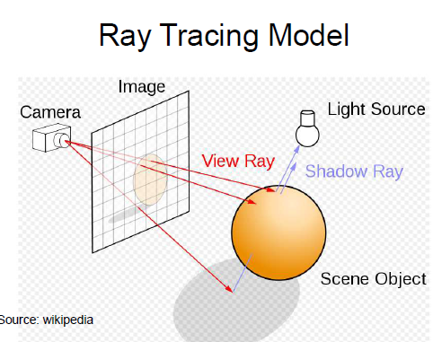
CSE 403: Computer Graphics
RAY TRACING:
Ray Tracing Model
Prof. Dr. A. H. M. Kamal, CSE, JKKNIU

Slide 13
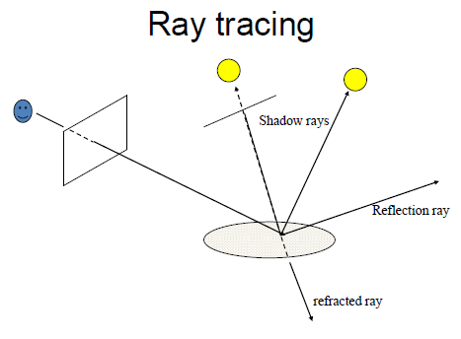
CSE 403: Computer Graphics
RAY TRACING:
Ray Tracing Model
Prof. Dr. A. H. M. Kamal, CSE, JKKNIU

Slide 14
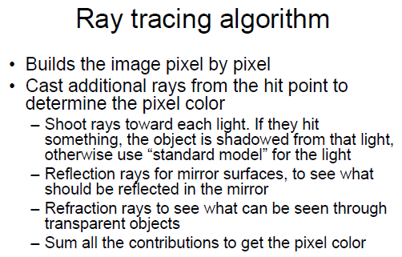
CSE 403: Computer Graphics
RAY TRACING:
Ray Tracing Model
Prof. Dr. A. H. M. Kamal, CSE, JKKNIU

