Slide 1
CSE 301
Microprocessors
Dr. Md. Sujan Ali
Associate Professor
Dept. of Computer Science and Engineering
Jatiya Kabi Kazi Nazrul Islam University
Trishal, Mymensingh, Bangladesh

Slide 2
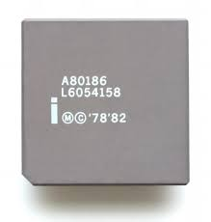
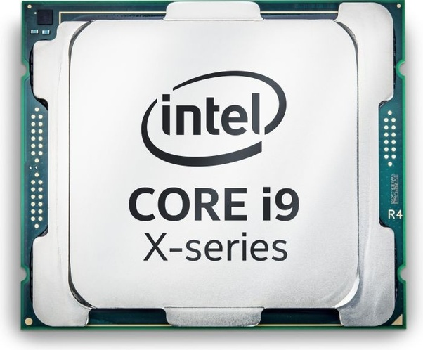
Overview of Other Processors

Slide 3
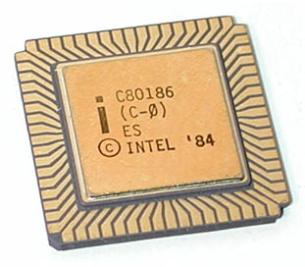
INTEL 80186

Slide 4
INTEL 80186
Basic block diagram of 80816
IN ADDITION TO THE BIU AND EU 80186/80188 FAMILY CONTAINS
    A CLOCK GENERATOR
    A PROGRAMMABLE INTERRUPT CONTROLLER
    PROGRAMMABLE TIMERS
    A PROGRAMMABLE DMA CONTROLLER
    A PROGRAMMABLE CHIP SELECTION UNIT.

Slide 5
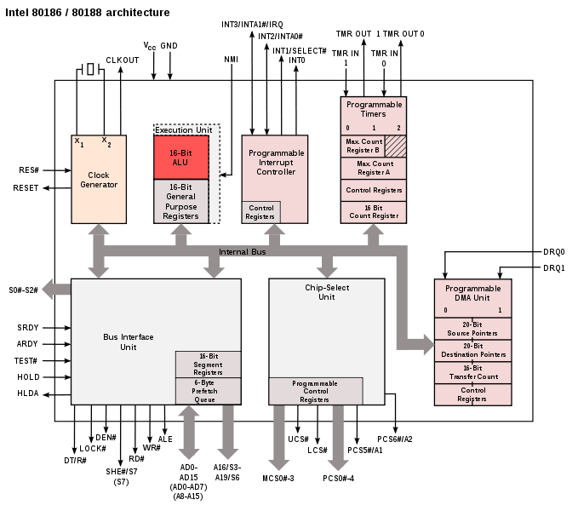

Slide 6
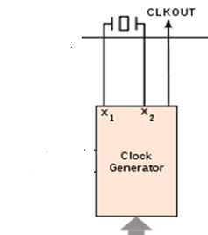
CLOCK GENERATOR
X1,X2 CONNECTED TO CRYSTAL
CLKOUT PROVIDS SYSTEM CLOCK SIGNAL

Slide 8
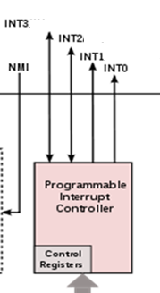
PROGRAMMABLE INTERRUPT CONTROLLER
WHICH ARBITRATES INTERNAL AND EXTERNAL INTERRUPTS

Slide 10
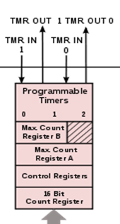
PROGRAMMABLE TIMERS
TIMER 0 AND 1 FOR EXTERNAL USE
TIMER 2 WATCH DOG TIMER- It can provide a clock to the other timers

Slide 12
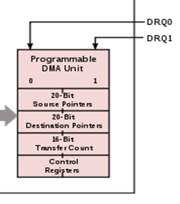
PROGRAMMABLE DMA UNIT
TO TRANSFER DATA WITHOUT GOING THROUGH CPU
LIKE 8237
IT CAN TRANSFER DATA
-BETWEEN MEMORY LOCATIONS,
-BETWEEN MEMORY AND I/O,
OR BETWEEN I/O DEVICES.

Slide 14
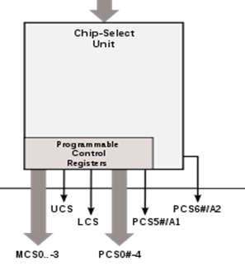
PROGRAMMABLE CHIP SELECT UNIT
PROGRAMMABLE BUILT IN MEMORY AND I/O DECODER

Slide 16
The 10 additional instructions that the 80186 has are as follows:
ENTER — Enter a procedure
LEAVE — Leave a procedure
BOUND — Check if an array index in a register is in range of array
INS — Input string byte or string word
OUTS — Output string byte or string word
PUSHA — Push all registers on stack
POPA — Pop all registers off stack
PUSH immediate — Push immediate number on stack
IMUL destination register, — Immediate x source to destination
source, immediate
SHIFT/ROTATE — Shift register or memory contents specified
immediate destination, immediate number of times

Slide 17
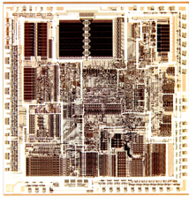
INTEL 80286

Slide 18
INTEL 80286
80286 microprocessor
Increased the number of address lines,
raising the number of possible addresses from
1 MB to 16 MB’s
Used by IBM in their IBM PC-AT computer
Ran at a max of 20 MHz

Slide 19
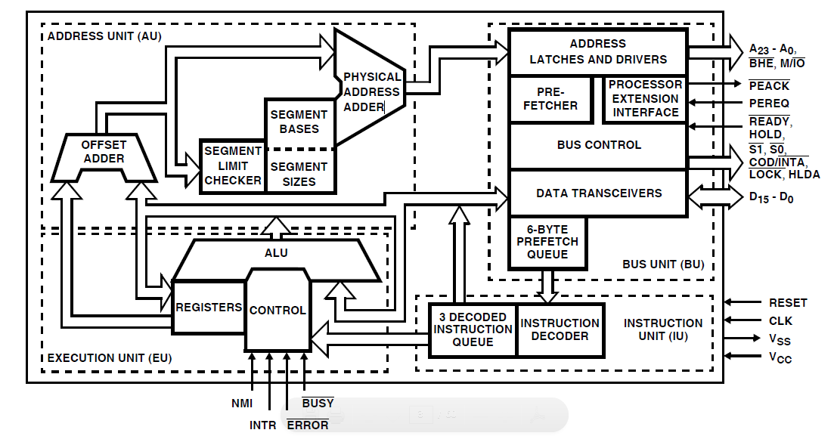
Architecture of 80286

Slide 20
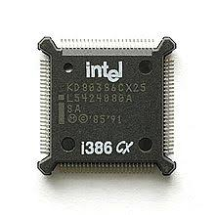
INTEL 80386 microprocessor
80836 microprocessor features
1st 32-bit processor
Could use a 16 byte cache
12.5 MHz – 33 MHz
16 Registers
Flags in 32 bit register
275 K transistors

Slide 21
Architecture of 80386

Slide 22
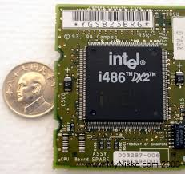
INTEL 80486 microprocessor
80846 microprocessor features
Included math co-processor (DX only)
120 MHz
Increased efficiency
RISC
1.2 M transistors
Intel released 80486 in 1989
redesigned using RISC concept :
  frequently used instruction : a single clock cycle
  new 5-stage execution pipeline
highly integrated
  8K memory cache
  floating-point processor
added 6 new instructions : for used by OS

Slide 23
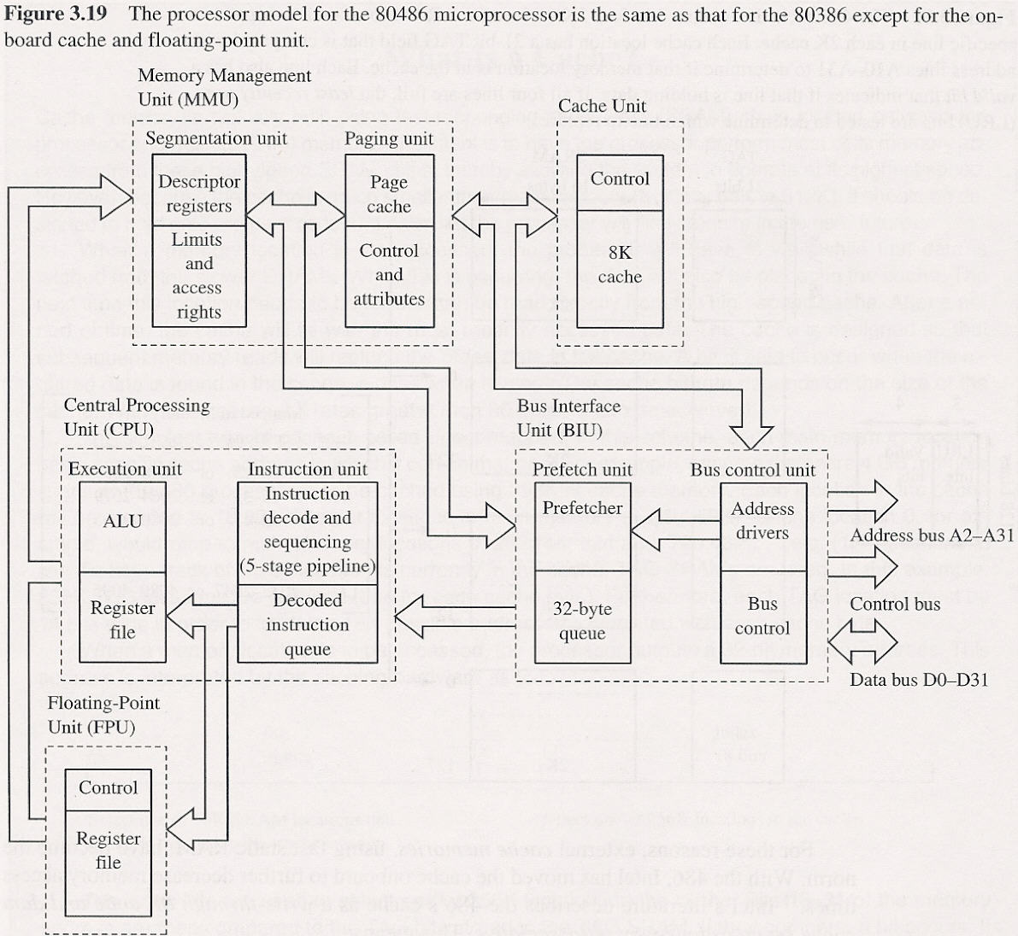
INTEL 80486 microprocessor

Slide 24
Pentium microprocessor
increasing the complexity of the IC: to scale the chip down
  if every line could be shrunk in half, same circuit could be built in one-forth the area
Superscaler : support 2 instruction pipelines(5 stage)
  ALU, address generation circuit, data cache interface
  actually execute two different instruction simultaneously
Pentium(1993) : originally labeled P5(80586)
  60, 66MHz(110MIPS)
  8K code cache, 8K data cache
  coprocessor : redesign(8-stage instruction pipeline)
  external data bus : 64 bit(higher data transfer rates)
  added 6 new instructions : for used by OS

Slide 25
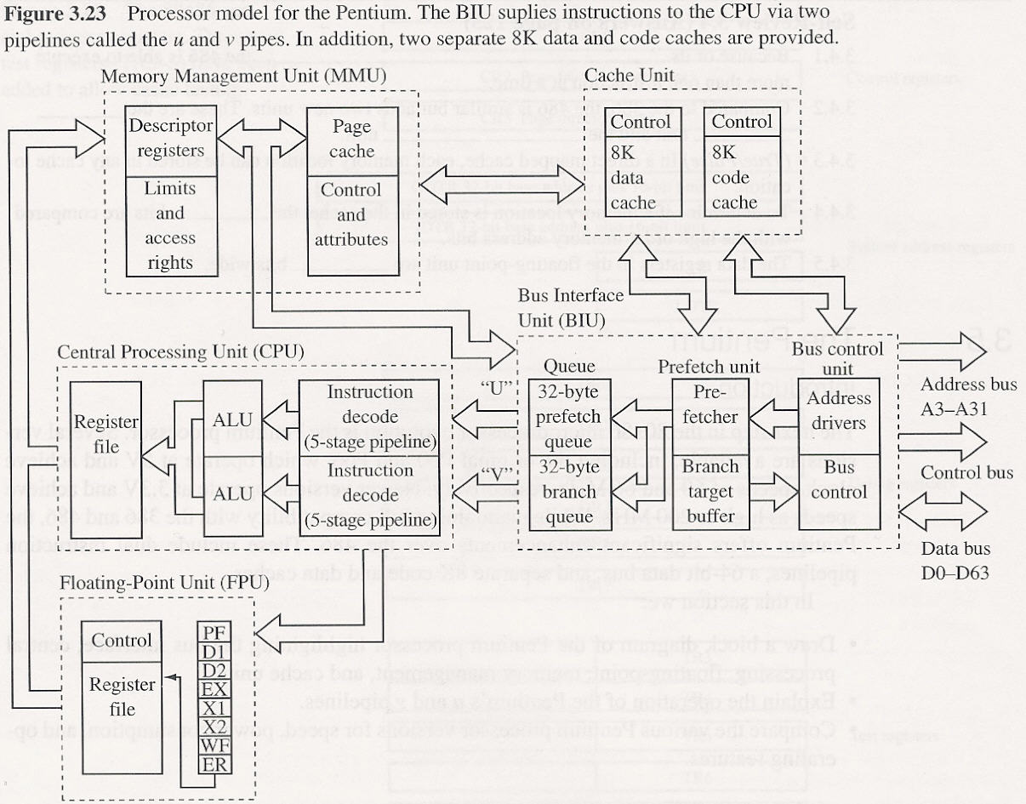
Pentium microprocessor

Slide 26
Pentium pro
Codenamed P6 : 1995
  basic clock frequency : 150, 166MHz
Two chips in one : two separate silicon die
  processor(large chip), 256K level two cache
Superscaler processor of degree three(12 stage)
Internal cache :
  level one(L1) : 8K instruction and data cache
  level two(L2) : 256K(or 512K)
36-bit address bus : 64G byte memory
Has been optimized to efficiently execute 32-bit code
  bundled with Windows NT : server market

Slide 27
PentiumⅡand PentiumⅡXeon Microprocessor
PentiumⅡmicroprocessor released in 1997
PentiumⅡ module : small circuit board
  Pentium pro with MMX : no internal L2 cache
  512K L2 cache(operated at speed of 133MHz)
main reason :
  L2 cache found main board of Pentium : 60, 66MHz
  not fast enough to justify a new microprocessor
  Pentium pro : not well yield
266~333MHz with 100MHz bus speed : in 1998
  bottleneck : external bus speed 66MHz
  use of 8ns SDRAM :

Slide 28
PentiumⅡand PentiumⅡXeon Microprocessor
new version of PentiumⅡcalled Xeon : mid-1998
  for high-end workstation and server applications
main difference from PentiumⅡ :
  L1 cache size : 32K bytes
  L2 cache size : 512K, 1M, 2M
change in Intel’s strategy :
  professional version and home/business version of PentiumⅡ microprocessor

Slide 29
Pentium Ⅲ Microprocessor
1. used faster core than PentiumⅡ
  is still P6 or Pentium pro processor
2. Two version :
  bus speed : 100MHz
  1. slot 1 version mounted on a plastic cartridge
  512K cache : one-half the clock speed
  2. socket 370 version called flip-chip : looks like the older Pentium package → Intel claim cost less
  256K cache : clock speed
3. clock frequency : 1 GHz

Slide 30
Pentium 4 Microprocessor
release in late 2000 : used Intel P6 architecture
main difference :
1. clock speed : 1.3, 1.4, 1.5 GHz
2. support to use RAMBUS memory technology
  DDR(double-data-rate) SDRAM : both edge
3. interconnection : from aluminum to copper
  copper : is better conductor → increase clock frequency
  bus speed : from current max. of 133MHz to 200MHz or higher

Slide 31
Intel Core i9-7900X X-Series Processor
Core i9-7980XE:
(2.6GHz, 4.4GHz burst)
18 cores/36 threads,
$1,999

Slide 32
The Future of Microprocessors
no one can really make accurate prediction :
  success of Intel family should continue for quite a few years
what may occur is : will occur
  a change to RISC technology,
  but more likely a change to a new technology being developed jointly by Intel and Hewlett-Packard
new technology :
  even will embody CISC instruction set of 80X86 family μ,
  so that software for system will survive
basic premise behind this technology : many μ
  will communicate directly with each other, allowing parallel processing without any change to instruction set or program

Slide 33
What does turbo boost up to 3.4 GHz mean?
Turbo Boost is built into the Intel CPU. By default the processor runs at 2.3Ghz, and when under heavy load, it will automatically speed up the cores up to 3.3Ghz. Intel Turbo Boost Technology 2.0 is activated when the Operating System (OS) requests the highest processor performance state (P0).
Gigahertz
Clock speed is the rate at which a processor executes a task and is measured in Gigahertz (GHz). Once, a higher number meant a faster processor, but advances in technology have made the processor chip more efficient so now they do more with less.

Slide 34
Processor Core
A processor core (or simply “core”) is an individual processor within a CPU. Many computers today have multi-core processors, meaning the CPU contains more than one core.
For many years, computer CPUs only had a single core. In the early 2000s, as processor clock speeds began plateauing, CPU manufacturers needed to find other ways to increase processing performance. Initially, they achieved this by putting multiple processors in high-end computers. While this was effective, it added significant cost to the computers and the multiprocessing performance was limited by the bus speed between the CPUs.
By combining processors on a single chip, CPU manufactures were able to increase performance more efficiently at a lower cost. The individual processing units became known as “cores” rather than processors. In the mid-2000s, dual-core and quad-core CPUs began replacing multi-processor configurations. While initially only high-end computers contained multiple cores, today nearly all PCs have multi-core processors.

Slide 35
A Brief Explanation of Threads
All central processing units have threads, but what exactly does that mean? In simple terms, the threads are what allow your CPU to perform multiple things at once. So if you want to run multiple processes that are very intensive, you will need a CPU with a lot of threads.
Threads refer to the highest level of code executed by a processor, so with many threads, your CPU can handle several tasks at the same time. All CPUs have active threads, and every process performed on your computer has at least a single thread.
The number of threads you have depends on the number of cores in your CPU. Each CPU core can have two threads. So a processor with two cores will have four threads. A processor with eight cores will have 16 threads.
A processor with 24 cores (yes, those exist), will have 48 threads.
Threads are important to the function of your computer because they determine how many tasks your computer can perform at any given time.

