Slide 1
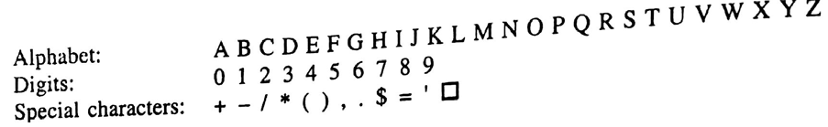
CSE 203: Data Structure
Data Structure
Character:
=> Non numerical data.
=> Are represented in memory by 8 bits

Slide 2
CSE 203: Data Structure
Data Structure
Character:
=> Non numerical data.
=> Are represented by 8 bits
String:
=> Sequence of characters.
=> A finite sequence of zero or more characters
=> Working on string is referred by string
processing/string manipulation/ text editing.
Example of string:
Let four string variables S1, S2, S3, S4 and S5 where:
S1= ‘CSE’
S2=‘JKKNIU’
S3=‘ MYMENSINGH’
S4=‘□’
S5=‘’

Slide 3
CSE 203: Data Structure
Data Structure
Character:
=> Non numerical data.
=> Are represented by 8 bits
Example of string:
Let five string variables S1, S2, S3, S4 and S5 where:
S1= ‘CSE’ S2=‘JKKNIU’
S3=‘ MYMENSINGH’ S4=‘□’
S5=‘’
Length of String:
length of S1 is 3
length of S2 is 6
length of S3 is 10
length of S4 is 1
length of S5 is 0
Length:
Number of characters in a string is its
length.
String with zero characters is called
empty/null string, ex. S5.

Slide 4
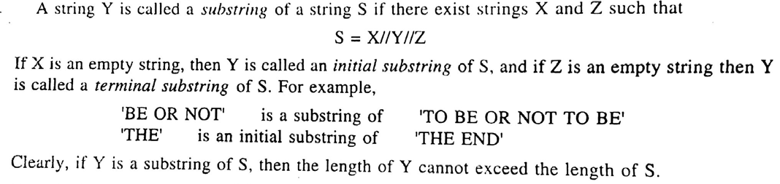
CSE 203: Data Structure
Data Structure

Slide 5
CSE 203: Data Structure
Data Structure
Storing String:
Three Structural Methods:
Fixed length structure
Variable length structure
Linked structure
Fixed length structure
Each line of print is viewed as a record.
All records have the same length.

Slide 6
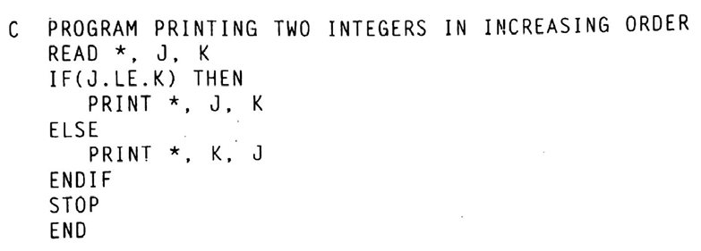
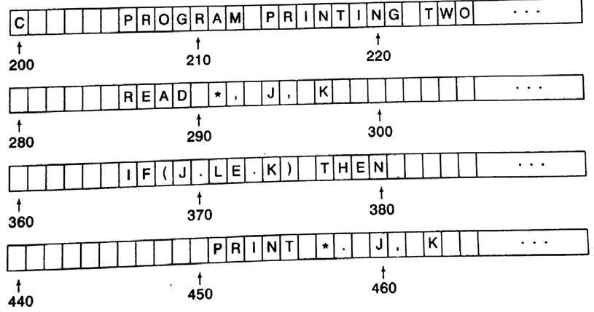
CSE 203: Data Structure
Data Structure
Storing String:
Fixed length structure
Each line of print is viewed as a record.
All records have the same length.
Consider the following program
Rec 1:
Rec 2:
….
To store the program
When the length of record is 80
….
….
Rec 9:

Slide 7
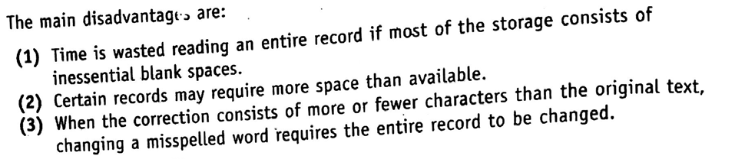
CSE 203: Data Structure
Data Structure
Storing String:
Fixed length structure

Slide 8
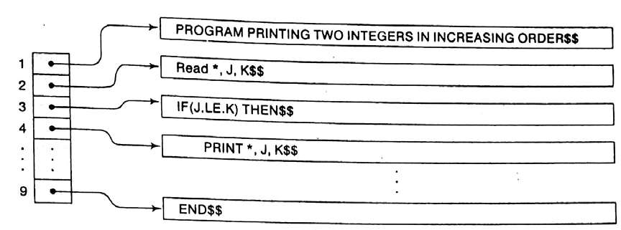
CSE 203: Data Structure
Data Structure
Storing String:
2. Variable length structure
One can use a marker at the end, For example $$

Slide 9
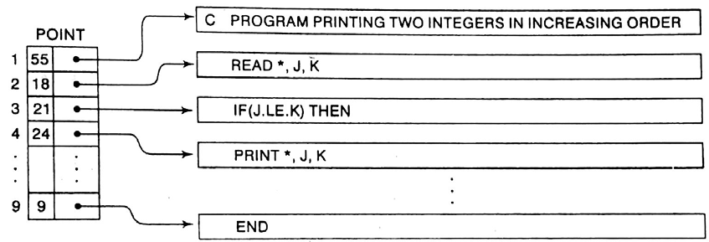
CSE 203: Data Structure
Data Structure
Storing String:
2. Variable length structure
One can use the length of the string

Slide 10
CSE 203: Data Structure
Data Structure
Storing String:
3. Linked structure

Slide 11
CSE 203: Data Structure
Data Structure
String Operations:
1. Substring:
Group of consecutive elements in a string
Substring (string, initial, length)
String: ‘CSE, JKKNIU’
Substring (‘CSE, JKKNIU’, 1, 3) => CSE
Substring (‘CSE, JKKNIU’, 3, 5) => E, JK
Substring: ‘CSE’, ‘JKKNIU’
int main()
{ char string[1000] ={“CSE, JKKNIU”}, sub[1000];
int position=3, length=5, c = 0;
while (c < length)
{ sub[c] = string[position+c-1];
c++;
}
sub[c] = '\0';
printf("Required substring is \"%s\"\n", sub);
return 0;
}

Slide 12
CSE 203: Data Structure
Data Structure
String Operations:
2. Indexing/
Pattern matching:
Where a pattern P is found in a text T
INDEX (Text, Pattern)
T=‘HIS FATHER IS THE PROFESSOR’
P=‘THE’
INDEX (T, P)
At index 7

Slide 13
CSE 203: Data Structure
Data Structure
String Operations:
void Index(char* txt, char* pat)
{
int M = strlen(pat);
int N = strlen(txt);
for (int i = 0; i <= N - M; i++) {
for (int j = 0; j < M; j++)
if (txt[i + j] != pat[j]) break;
if (j == M) // if pat[0...M-1] = txt[i, i+1, ...i+M-1]
printf("Pattern found at index %d ", i);
}
}
int main()
{
char txt[] = "AABAACAADAABAAABAA";
char pat[] = "AABA";
Index(txt, pat);
return 0;
}
2. Indexing/
Pattern matching:
Where a pattern P is found in a text T
INDEX (Text, Pattern)
T=‘HIS FATHER IS THE PROFESSOR’
P=‘THE’
INDEX (T, P)

Slide 14
CSE 203: Data Structure
Data Structure
String Operations:
void search(char* pat, char* txt)
{
int M = strlen(pat);
int N = strlen(txt);
for (int i = 0; i <= N - M; i++) {
for (int j = 0; j < M; j++)
if (txt[i + j] != pat[j]) break;
if (j == M) // if pat[0...M-1] = txt[i, i+1, ...i+M-1]
printf("Pattern found at index %d ", i);
}
}
int main()
{
char txt[] = "ABAAABABAA";
char pat[] = "AABA";
search(pat, txt);
return 0;
}
2. Indexing/
Pattern matching:
Where a pattern P is found in a text T
INDEX (Text, Pattern)
T=‘HIS FATHER IS THE PROFESSOR’
INDEX (T, P)
M=4
N=10
N-M=6
When i=0, j=0
text[0]==pat[0]
When i=0, j=1
text[1]!=pat[1]
Break j loop

Slide 15
CSE 203: Data Structure
Data Structure
String Operations:
void search(char* pat, char* txt)
{
int M = strlen(pat);
int N = strlen(txt);
for (int i = 0; i <= N - M; i++) {
for (int j = 0; j < M; j++)
if (txt[i + j] != pat[j]) break;
if (j == M) // if pat[0...M-1] = txt[i, i+1, ...i+M-1]
printf("Pattern found at index %d ", i);
}
}
int main()
{
char txt[] = "ABAAABABAA";
char pat[] = "AABA";
search(pat, txt);
return 0;
}
2. Indexing/
Pattern matching:
Where a pattern P is found in a text T
INDEX (Text, Pattern)
T=‘HIS FATHER IS THE PROFESSOR’
INDEX (T, P)
M=4
N=10
N-M=6
When i=1
For j=0, text[1]!=pat[0]
Break j loop

Slide 16
CSE 203: Data Structure
Data Structure
String Operations:
void search(char* pat, char* txt)
{
int M = strlen(pat);
int N = strlen(txt);
for (int i = 0; i <= N - M; i++) {
for (int j = 0; j < M; j++)
if (txt[i + j] != pat[j]) break;
if (j == M) // if pat[0...M-1] = txt[i, i+1, ...i+M-1]
printf("Pattern found at index %d ", i);
}
}
int main()
{
char txt[] = "ABAAABABAA";
char pat[] = "AABA";
search(pat, txt);
return 0;
}
2. Indexing/
Pattern matching:
Where a pattern P is found in a text T
INDEX (Text, Pattern)
T=‘HIS FATHER IS THE PROFESSOR’
INDEX (T, P)
M=4
N=10
N-M=6
When i=2,
For j=0, text[2]==pat[0]
For j=1, text[3]==pat[1]
For j=2, text[4]!=pat[2]
Break j loop

Slide 17
CSE 203: Data Structure
Data Structure
String Operations:
void search(char* pat, char* txt)
{
int M = strlen(pat);
int N = strlen(txt);
for (int i = 0; i <= N - M; i++) {
for (int j = 0; j < M; j++)
if (txt[i + j] != pat[j]) break;
if (j == M) // if pat[0...M-1] = txt[i, i+1, ...i+M-1]
printf("Pattern found at index %d ", i);
}
}
int main()
{
char txt[] = "ABAAABABAA";
char pat[] = "AABA";
search(pat, txt);
return 0;
}
2. Indexing/
Pattern matching:
Where a pattern P is found in a text T
INDEX (Text, Pattern)
T=‘HIS FATHER IS THE PROFESSOR’
INDEX (T, P)
M=4
N=10
N-M=6
When i=3,
For j=0, text[3]==pat[0]
For j=1, text[4]==pat[1]
For j=2, text[5]==pat[2]
For j=3, text[6]==pat[3]
Then J=4

Slide 18
CSE 203: Data Structure
Data Structure
String Operations:
void search(char* pat, char* txt)
{
int M = strlen(pat);
int N = strlen(txt);
for (int i = 0; i <= N - M; i++) {
for (int j = 0; j < M; j++)
if (txt[i + j] != pat[j]) break;
if (j == M) // if pat[0...M-1] = txt[i, i+1, ...i+M-1]
printf("Pattern found at index %d ", i);
}
}
int main()
{
char txt[] = "ABAAABABAA";
char pat[] = "AABA";
search(pat, txt);
return 0;
}
2. Indexing/
Pattern matching:
Where a pattern P is found in a text T
INDEX (Text, Pattern)
T=‘HIS FATHER IS THE PROFESSOR’
INDEX (T, P)
M=4
N=10
N-M=6
When i=3,
For j=0, text[3]==pat[0]
For j=1, text[4]==pat[1]
For j=2, text[5]==pat[2]
For j=3, text[6]==pat[3]
Then J=4

Slide 19
CSE 203: Data Structure
Data Structure
String Operations:
main()
{
char A[]="ABABAABABC", B[]="AABA", C[10];
int i, j, k, L1,L2;
L1=strlen(A);
L2=strlen(B);
for(i=0;i<(L1-L2);i++)
{
for(j=0;j<L2;j++)
C[j]=A[i+j];
C[j]='\0';
k=strcmp(B,C);
if(k==0) break;
}
if(k==0) printf("Pattern is found at %d",i);
else printf("Not matching");
getch();
}
2. Indexing/
Pattern matching:
Where a pattern P is found in a text T
INDEX (Text, Pattern)
T=‘HIS FATHER IS THE PROFESSOR’
INDEX (T, P)
Another method

Slide 20
CSE 203: Data Structure
Data Structure
String Operations:
3. Concatenation of String:
Let S1 and S2 be two individual string. Consisting of S1 and S2 is the string consisting of the character of S1 followed by the characters of S2. Denoted by S1//S2.
S1=‘CSE’
‘CSE
S2=‘JKKNIU’
JKKNIU’
S1//S2
main()
{ char A[]=“CSE, ”, B[]=“JKKNIU”, C[20], D[20];
//Method 1
C=strcat(A,B);
printf(“%s”,C);
//Method 2
for(i=0;i<strlen(A);i++)
D[i]=A[i];
For(j=i; j<(i+strlen(B)); j++)
D[j]=B[j-i];
D[j]=‘\0’;
Printf(“%s”, D)
}

Slide 21
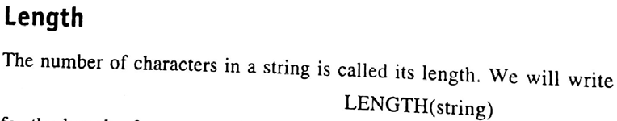
CSE 203: Data Structure
Data Structure
4. Length:
C command:
First include string header file using
#include<string.h>
Char S[]=“JKKNIU”;
Method 1:
Int L=strlen(S);
printf(“%d”, L)
Method 2:
int L=0;
while(S[L]!=‘\0’) L++;
printf(“%d”,L);

Slide 22
CSE 203: Data Structure
Data Structure
4. Length:
TRIM omits trailing blanks.
TRIM(‘ CSE ‘) => ‘CSE’
LTRIM(‘ CSE ‘) => ‘CSE ‘
RTRIM(‘ CSE ‘) => ‘ CSE’
#include<stdio.h>
#include<string.h>
main()
{ char S[]=" CSE ", T[10];
int i=0, j, k;
j=strlen(S)-1;
while(S[i]==' ') i++;
while(S[j]==' ') j--;
for(k=i; k<=j; k++)
T[k-i]=S[k];
T[k-i]='\0';
printf("%s", T);
}

Slide 23



CSE 203: Data Structure
Data Structure
Word Processing:
By String Operation:

Slide 24
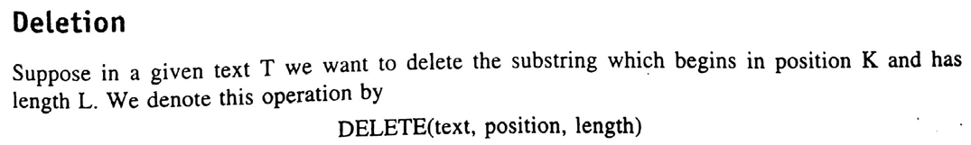

CSE 203: Data Structure
Data Structure
Word Processing:
Using String Operations:

Slide 25
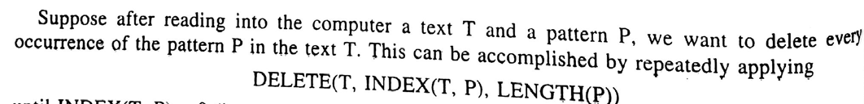
CSE 203: Data Structure
Data Structure
Word Processing:

Slide 26
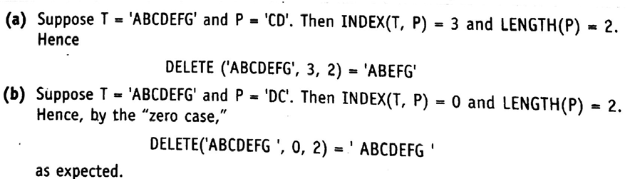
CSE 203: Data Structure
Data Structure
Word Processing:

Slide 27
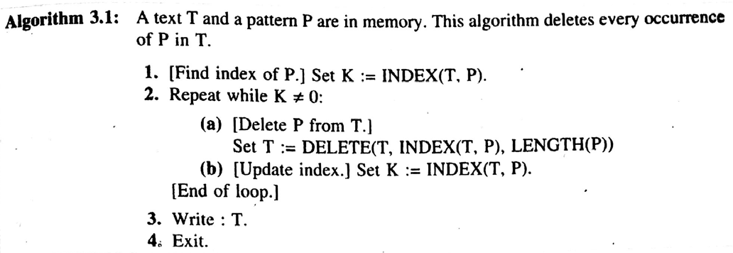
CSE 203: Data Structure
Data Structure
Word Processing:

Slide 28
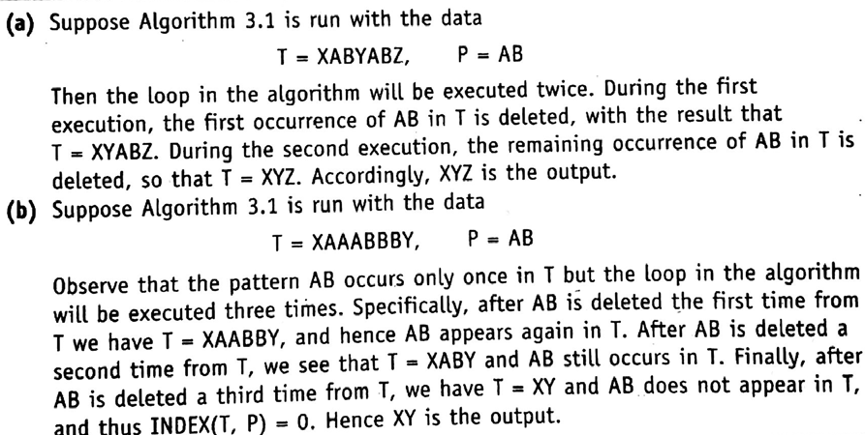
CSE 203: Data Structure
Data Structure
Word Processing:

Slide 29
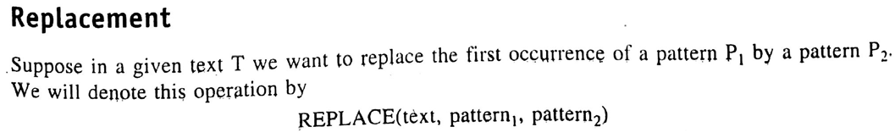

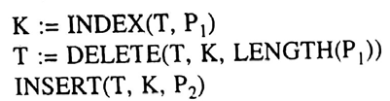
CSE 203: Data Structure
Data Structure
Word Processing:
Can ne executed by three steps:

Slide 30
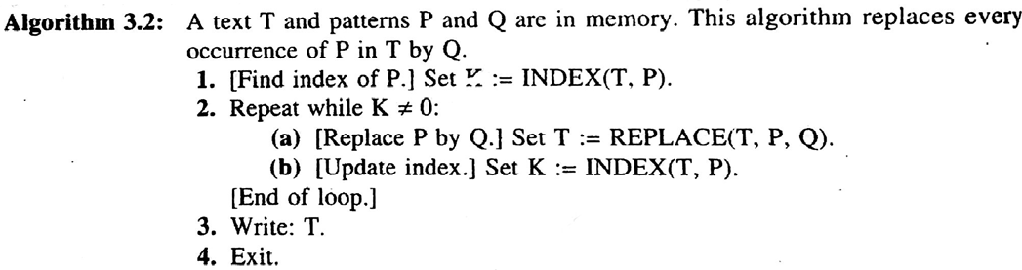

CSE 203: Data Structure
Data Structure
Word Processing:
Run Algorithm 3.2 with

Slide 31


CSE 203: Data Structure
Data Structure
Word Processing:
Run Algorithm 3.2 with
Pass 1
Pass 2

Slide 32
CSE 203: Data Structure
Data Structure

Slide 33
CSE 203: Data Structure
Data Structure

