Slide 1
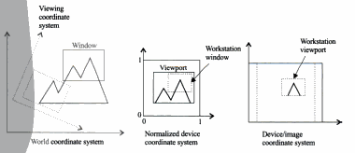
CSE 403: Computer Graphics
Graphics Application
Two Dimensional Viewing and Clipping:
World Coordinate System (WCS): Objects are placed into the scene by modeling transformations to a master coordinate. That master coordinate is commonly referred to as world coordinate system (WCS).
Viewing Coordinate System (VCS): Sometimes, an additional coordinate system called the viewing coordinate system is introduced to simulate the effect of moving and/or tilting the camera.
Normalized Device Coordinate System (NDCS): Monitor sizes differ from one system to another, Hence, a device-independent tool to describe the display area is needed, known as normalized device coordinate system. The tool is a unit(1 x 1) square whose lower left corner is at the origin of the coordinate system. It defines the display area of the virtual display device.
Prof. Dr. A. H. M. Kamal, CSE, JKKNIU

Slide 2
CSE 403: Computer Graphics
Graphics Application
Two Dimensional Viewing and Clipping:
Normalized Device Coordinate System (NDCS): Monitor sizes differ from one system to another, Hence, a device-independent tool to describe the display area is needed, known as normalized device coordinate system. The tool is a unit(1 x 1) square whose lower left corner is at the origin of the coordinate system. It defines the display area of the virtual display device.
Workstation Window: The process that maps normalized device coordinate to discrete device/image coordinate is called workstation transformation. A working window, set in NDCS to do that transformation, is called workstation window. The window works as a workstation window in the NDCS and workstation viewport in the device coordinate system. Workstation transformation depends on the resolution of the display device/ frame buffer.
Coordinate mapping from NDCS to device coordinate/image coordinate is called viewing transformation
Prof. Dr. A. H. M. Kamal, CSE, JKKNIU

Slide 3
CSE 403: Computer Graphics
Graphics Application
Two Dimensional Viewing and Clipping:
Clipping: A localized view in a scene is performed by setting a window. Since the objects in the scene may be completely inside the window, completely outside the window and partially visible through the window, the clipping operation eliminates objects or portion of objects that are not visible through the window.
In world coordinate system, the viewport is called clipping window whereas
In viewing coordinate, the workstation window is called clipping window.
Prof. Dr. A. H. M. Kamal, CSE, JKKNIU

Slide 4
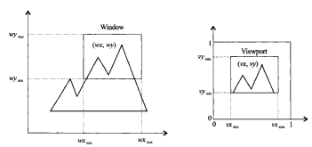
CSE 403: Computer Graphics
Graphics Application
Two Dimensional Viewing and Clipping:
Window-to-viewport mapping:
A window is defined by four world coordinates wx_{min}, wx_{max}, wy_{min}, wy_{max}.
Similarly a viewport is defined by four world coordinates vx_{min}, vx_{max}, vy_{min}, vy_{max}.
The objective of window-to-viewport mapping is to convert the world coordinate (wx, wy) of an arbitrary point to its normalized device coordinate (vx, vy).
Prof. Dr. A. H. M. Kamal, CSE, JKKNIU

Slide 5



CSE 403: Computer Graphics
Graphics Application
Two Dimensional Viewing and Clipping:
Window-to-viewport mapping:
In order to maintain the relative placement we have to maintain the following relationship.
and
Prof. Dr. A. H. M. Kamal, CSE, JKKNIU

Slide 6


CSE 403: Computer Graphics
Graphics Application
Two Dimensional Viewing and Clipping:
and
Where,
Prof. Dr. A. H. M. Kamal, CSE, JKKNIU

Slide 7

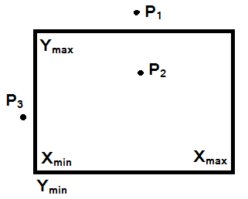
CSE 403: Computer Graphics
Graphics Application
Two Dimensional Viewing and Clipping:
Prof. Dr. A. H. M. Kamal, CSE, JKKNIU

Slide 8
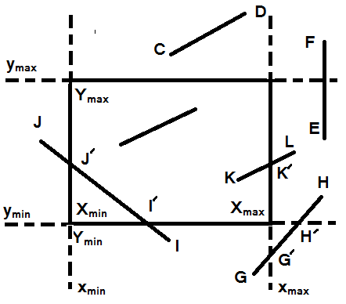

CSE 403: Computer Graphics
Graphics Application
Two Dimensional Viewing and Clipping:
Line Clipping: The Cohen-Southerland Algorithm
The algorithm divides the clipping process into two phases:
Identifies those lines which intersect the clipping window and so need to be clipped
Perform the clipping
First categorizes lines in three groups:
Visible – both end points of the line inside the clipping window
Not visible – the line identifies outside the window if two end points (x₁,y₁) and(x₂, y₂) satisfies one of the lowing inequalities:
Clipping candidate – the line is neither in category 1 and 2.
Prof. Dr. A. H. M. Kamal, CSE, JKKNIU

Slide 9
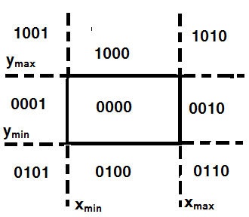

CSE 403: Computer Graphics
Graphics Application
Two Dimensional Viewing and Clipping:
Line Clipping: The Cohen-Southerland Algorithm
Line Categorizing Algorithm
Process in two steps:
Assign a 4-bit region code to each end points of each line according to the following figure
f
The line of category 3 requires to be clipped.
Prof. Dr. A. H. M. Kamal, CSE, JKKNIU

Slide 10
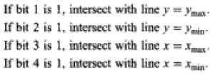


CSE 403: Computer Graphics
Graphics Application
Two Dimensional Viewing and Clipping:
Line Clipping: The Cohen-Southerland Algorithm
Finding clipping point:
Prof. Dr. A. H. M. Kamal, CSE, JKKNIU

Slide 11
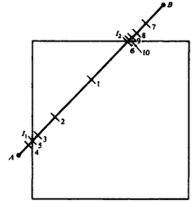
CSE 403: Computer Graphics
Graphics Application
Two Dimensional Viewing and Clipping:
Line Clipping: Mid Point Subdivision Algorithm
Categorizing lines into three groups:
Mid Point Algorithm:
Find the mid point of the line.
Mid point finding rules are:
X_{m}=(X₁+X₂)/2 and Y_{m}=(Y₁+Y₂)/2
Determine the clipping categories of these two line segment using region code.
Each segment in category 3 is divided further.
The process of doing bisection and finding clipping categorization (that is step 1 to 5) is continued until a section’s end point falls the boundary of the window.
Visible – both end points of the line inside the clipping window
Not visible – the line identifies outside the window if two end points (x₁,y₁) and(x₂, y₂) satisfies one of the lowing inequalities:
Clipping candidate – the line is neither in category 1 and 2.
Prof. Dr. A. H. M. Kamal, CSE, JKKNIU

Slide 12
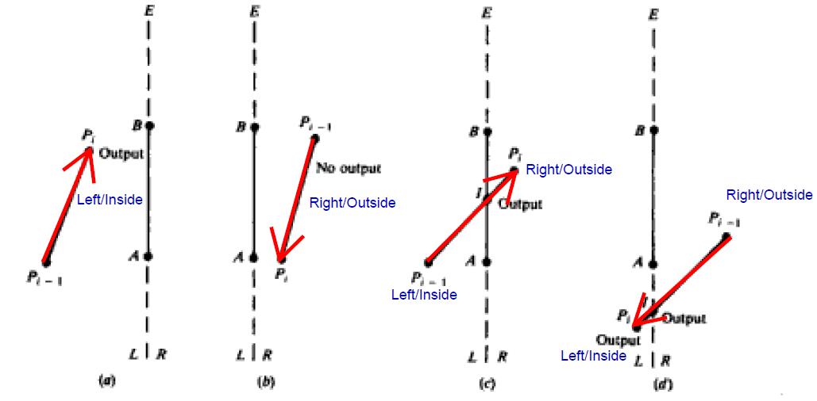
CSE 403: Computer Graphics
Graphics Application
Two Dimensional Viewing and Clipping:
Polygon Clipping: Sutherland-Hodgman Algorithm
Let P₁, P₂, P₃, …., P_{n} are the list of vertices of the polygon and A and B are the end points of any positively oriented edge E of the polygon.
Consider an edge E1 {P_{i-1}P_{i}}.
If both P_{i-1} and P_{i} are to the left of E (see Fig a), vertex P is placed on the output list
If P_{i-1} and P_{i} are to the right of E (see Fig b), nothing to do.
If P_{i-1} is to the left and P_{i} is to the right of E, (see Fig c), intersection point I of E1 and E are computed and placed on the output list.
If P_{i-1} is to the right and P_{i} is to the left of E, (see Fig d), intersection point I of E1 and E are computed and both I and P_{i} are placed on the output list.
Prof. Dr. A. H. M. Kamal, CSE, JKKNIU

Slide 13
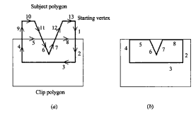
CSE 403: Computer Graphics
Graphics Application
Two Dimensional Viewing and Clipping:
Polygon Clipping: Weller-Atherton Algorithm
We start with an arbitrary vertex of the subject polygon and trace around its boarder in the clockwise direction until an intersection with the clip polygon is encountered.
.
.
If the edge enters the clip polygon, record the intersection point and continue to trace the subject polygon.
If the edge leaves the polygon, record the intersection point and make a right turn to follow the clip window
Prof. Dr. A. H. M. Kamal, CSE, JKKNIU

Slide 14
CSE 403: Computer Graphics
Graphics Application
Two Dimensional Viewing and Clipping:
SELF STUDY
Solved problem 5.6, 5.7, 5.8
Prof. Dr. A. H. M. Kamal, CSE, JKKNIU

