Slide 1
CSE 203: Data Structure
Data Structure
Algorithomic Notation:
Pseudo Code
Flowchart

Slide 2
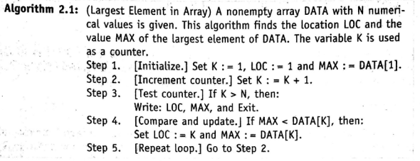
CSE 203: Data Structure
Data Structure
Algorithomic Notation: Pseudo Code

Slide 3
CSE 203: Data Structure
Data Structure
Conventions Used in Presenting Algorithm:
Identification No: Each algorithm is assigned an identification no, e.g., Algorithm 4.3
Steps: Each instruction in the algorithm is assigned a step no.
Control: Execution control may be transferred to step n from step i by the statement go to step n.
Exit: The algorithm is ended by the statement exit.
Comments: Additional information are included in the algorithm by enclosing them in brackets.
Variable Name: Variable name will use capital letters.
Assignment statement: :=
Input: read in variable
Output: write message or variable’s value
Procedure: To refer to another independent algorithm.

Slide 4
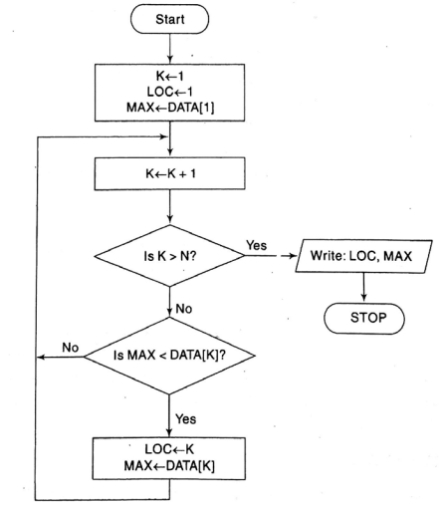
CSE 203: Data Structure
Data Structure
Algorithomic Notation: Flowchart

Slide 5
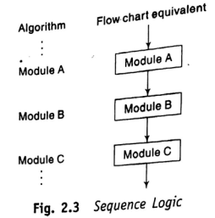

CSE 203: Data Structure
Data Structure
Control Structure:

Slide 6
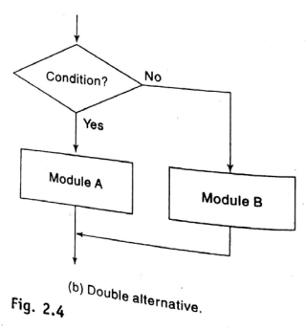
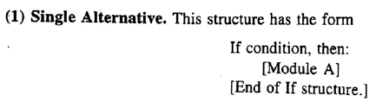
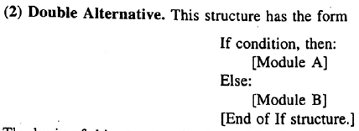
CSE 203: Data Structure
Data Structure
Control Structure:

Slide 7
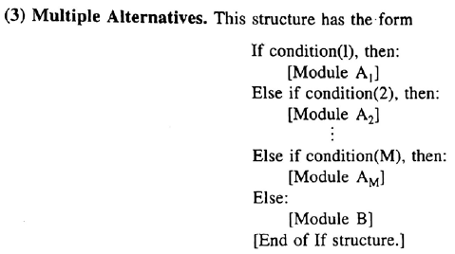
CSE 203: Data Structure
Data Structure
Control Structure:

Slide 8
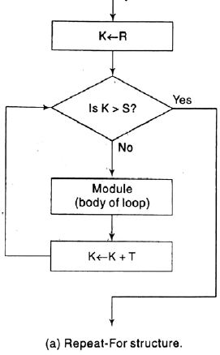

CSE 203: Data Structure
Data Structure
Control Structure:

Slide 9
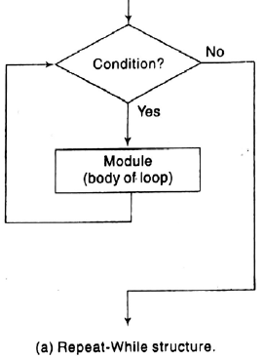

CSE 203: Data Structure
Data Structure
Control Structure:

Slide 10
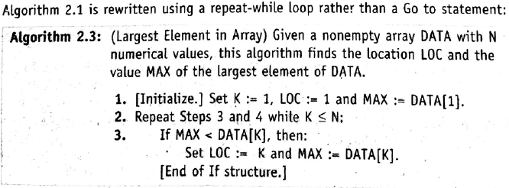
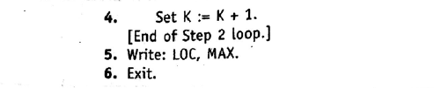
CSE 203: Data Structure
Data Structure

Slide 11
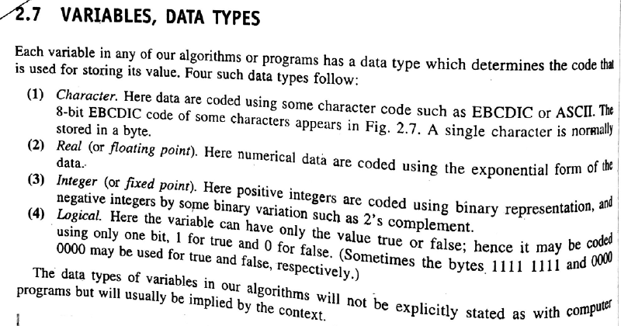
CSE 203: Data Structure
Data Structure

Slide 12
CSE 203: Data Structure
Data Structure

Slide 13
CSE 203: Data Structure
Data Structure

Slide 14
CSE 203: Data Structure
Data Structure

Slide 15
CSE 203: Data Structure
Data Structure

