Slide 1
CSE 403: Computer Graphics
Graphics Application
Two Dimensional Transformation:
Prof. Dr. A. H. M. Kamal, CSE, JKKNIU

Slide 2
CSE 403: Computer Graphics
Graphics Application
Two Dimensional Transformation: Coordinate Transformation
Suppose, we have two coordinate systems in a plane.
First coordinate system is located at O with coordinate axis xy and
Second coordinate system is located at O¹ with coordinate axis x¹ y¹
Now each point in the plane has two coordinate systems.
If the second system x¹ y¹ is arising from the transformation applied to the first system xy, we say that a coordinate transformation system has been applied.
x1
Distance O from O1
y1
Distance of P from O1
x
O1
P(x,y)
(x1,y1)
O
y
Distance of P from O
Prof. Dr. A. H. M. Kamal, CSE, JKKNIU

Slide 3
CSE 403: Computer Graphics
Graphics Application
Two Dimensional Transformation: Coordinate Transformation
Translation
Rotation
Scaling
Mirroring
Prof. Dr. A. H. M. Kamal, CSE, JKKNIU

Slide 4
CSE 403: Computer Graphics
Graphics Application
Two Dimensional Transformation: Coordinate Transformation
Translation
Rotation
Scaling
Mirroring
If the xy coordinate system is placed to a new position where the direction and distance of a displacement is given by a vector v=t_{x}I+t_{y}J., the coordinates of a point in both systems are related to translation transformation T̅v.
Now distance between coordinate systems has been reduced by t_{y} and t_{y}.
x1
Now distance between:
O and O1
O and P
Are these the same as earlier?
Definitely not.
As the systems of (x,y) and (x1,y1) are related, hence, it is required to update the values of x1 and y1.
Distance O from O1
y1
Distance of P from O1
x
O1
v=t_{y}I+t_{y}J
P(x,y)
(x1,y1)
(x1, y1)=T̅v(x,y)
Where,
X1=x-t_{x}
Y1=y-t_{y}
O
y
Distance of P from O
Prof. Dr. A. H. M. Kamal, CSE, JKKNIU

Slide 5
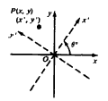
CSE 403: Computer Graphics
Graphics Application
Two Dimensional Transformation: Coordinate Transformation
Translation
Rotation
Scaling
Mirroring
xy plane is rotated by θº about origin O.
Prof. Dr. A. H. M. Kamal, CSE, JKKNIU

Slide 6
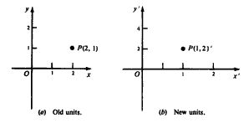
CSE 403: Computer Graphics
Graphics Application
Two Dimensional Transformation: Coordinate Transformation
Translation
Rotation
Scaling
Mirroring
With respect to origin O. A new coordinate system is formed by leaving the origin and coordinate axis unchanged, but introducing different level of measurement along x and y axis.
Prof. Dr. A. H. M. Kamal, CSE, JKKNIU

Slide 7
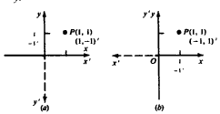
CSE 403: Computer Graphics
Graphics Application
Two Dimensional Transformation: Coordinate Transformation
Translation
Rotation
Scaling
Mirroring
If the new coordinate system is obtained by reflecting the old system about x or y axis, the relationship between the coordinate system is given by the transformation matrix M_{x}̅ and M̅_{y}. That is:
Prof. Dr. A. H. M. Kamal, CSE, JKKNIU

Slide 8
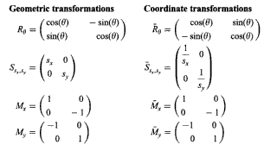
CSE 403: Computer Graphics
Graphics Application
Two Dimensional Transformation: Matrices
Prof. Dr. A. H. M. Kamal, CSE, JKKNIU

Slide 9
CSE 403: Computer Graphics
Graphics Application
Two Dimensional Transformation: Problems
Solved Problems:
4.1 of page 77, to 4.11
Prof. Dr. A. H. M. Kamal, CSE, JKKNIU

