Slide 1

CSE 447 : Digital Signal Processing
Dr. Md. Sujan Ali
Associate Professor
Dept. of Computer Science and Engineering
Jatiya Kabi Kazi Nazrul Islam University

Slide 2
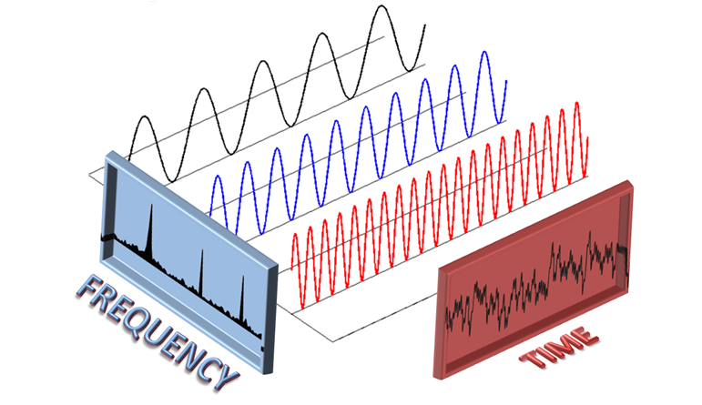
The Discrete Fourier Transform (DFT)

Slide 3


Slide 4
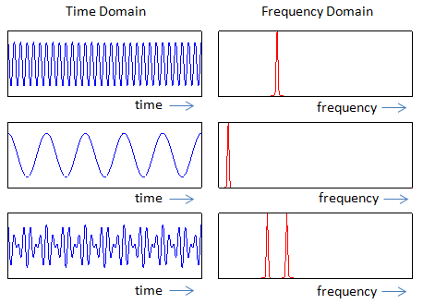
The Discrete Fourier Transform (DFT)
Time Domain
The time domain refers to the analysis of mathematical functions or signals with respect to time.
Frequency Domain
The frequency domain refers to the analysis of mathematical functions or signals with respect to frequency, rather than time.

Slide 5


The Discrete Fourier Transform (DFT)
Fourier Transform
The Fourier transform decomposes a function of time (a signal) into the frequencies that make it up.
Where,

Slide 6
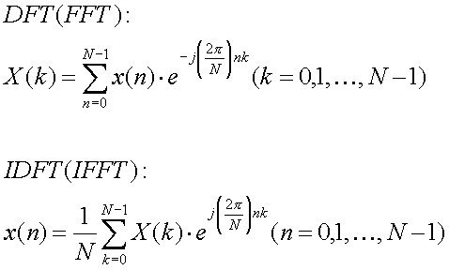
The Discrete Fourier Transform (DFT)
Discrete Fourier Transform (DFT)

Slide 7
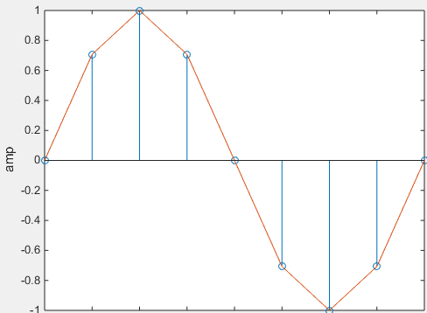
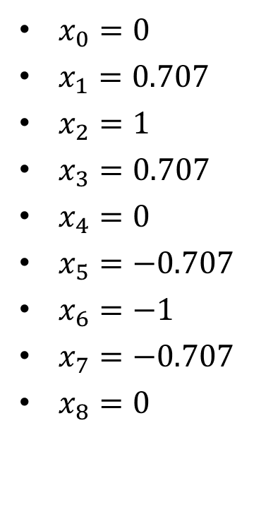
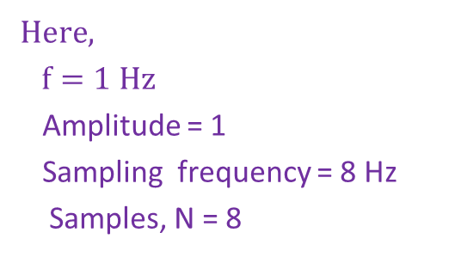
DFT Analysis
The Discrete Fourier Transform (DFT)
1
.707
.707
$x_{0}=0$
$x_{1}=0.707$
$x_{2}=1$
$x_{3}=0.707$
$x_{4}=0$
$x_{5}=−0.707$
$x_{6}=−1$
$x_{7}=−0.707$
$x_{8}=0$
0
0
0
-.707
-.707
0 sec
-1
1 sec
Time
$$Here,$$
$$f=1 Hz$$
Amplitude = 1
Sampling frequency = 8 Hz
Samples, N = 8

Slide 8

The Discrete Fourier Transform (DFT)
DFT Analysis
We know,
${ X}_{k}=\sum_{n=0}^{N−1}{{ x}_{n}∗ e^{\frac{−j2πkn}{N}}}$………… (1)
${ and e}^{jx}=cos x+j sinx$ [Euler Formula]

Slide 9
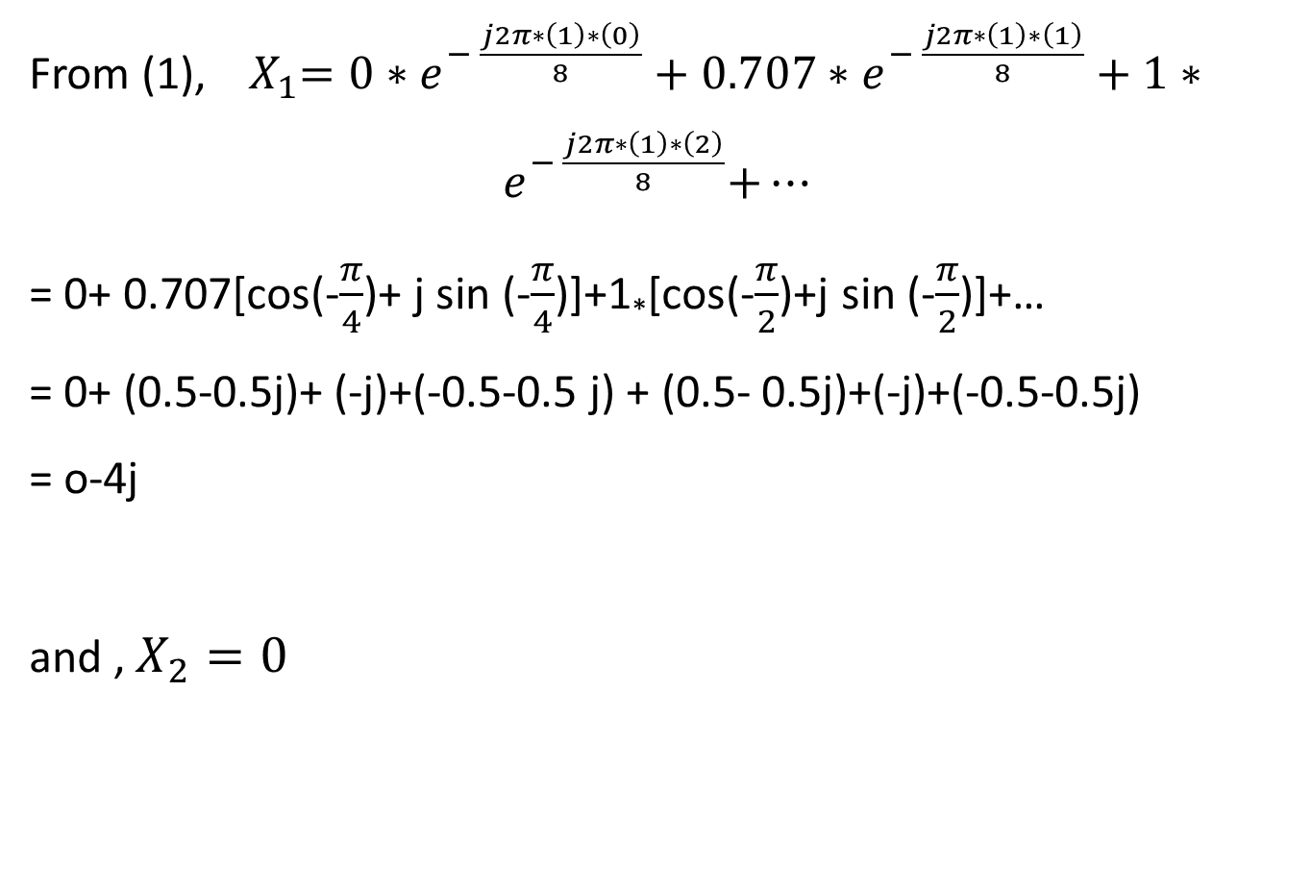
The Discrete Fourier Transform (DFT)
DFT Analysis
From (1), ${ X}_{1}=0∗e^{− \frac{j2π∗\left(1\right)∗\left(0\right)}{8}}+0.707∗e^{− \frac{j2π∗\left(1\right)∗\left(1\right)}{8}}+1∗{ e}^{− \frac{j2π∗\left(1\right)∗\left(2\right)}{8}}+…$
= 0+ 0.707[cos(-$\frac{π}{4}$)+ j sin (-$\frac{π}{4}$)]+1*[cos(-$\frac{π}{2}$)+j sin (-$\frac{π}{2}$)]+…
= 0+ (0.5-0.5j)+ (-j)+(-0.5-0.5 j) + (0.5- 0.5j)+(-j)+(-0.5-0.5j)
= o-4j
and , $X_{2}=0$

Slide 10
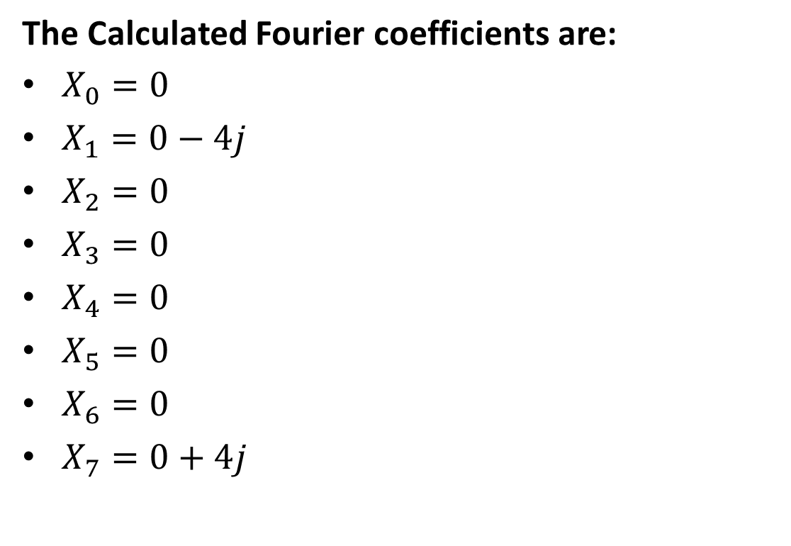
The Discrete Fourier Transform (DFT)
DFT Analysis
The Calculated Fourier coefficients are:
$X_{0}=0$
$X_{1}=0−4j$
$X_{2}=0$
$X_{3}=0$
$X_{4}=0$
$X_{5}=0$
$X_{6}=0$
$X_{7}=0+4j$

Slide 11

The Discrete Fourier Transform (DFT)
DFT Analysis
We can calculate magnitude,
$$Mag=\sqrt{{(A}_{k})^{2}+{(B}_{k})^{2}}$$
$$=\sqrt{0^{2}+{\left(−4\right)}^{2}}$$
=$4$

Slide 12
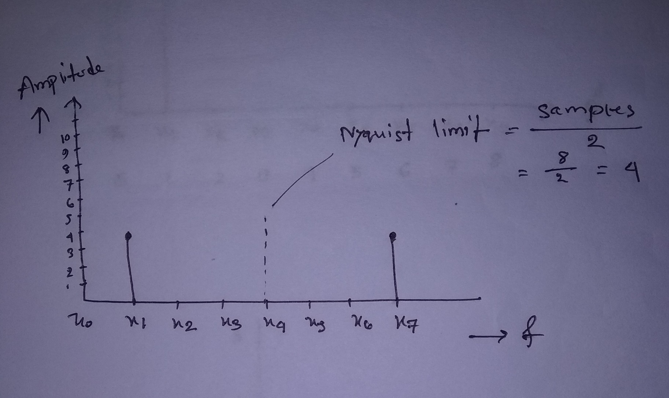
The Discrete Fourier Transform (DFT)
DFT Analysis

Slide 13
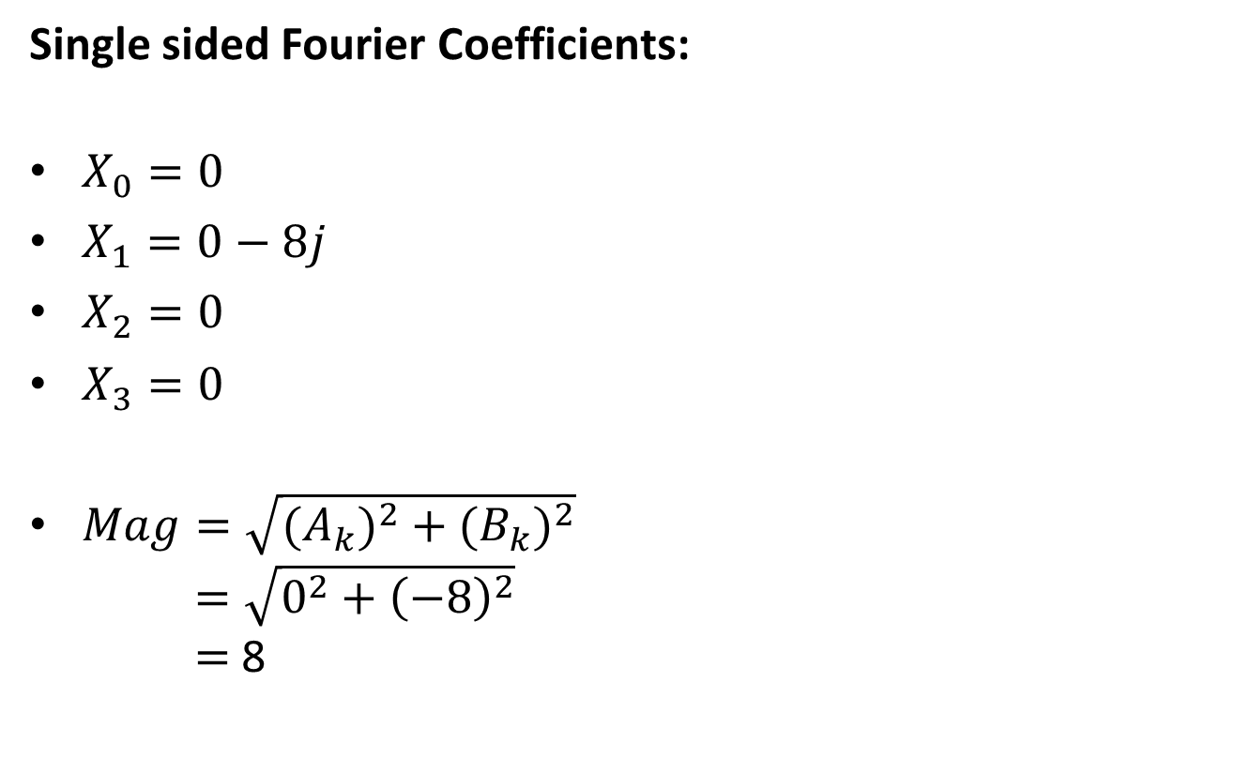
The Discrete Fourier Transform (DFT)
DFT Analysis
Single sided Fourier Coefficients:
$X_{0}=0$
$X_{1}=0−8j$
$X_{2}=0$
$X_{3}=0$
$Mag=\sqrt{{(A}_{k})^{2}+{(B}_{k})^{2}}$
$=\sqrt{0^{2}+{\left(−8\right)}^{2}}$
$=$ 8

Slide 14

The Discrete Fourier Transform (DFT)
DFT Analysis
Amp.
8
Avg. amplitude=8/8=1
7
6
5
4
3
2
1

Slide 15


The Discrete Fourier Transform (DFT)
DFT Analysis
Example-1
$x\left(n\right)=\frac{1}{4}$$0≤n≤2$
=$0$ otherwise
Find X$(k)$ = ?
1
$$\frac{1}{4}$$
0
0
0
0
1
2
3
→N

Slide 16
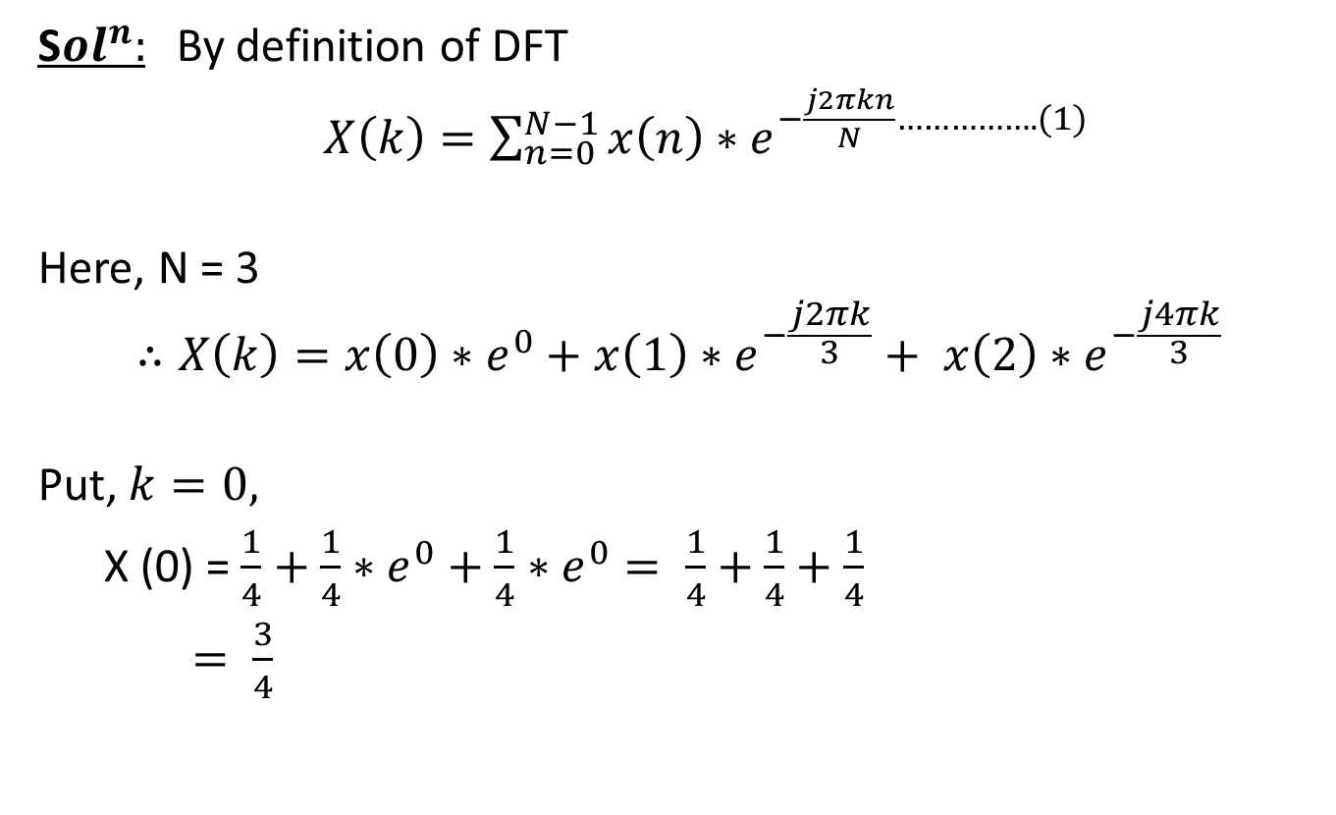
The Discrete Fourier Transform (DFT)
S$ol^{n}:$By definition of DFT
$X\left(k\right)=\sum_{n=0}^{N−1}{x\left(n\right)∗}$$e^{−\frac{j2πkn}{N}…………….(1)}$
Here, N = 3
$$∴X\left(k\right)=x\left(0\right)∗e^{0}+x\left(1\right)∗e^{−\frac{j2πk}{3}}+ x\left(2\right)∗e^{−\frac{j4πk}{3}}$$
Put, $k=0,$
X (0) = $\frac{1}{4}+\frac{1}{4}∗e^{0}+\frac{1}{4}∗e^{0}= \frac{1}{4}+\frac{1}{4}+\frac{1}{4}$
$= \frac{3}{4}$

Slide 17
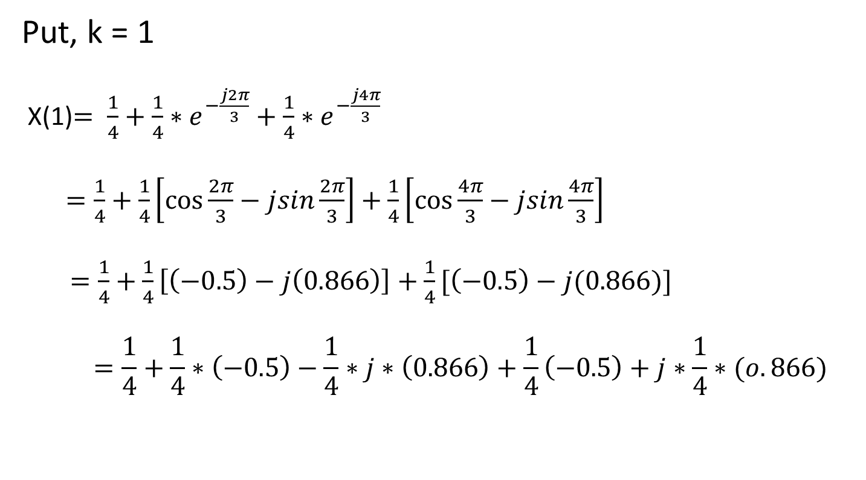
The Discrete Fourier Transform (DFT)
Put, k = 1
X(1)$= \frac{1}{4}+\frac{1}{4}∗e^{−\frac{j2π}{3}}+\frac{1}{4}∗e^{−\frac{j4π}{3}}$
$=\frac{1}{4}+\frac{1}{4}\left[\cos{\frac{2π}{3}}−jsin\frac{2π}{3}\right]+\frac{1}{4}\left[\cos{\frac{4π}{3}}−jsin\frac{4π}{3}\right]$
$=\frac{1}{4}+\frac{1}{4}\left[\left(−0.5\right)−j\left(0.866\right)\right]+\frac{1}{4}[\left(−0.5\right)−j(0.866)]$
$$=\frac{1}{4}+\frac{1}{4}∗\left(−0.5\right)−\frac{1}{4}∗j∗\left(0.866\right)+\frac{1}{4}\left(−0.5\right)+j∗\frac{1}{4}∗(o.866)$$

Slide 18
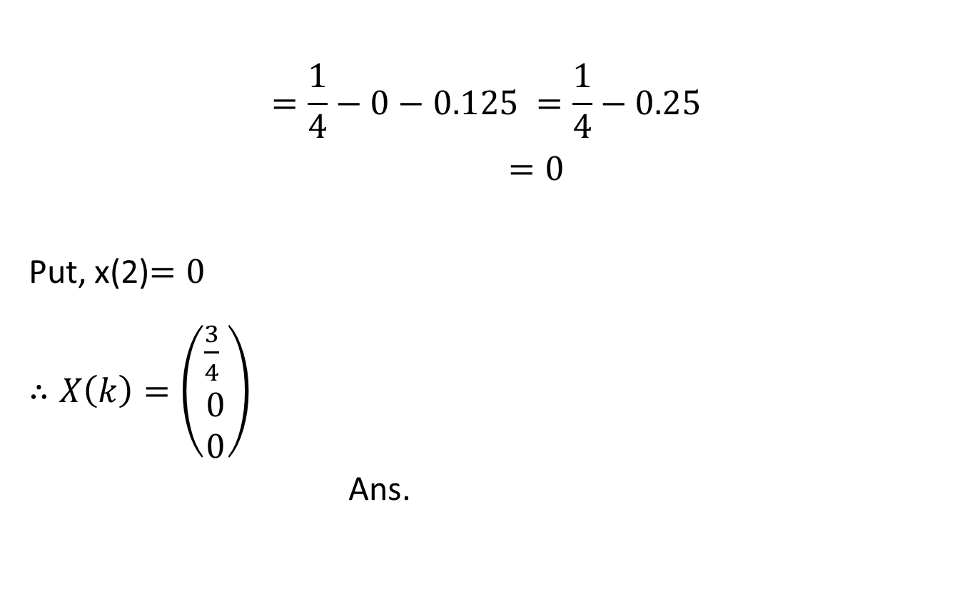
The Discrete Fourier Transform (DFT)
$$=\frac{1}{4}−0−0.125 =\frac{1}{4}−0.25$$
$=0$
Put, x(2)$=0$
$∴X\left(k\right)=\left(\begin{aligned}\frac{3}{4} \\ 0 \\ 0\end{aligned}\right)$
Ans.

Slide 19

The Discrete Fourier Transform (DFT)
$$\frac{3}{4}$$
0
1
2
k

Slide 20
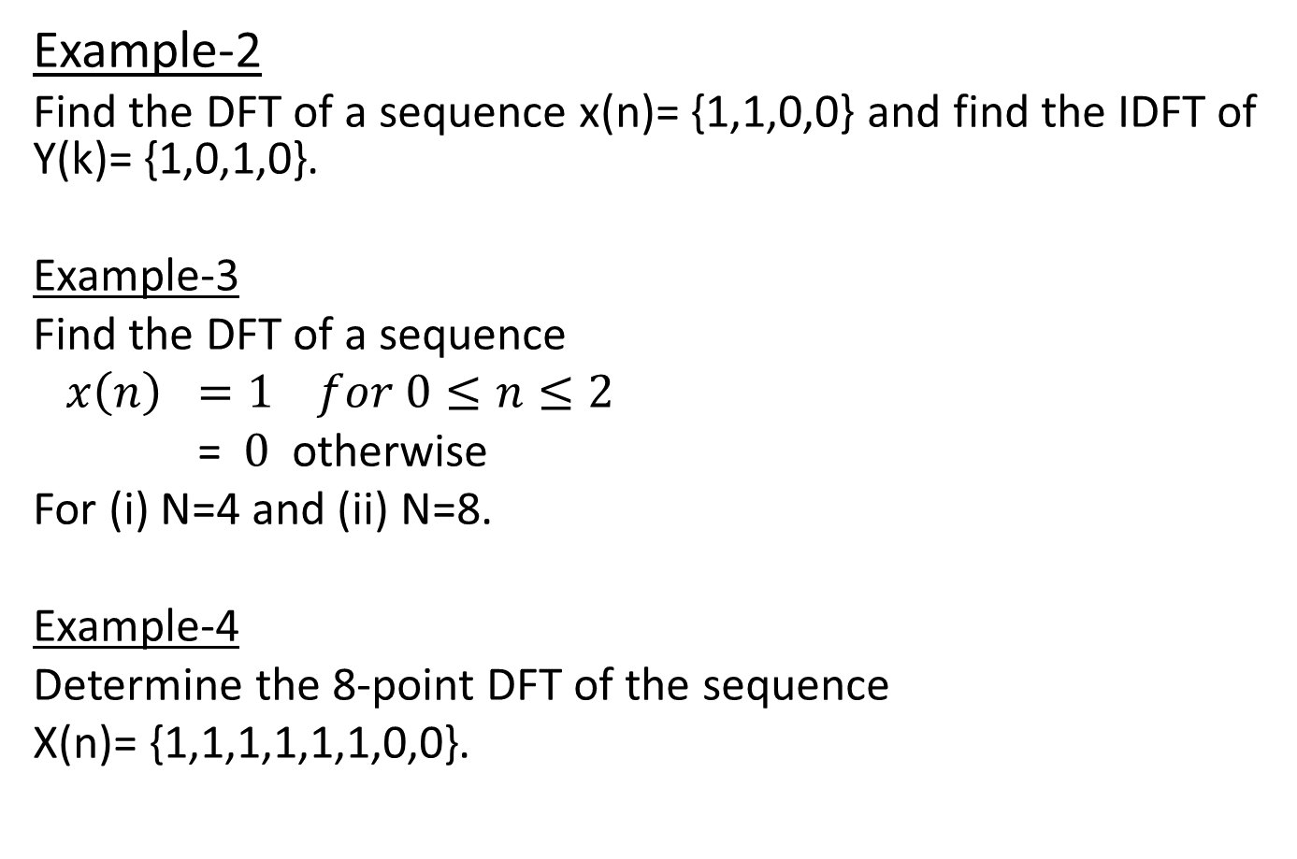
The Discrete Fourier Transform (DFT)
Example-2
Find the DFT of a sequence x(n)= {1,1,0,0} and find the IDFT of Y(k)= {1,0,1,0}.
Example-3
Find the DFT of a sequence
$x\left(n\right) =1 for 0≤n≤2$
=$0$otherwise
For (i) N=4 and (ii) N=8.
Example-4
Determine the 8-point DFT of the sequence
X(n)= {1,1,1,1,1,1,0,0}.

Slide 21
Fast Fourier Transform (FFT)
The Discrete Fourier Transform (DFT)
A fast Fourier transform (FFT) is an algorithm that calculates the Discrete Fourier transform (DFT) of some sequence
The Fast Fourier transform (FFT) is a discrete Fourier transform algorithm which reduces the number of computations needed for N points from N² to N/2 log ₂ N.
It is based on the fundamental principle of decomposing the computation of DFT of a sequence of length N into successively smaller DFT.

Slide 22
The Discrete Fourier Transform (DFT)
FFT algorithm provides speed increase factors.
Example
The number of complex multiplications required using direct computation is
N²=64²=4096
The number of complex multiplications required using FFT is
N/2log₂N=64/2log₂64=192
Speed improvement factor =4096/192= 21.33

Slide 23
The Discrete Fourier Transform (DFT)
There are two types of FFT algorithms. They are
1. Decimation in time
2. Decimation in frequency

Slide 24
The Discrete Fourier Transform (DFT)
Decimation in time
DIT algorithm is used to calculate the DFT of a N-point sequence.
The idea is to break the N-point sequence into two sequences, the DFTs of which can be obtained to give the DFT of the original N-point sequence.
Initially the N-point sequence is divided into N/2-point sequences x_{e}(n) and x_{o}(n), which have even and odd numbers of x(n) respectively.

Slide 25
The Discrete Fourier Transform (DFT)
Decimation in time
The N/2-point DFTs of these two sequences are evaluated and combined to give N-point DFT.
Similarly the N/2-point DFTs can be expressed as a combination of N/4-point DFTs.
This process is continued until we are left with two point DFT.
This algorithm is called decimation-in-time because the sequence x(n) is often split into smaller sequences.

Slide 26
The Discrete Fourier Transform (DFT)
Radix-2 FFT:
FFT algorithm is most efficient in calculating N-point DFT. If number of output points N can be expressed as N=2^{M}, where M is an integer, then the algorithm is known as radix-2 FFT algorithm.

Slide 27
The Discrete Fourier Transform (DFT)
Radix-2 DIT-FFT Algorithm

Slide 28
The Discrete Fourier Transform (DFT)
Decimation in frequency
It is popular form of FFT algorithm.
In this the output sequence x(k) is divided into smaller and smaller subsequences, that is why the name decimation in frequency.
Initially the input sequence x(n) is divided into two sequences x1(n) and x2(n) consisting of the first n/2 samples of x(n) and the last n/2 samples of x(n) respectively.

Slide 29
The Discrete Fourier Transform (DFT)
Radix-2 DIF-FFT Algorithm

Slide 30
The Discrete Fourier Transform (DFT)
Differences and Similarities between DIT and DIF Algorithms.
Differences:
For DIF, the input is bit reversal while the output is in
natural order, whereas for DIF, the input is in natural order
while the output is bit reversal.
Similarities:
Both algorithms require same number of operations of compute the DFT.
Both algorithm can be done in-place and both need to perform bit reversal at some place during the computation.

Slide 31
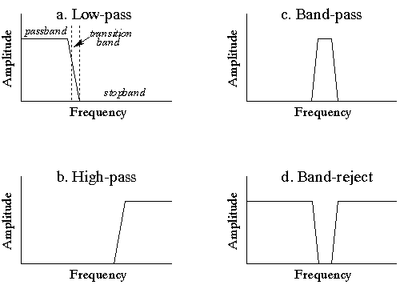
Frequency Domain Analysis
Digital Filters
In signal processing, a digital filter is a system that performs mathematical operations on a sampled, discrete-time signal to reduce or enhance certain aspects of that signal.

Slide 32
Frequency Domain Analysis
FIR Filters
In signal processing, a finite impulse response (FIR) filter is a filter whose impulse response (or response to any finite length input) is of finite duration, because it settles to zero in finite time.
Where N is filter order

