Slide 1
CSE 301
Microprocessors
Dr. Md. Sujan Ali
Associate Professor
Dept. of Computer Science and Engineering
Jatiya Kabi Kazi Nazrul Islam University
Trishal, Mymensingh, Bangladesh

Slide 2
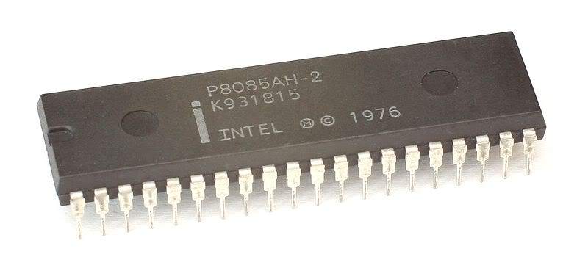
Intel 8085 Microprocessor

Slide 3
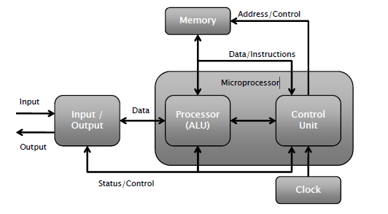
Introduction
A digital computer is a multipurpose, programmable machine that reads binary instructions from its memory, accepts binary data as input and processes data according to those instructions, and provide output.

Slide 4
Introduction
The CPU consists of memory (Array of registers) to store data, the ALU to perform arithmetic and logical operations and control unit (decoders, counters, encoders, and control lines)
Integrated circuit (IC):
  In 1959 Integrated Circuit was invented it consists of several electronic components like transistors resistors etc grown on a single silicon chip eliminating wires from circuit.
  Microprocessor:
  As the technology moved from SSI to VLSI the face of the computer changed. Initially, computers were built with discrete logic gates. As more and more logic circuits were built on one chip using LSI technology it was became possible to build the whole CPU with its related timing function on a single chip. The central processing unit of a digital computer, built into a single IC is called microprocessor.

Slide 5
Introduction to 8085
Introduced in 1977.
It is 8-bit MP.
Capable of addressing 64 k of memory
It is a 40 pin dual-in-line chip.
It uses a single +5V supply for its operations.
This processor is available in three versions such as 8085 AH, 8085 AH1, and 8085 AH2 which are designed with HMOS technology.
The highly developed versions use 20% of the power supply.
The CLK frequencies of the versions of this processor are 8085 A- 3 MHz, 8085AH-3 MHz, 8085 AH2-5 MHz, and 8085 AH1-6 MHz.

Slide 6
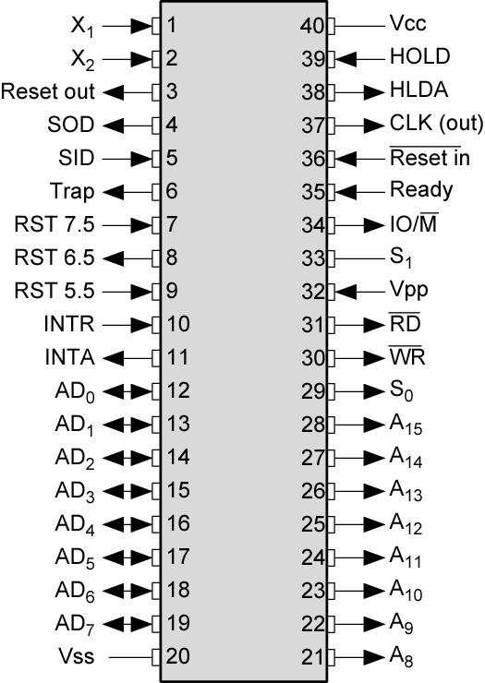
Pin configuration of 8085

Slide 7
Pin description of 8085 (cont’d)
Address Bus (A8-A15)
The address bus pins are ranges from A8 to A15 and these are mainly applicable to the most considerable memory address bit.
Address Bus (or) Data Bus (AD0-AD7)
The address bus pins or data bus pins are ranges from AD0 to AD7, and these pins are applicable for LSB (least significant bits) of the address bus in the primary apparatus CLK cycle as well as employed as a data bus for second clock cycle & third clock cycle.

Slide 8
Pin description of 8085 (cont’d)
Address Latch Enable (ALE)
Basically, ALE assists in de-multiplexing the data bus as well as low order address.
This will go high throughout the primary clock cycle as well as allows the address bits with low order.
The address bus with low order is added for memory otherwise any exterior latch.
Status Signal (IO/M)
The status signal IO/M resolves whether the address is intended for memory or input/output.
When the address is high then the address of the address bus is used for the devices of input/output devices.
When the address is low then the address of the address bus is used for the memory.

Slide 9
Pin description of 8085 (cont’d)
Status Signals (S0-S1)
The status signals S0, S1 gives different functions as well as status based on their status.
When the S0, S1 are 01 then the operation will be HALT.
the S0, S1 is 10 then the operation will be WRITE
When the S0, S1 is 10 then the operation will be READ
When the S0, S1 are 11 then the operation will be FETCH

Slide 10
Pin description of 8085 (cont’d)
Active Low Signal (RD)
The RD is an energetic low signal and an operation is executed whenever the indication goes small, and it is used for controlling the microprocessor READ operation.
When RD pin goes small then the 8085 microprocessor understands the information from I/O device or memory.
Active Low Signal (WR)
This is an energetic low signal, and it controls the microprocessor’s write operations.
Whenever WR pin goes small, then the information will be written to the I/O device or memory.

Slide 11
Pin description of 8085 (cont’d)
READY
The READY pin is employed with the 8085 microprocessor for ensuring whether a device is set for accepting or transferring data.
A device may be an A/D converter or LCD display, etc. These devices are associated with the 8085 microprocessor with the READY-pin.
When this pin is high, the device is prepared for transferring the information, if it is not then the microprocessor stays until this pin goes high.

Slide 12
Pin description of 8085 (cont’d)
HOLD
The HOLD pin specifies when any device is demanding the employ of address as well as a data bus. The two devices are LCD as well as A/D converter.
Assume that if A/D converter is employing the address bus as well as a data bus.
When LCD desires the utilize of both the buses by providing HOLD signal, subsequently the microprocessor transmits the control signal toward the LCD after that the existing cycle will be ended.
When the LCD procedure is over, then the control signal is transmitted reverse to A/D converter.

Slide 13
Pin description of 8085 (cont’d)
HLDA
This is the response signal of HOLD, and it specifies whether this signal is obtained or not obtained.
After the implementation of HOLD demand, this signal will go low.
INTR
This is an interrupt signal, and the priority of this among the interrupts is low.
This signal can be allowed or not allowed by the software.
When INTR pin goes high then the 8085 microprocessor completes the instruction of current which is being executed and then recognizes the INTR signal and progresses it.

Slide 14
Pin description of 8085 (cont’d)
INTA
When the 8085 microprocessor gets an interrupt signal, then it should be recognized.
This will be done by INTA.
As a result, when the interrupt will be obtained then INTA will go high.
RST 5.5, RST 6.5, RST 7.5
These pins are the restart maskable interrupts or Vectored Interrupts, used to insert an inner restart function repeatedly.
All these interrupts are maskable, they can be allowed or not allowed by using programs.

Slide 15
Pin description of 8085 (cont’d)
TRAP
Along with the 8085 microprocessor interrupts, TRAP is a non-maskable interrupt, and it doesn’t allow or stopped by a program.
TRAP has the maximum precedence between the interrupts.
The priority order from maximum to low includes TRAP, RST 5.5, RST 6.5, RST 7.5, and INTR.
RESET IN
RESET IN pin is used to reset the program counter toward zero and rearranges interrupt enable as well as HLDA flip-flops (FFs).
The central processing unit is detained in RST condition till this pin is high.
But the registers as well as flags won’t get damaged apart from instruction register.

Slide 16
Pin description of 8085 (cont’d)
RST (RESET) OUT
RESET OUT pin specifies that the central processing unit has been rearranged with RST IN.
X1 X2
X1, X2 terminals that are associated with the exterior oscillator for generating the required as well as appropriate operation of a clock.
CLK
Sometimes it is compulsory to generate CLK o/PS from 8085 microprocessors so they can be used in favor of other peripherals or else other digital integrated circuits.
This is offered with CLK pin. Its frequency is continually similar because the frequency at which the microprocessor works.

Slide 17
Pin description of 8085
SID
This is a serial i/p data, and the information on this pin is uploaded into the 7th-bit of the accumulator while RIM (Read Interrupt Mask) instruction is performed.
RIM verifies the interrupt whether it is covered or not covered.
SOD
This is the serial o/p data, and the data on this pin sends its output toward the 7th-bit of the accumulator whenever an instruction of SIM is performed.
VSS and VCC
VSS is a ground pin whereas Vcc is +5v pin.

Slide 18
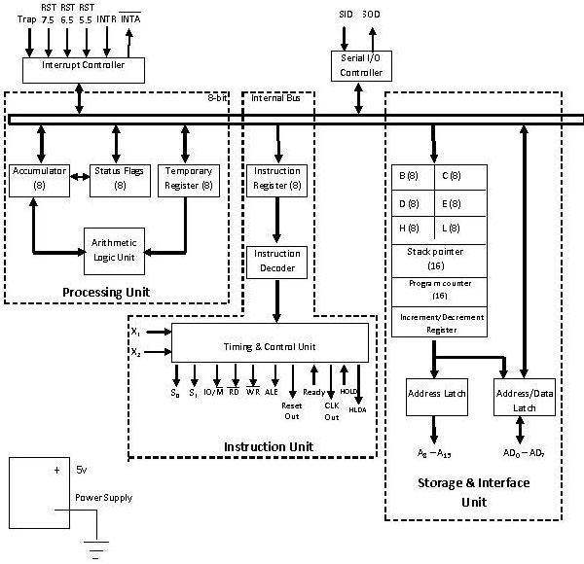
Internal architecture of 8085 (cont’d)

Slide 19
Internal architecture of 8085 (cont’d)
Three Units of 8085
Processing Unit
Instruction Unit
Storage and Interface Unit

Slide 20
Internal architecture of 8085 (cont’d)
Processing Unit
Arithmetic and Logic Unit
Accumulator
Status Flags
Temporary Register

Slide 21
Internal architecture of 8085 (cont’d)
Instruction Unit
Instruction Register
Instruction Decoder
Timing and Control Unit

Slide 22
Internal architecture of 8085 (cont’d)
Storage and Interface Unit
General Purpose Registers
Stack Pointer
Program Counter
Increment/Decrement Register
Address Latch
Address/Data Latch

Slide 23
Internal architecture of 8085 (cont’d)
Three Other Units
Interrupt Controller
Serial I/O Controller
Power Supply

Slide 24
Internal architecture of 8085 (cont’d)
Accumulator
It the main register of microprocessor.
It is also called register ‘A’.
It is an 8-bit register.
It is used in the arithmetic and logic operations.
It always contains one of the operands on which arithmetic/logic has to be performed.
After the arithmetic/logic operation, the contents of accumulator are replaced by the result.

Slide 25
Internal architecture of 8085 (cont’d)
Arithmetic and Logic Unit
It performs various arithmetic and logic operations.
The data is available in accumulator and temporary/general purpose registers.
Arithmetic Operations:
  Addition, Subtraction, Increment, Decrement etc.
Logic Operations:
  AND, OR, X-OR, Complement etc.

Slide 26
Internal architecture of 8085 (cont’d)
Temporary Register
It is an 8-bit register.
It is used to store temporary 8-bit operand from general purpose register.
It is also used to store intermediate results.

Slide 27
Internal architecture of 8085 (cont’d)
Status Flags
Status Flags are set of flip-flops which are used to check the status of Accumulator after the operation is performed.
x*= don’t care condition
D7 | D6 | D5 | D4 | D3 | D2 | D1 | D0
S | Z | X* | AC | X* | P | X* | CY

Slide 28
Internal architecture of 8085 (cont’d)
Status Flags
S = Sign Flag
Z = Zero Flag
AC = Auxiliary Carry Flag
P = Parity Flag
CY = Carry Flag

Slide 29
Internal architecture of 8085 (cont’d)
Sign Flag (S):
  It tells the sign of result stored in Accumulator after the operation is performed.
  If result is –ve, sign flag is set (1).
  If result is +ve, sign flag is reset (0).

Slide 30
Internal architecture of 8085 (cont’d)
Zero Flag (Z):
  It tells whether the result stored in Accumulator is zero or not after the operation is performed.
  If result is zero, zero flag is set (1).
  If result is not zero, zero flag is reset (0).

Slide 31
Internal architecture of 8085 (cont’d)
Auxiliary Carry Flag (AC):
  It is used in BCD operations.
  When there is carry in BCD addition, we add 0110 (6) to the result.
  If there is carry in BCD addition, auxiliary carry is set (1).
  If there is no carry, auxiliary carry is reset (0).

Slide 32
Internal architecture of 8085 (cont’d)
Parity Flag (P):
  It tells the parity of data stored in Accumulator.
  If parity is even, parity flag is set (1).
  If parity is odd, parity flag is reset (0).

Slide 33
Internal architecture of 8085 (cont’d)
Program Status Word (PSW)
In a flag register five bits (D₀, D₂, D₄, D₆, D₇) indicate status and three bits (D₅, D₃, D₁) is undefined
Combination of these 8 bits known as Program Status Word (PSW)

Slide 34
Internal architecture of 8085 (cont’d)
Instruction Register
It is used to hold the current instruction which the microprocessor is about to execute.
It is an 8-bit register.

Slide 35
Internal architecture of 8085 (cont’d)
Instruction Decoder
It interprets the instruction stored in instruction register.
It generates various machine cycles depending upon the instruction.
The machine cycles are then given to the Timing and Control Unit.

Slide 36
Internal architecture of 8085 (cont’d)
Timing and Control Unit
It controls all the operations of microprocessor and peripheral devices.
Depending upon the machine cycles received from Instruction Decoder, it generates 12 control signals:
  S₀ and S₁ (Status Signals).
  ALE (Address Latch Enable).

Slide 37
Internal architecture of 8085 (cont’d)
  Timing and Control Unit
  RD (Read, active low).
  WR (Write, active low).
  IO/M (Input-Output/Memory).
  READY
  RESET IN
  RESET OUT
  CLK OUT
  HOLD and HLDA

Slide 38
Internal architecture of 8085 (cont’d)
General Purpose Registers
There are 6 general purpose registers, namely B, C, D, E, H, L.
Each of the them is 8-bit register.
They are used to hold data and results.
To hold 16-bit data, combination of two 8-bit registers can be used.
This combination is known as Register Pair.
The valid register pairs are:
  B – C, D – E, H – L.

Slide 39
Internal architecture of 8085 (cont’d)
Program Counter
It is used to hold the address of next instruction to be executed.
It is a 16-bit register.
The microprocessor increments the value of Program Counter after the execution of the current instruction, so that, it always points to the next instruction.

Slide 40
Internal architecture of 8085 (cont’d)
Stack Pointer
It holds the address of top most item in the stack.
It is also 16-bit register.
Any portion of memory can be used as stack.

Slide 41
Internal architecture of 8085 (cont’d)
Increment/Decrement Register
This register is used to increment or decrement the value of Stack Pointer.
During PUSH operation, the value of Stack Pointer is incremented.
During POP operation, the value of Stack Pointer is decremented.

Slide 42
Internal architecture of 8085 (cont’d)
Address Latch
It is group of 8 buffers.
The upper-byte of 16-bit address is stored in this latch.
And then it is made available to the peripheral devices.

Slide 43
Internal architecture of 8085 (cont’d)
Address/Data Latch
The lower-byte of address and 8-bit of data are multiplexed.
It holds either lower-byte of address or 8-bits of data.
This is decided by ALE (Address Latch Enable) signal.
If ALE = 1 then
  Address/Data Latch contains lower-byte of address.
If ALE = 0 then
  It contains 8-bit data.

Slide 44
Internal architecture of 8085 (cont’d)
Serial I/O Controller
It is used to convert serial data into parallel and parallel data into serial.
Microprocessor works with 8-bit parallel data.
Serial I/O devices works with serial transfer of data.
Therefore, this unit is the interface between microprocessor and serial I/O devices.

Slide 45
Internal architecture of 8085 (cont’d)
Interrupt Controller
It is used to handle the interrupts.
There are 5 interrupt signals in 8085:
  TRAP
  RST 7.5
  RST 6.5
  RST 5.5
  INTR

Slide 46
Internal architecture of 8085 (cont’d)
Interrupt Controller
Interrupt controller receives these interrupts according to their priority and applies them to the microprocessor.
There is one outgoing signal INTA which is called Interrupt Acknowledge.

Slide 47
Internal architecture of 8085
Power Supply
This unit provides +5V power supply to the microprocessor.
The microprocessor needs +5V power supply for its operation.

Slide 48
Operation of 8085 microprocessor
It performance four different operations
  Memory read
  Memory write
  Input/output read
  Input/output write

Slide 49
Memory read operation (cont’d)
Microprocessor place 16 bit address in to the address bus.
Decoding the address bus for identifying the memory address of data.
Microprocessor sends controls signal enable the memory IC.
Data of memory location is placed in data bus and microprocessor
The 16 bit memory address is stored into program counter
Program counter sends the 16 bit address on the address bus
Memory address decoder is decoded and identified the specified memory location

Slide 50
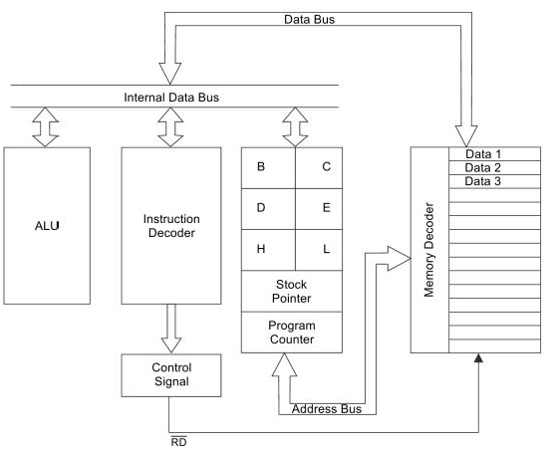
Memory read operation (cont’d)

Slide 51
Memory read operation
The control unit sends the control signal RD in the next clock cycle and the memory IC is enabled
RD is active for two clock periods.
When the memory IC is enabled, the byte from the memory location is placed on the data bus AD₇ – AD₀. after that data is transferred to the microprocessor.

Slide 52
Addressing modes of 8085 microprocessor (cont’d)
Each instruction performs an operation on the specified data called operand. An operand must be specified for an instruction to be executed.
The operand may be in the general purpose register, accumulator or in a memory location.
The way in which the operand is specified for an instruction is called addressing mode.
Various addressing modes used in MP 8085 are:
  Direct Addressing
  Register Addressing
  Register Indirect Addressing
  Immediate Addressing.
  Implicit Addressing

Slide 53
Addressing modes of 8085 microprocessor (cont’d)
Direct addressing
In this mode of addressing the address of the operand (data) is given in the instruction itself. For example:
  STA 2400H: Store the content of the accumulator to memory location 2400H.
  2. IN 02: Read data from port C , 02 is the address of the port C of an I/O port from where data is to be read.

Slide 54
Addressing modes of 8085 microprocessor (cont’d)
Register Addressing
In register addressing mode the operands are in the general purpose registers. For example:
  MOV A,B: This instruction moves the contents of register B to register A or Accumulator.
  2. ADD B: Add the contents of register B to accumulator.

Slide 55
Addressing modes of 8085 microprocessor (cont’d)
Register indirect addressing
In this mode of addressing the address of the operand (data) is specified by a register pair. For example:
  LXI H, 2500H: Load HL pair with 2500H. MOV A,M : Move the contents of memory location whose address is given in HL pair to the accumulator. HLT: Stop the program.
  In this program MOV A,M is the example of Register Indirect addressing.
  2. LXI H, 2500H: Load HL pair with 2500H. ADD M : Add the contents of memory location whose address is given in HL pair to the accumulator. HLT: Stop the program.
  In this program ADD ,M is the example of Register Indirect addressing.

Slide 56
Addressing modes of 8085 microprocessor (cont’d)
Immediate Addressing
In immediate addressing mode the operands are specified within the instruction itself. For example:
  MVI A,05 : Move 05 in the Accumulator.
  2. ADI 06 : Add 06 to the contents of the accumulator.

Slide 57
Addressing modes of 8085 microprocessor
Implicit Addressing
There are certain instructions which operate on the content or the Accumulator directly, these instructions do not require the address of the operands. For example
  CMA : Compliment the contents of the Accumulator.
  2. RAR : Rotate the contents of the accumulator right by one bit.
  3. RAL : Rotate the contents of the accumulator left by one bit.

Slide 58
Instruction Set of 8085 (cont’d)
An instruction is a binary pattern designed inside a microprocessor to perform a specific function.
The entire group of instructions that a microprocessor supports is called Instruction Set.
8085 has 246instructions.
Each instruction is represented by an 8-bit binary value.
These 8-bits of binary value is called Op-Codeor Instruction Byte.

Slide 59
Instruction Set of 8085 (cont’d)
Classification of Instruction Set
Data Transfer Instruction
Arithmetic Instructions
Logical Instructions
Branching Instructions
Control Instruction

Slide 60
Instruction Set of 8085 (cont’d)
Data Transfer Instructions (cont’d)
These instructions move data between registers, or between memory and registers.
These instructions copy data from source to destination.
While copying, the contents of source are not modified.

Slide 61
Instruction Set of 8085 (cont’d)
Data Transfer Instructions
This instruction copies the contents of the source register into the destination register.
The contents of the source register are not altered.
If one of the operands is a memory location, its location is specified by the contents of the HL registers.
Example: MOV B, C
MOV B, M
MOV M, C
Opcode | Operand | Description
MOV | Rd, Rs Rd, M M, Rs | Copy from source to destination

Slide 62
Instruction Set of 8085 (cont’d)
Arithmetic Instructions
These instructions perform the operations like:
Addition
Subtract
Increment
Decrement

Slide 63
Instruction Set of 8085 (cont’d)
Arithmetic Instructions
Addition
Any 8-bit number, or the contents of register, or the contents of memory location can be added to the contents of accumulator.
The result (sum) is stored in the accumulator.
No two other 8-bit registers can be added directly.
Example:The contents of register B cannot be added directly to the contents of register C.

Slide 64
Interrupts of Intel 8085 (cont’d)
What is interrupt?
Interrupt is a signal send by an external device to the processor, to the processor to perform a particular task or work.
Mainly in the microprocessor based system the interrupts are used for data transfer between the peripheral and the microprocessor.
When a peripheral is ready for data transfer, it interrupts the processor by sending an appropriate signal to the interrupt pin of the processor.
If the processor accepts the interrupt then the processor suspends its current activity and executes an interrupt service subroutine to complete the data transfer between the peripheral and processor.
After executing the interrupt service routine the processor resumes its current activity.

Slide 65
Interrupts of Intel 8085 (cont’d)
Types of interrupt (cont’d)
Software interrupts
The software interrupts are program instructions.
These instructions are inserted at desired locations in a program.
While running a program, lf a software interrupt instruction is encountered, then the processor executes an interrupt service routine (ISR).
The software interrupts of 8085 are RST 0, RST 1, RST 2, RST 3, RST 4, RST 5, RST 6 and RST 7.

Slide 66
Interrupts of Intel 8085 (cont’d)
Types of interrupt (cont’d)
Hardware interrupts
The hardware interrupts are initiated by an external device by placing an appropriate signal at the interrupt pin of the processor.
If the interrupt is accepted, then the processor executes an interrupt service routine (ISR).
The hardware interrupts of 8085 are TRAP, RST 7.5, RST 6.5, RST 5.5 and INTR

Slide 67
Interrupts of Intel 8085 (cont’d)
Types of interrupt (cont’d)
Vectored interrupts
In vectored interrupts, the processor automatically branches to the specific address in response to an interrupt.
The TRAP, RST 7.5, RST 6.5 and RST 5.5 are vectored interrupts.

Slide 68
Interrupts of Intel 8085 (cont’d)
Types of interrupt (cont’d)
Non-vectored interrupts
But in non-vectored interrupts the interrupted device should give the address of the interrupt service routine (ISR).
In vectored interrupts, the manufacturer fixes the address of the ISR to which the program control is to be transferred.•
The INTR is a non-vectored interrupt.
Hence when a device interrupts through INTR, it has to supply the address of ISR after receiving interrupt acknowledge signal.

Slide 69
Interrupts of Intel 8085 (cont’d)
Types of interrupt (cont’d)
Maskable interrupts
Maskable Interrupts are those which can be disabled or ignored by the microprocessor.
These interrupts are either edge-triggered or level-triggered, so they can be disabled. INTR, RST 7.5, RST 6.5, RST 5.5 are maskable interrupts in 8085 microprocessor.
The maskable interrupt process in the 8085 is controlled by a single flip flop inside the microprocessor.
This Interrupt Enable flip flop is controlled using the two instructions “EI” and “DI”.

Slide 70
Interrupts of Intel 8085 (cont’d)
Types of interrupt (cont’d)
Non-maskabled interrupts
Non-Maskable Interrupts are those which cannot be disabled or ignored by microprocessor.
TRAP is a non-maskable interrupt.
The non-maskable interrupt is not affected by the value of the Interrupt Enable flip flop.

Slide 71
Interrupts of Intel 8085 (cont’d)
Vectored interrupts
In vectored interrupts, the processor automatically branches to the specific address in response to an interrupt.
The TRAP, RST 7.5, RST 6.5 and RST 5.5 are vectored interrupts
Non-Vectored Interrupts
Non-vectored interrupts are those in which vector address is not predefined. The interrupting device gives the address of sub-routine for these interrupts.
INTR is the only non-vectored interrupt in 8085 microprocessor.

