Slide 1
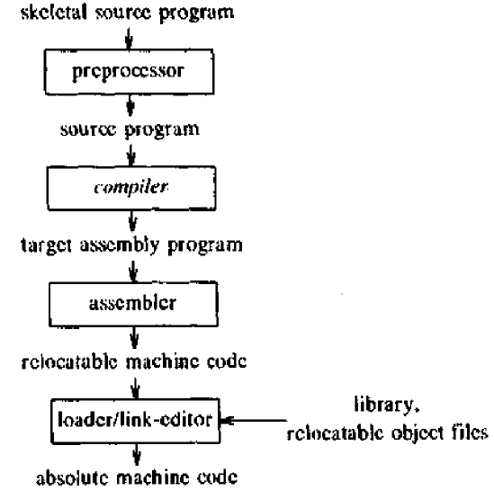
Introduction to Compiler
Types
A language processing system:

Slide 2
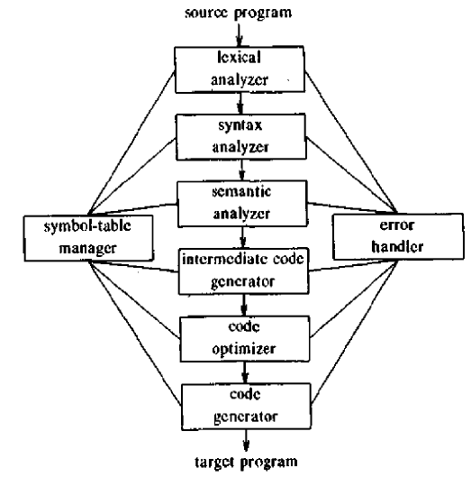
Introduction to Compiler
Types
Phases of a compiler:
In broad sense a compiler consists of two parts:
Analyzer
Code generator

Slide 3
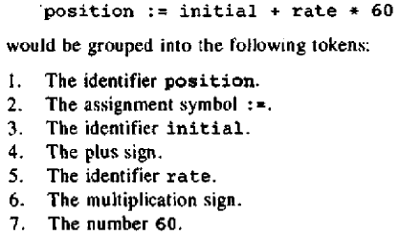
Introduction to Compiler
Types
Phases of a compiler:
Linear analysis
In broad sense a compiler consists of two parts:
Analyzer
Code generator

Slide 4
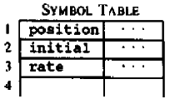
Introduction to Compiler
Types
Phases of a compiler:
Linear analysis
In broad sense a compiler consists of two parts:
Analyzer
Code generator
Variable information

Slide 5
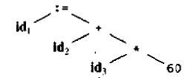
Introduction to Compiler
Types
Phases of a compiler:
Linear analysis
Create parse three/ table
In broad sense a compiler consists of two parts:
Analyzer
Code generator
Variable information

Slide 6
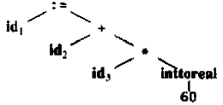
Introduction to Compiler
Types
Phases of a compiler:
Linear analysis
Create parse three/ table
In broad sense a compiler consists of two parts:
Analyzer
Code generator
-Binds variable to type and memory location
Variable information

Slide 7

Introduction to Compiler
Types
Phases of a compiler:
Linear analysis
Create parse three/ table
In broad sense a compiler consists of two parts:
Analyzer
Code generator
-Binds variable to type and memory location
Variable information
-Generate three address code

Slide 8

Introduction to Compiler
Types
Phases of a compiler:
Linear analysis
Create parse three/ table
In broad sense a compiler consists of two parts:
Analyzer
Code generator
-Binds variable to type and memory location
Variable information
-Generate three address code
-Optimize code

Slide 9
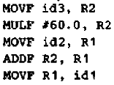
Introduction to Compiler
Types
Phases of a compiler:
Linear analysis
Create parse three/ table
In broad sense a compiler consists of two parts:
Analyzer
Code generator
-Generate code
-Binds variable to type and memory location
Variable information
-Generate three address code
-Optimize code

Slide 10
Introduction to Compiler
Types
Phases of a compiler:
Linear analysis
Create parse three/ table
In broad sense a compiler consists of two parts:
Analyzer
Code generator
-Generate code
-Binds variable to type and memory location
-Somehow handle errors in each phase
Variable information
-Generate three address code
-Optimize code

