Slide 1
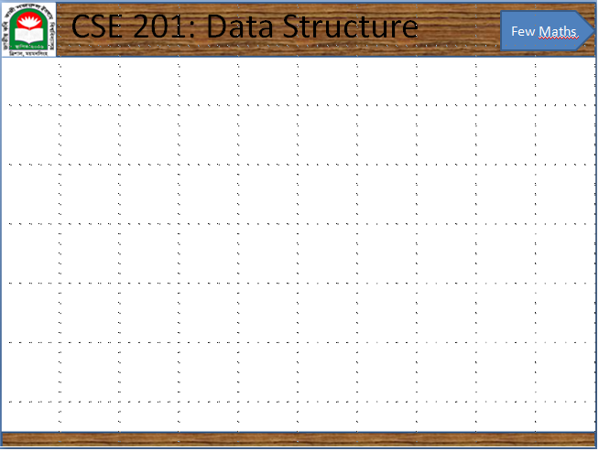
Mathematical background

Slide 2
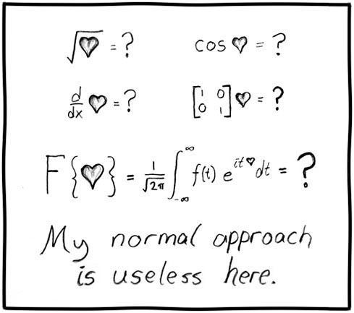
Mathematics and engineering
For engineers, mathematics is a tool:
  Of course, that doesn’t mean it always works...

Slide 3
Justification
However, as engineers, you will not be paid to say:
Method A is better than Method B
or
Algorithm A is faster than Algorithm B
Such comparisons are said to be qualitative:
qualitative, a. Relating to, connected or concerned with, quality or qualities.
Now usually in implied or expressed opposition to quantitative.

Slide 4
Justification
Qualitative statements cannot guide engineering design decisions:
  Algorithm A could be better than Algorithm B, but Algorithm A would require three person weeks to implement, test, and integrate while Algorithm B has already been implemented and has been used for the past year
  There are circumstances where it may beneficial to use Algorithm A, but not based on the word better

Slide 5
Justification
Thus, we will look at a quantitative means of describing data structures and algorithms:
quantitative, a. Relating to, concerned with, quantity or its measurement;
ascertaining or expressing quantity.
This will be based on mathematics, and therefore we will look at a number of properties which will be used again and again throughout this course

Slide 6
Floor and ceiling functions
The floor function maps any real number x onto the greatest integer less than or equal to x:
  Consider it rounding towards negative infinity
The ceiling function maps x onto the least integer greater than or equal to x:
  Consider it rounding towards positive infinity

Slide 7
Logarithms
We will begin with a review of logarithms:
If n = e^{m}, we define
m = ln( n )
It is always true that e^{ln(n)} = n; however, ln(e^{n}) = n requires that n is real

Slide 8
Logarithms
Exponentials grow faster than any non-constant polynomial
for any d > 0
Thus, their inverses—logarithms—grow slower than any polynomial
Notes:
This can be also argued as follows:
The inverse of n^{d} is n^{1/d} and to assume otherwise would suggest that a polynomial grows as fast as an exponential, which is false simply by applying l’Hopital’s rule.

Slide 9
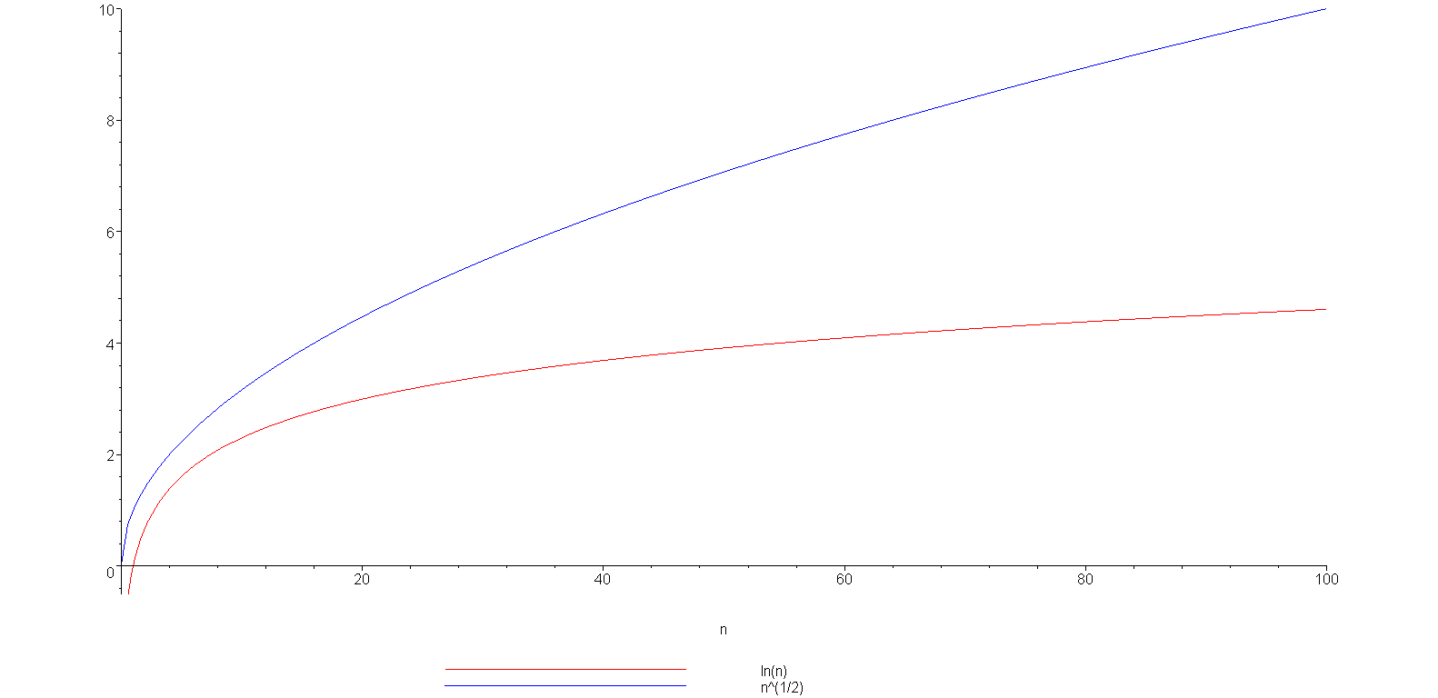
Logarithms
Example: is strictly greater than ln(n)
ln(n)

Slide 10
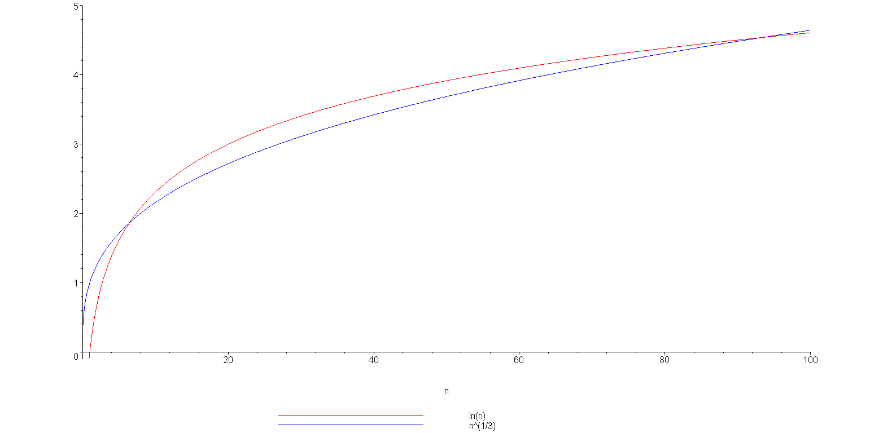
Logarithms
grows slower but only up to n = 93
(93.354, 4.536)
ln(n)

Slide 11
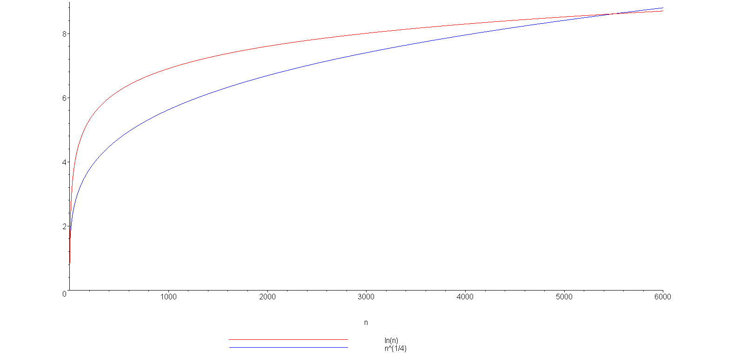
Logarithms
You can view this with any polynomial
ln(n)
(5503.66, 8.61)

Slide 12
Logarithms
We have compared logarithms and polynomials
  How about log₂(n) versus ln(n) versus log₁₀(n)
You have seen the formula
All logarithms are scalar multiples of each others
Constant
Because,

Slide 13
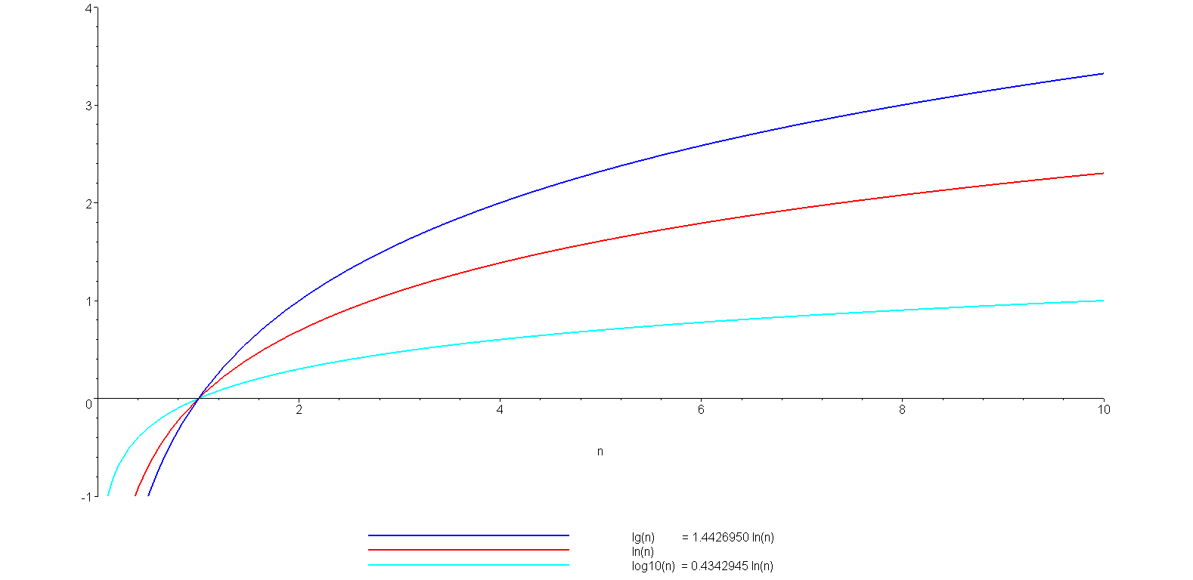
Logarithms
A plot of log₂(n) = lg(n), ln(n), and log₁₀(n)
lg(n)
ln(n)
log₁₀(n)

Slide 14
Logarithms
You should also, as electrical or computer engineers be aware of the relationship:
lg(2¹⁰) = lg(1024) = 10
lg(2²⁰) = lg(1 048 576) = 20
and consequently:
lg(10³) = lg(1000) ≈ 10 kilo
lg(10⁶) = lg(1 000 000) ≈ 20 mega
lg(10⁹) ≈ 30 giga
lg(10¹²) ≈ 40 tera

Slide 15
Arithmetic series
Next we will look various series
Each term in an arithmetic series is increased by a constant value (usually 1) :

Slide 16
Arithmetic series
Proof 1: write out the series twice and add each column
1 + 2 + 3 + . . . + n – 2 + n – 1 + n
+ n + n – 1 + n – 2 + . . . + 3 + 2 + 1
(n + 1) + (n + 1) + (n + 1) + . . . + (n + 1) + (n + 1) + (n + 1)
= n (n + 1)
Since we added the series twice, we must divide the result by 2

Slide 17
Arithmetic series
Proof 2 (by induction):
The statement is true for n = 0:
Assume that the statement is true for an arbitrary n:

Slide 18
Arithmetic series
Using the assumption that
for n, we must show that

Slide 19
Arithmetic series
Then, for n + 1, we have:
By assumption, the second sum is known:

Slide 20
Arithmetic series
The statement is true for n = 0 and
the truth of the statement for n implies
the truth of the statement for n + 1.
Therefore, by the process of mathematical induction, the statement is true for all values of n ≥ 0.
Reference: Mr. Oprendick

Slide 21
Other polynomial series
We could repeat this process, after all:
however, it is easier to see the pattern:

Slide 22
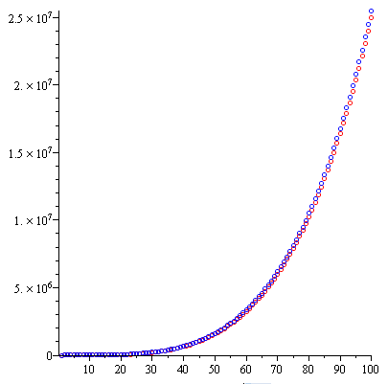
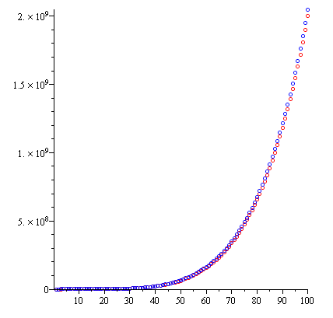
Other polynomial series
We can generalize this formula
Demonstrating with d = 3 and d = 4:

Slide 23
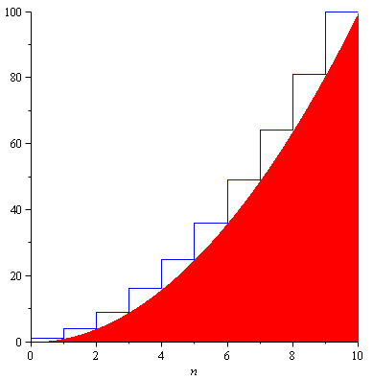
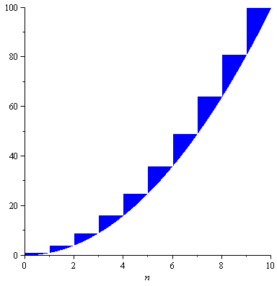
Other polynomial series
The justification for the approximation is that we are approximating the sum with an integral:
n²

Slide 24
Other polynomial series
The ratio between the error and the actual value goes to zero:
  In the limit, as n → ∞, the ratio between the sum and the approximation goes to 1
  The relative error of the approximation goes to 0

Slide 25
Geometric series
The next series we will look at is the geometric series with common ratio r:
and if |r| < 1 then it is also true that

Slide 26
Geometric series
Elegant proof: multiply by
Ref: Bret D. Whissel, A Derivation of Amortization
Telescoping series:
all but the first and last terms cancel

Slide 27
Geometric series
Note that we can use a change-of-index with summations like we do with integration:
Letting j = i – 1:

Slide 28
Recurrence relations
Finally, we will review recurrence relations:
  Sequences may be defined explicitly: x_{n} = 1/n
  1, ¹/₂, ¹/₃, ¹/₄, ...
  Here n is x_{n} independent.
  Consider a fibonacci series where F₁=1, F₂=2 and F=F+F
  Then the series is 1, 2, 3, 5, 8, 13, 21, …
  A recurrence relationship is a means of defining a sequence based on previous values in the sequence
  Such definitions of sequences are said to be recursive

Slide 29
Recurrence relations
Define an initial value: e.g., x₁ = 1
Defining x_{n} in terms of previous values:
  For example,
x_{n} = x_{n – 1} + 2
x_{n} = 2x_{n – 1} + n
x_{n} = x_{n – 1} + x_{n – 2}

Slide 30
Recurrence relations
Given the two recurrence relations
x_{n} = x_{n – 1} + 2 x_{n} = 2x_{n – 1} + n
and the initial condition x₁ = 1 we would like to find explicit formulae for the sequences
In this case, we have
x_{n} = 2n – 1 x_{n} = 2^{n + 1} – n – 2
respectively

Slide 31
Recurrence relations
We will use a functional form of recurrence relations:
Calculus | CSE
x₁ = 1............. | f(1) = 1...................
x_{n} = x_{n – 1} + 2.. | f(n) = f(n – 1) + 2...
x_{n} = 2x_{n – 1} + n | f(n) = 2 f(n – 1) + n

Slide 32
Recurrence relations
The previous examples using the functional notation are:
  f(n) = f(n – 1) + 2 g(n) = 2 g(n – 1) + n
With the initial conditions f(1) = g(1) = 1, the solutions are:
f(n) = 2n – 1 g(n) = 2^{n + 1} – n – 2

Slide 33
Recurrence relations
In some cases, given the recurrence relation, we can find the explicit formula:
  Consider the Fibonacci sequence:
f(n) = f(n – 1) + f(n – 2)
f(0) = f(1) = 1
  that has the solution
where φ is the golden ratio:

Slide 34
Weighted averages
Given n objects x₁, x₂, x₃, ..., x_{n}, the average is
Given a sequence of coefficients c₁ , c₂ , c₃ , … , c_{n} where
then we refer to
as a weighted average
For an average,

Slide 35
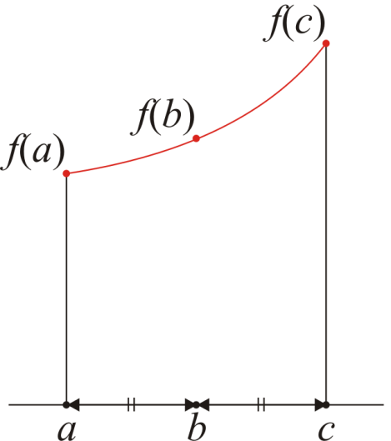
Weighted averages
Examples:
  Simpson’s method approximates an integral by sampling
  the function at three points: f(a), f(b), f(c)
  The average value of the function is approximated by
  It can be shown that that
  is a significant better approximation than

Slide 36
Weighted averages
Examples:
  Using the weighted average:
  Using a simple average:

Slide 37
Combinations
Given n distinct items, in how many ways can you choose k of these?
  I.e., “In how many ways can you combine k items from n?”
  For example, given the set {1, 2, 3, 4, 5}, I can choose three of these
  in any of the following ways:
  {1, 2, 3}, {1, 2, 4}, {1, 2, 5}, {1, 3, 4}, {1, 3, 5},
  {1, 4, 5}, {2, 3, 4}, {2, 3, 5}, {2, 4, 5}, {3, 4, 5},
The number of ways such items can be chosen is written
where is read as “n choose k”s
There is a recursive definition:

Slide 38
Combinations
The most common question we will ask in this vein:
  Given n items, in how many ways can we choose two of them?
  In this case, the formula simplifies to:
For example, given {0, 1, 2, 3, 4, 5, 6}, we have the following 21 pairs:
{0, 1}, {0, 2}, {0, 3}, {0, 4}, {0, 5}, {0, 6},
{1, 2}, {1, 3}, {1, 4}, {1, 5}, {1, 6},
{2, 3}, {2, 4}, {2, 5}, {2, 6},
{3, 4}, {3, 5}, {3, 6},
{4, 5}, {4, 6},
{5, 6}

Slide 39
Combinations
You have also seen this in expanding polynomials:
For example,

Slide 40
Combinations
These are also the coefficients of Pascal’s triangle:

Slide 41
Absolute Value or Modulus of a
|a|= non-negative value of a
Example:
|5|=5
|0|=0
|-5|=5
|-5.5|=5.5

Slide 42


Modulo
the result of the modulo operation is the remainder of the Euclidean division.
In nearly all computing systems, the quotient q and the remainder r of a divided by n satisfy
q is an integer number.
a=nq+r
|r|<|n|
This is then written as
r=(a mod n)

Slide 43

Modulo
(-a mod n)=n-(a mod n)
Example:
16 mod 3=1, -16 mod 3=2

Slide 44
End of the Chapter

