Slide 1
CSE 403: Computer Graphics
Graphics Application
Output Primitives:
1. Point
2. Line
3. Circle
4. Arc
5. Ellipse
6. Rectangle
7. Curve
8. Many other curves
9. Polygon
Prof. Dr. A. H. M. Kamal, CSE, JKKNIU

Slide 2
CSE 403: Computer Graphics
Graphics Application
Output Primitives:
1. Point : a small, squared and unit area in a sheet.
Prof. Dr. A. H. M. Kamal, CSE, JKKNIU

Slide 3
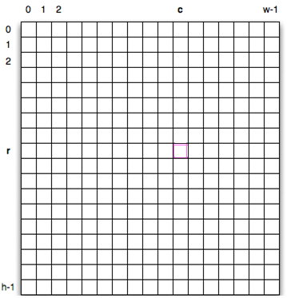
CSE 403: Computer Graphics
Graphics Application
Output Primitives:
1. Point : is a mathematical point (x, y) within an image area hxw.
Prof. Dr. A. H. M. Kamal, CSE, JKKNIU

Slide 4
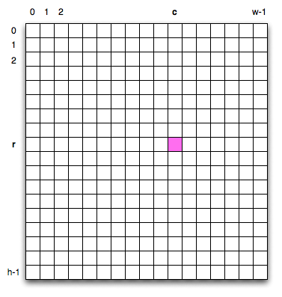
CSE 403: Computer Graphics
Graphics Application
Output Primitives:
1. Point
Scan Conversion: is digitizing a picture definition given in an application program into a set of pixel intensity values for storing in the frame buffer.
Prof. Dr. A. H. M. Kamal, CSE, JKKNIU

Slide 5
CSE 403: Computer Graphics
Graphics Application
Output Primitives:
1. Point
Scan Conversion: is digitizing a picture definition given in an application program into a set of pixel intensity values for storing in the frame buffer.
Point scan conversion functions:
setPixel(x,y): draws a pixel at (x,y) position in the grid.
getPixel(x,y): reads the color value of a pixel of a location (x, y)
Prof. Dr. A. H. M. Kamal, CSE, JKKNIU

Slide 6
CSE 403: Computer Graphics
Graphics Application
Output Primitives:
1. Point
Scan Conversion: is digitizing a picture definition given in an application program into a set of pixel intensity values for storing in the frame buffer.
Point scan conversion functions:
setPixel(x,y): draws a pixel at (x,y) position in the grid.
getPixel(x,y): reads the color value of a pixel of a location (x, y)
Using the function of C/C++:
Implementation of setPixel(x,y) function: putpixel (x, y, c)
Implementation of getPixel(x,y) function: c=getpixel (x, y)
These functions draw/read a pixel of color value c to/from (x, y) location.
Prof. Dr. A. H. M. Kamal, CSE, JKKNIU

Slide 7
CSE 403: Computer Graphics
Graphics Application
Output Primitives:
1. Point
Scan Conversion: is digitizing a picture definition given in an application program into a set of pixel intensity values for storing in the frame buffer.
Point scan conversion functions:
setPixel(x,y): draws a pixel at (x,y) position in the grid.
getPixel(x,y): reads the color value of a pixel of a location (x, y)
Using the function of C/C++:
Implementation of setPixel(x,y) function: putpixel (x, y, c)
Implementation of getPixel(x,y) function: c=getpixel (x, y)
These functions draw/read a pixel of color value c to/from (x, y) location.
Question:
Range of c?
Each c value means?
Prof. Dr. A. H. M. Kamal, CSE, JKKNIU

Slide 8
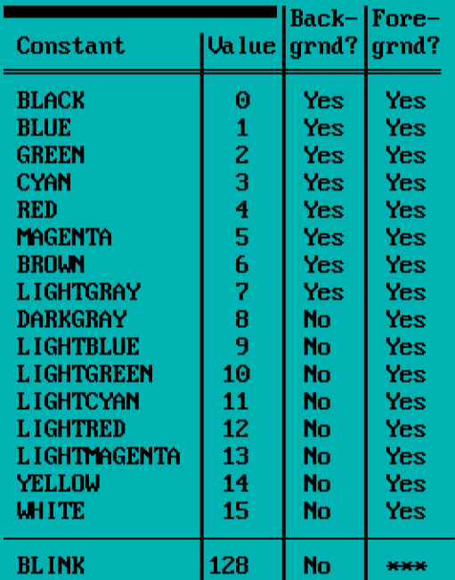
CSE 403: Computer Graphics
Graphics Application
Output Primitives:
1. Point
Using the function of C/C++:
putpixel (x, y, c)
c=getpixel (x, y)
Value of c
Color and respective code value in C/C++
Header file to include in c/c++ program:
graphics.h
Including style:
#include<graphics.h>
Prof. Dr. A. H. M. Kamal, CSE, JKKNIU

Slide 9
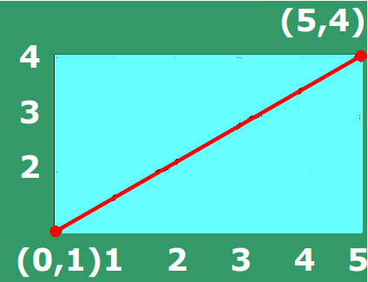
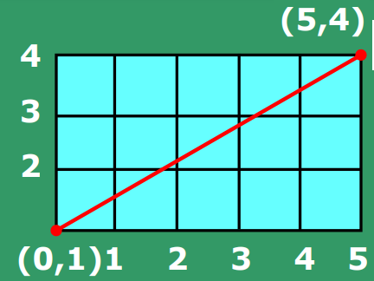
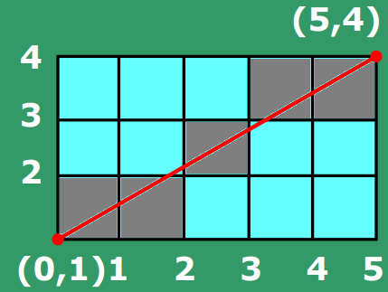
CSE 403: Computer Graphics
Graphics Application
Output Primitives:
2. Line
A line drawing is accomplished by computing intermediate positions between two end points along a line path. An output device fills these positional pixels between the end points.
1. A line in a sheet
2. A line in a grid
3. A scan converted line (connected gray color pixels)
Prof. Dr. A. H. M. Kamal, CSE, JKKNIU

Slide 10
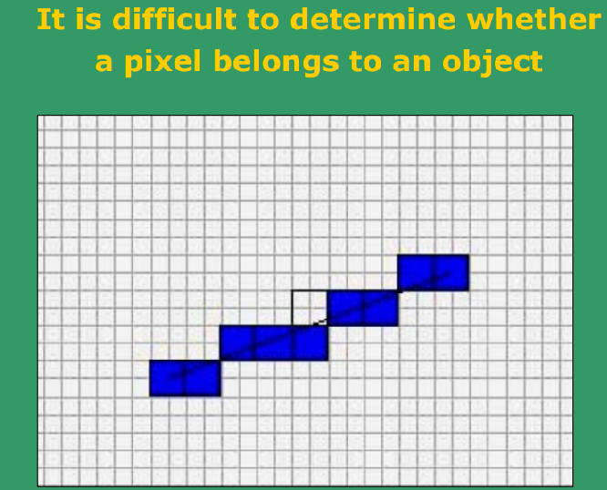
CSE 403: Computer Graphics
Graphics Application
Output Primitives:
2. Line
A geometrical line may pass through two vertical pixels.
Problem is to decide which pixel to light.
Prof. Dr. A. H. M. Kamal, CSE, JKKNIU

Slide 11
CSE 403: Computer Graphics
Graphics Application
Output Primitives:
2. Line
Scan converting a line using:
Direct application of line equation
Digital Differential Analyzer (DDA)
Bresenham’s Line Algorithm
Prof. Dr. A. H. M. Kamal, CSE, JKKNIU

Slide 12
CSE 403: Computer Graphics
Graphics Application
Output Primitives:
2. Line
Scan converting a line using:
Direct application of line equation
P₂(x_{2,}y₂)
Let two points in a graph sheet are P₁ and P₂ at coordinate positions (x₁, y₁) and (x₂, y₂), respectively.
A line equation is y=mx+b.
P₁(x₁,y₁)
Here,
x₁, y_{1,} x₂, y₂ and m are known values.
Set x= x₁ and y=y₁
Draw a pixel at (x, y) location in the output device.
Increase x by 1.
Compute y from line equation y=mx+b
Draw a pixel at (x, y) location in the output device.
Repeat the computing process of x and y and drawing pixel at (x, y) till x>x₂.
Repeat
Prof. Dr. A. H. M. Kamal, CSE, JKKNIU

Slide 13
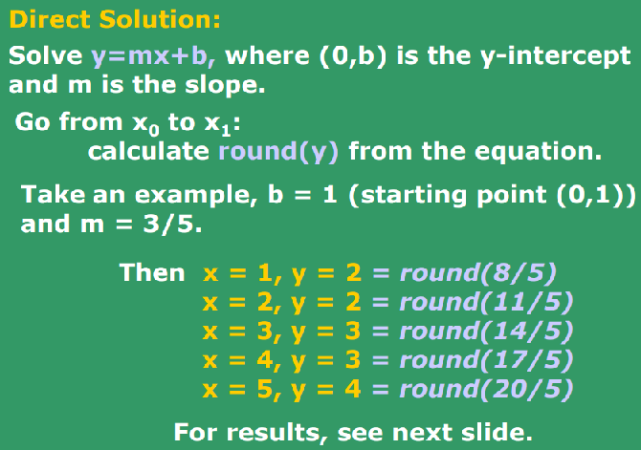
CSE 403: Computer Graphics
Graphics Application
Output Primitives:
2. Line
Scan converting a line using:
Direct application of line equation
P_{d}(x_{d},y_{d})
P_{s}(x_{s},y_{s})
Here, P_{s} is a start point, P_{d} is a destination point.
Starting Step:
x=x_{s}=0.
y=y_{s}=b
Step 2: x=x_{s}+1, compute y.
Draw pixel at (x, y)
using putpixel(x,y,c)
Step 3: x=x_{s}+2, compute y.
Draw pixel at (x, y)
using putpixel(x,y,c)
…. ….
Last Step: x=x_{d}, compute y.
Draw pixel at (x, y)
using putpixel(x,y,c)
Prof. Dr. A. H. M. Kamal, CSE, JKKNIU

Slide 14
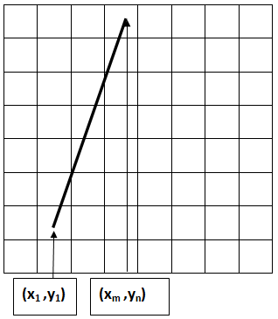
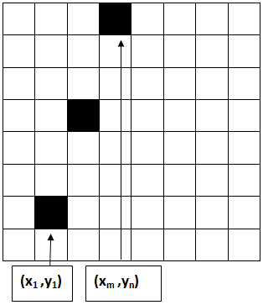
CSE 403: Computer Graphics
Graphics Application
Output Primitives:
2. Line
Scan converting a line using:
Direct application of line equation
P_{d}(x_{d},y_{d})
Disadvantage:
Consider the following scenario in left figure.
Only three pixels are dawn. I does not looks like a line.
P_{s}(x_{s},y_{s})
Here, P_{s} is a start point, P_{d} is a destination point.
Starting Step:
x=x_{s}=0.
y=y_{s}=b
Step 2: x=x_{s}+1, compute y.
Draw pixel at (x, y)
using putpixel(x,y,c)
Step 3: x=x_{s}+2, compute y.
Draw pixel at (x, y)
using putpixel(x,y,c)
…. ….
Last Step: x=x_{d}, compute y.
Draw pixel at (x, y)
using putpixel(x,y,c)
Prof. Dr. A. H. M. Kamal, CSE, JKKNIU

Slide 15
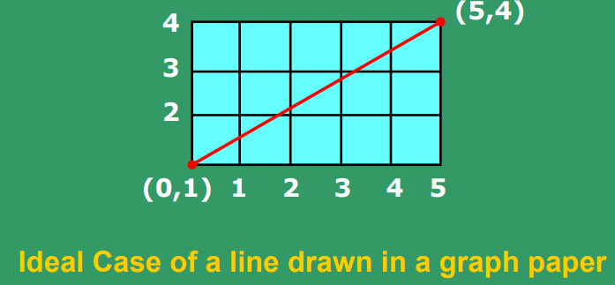
CSE 403: Computer Graphics
Graphics Application
Output Primitives:
2. Line
Scan converting a line using:
Direct application of line equation
Drawing in a graph paper
Prof. Dr. A. H. M. Kamal, CSE, JKKNIU

Slide 16
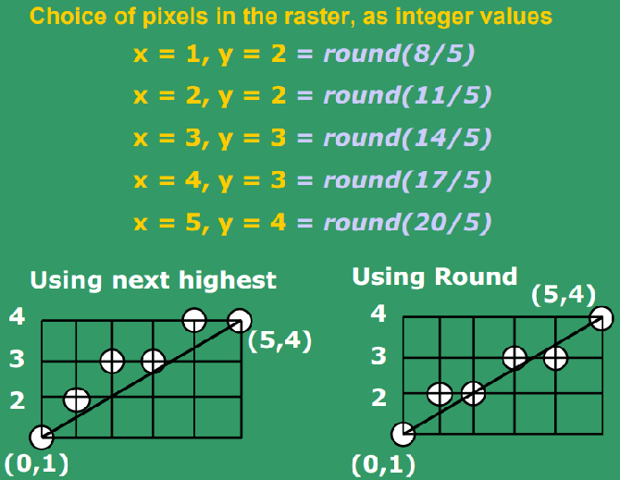
CSE 403: Computer Graphics
Graphics Application
Output Primitives:
2. Line
Scan converting a line using:
Direct application of line equation
Prof. Dr. A. H. M. Kamal, CSE, JKKNIU

Slide 17
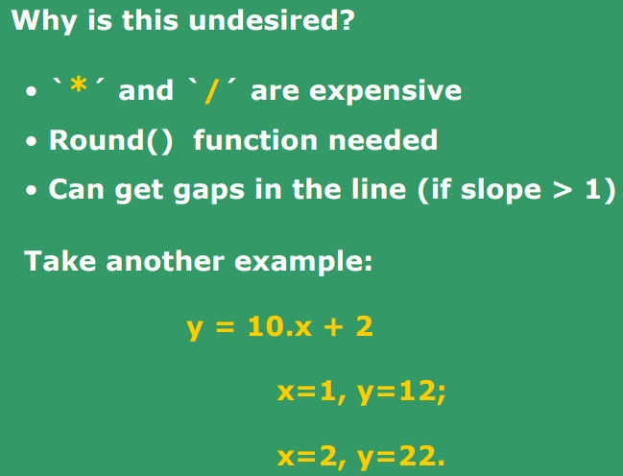
CSE 403: Computer Graphics
Graphics Application
Output Primitives:
2. Line
Scan converting a line using:
Direct application of line equation
Prof. Dr. A. H. M. Kamal, CSE, JKKNIU

Slide 18
CSE 403: Computer Graphics
Graphics Application
Output Primitives:
2. Line
Scan converting a line using:
Direct application of line equation
Digital Differential Analyzer (DDA)
Bresenham’s Line Algorithm
Prof. Dr. A. H. M. Kamal, CSE, JKKNIU

Slide 19
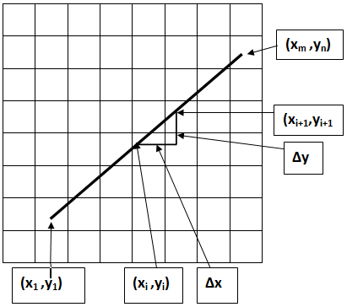
CSE 403: Computer Graphics
Graphics Application
Output Primitives:
2. Line
Scan converting a line using: 2. Digital Differential Analyzer (DDA)
The digital differential analyzer algorithm is an incremental scan-conversion method.
The approach performs calculation at each step using results of preceding step.
Start point (x₁, y₁), end point (x_{m}, y_{n})
Suppose at step I, we have calculated a point (x_{i}, y_{i})
The next point that would be computed is (x_{i+1}, y_{i+1})
Computation process:
1. Δx=x_{m}-x₁ 2. Δy=y_{n}-y₁ 3. m=Δy/Δx
yes
no
|m|≤1
x=x1, y=y1, Δx=1
Step=x₁ - x_{m}
putpixel(x,y,c)
For k=2 to Step-1
x=x+Δx, y=y+m
putpixel(x,y,c)
x=x1, y=y1, Δy=1
Step=y₁ – y_{n}, InvSlope=1/m
putpixel(x,y,c)
For k=2 to Step-1
y=y+Δy, x=x+ InvSlope
putpixel(x,y,c)
Prof. Dr. A. H. M. Kamal, CSE, JKKNIU

Slide 20
CSE 403: Computer Graphics
Graphics Application
Output Primitives:
2. Line
Scan converting a line using: 2. Digital Differential Analyzer (DDA)
The digital differential analyzer algorithm is an incremental scan-conversion method.
The approach performs calculation at each step using results of preceding step.
DDA Algorithm
Advantage:
It is faster than the direct use of line equation
It calculate points without any floating-point multiplication
Disadvantage:
Still, it adds floating points.
Happens cumulative errors due to limited precision.
When the line is long, calculated point may drift away from the true position.
Start point (x₁, y₁), end point (x_{m}, y_{n})
Suppose at step I, we have calculated a point (x_{i}, y_{i})
The next point that would be computed is (x_{i+1}, y_{i+1})
Computation process:
1. Δx=x_{m}-x₁ 2. Δy=y_{n}-y₁ 3. m=Δy/Δx
yes
no
|m|≤1
x=x1, y=y1, Δx=1
Step=x₁ - x_{m}
putpixel(x,y,c)
For k=2 to Step-1
x=x+Δx, y=y+m
putpixel(x,y,c)
x=x1, y=y1, Δy=1
Step=y₁ – y_{n} InvSlope=1/m
putpixel(x,y,c)
For k=2 to Step-1
y=y+Δy, x=x+ InvSlope
putpixel(x,y,c)
Prof. Dr. A. H. M. Kamal, CSE, JKKNIU

Slide 21
CSE 403: Computer Graphics
Graphics Application
Output Primitives:
2. Line
Scan converting a line using:
Direct application of line equation
Digital Differential Analyzer (DDA)
Bresenham’s Line Algorithm
Prof. Dr. A. H. M. Kamal, CSE, JKKNIU

Slide 22
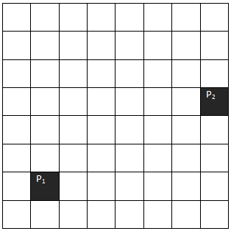
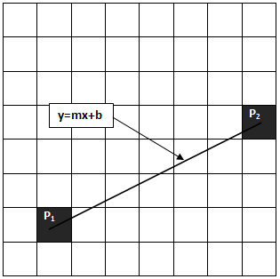
CSE 403: Computer Graphics
Graphics Application
Output Primitives:
2. Line
Scan converting a line using: 3. Bresenham’s Line Algorithm
Target is to draw a line between two points P₁ and P₂.
True line by equation y=mx+b between the points P₁ and P₂.
Prof. Dr. A. H. M. Kamal, CSE, JKKNIU

Slide 23
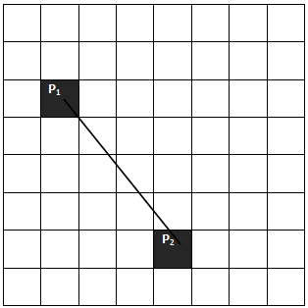
CSE 403: Computer Graphics
Graphics Application
Output Primitives:
2. Line
Scan converting a line using: 3. Bresenham’s Line Algorithm
Measure slope m by
If m 1 then exchange coordinates so that m < 1.
True line by equation y=mx+b between the points P₁ and P₂.
Here, m>1
Prof. Dr. A. H. M. Kamal, CSE, JKKNIU

Slide 24
CSE 403: Computer Graphics
Graphics Application
Output Primitives:
2. Line
Scan converting a line using: 3. Bresenham’s Line Algorithm
Measure slope m by
If m 1 then exchange coordinates so that m < 1.
True line by equation y=mx+b between the points P₁ and P₂.
Do it by rotating by 90⁰ or -90⁰ for drawing purpose only.
Now m<1
Prof. Dr. A. H. M. Kamal, CSE, JKKNIU

Slide 25
CSE 403: Computer Graphics
Graphics Application
Output Primitives:
2. Line
Scan converting a line using: 3. Bresenham’s Line Algorithm
Measure slope m by
If m 1 then exchange coordinates so that m < 1.
True line by equation y=mx+b between the points P₁ and P₂.
Prof. Dr. A. H. M. Kamal, CSE, JKKNIU

Slide 26
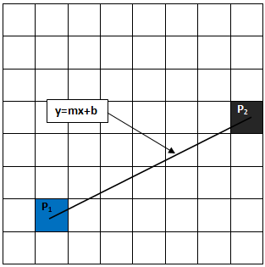
CSE 403: Computer Graphics
Graphics Application
Output Primitives:
2. Line
Scan converting a line using: 3. Bresenham’s Line Algorithm
Measure slope m by
If m 1 then exchange coordinates so that m < 1.
Set x_{i}=x₁ and y_{i}=y₁, draw a pixel at (x_{i}, y_{i}) location, here i=1
True line by equation y=mx+b between the points P₁ and P₂.
Prof. Dr. A. H. M. Kamal, CSE, JKKNIU

Slide 27
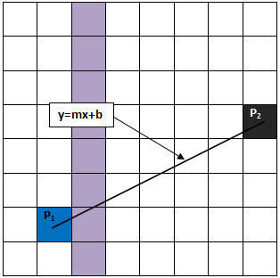
CSE 403: Computer Graphics
Graphics Application
Output Primitives:
2. Line
Scan converting a line using: 3. Bresenham’s Line Algorithm
Measure slope m by
If m 1 then exchange coordinates so that m < 1.
Set x_{i}=x₁ and y_{i}=y₁, draw a pixel at (x_{i}, y_{i}) location, here i=1
Increase x_{i} by 1, that is x_{i}=x_{i}+1. Indicated column shown in Fig
True line by equation y=mx+b between the points P₁ and P₂.
Prof. Dr. A. H. M. Kamal, CSE, JKKNIU

Slide 28
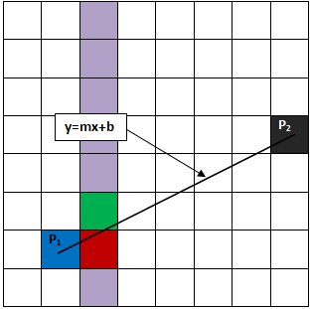
CSE 403: Computer Graphics
Graphics Application
Output Primitives:
2. Line
Scan converting a line using: 3. Bresenham’s Line Algorithm
Measure slope m by
If m 1 then exchange coordinates so that m < 1.
Set x_{i}=x₁ and y_{i}=y₁, draw a pixel at (x_{i}, y_{i}) location, here i=1
Increase x_{i} by 1, that is x_{i}=x_{i}+1. Indicated column shown in Fig
True line by equation y=mx+b between the points P₁ and P₂.
What pixel to draw: red or green?
Prof. Dr. A. H. M. Kamal, CSE, JKKNIU

Slide 29
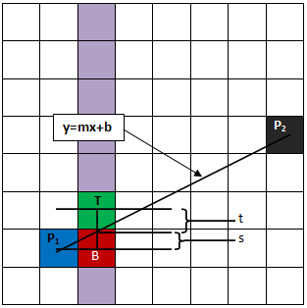
CSE 403: Computer Graphics
Graphics Application
Output Primitives:
2. Line
Scan converting a line using: 3. Bresenham’s Line Algorithm
Measure slope m by
If m 1 then exchange coordinates so that m < 1.
Set x_{i}=x₁ and y_{i}=y₁, draw a pixel at (x_{i}, y_{i}) location, here i=1
Increase x_{i} by 1, that is x_{i}=x_{i}+1. Indicated column shown in Fig
Here, y_{T} = y_{i}+1, y_{B} = y_{i}.
t=y_{i}+1– y, and s=y-y_{i}
s-t=2y-2y_{i}-1
True line by equation y=mx+b between the points P₁ and P₂.
Prof. Dr. A. H. M. Kamal, CSE, JKKNIU

Slide 30
CSE 403: Computer Graphics
Graphics Application
Output Primitives:
2. Line
Scan converting a line using: 3. Bresenham’s Line Algorithm
Measure slope m by
If m 1 then exchange coordinates so that m < 1.
Set x_{i}=x₁ and y_{i}=y₁, draw a pixel at (x_{i}, y_{i}) location, here i=1
Increase x_{i} by 1, that is x_{i}=x_{i}+1. Indicated column shown in Fig
Here, y_{T} = y_{i}+1, y_{B} = y_{i}.
t=y_{i}+1– y, and s=y-y_{i}
s-t=2y-2y_{i}-1=2m(x_{i}+1)+2b-2y_{i}-1
We know that m=Δy/Δx.
True line by equation y=mx+b between the points P₁ and P₂.
Prof. Dr. A. H. M. Kamal, CSE, JKKNIU

Slide 31
CSE 403: Computer Graphics
Graphics Application
Output Primitives:
2. Line
Scan converting a line using: 3. Bresenham’s Line Algorithm
Measure slope m by
If m 1 then exchange coordinates so that m < 1.
Set x_{i}=x₁ and y_{i}=y₁, draw a pixel at (x_{i}, y_{i}) location, here i=1
Increase x_{i} by 1, that is x_{i}=x_{i}+1. Indicated column shown in Fig
Here, y_{T} = y_{i}+1, y_{B} = y_{i}.
t=y_{i}+1– y, and s=y-y_{i}
s-t=2y-2y_{i}-1=2m(x_{i}+1)+2b-2y_{i}-1=2Δy/Δx(x_{i}+1)+2b-2y_{i}-1
True line by equation y=mx+b between the points P₁ and P₂.
Prof. Dr. A. H. M. Kamal, CSE, JKKNIU

Slide 32
CSE 403: Computer Graphics
Graphics Application
Output Primitives:
2. Line
Scan converting a line using: 3. Bresenham’s Line Algorithm
Measure slope m by
If m 1 then exchange coordinates so that m < 1.
Set x_{i}=x₁ and y_{i}=y₁, draw a pixel at (x_{i}, y_{i}) location, here i=1
Increase x_{i} by 1, that is x_{i}=x_{i}+1. Indicated column shown in Fig
Here, y_{T} = y_{i}+1, y_{B} = y_{i}.
t=y_{i}+1– y, and s=y-y_{i}
s-t=2y-2y_{i}-1=2m(x_{i}+1)+2b-2y_{i}-1=2Δy/Δx(x_{i}+1)+2b-2y_{i}-1
Δx(s-t) = 2Δy*(x_{i}+1)+2Δx*b-2Δx*y_{i}-Δx*1
True line by equation y=mx+b between the points P₁ and P₂.
Prof. Dr. A. H. M. Kamal, CSE, JKKNIU

Slide 33
CSE 403: Computer Graphics
Graphics Application
Output Primitives:
2. Line
Scan converting a line using: 3. Bresenham’s Line Algorithm
Measure slope m by
If m 1 then exchange coordinates so that m < 1.
Set x_{i}=x₁ and y_{i}=y₁, draw a pixel at (x_{i}, y_{i}) location, here i=1
Increase x_{i} by 1, that is x_{i}=x_{i}+1. Indicated column shown in Fig
Here, y_{T} = y_{i}+1, y_{B} = y_{i}.
t=y_{i}+1– y, and s=y-y_{i}
s-t=2y-2y_{i}-1=2m(x_{i}+1)+2b-2y_{i}-1=2Δy/Δx(x_{i}+1)+2b-2y_{i}-1
Δx(s-t) = 2Δy*(x_{i}+1)+2Δx*b-2Δx*y_{i}-Δx =2Δy*x_{i}+2Δy*1+2Δx*b-2Δx*y_{i}-Δx
True line by equation y=mx+b between the points P₁ and P₂.
Prof. Dr. A. H. M. Kamal, CSE, JKKNIU

Slide 34
CSE 403: Computer Graphics
Graphics Application
Output Primitives:
2. Line
Scan converting a line using: 3. Bresenham’s Line Algorithm
Measure slope m by
If m 1 then exchange coordinates so that m < 1.
Set x_{i}=x₁ and y_{i}=y₁, draw a pixel at (x_{i}, y_{i}) location, here i=1
Increase x_{i} by 1, that is x_{i}=x_{i}+1. Indicated column shown in Fig
Here, y_{T} = y_{i}+1, y_{B} = y_{i}.
t=y_{i}+1– y, and s=y-y_{i}
s-t=2y-2y_{i}-1=2m(x_{i}+1)+2b-2y_{i}-1=2Δy/Δx(x_{i}+1)+2b-2y_{i}-1
Δx(s-t) = 2Δy*x_{i}+2Δy*1+2Δx*b-2Δx*y_{i}-Δx =2Δy*x_{i}- 2Δx*y_{i} + 2Δy+ Δx(2b-1)
True line by equation y=mx+b between the points P₁ and P₂.
Prof. Dr. A. H. M. Kamal, CSE, JKKNIU

Slide 35
CSE 403: Computer Graphics
Graphics Application
Output Primitives:
2. Line
Scan converting a line using: 3. Bresenham’s Line Algorithm
Measure slope m by
If m 1 then exchange coordinates so that m < 1.
Set x_{i}=x₁ and y_{i}=y₁, draw a pixel at (x_{i}, y_{i}) location, here i=1
Increase x_{i} by 1, that is x_{i}=x_{i}+1. Indicated column shown in Fig
Here, y_{T} = y_{i}+1, y_{B} = y_{i}.
t=y_{i}+1– y, and s=y-y_{i}
s-t=2y-2y_{i}-1=2m(x_{i}+1)+2b-2y_{i}-1=2Δy/Δx(x_{i}+1)+2b-2y_{i}-1
Δx(s-t) = 2Δy*x_{i}- 2Δx*y_{i} + 2Δy+ Δx(2b-1)
Let C= 2Δy+ Δx(2b-1)
True line by equation y=mx+b between the points P₁ and P₂.
Prof. Dr. A. H. M. Kamal, CSE, JKKNIU

Slide 36
CSE 403: Computer Graphics
Graphics Application
Output Primitives:
2. Line
Scan converting a line using: 3. Bresenham’s Line Algorithm
Measure slope m by
If m 1 then exchange coordinates so that m < 1.
Set x_{i}=x₁ and y_{i}=y₁, draw a pixel at (x_{i}, y_{i}) location, here i=1
Increase x_{i} by 1, that is x_{i}=x_{i}+1. Indicated column shown in Fig
Here, y_{T} = y_{i}+1, y_{B} = y_{i}.
t=y_{i}+1– y, and s=y-y_{i}
s-t=2y-2y_{i}-1=2m(x_{i}+1)+2b-2y_{i}-1=2Δy/Δx(x_{i}+1)+2b-2y_{i}-1
Δx(s-t) = 2Δy*x_{i}- 2Δx*y_{i} + 2Δy+ Δx(2b-1)
Let C= 2Δy+ Δx(2b-1), all are constant.
Δx(s-t) = 2Δy*x_{i}- 2Δx*y_{i} +C
True line by equation y=mx+b between the points P₁ and P₂.
Prof. Dr. A. H. M. Kamal, CSE, JKKNIU

Slide 37
CSE 403: Computer Graphics
Graphics Application
Output Primitives:
2. Line
Scan converting a line using: 3. Bresenham’s Line Algorithm
Measure slope m by
If m 1 then exchange coordinates so that m < 1.
Set x_{i}=x₁ and y_{i}=y₁, draw a pixel at (x_{i}, y_{i}) location, here i=1
Increase x_{i} by 1, that is x_{i}=x_{i}+1. Indicated column shown in Fig
Here, y_{T} = y_{i}+1, y_{B} = y_{i}.
t=y_{i}+1– y, and s=y-y_{i}
s-t=2y-2y_{i}-1=2m(x_{i}+1)+2b-2y_{i}-1=2Δy/Δx(x_{i}+1)+2b-2y_{i}-1
Δx(s-t) = 2Δy*x_{i}- 2Δx*y_{i} + 2Δy+ Δx(2b-1)
Let C= 2Δy+ Δx(2b-1) , all are constant.
Δx(s-t) = 2Δy*x_{i}- 2Δx*y_{i} +C
Again, let d_{i} = Δx(s-t), used d_{i} instead of d because s and t varies from pixel to pixel.
True line by equation y=mx+b between the points P₁ and P₂.
Prof. Dr. A. H. M. Kamal, CSE, JKKNIU

Slide 38
CSE 403: Computer Graphics
Graphics Application
Output Primitives:
2. Line
Scan converting a line using: 3. Bresenham’s Line Algorithm
Measure slope m by
If m 1 then exchange coordinates so that m < 1.
Set x_{i}=x₁ and y_{i}=y₁, draw a pixel at (x_{i}, y_{i}) location, here i=1
Increase x_{i} by 1, that is x_{i}=x_{i}+1. Indicated column shown in Fig
Here, y_{T} = y_{i}+1, y_{B} = y_{i}.
t=y_{i}+1– y, and s=y-y_{i}
s-t=2y-2y_{i}-1=2m(x_{i}+1)+2b-2y_{i}-1=2Δy/Δx(x_{i}+1)+2b-2y_{i}-1
Δx(s-t) = 2Δy*x_{i}- 2Δx*y_{i} + 2Δy+ Δx(2b-1)
Let C= 2Δy+ Δx(2b-1) , all are constant.
Δx(s-t) = 2Δy*x_{i}- 2Δx*y_{i} +C
Again, let d_{i} = Δx(s-t), used d_{i} instead of d because s and t varies from pixel to pixel.
d_{i} = 2Δy*x_{i}- 2Δx*y_{i} +C
True line by equation y=mx+b between the points P₁ and P₂.
Prof. Dr. A. H. M. Kamal, CSE, JKKNIU

Slide 39
CSE 403: Computer Graphics
Graphics Application
Output Primitives:
2. Line
Scan converting a line using: 3. Bresenham’s Line Algorithm
Measure slope m by
If m 1 then exchange coordinates so that m < 1.
Set x_{i}=x₁ and y_{i}=y₁, draw a pixel at (x_{i}, y_{i}) location, here i=1
Increase x_{i} by 1, that is x_{i}=x_{i}+1. Indicated column shown in Fig
d_{i} = 2Δy*x_{i}- 2Δx*y_{i} +C
This is decision parameter.
True line by equation y=mx+b between the points P₁ and P₂.
Prof. Dr. A. H. M. Kamal, CSE, JKKNIU

Slide 40
CSE 403: Computer Graphics
Graphics Application
Output Primitives:
2. Line
Scan converting a line using: 3. Bresenham’s Line Algorithm
Measure slope m by
If m 1 then exchange coordinates so that m < 1.
Set x_{i}=x₁ and y_{i}=y₁, draw a pixel at (x_{i}, y_{i}) location, here i=1
Increase x_{i} by 1, that is x_{i}=x_{i}+1. Indicated column shown in Fig
d_{i} = 2Δy*x_{i}- 2Δx*y_{i} +C
At next step, d_{i+1} = 2Δy*x_{i+1}- 2Δx*y_{i+1} +C
True line by equation y=mx+b between the points P₁ and P₂.
Prof. Dr. A. H. M. Kamal, CSE, JKKNIU

Slide 41
CSE 403: Computer Graphics
Graphics Application
Output Primitives:
2. Line
Scan converting a line using: 3. Bresenham’s Line Algorithm
Measure slope m by
If m 1 then exchange coordinates so that m < 1.
Set x_{i}=x₁ and y_{i}=y₁, draw a pixel at (x_{i}, y_{i}) location, here i=1
Increase x_{i} by 1, that is x_{i}=x_{i}+1. Indicated column shown in Fig
d_{i} = 2Δy*x_{i}- 2Δx*y_{i} +C
At next step, d_{i+1} = 2Δy*x_{i+1}- 2Δx*y_{i+1} +C
Computing d_{i+1} - d_{i} =2Δy(x_{i+1}-x_{i})-2Δx(y_{i+1}-y_{i})
True line by equation y=mx+b between the points P₁ and P₂.
Prof. Dr. A. H. M. Kamal, CSE, JKKNIU

Slide 42
CSE 403: Computer Graphics
Graphics Application
Output Primitives:
2. Line
Scan converting a line using: 3. Bresenham’s Line Algorithm
Measure slope m by
If m 1 then exchange coordinates so that m < 1.
Set x_{i}=x₁ and y_{i}=y₁, draw a pixel at (x_{i}, y_{i}) location, here i=1
Increase x_{i} by 1, that is x_{i}=x_{i}+1. Indicated column shown in Fig
d_{i} = 2Δy*x_{i}- 2Δx*y_{i} +C
At next step, d_{i+1} = 2Δy*x_{i+1}- 2Δx*y_{i+1} +C
Computing d_{i+1} - d_{i} =2Δy(x_{i+1}-x_{i})-2Δx(y_{i+1}-y_{i})
We know that x_{i+1}=x_{i}+1
True line by equation y=mx+b between the points P₁ and P₂.
Prof. Dr. A. H. M. Kamal, CSE, JKKNIU

Slide 43
CSE 403: Computer Graphics
Graphics Application
Output Primitives:
2. Line
Scan converting a line using: 3. Bresenham’s Line Algorithm
Measure slope m by
If m 1 then exchange coordinates so that m < 1.
Set x_{i}=x₁ and y_{i}=y₁, draw a pixel at (x_{i}, y_{i}) location, here i=1
Increase x_{i} by 1, that is x_{i}=x_{i}+1. Indicated column shown in Fig
d_{i} = 2Δy*x_{i}- 2Δx*y_{i} +C
At next step, d_{i+1} = 2Δy*x_{i+1}- 2Δx*y_{i+1} +C
Computing d_{i+1} - d_{i} =2Δy(x_{i+1}-x_{i})-2Δx(y_{i+1}-y_{i})
We know that x_{i+1}=x_{i}+1
d_{i+1} = d_{i} +2Δy-2Δx(y_{i+1}-y_{i})
True line by equation y=mx+b between the points P₁ and P₂.
Prof. Dr. A. H. M. Kamal, CSE, JKKNIU

Slide 44
CSE 403: Computer Graphics
Graphics Application
Output Primitives:
2. Line
Scan converting a line using: 3. Bresenham’s Line Algorithm
Measure slope m by
If m 1 then exchange coordinates so that m < 1.
Set x_{i}=x₁ and y_{i}=y₁, draw a pixel at (x_{i}, y_{i}) location, here i=1
Increase x_{i} by 1, that is x_{i}=x_{i}+1. Indicated column shown in Fig
d_{i} = 2Δy*x_{i}- 2Δx*y_{i} +C
At next step, d_{i+1} = 2Δy*x_{i+1}- 2Δx*y_{i+1} +C
Computing d_{i+1} - d_{i} =2Δy(x_{i+1}-x_{i})-2Δx(y_{i+1}-y_{i})
We know that x_{i+1}=x_{i}+1
d_{i+1} = d_{i} +2Δy-2Δx(y_{i+1}-y_{i})
If d_{i}≥0, then pixel T is drawn and y_{i+1}=y_{i}+1
Then, d_{i+1} = d_{i} +2(Δy-Δx)
True line by equation y=mx+b between the points P₁ and P₂.
Prof. Dr. A. H. M. Kamal, CSE, JKKNIU

Slide 45
CSE 403: Computer Graphics
Graphics Application
Output Primitives:
2. Line
Scan converting a line using: 3. Bresenham’s Line Algorithm
Measure slope m by
If m 1 then exchange coordinates so that m < 1.
Set x_{i}=x₁ and y_{i}=y₁, draw a pixel at (x_{i}, y_{i}) location, here i=1
Increase x_{i} by 1, that is x_{i}=x_{i}+1. Indicated column shown in Fig
d_{i} = 2Δy*x_{i}- 2Δx*y_{i} +C
At next step, d_{i+1} = 2Δy*x_{i+1}- 2Δx*y_{i+1} +C
Computing d_{i+1} - d_{i} =2Δy(x_{i+1}-x_{i})-2Δx(y_{i+1}-y_{i})
We know that x_{i+1}=x_{i}+1
d_{i+1} = d_{i} +2Δy-2Δx(y_{i+1}-y_{i})
If d_{i}≥0, then pixel T is drawn and y_{i+1}=y_{i}+1
Then, d_{i+1} = d_{i} +2(Δy-Δx)
Else pixel B is drawn and y_{i}=y_{i}
Then, d_{i+1} = d_{i} +2Δy
True line by equation y=mx+b between the points P₁ and P₂.
Prof. Dr. A. H. M. Kamal, CSE, JKKNIU

Slide 46
CSE 403: Computer Graphics
Graphics Application
Output Primitives:
2. Line
Scan converting a line using: 3. Bresenham’s Line Algorithm
We earlier, computed that
s-t=2m(x_{i}+1)+2b-2y_{i}-1
True line by equation y=mx+b between the points P₁ and P₂.
Prof. Dr. A. H. M. Kamal, CSE, JKKNIU

Slide 47
CSE 403: Computer Graphics
Graphics Application
Output Primitives:
2. Line
Scan converting a line using: 3. Bresenham’s Line Algorithm
We earlier, computed that
s-t=2m(x_{i}+1)+2b-2y_{i}-1
Δx(s-t)=Δx(2m(x_{i}+1)+2b-2y_{i}-1)
True line by equation y=mx+b between the points P₁ and P₂.
Prof. Dr. A. H. M. Kamal, CSE, JKKNIU

Slide 48
CSE 403: Computer Graphics
Graphics Application
Output Primitives:
2. Line
Scan converting a line using: 3. Bresenham’s Line Algorithm
We earlier, computed that
s-t=2m(x_{i}+1)+2b-2y_{i}-1
d_{i}=Δx(2m(x_{i}+1)+2b-2y_{i}-1)
True line by equation y=mx+b between the points P₁ and P₂.
Prof. Dr. A. H. M. Kamal, CSE, JKKNIU

Slide 49
CSE 403: Computer Graphics
Graphics Application
Output Primitives:
2. Line
Scan converting a line using: 3. Bresenham’s Line Algorithm
We earlier, computed that
s-t=2m(x_{i}+1)+2b-2y_{i}-1
d_{i}=Δx(2m(x_{i}+1)+2b-2y_{i}-1)
The base value d₁ will be computed from
d₁=Δx(2m(x₁+1)+2b-2y₁-1)
=Δx[2(mx₁+b-y₁)+2m-1]
Since, mx₁+b-y₁=0, d₁=2Δy-Δx
True line by equation y=mx+b between the points P₁ and P₂.
Prof. Dr. A. H. M. Kamal, CSE, JKKNIU

Slide 50
CSE 403: Computer Graphics
Graphics Application
Output Primitives:
2. Line
Scan converting a line using: 3. Bresenham’s Line Algorithm
We earlier, computed that
s-t=2m(x_{i}+1)+2b-2y_{i}-1
d_{i}=Δx(2m(x_{i}+1)+2b-2y_{i}-1)
The base value d₁ will be computed from
d₁=Δx(2m(x₁+1)+2b-2y₁-1)
=Δx[2(mx₁+b-y₁)+2m-1]
d₁=2Δy-Δx
Next decision value d_{i+1} will be computed by
True line by equation y=mx+b between the points P₁ and P₂.
Prof. Dr. A. H. M. Kamal, CSE, JKKNIU

Slide 51
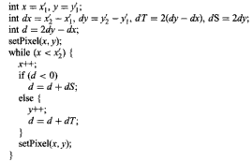
CSE 403: Computer Graphics
Graphics Application
Output Primitives:
2. Line
Scan converting a line using: 3. Bresenham’s Line Algorithm
True line by equation y=mx+b between the points P₁ and P₂.
Prof. Dr. A. H. M. Kamal, CSE, JKKNIU

Slide 52
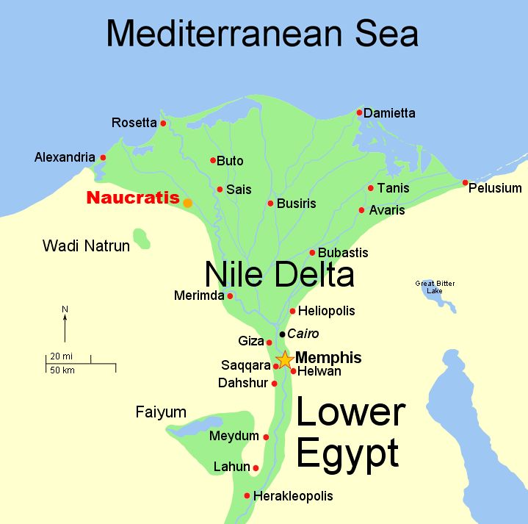
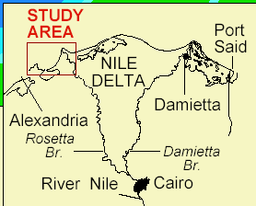
CSE 403: Computer Graphics
Graphics Application
Delta Symbol:
Delta (uppercase Δ, lowercase δ or 𝛿) is the fourth letter of the Greek alphabet.
A river delta (originally, the Nile River delta) is so named because its shape approximates the triangular uppercase letter delta.
Prof. Dr. A. H. M. Kamal, CSE, JKKNIU

Slide 53
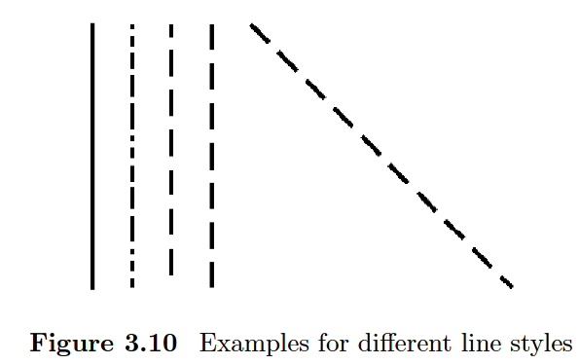
CSE 403: Computer Graphics
Graphics Application
Output Primitives:
2. Line
Prof. Dr. A. H. M. Kamal, CSE, JKKNIU

Slide 54
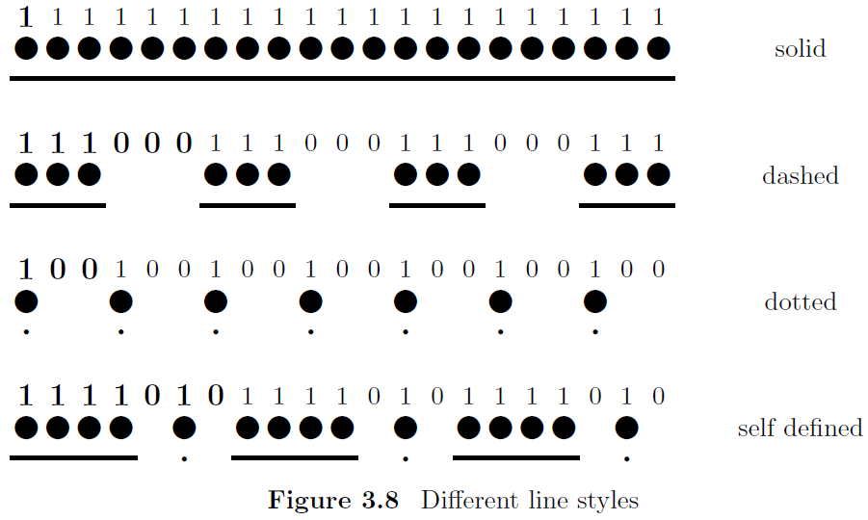
CSE 403: Computer Graphics
Graphics Application
Output Primitives:
2. Line
Prof. Dr. A. H. M. Kamal, CSE, JKKNIU

Slide 55
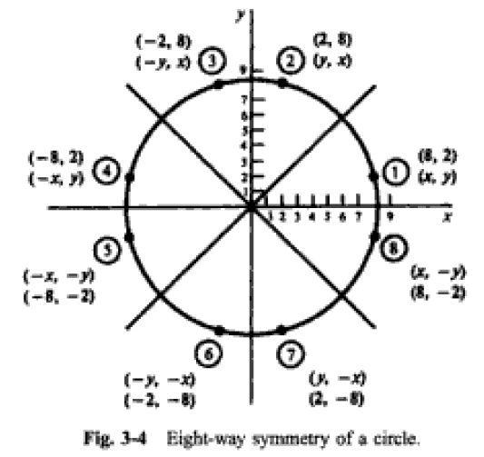
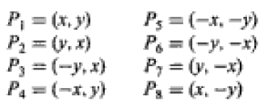
CSE 403: Computer Graphics
Graphics Application
Output Primitives:
3. Circle
Scan Conversion of a Circle
If we know a point P₁ (x, y) in a circle, we know more 7 symmetric points. These are P₂, P₃, P₄, P₅, P₆, P₇, P₈:
45⁰
Therefore, only 45⁰ scan converted points and their symmetrical points will complete a circle drawing.
Prof. Dr. A. H. M. Kamal, CSE, JKKNIU

Slide 56
CSE 403: Computer Graphics
Graphics Application
Output Primitives:
3. Circle
Scan Conversion of a Circle
Defining a circle:
First Method using Equation
Where, x: the x coordinate
y: the y coordinate
r: the radius of the circle
B
y
r
O
x
Hence, a point (x, y) means
Prof. Dr. A. H. M. Kamal, CSE, JKKNIU

Slide 57
CSE 403: Computer Graphics
Graphics Application
Output Primitives:
3. Circle
Scan Conversion of a Circle
Defining a circle:
First Method using Equation
Where, x: the x coordinate
y: the y coordinate
r: the radius of the circle
B
y
r
O
x
Hence, a point (x, y) means
If we set a value for x, we could be able to compute y.
Prof. Dr. A. H. M. Kamal, CSE, JKKNIU

Slide 58
CSE 403: Computer Graphics
Graphics Application
Output Primitives:
3. Circle
Scan Conversion of a Circle
Defining a circle:
First Method using Equation
Compute all coordinates for only the curve BC and find the symmetries.
Where, x: the x coordinate
y: the y coordinate
r: the radius of the circle
C
B
y
r
O
x
Hence, a point (x, y) means
If we set a value for x, we could be able to compute y.
Prof. Dr. A. H. M. Kamal, CSE, JKKNIU

Slide 59
CSE 403: Computer Graphics
Graphics Application
Output Primitives:
3. Circle
Scan Conversion of a Circle
Defining a circle:
First Method using Equation
Compute all coordinates for only the curve BC and find the symmetries.
Where, x: the x coordinate
y: the y coordinate
r: the radius of the circle
C
B
r
y
O
x
A
Hence, a point (x, y) means
If we set a value for x, we could be able to compute y.
Vary x from O to A. Each time compute y.
Draw the points (x, y) on the curve BC and its symmetries.
Prof. Dr. A. H. M. Kamal, CSE, JKKNIU

Slide 60
CSE 403: Computer Graphics
Graphics Application
Output Primitives:
3. Circle
Scan Conversion of a Circle
Defining a circle:
First Method using Equation
Compute all coordinates for only the curve BC and find the symmetries.
Where, x: the x coordinate
y: the y coordinate
r: the radius of the circle
C
B
r
y
O
x
A
Hence, a point (x, y) means
If we set a value for x, we could be able to compute y.
Step 1. Set x to 0, compute y, draw 8 points using symmetry
Step 2. Increase x by 1, compute y, draw 8 points using symmetry
Step 3. Repeat step 2 until x<=OA
What will be the value of OA?
Prof. Dr. A. H. M. Kamal, CSE, JKKNIU

Slide 61
CSE 403: Computer Graphics
Graphics Application
Output Primitives:
3. Circle
Scan Conversion of a Circle
Defining a circle:
First Method using Equation
It is a triangle.
Where, x: the x coordinate
y: the y coordinate
r: the radius of the circle
C
B
r
y
O
x
A
Hence, a point (x, y) means
If we set a value for x, we could be able to compute y.
Step 1. Set x to 0, compute y, draw 8 points using symmetry
Step 2. Increase x by 1, compute y, draw 8 points using symmetry
Step 3. Repeat step 2 until x<=OA
To calculate OA, consider the blue filled triangle
Prof. Dr. A. H. M. Kamal, CSE, JKKNIU

Slide 62
CSE 403: Computer Graphics
Graphics Application
Output Primitives:
3. Circle
Scan Conversion of a Circle
Zoomed Triangle
B
Defining a circle:
First method using equation
r
y
Where, x: the x coordinate
y: the y coordinate
r: the radius of the circle
C
B
O
x
A
r
y
O
x
A
Hence a point (x, y) means
Therefore, if we set a value for x, we could be able to compute y.
Step 1. Set x to 0, compute y, draw 8 points using symmetry
Step 2. Increase x by compute y, draw 8 points using symmetry
Step 3. Repeat step 2 until x>OA
To calculate OA, consider the blue filled triangle
Prof. Dr. A. H. M. Kamal, CSE, JKKNIU

Slide 63
CSE 403: Computer Graphics
Graphics Application
Output Primitives:
3. Circle
Scan Conversion of a Circle
Zoomed Triangle
B
Defining a circle:
First method using equation
r
y
Where, x: the x coordinate
y: the y coordinate
r: the radius of the circle
C
B
45⁰
O
x
A
r
y
O
x
A
Hence a point (x, y) means
Therefore, if we set a value for x, we could be able to compute y.
Step 1. Set x to 0, compute y, draw 8 points using symmetry
Step 2. Increase x by compute y, draw 8 points using symmetry
Step 3. Repeat step 2 until x>OA
To calculate OA, consider the blue filled triangle
Prof. Dr. A. H. M. Kamal, CSE, JKKNIU

Slide 64
CSE 403: Computer Graphics
Graphics Application
Output Primitives:
3. Circle
Scan Conversion of a Circle
B
Defining a circle:
First method using equation
r
y
Where, x: the x coordinate
y: the y coordinate
r: the radius of the circle
C
B
45⁰
O
x
A
r
y
O
x
A
Now,
Step 1. start from x=0, compute y, draw point (x, y) on the curve BC, draw more 7 symmetric points
Step 2. increase x by 1, compute y, draw point (x, y) on the curve BC, draw more 7 symmetric points
Step 3. repeat step 2 until x<r/√2
Hence a point (x, y) means
Therefore, if we set a value for x, we could be able to compute y.
Step 1. Set x to 0, compute y, draw 8 points using symmetry
Step 2. Increase x by compute y, draw 8 points using symmetry
Step 3. Repeat step 2 until x>OA
To calculate OA, consider the blue filled triangle
Prof. Dr. A. H. M. Kamal, CSE, JKKNIU

Slide 65
CSE 403: Computer Graphics
Graphics Application
Output Primitives:
3. Circle
Scan Conversion of a Circle
Defining a circle:
Second Method using Trigonometric Functions
Prof. Dr. A. H. M. Kamal, CSE, JKKNIU

Slide 66
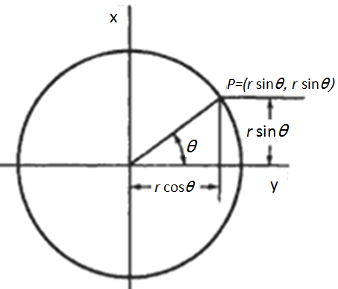
CSE 403: Computer Graphics
Graphics Application
Output Primitives:
3. Circle
Scan Conversion of a Circle
Defining a circle:
Second Method using Trigonometric Functions
From trigonometric function:
x=r cos θ y=r sin θ
θ: Current angle
r: Circle Radius
x: x-coordinate
y: y-coordinate
Prof. Dr. A. H. M. Kamal, CSE, JKKNIU

Slide 67
CSE 403: Computer Graphics
Graphics Application
Output Primitives:
3. Circle
Scan Conversion of a Circle
Defining a circle:
Second Method using Trigonometric Functions
From trigonometric function:
x=r cos θ, y=r sin θ
θ: Current angle
r: Circle Radius
x: x-coordinate
y: y-coordinate
Working Steps (Algorithm):
Step 1: set θ =0, compute x and y value, draw point
(x, y) and its 7 symmetric points.
Step 2: set θ = θ +Δ, where Δ is a positive value
Step 3: compute the value of x any
Step 4: draw point (x, y) and its 7 symmetric points.
Step 5: if θ <π/4, goto step 2.
Prof. Dr. A. H. M. Kamal, CSE, JKKNIU

Slide 68
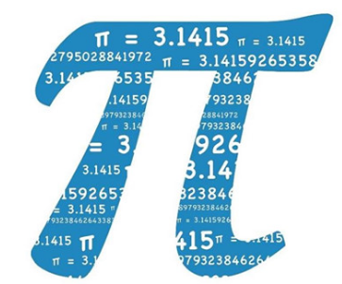
CSE 403: Computer Graphics
Graphics Application
পৃথিবীর যে সকল বিষয়ে যত বেশি রহস্য থাকে সেই সকল বিষয় নিয়ে মানুষের আগ্রহের পরিমাণ তত বেশি। তেমনি এক রহস্যে ঘেরা গাণিতিক চিহ্ন পাই(π)। আজ থেকে প্রায় ৪০০০ হাজার বছর পূর্বে মিসরীয়রা সর্বপ্রথম (π) নিয়ে কাজ শুরু করে এবং ধারনা করা হয় ঐ সময়েই তাঁরা পাই এর ব্যবহার জানতেন। সেই সময় থেকে শুরু করে বর্তমানের গণিত পিপাসুরা সমান আগ্রহে (π) নিয়ে গবেষণা করে যাচ্ছে। গণিতে পাই এর গুরুত্ব অপরিসীম। পাই এর মান ৩.১৪১৬ বলে প্রতি বছর মার্চের ১৪ তারিখ পাই দিবস উদযাপন করা হয়। পাই(π) দিবস কখনও কখনও ১৪ই মার্চ দুপুর ১টা ৫৯ মিনিটে উদযাপন করা হয়। ঐ দিন দুপুর ১টা ৫৯ মিনিটকে পাই মিনিট নামে আখ্যায়িত করা হয়।
Prof. Dr. A. H. M. Kamal, CSE, JKKNIU

Slide 69
CSE 403: Computer Graphics
Graphics Application
Output Primitives:
3. Circle
Scan Conversion of a Circle
Defining a circle:
Third Method using Bresenham’s Circle Algorithm
It is always desirable to perform calculation using only:
Integer Addition
Integer Subtraction
Multiplication by power of 2
Bresenham’s Algorithm allows these goals to me met.
Prof. Dr. A. H. M. Kamal, CSE, JKKNIU

Slide 70
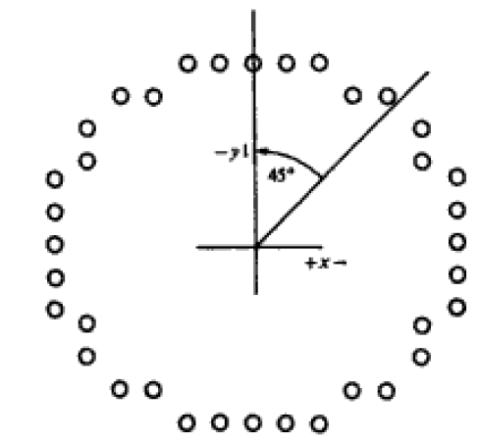
CSE 403: Computer Graphics
Graphics Application
Output Primitives:
3. Circle
Scan Conversion of a Circle
Defining a circle:
Third Method using Bresenham’s Circle Algorithm
Method:
Points are generated by scanning from 90⁰ to 45⁰ and eight symmetries are considered.
Moves will be made only in the +x and –y directions
Steps:
Prof. Dr. A. H. M. Kamal, CSE, JKKNIU

Slide 71
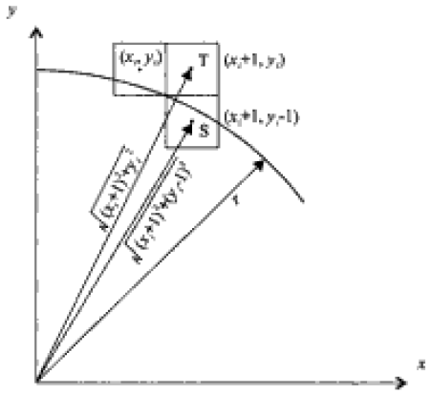
CSE 403: Computer Graphics
Graphics Application
Output Primitives:
3. Circle
Scan Conversion of a Circle
Defining a circle:
Third Method using Bresenham’s Circle Algorithm
Method:
Points are generated by scanning from 90⁰ to 45⁰ and eight symmetries are considered.
Moves will be made only in the +x and –y directions
Steps:
Let we are at a point (x_{i}, y_{i}).
Set x1=x_{i}+1, y1=y_{i};, Point T is (x₁, y₁)
Set x2=x_{i}+1, y2=y_{i}-1; Point S is at (x₂, y₂)
Prof. Dr. A. H. M. Kamal, CSE, JKKNIU

Slide 72
CSE 403: Computer Graphics
Graphics Application
Output Primitives:
3. Circle
Scan Conversion of a Circle
Defining a circle:
Third Method using Bresenham’s Circle Algorithm
Method:
Points are generated by scanning from 90⁰ to 45⁰ and eight symmetries are considered.
Moves will be made only in the +x and –y directions
Steps:
Let we are at a point (x_{i}, y_{i}).
Set x1=x_{i}+1, y1=y_{i};, Point T is (x₁, y₁)
Set x2=x_{i}+1, y2=y_{i}-1; Point S is at (x₂, y₂)
Distance of origin from T is r1
r1= (x1)² +(y1)²= (x_{i}+1)² +(y_{i})²
Distance of T from true circle is
D(T)=r1-r= (x_{i}+1)² +(y_{i})² –r
6. Distance of origin from S is r2
r2= (x2)² +(y2)²= (x_{i}+1)² +(y_{i}-1)²
Distance of T from true circle is
D(S)=r2-r= (x_{i}+1)² +(y_{i}-1)² –r
Prof. Dr. A. H. M. Kamal, CSE, JKKNIU

Slide 73
CSE 403: Computer Graphics
Graphics Application
Output Primitives:
3. Circle
Scan Conversion of a Circle
Defining a circle:
Third Method using Bresenham’s Circle Algorithm
Method:
Points are generated by scanning from 90⁰ to 45⁰ and eight symmetries are considered.
Moves will be made only in the +x and –y directions
Steps:
D(T)=r1-r= (x_{i}+1)² +(y_{i})² –r
D(S)=r2-r= (x_{i}+1)² +(y_{i}-1)² –r
A decision variable d_{i} may be defined as
d_{i} =D(T)+D(S)=2(x_{i} +1)² +y_{i}² +(y_{i} -1)² -2r²
If d_{i}<0, |D(T)|<|D(S)| and pixel T is chosen.
Else pixel S is chosen.
Prof. Dr. A. H. M. Kamal, CSE, JKKNIU

Slide 74
CSE 403: Computer Graphics
Graphics Application
Output Primitives:
3. Circle
Scan Conversion of a Circle
Defining a circle:
Third Method using Bresenham’s Circle Algorithm
Method:
Points are generated by scanning from 90⁰ to 45⁰ and eight symmetries are considered.
Moves will be made only in the +x and –y directions
Steps:
The decision variable d_{i} is
d_{i} =2(x_{i} +1)² +y_{i}² +(y_{i} -1)² -2r²
Prof. Dr. A. H. M. Kamal, CSE, JKKNIU

Slide 75
CSE 403: Computer Graphics
Graphics Application
Output Primitives:
3. Circle
Scan Conversion of a Circle
Defining a circle:
Third Method using Bresenham’s Circle Algorithm
Method:
Points are generated by scanning from 90⁰ to 45⁰ and eight symmetries are considered.
Moves will be made only in the +x and –y directions
Steps:
The decision variable d_{i} is
d_{i} =2(x_{i} +1)² +y_{i}² +(y_{i} -1)² -2r²
d_{i+1} =2(x_{i+1} +1)² +y_{i+1}² +(y_{i+1} -1)² -2r²
d_{i+1} - d_{i} = 2(x_{i+1} +1)² +y_{i+1}² +(y_{i+1} -1)² - 2(x_{i} +1)² -y_{i}² -(y_{i} -1)²
Since, x_{i+1} = x_{i} +1
d_{i+1} = d_{i} + 4x_{i} +2(y_{i+1}² –y_{i}²)-2(y_{i+1} –y_{i}) + 6
If T is chosen y_{i+1} =y_{i}
d_{i+1} = d_{i} + 4x_{i}+6
Again if S is chosen y_{i+1} =y_{i} - 1, then
d_{i+1} = d_{i} + 4(x_{i} – y_{i})+10
Prof. Dr. A. H. M. Kamal, CSE, JKKNIU

Slide 76

CSE 403: Computer Graphics
Graphics Application
Output Primitives:
3. Circle
Scan Conversion of a Circle
Defining a circle:
Third Method using Bresenham’s Circle Algorithm
Finally start the method from (0,r)
Compute the base value d₁ by
Prof. Dr. A. H. M. Kamal, CSE, JKKNIU

Slide 77
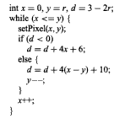
CSE 403: Computer Graphics
Graphics Application
Output Primitives:
3. Circle
Scan Conversion of a Circle
Defining a circle:
Third Method using Bresenham’s Circle Algorithm
The algorithm in C is
Prof. Dr. A. H. M. Kamal, CSE, JKKNIU

Slide 78
CSE 403: Computer Graphics
Graphics Application
Output Primitives:
3. Circle
Scan Conversion of a Circle
Defining a circle:
Fourth Method using Mid Point Algorithm
Let the drawing is a part of a circle
Prof. Dr. A. H. M. Kamal, CSE, JKKNIU

Slide 79

CSE 403: Computer Graphics
Graphics Application
Output Primitives:
3. Circle
Scan Conversion of a Circle
Defining a circle:
Fourth Method using Mid Point Algorithm
Let the drawing is a part of a circle
Small squares are two pixels.
Prof. Dr. A. H. M. Kamal, CSE, JKKNIU

Slide 80
CSE 403: Computer Graphics
Graphics Application
Output Primitives:
3. Circle
Scan Conversion of a Circle
Defining a circle:
Fourth Method using Mid Point Algorithm
Zoomed
Mid point x_{i} +1, y_{i} -0.5
Let the drawing is a part of a circle
Small squares are two pixels.
T
S
Prof. Dr. A. H. M. Kamal, CSE, JKKNIU

Slide 81
CSE 403: Computer Graphics
Graphics Application
Output Primitives:
3. Circle
Scan Conversion of a Circle
Defining a circle:
Fourth Method using Mid Point Algorithm
Zoomed
Mid point x_{i} +1, y_{i} -0.5
Let the drawing is a part of a circle
Small squares are two pixels.
T
S
Prof. Dr. A. H. M. Kamal, CSE, JKKNIU

Slide 82
CSE 403: Computer Graphics
Graphics Application
Output Primitives:
3. Circle
Scan Conversion of a Circle
Defining a circle:
Fourth Method using Mid Point Algorithm
Zoomed
Mid point x_{i} +1, y_{i} -0.5
If p is negative, the mid point is inside the circle.
Then chose pixel T
Otherwise select pixel S
Let the drawing is a part of a circle
Small squares are two pixels.
T
S
Prof. Dr. A. H. M. Kamal, CSE, JKKNIU

Slide 83
CSE 403: Computer Graphics
Graphics Application
Output Primitives:
3. Circle
Scan Conversion of a Circle
Defining a circle:
Fourth Method using Mid Point Algorithm
Zoomed
Mid point x_{i} +1, y_{i} -0.5
Next decision parameter is
As x_{i+1} =x_{i}+1
Let the drawing is a part of a circle
Small squares are two pixels.
T
S
Prof. Dr. A. H. M. Kamal, CSE, JKKNIU

Slide 84
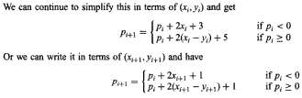
CSE 403: Computer Graphics
Graphics Application
Output Primitives:
3. Circle
Scan Conversion of a Circle
Defining a circle:
Fourth Method using Mid Point Algorithm
Let the drawing is a part of a circle
Small squares are two pixels.
Prof. Dr. A. H. M. Kamal, CSE, JKKNIU

Slide 85
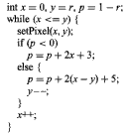
CSE 403: Computer Graphics
Graphics Application
Output Primitives:
3. Circle
Scan Conversion of a Circle
Defining a circle:
Fourth Method using Mid Point Algorithm
Prof. Dr. A. H. M. Kamal, CSE, JKKNIU

Slide 86
CSE 403: Computer Graphics
Graphics Application
Output Primitives:
3. Circle
Scan Conversion of a Circle
Defining a circle:
In all the above, the centre pixel is considered at (0,0)
To draw a circle at an arbitrary centre (a,b)
Draw points using putpixel (x+a, y+b, c)
Prof. Dr. A. H. M. Kamal, CSE, JKKNIU

Slide 87
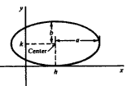

CSE 403: Computer Graphics
Graphics Application
Output Primitives:
4. Ellipse
Scan Conversion of a Ellipse
Defining a Ellipse:
Like circle, Ellipse shows symmetries and it is four symmetries.
Method 1: Polynomial method
Prof. Dr. A. H. M. Kamal, CSE, JKKNIU

Slide 88
CSE 403: Computer Graphics
Graphics Application
Output Primitives:
4. Ellipse
Scan Conversion of a Ellipse
Defining a Ellipse:
Like circle, Ellipse shows symmetries and it is four symmetries.
Method 1: Polynomial method
Steps:
Set x=h, y=k+b.
Draw four symmetric points
Set x=x+1
Compute
Draw four symmetric points.
If x<=(h+a) goto step 3.
Prof. Dr. A. H. M. Kamal, CSE, JKKNIU

Slide 89
CSE 403: Computer Graphics
Graphics Application
Output Primitives:
4. Ellipse
Scan Conversion of a Ellipse
Defining a Ellipse:
Like circle, Ellipse shows symmetries and it is four symmetries.
Method 1: Polynomial method
Steps:
Set x=h, y=k+b.
Draw four symmetric points
Set x=x+1
Compute
Draw four symmetric points.
If x<=(h+a) goto step 3.
The method is inefficient, because:
It performs square of and
The floating point multiplication of
by b.
Prof. Dr. A. H. M. Kamal, CSE, JKKNIU

Slide 90
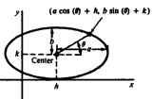
CSE 403: Computer Graphics
Graphics Application
Output Primitives:
4. Ellipse
Scan Conversion of a Ellipse
Defining a Ellipse:
Like circle, Ellipse shows symmetries and it is four symmetries.
Method 1: Trigonometric method
Steps:
Set x=h+a, y=k and θ=0.
Draw four symmetric points
Set a small value to Δθ
Set θ= θ+Δθ
Compute x and y
Draw four symmetric points.
If θ <=π/2 goto step 4.
Prof. Dr. A. H. M. Kamal, CSE, JKKNIU

Slide 91
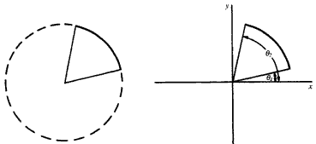
CSE 403: Computer Graphics
Graphics Application
Output Primitives:
5. Arc
Scan Conversion of an Arc
Defining an Arc:
Could be drawn by polynomial, trigonometry, Bresenham’s and midpoint algorithm.
Just compute (x_{i}, y_{i}) as of cicle
Draw only (x_{i}, y_{i}) but not their symmetries.
Prof. Dr. A. H. M. Kamal, CSE, JKKNIU

Slide 92
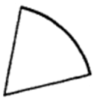

CSE 403: Computer Graphics
Graphics Application
Output Primitives:
6. Sector
Scan Conversion of a Sector
Defining an Sector:
A sector is scan-converted by using any of the method of scan-converting an arc AB and then scan converting two lines from the centre of the arc O to the two end points A and B of the arc.
A
B
O
Prof. Dr. A. H. M. Kamal, CSE, JKKNIU

Slide 93
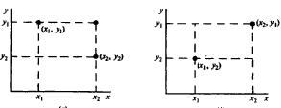
CSE 403: Computer Graphics
Graphics Application
Output Primitives:
7. Rectangle
Scan Conversion of a Rectangle
Defining an Rectangle:
Case 1:
Left top and right bottom points are given.
Two other points are computed.
Case 2:
Left bottom and right top points are given.
Two other points are computed.
In both cases draw lines:
Prof. Dr. A. H. M. Kamal, CSE, JKKNIU

Slide 94
CSE 403: Computer Graphics
Graphics Application
Scan Converting a Character
Letter
Digit
Appearance
Bold
Italic
Bold and Italic
Font Types:
Bitmap Font
Outline Font
Building block of textural contents of an image.
Prof. Dr. A. H. M. Kamal, CSE, JKKNIU

Slide 95
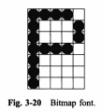
CSE 403: Computer Graphics
Graphics Application
Scan Converting a Character: Bitmap Font
Bitmap or Raster Font: Each character is represented by the on pixels in a bilevel pixel grid pattern called a bitmap
Prof. Dr. A. H. M. Kamal, CSE, JKKNIU

Slide 96
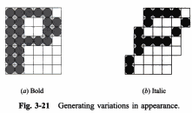
CSE 403: Computer Graphics
Graphics Application
Scan Converting a Character: Bitmap Font
Bold: We may overlay the bitmap in Fig. 3-20 onto itself with a horizontal offset of one pixel to produce bold, as in Fig. 3-21(a).
Italic: We may shift rows of pixels in Fig. 3-20 to produce italic, as in Fig. 3-21(b)
Prof. Dr. A. H. M. Kamal, CSE, JKKNIU

Slide 97
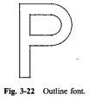
CSE 403: Computer Graphics
Graphics Application
Scan Converting a Character: Outline Font
Outline or Vector Font: Graphical primitives such as lines and arcs are used to define the outline of each character, see Fig. 3-22.
Prof. Dr. A. H. M. Kamal, CSE, JKKNIU

Slide 98
CSE 403: Computer Graphics
Graphics Application
Aliasing Effect:
Scan conversion is essentially a systematic approach to mapping objects that are defined in continuous space to their discrete approximation. The various forms of distortion that result from this operation are collectively referred to as the aliasing effects of scan conversion.
Staircase: We see the stair steps or jaggies along the border of a filled region.
Unequal brightness: May appear unequal brightness of lines of different orientations.
The Picket Fence Problem: occurs when an object is not aligned with or does not fit into the pixel grid properly.
Prof. Dr. A. H. M. Kamal, CSE, JKKNIU

Slide 99
CSE 403: Computer Graphics
Graphics Application
Anti-Aliasing Effect:
Aliasing can have a significant impact on our viewing experience in many cases. There are techniques that can greatly reduce aliasing artifacts and improve the appearance of images without increasing their resolution. These techniques are collectively referred to as anti-aliasing techniques.
Pre-filtering and post filtering:
Area Sampling
Super Sampling
Lowpass Filtering
Pixel Phasing
Prof. Dr. A. H. M. Kamal, CSE, JKKNIU

