Slide 1

CSE 447 : Digital Signal Processing
Dr. Md. Sujan Ali
Associate Professor
Dept. of Computer Science and Engineering
Jatiya Kabi Kazi Nazrul Islam University

Slide 2
Reference Books
Digital Signal Processing, fourth edition
- John G. Proakis
Digital Signal Processing, third edition
- P. Ramesh Babu

Slide 3
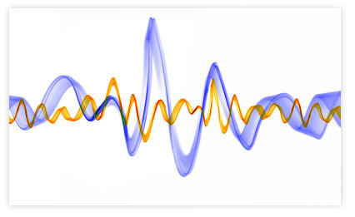
Introduction to signals

Slide 4

“প্রকৃত আনন্দ পেতে হলে দুঃখবরণ আবশ্যক”
-মহাভারত

Slide 5
Applications
Digital Signal Processing (DSP) is being used very widely in applications that include-
Audio signal processing/Speech recognition
Eco location
Pattern recognition
Biometrics
Brain Computer Interface (BCI)

Slide 6
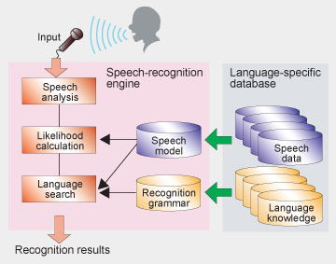
DSP Application: Audio Processing
Audio signal processing/Speech recognition
Speech recognition: DSP generally approaches the problem of voice recognition in two steps: feature extraction followed by feature matching.
Source: Canon

Slide 7
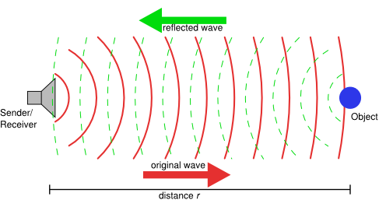
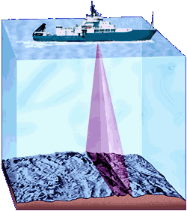
DSP Application: Echo Location
A common method of obtaining information about a remote object is to bounce a wave off of it.
Applications include radar and sonar.
DSP can be used for filtering and compressing the data.
Source: WHIO
Source: CCTT.org

Slide 8
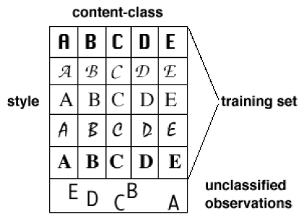
DSP Application: Pattern Recognition
Pattern recognition is a research area that is closely related to digital signal processing.
Definition: “the act of taking in raw data and taking an action based on the category of the data”.
Pattern recognition
classifies data based on
either a priori knowledge
or on statistical information
extracted from the patterns.
Source: merl.com

Slide 9
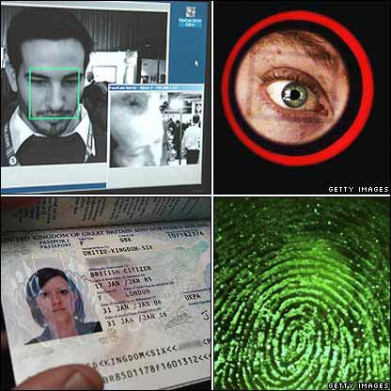
DSP Application: Biometrics
The “Biometrics” field focuses on methods for uniquely identifying humans using one or more of their intrinsic physical or behavioural traits.
Examples include using face, voice, fingerprints, iris, handwriting or the method of walking.
Source: BBC

Slide 10

DSP Application: Brain computer interface
A means for communication between a brain and a computer via measurements associated with brain activity.
No muscle motion is involved (e.g., eye movement).

Slide 11
Why signals should be processed?
Signals are carriers of information
  Useful and unwanted
  Extracting, enhancing, storing and transmitting the useful information
How signals are being processed?
  Analog Signal Processing vs.
  Digital Signal Processing

Slide 12
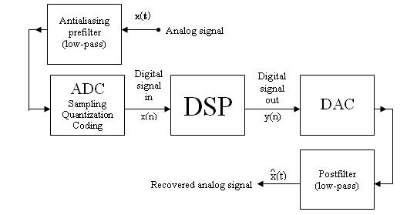
Digital Signal Processing (DSP) System

Slide 13
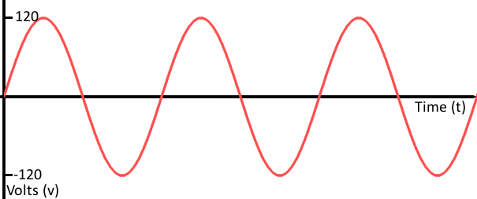
Signal Basics
Signals
A signal is a function that represents the variation of a physical quantity with respect to any parameter (independent quantity e.g., time, distance, space, temperature etc.) which conveys information.
Signal = f(t) = sin (ωt)
X axis used for independent quantity
Y axis used for dependent quantity

Slide 14
Signal Basics
Function
A function is a relation between a set of inputs and a set of outputs.
A function relates an input to an output.
It is like a machine that has an input and an output.
And the output is related somehow to the input.
f(x)=x² (we say f of x equals x squared)
Function without name:
y = x²
x= input, y=output, squaring is the relation

Slide 15
Examples of Signals
Signals are everywhere and may reflect countless measurements of some physical quantity such as:
  electric voltages
  brain signals
  heart rates
  temperatures
  image luminance
  investment prices
  vehicle speeds
  seismic activity
  human speech

Slide 16
Advantage of Digital Over Analog Signal Processing
Digital signals can convey information with greater noise immunity, because each information component (byte etc) is determined by the presence or absence of a data bit (0 or one). Analog signals vary continuously and their value is affected by all levels of noise.
Enables transmission of signals over a long distance.
Transmission is at a higher rate and with a wider broadband width.
It is more secure.
It is also easier to translate human audio and video signals and other messages into machine language.

Slide 17
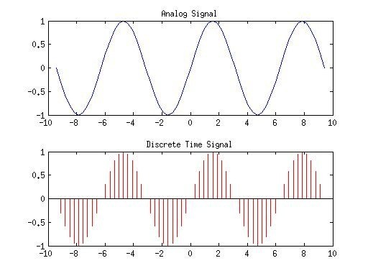
Signal Basics
Continuous-time signals
A signal x(t) is said to be a continuous-time signal if it is defined for all time t.
Discrete-time signals
Discrete-time signal is defined only at discrete instant of time. Thus, in this case, the independent variable has discrete values only.

Slide 18
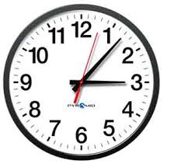
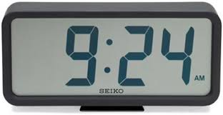
Signal Basics
What?!

Slide 19
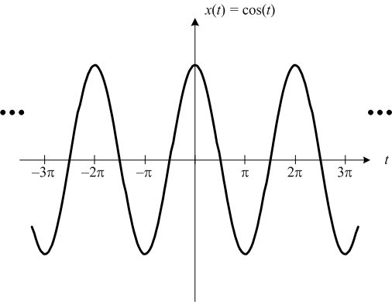
Continuous Time Signals
In continuous time signals the independent variable is continuous, and they are defined for a continuum of values
They take on values in the continuous interval (a, b), where a can be -∞ and b can be ∞
the symbol ‘t’ is used to denote the continuous time independent variable
Example

Slide 20
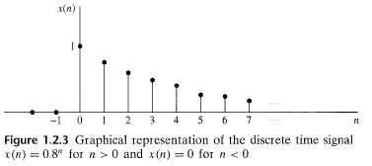

Discrete Time Signal
Discrete time signals are defined only at discrete times and for these signals the independent variable takes on only a discrete set of values
The symbol ‘n’ is used to denote the discrete time independent variable
Example

Slide 21
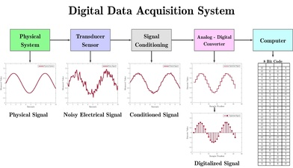
Signal Basics
Data Acquisition
Data acquisition (DAQ) is the process of measuring an electrical or physical phenomenon such as voltage, current, temperature, pressure, or sound with a computer.
A DAQ system consists of sensors, DAQ measurement hardware, and a computer with programmable software.

Slide 22
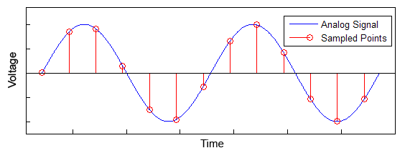
Signal Basics
Sampling
In signal processing, sampling is the reduction of a continuous-time signal to a discrete-time signal.
A sample is a value or set of values at a point in time and/or space.

Slide 23
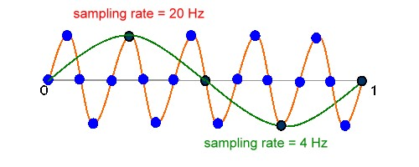
Signal Basics
Sampling Theory
The Sampling Theory states that a signal can be exactly reproduced if it is sampled at a frequency F, where F is greater than twice the maximum frequency in the signal
Nyquist Rate
In general, to preserve the full information in the signal, it is necessary to sample at twice the maximum frequency of the signal. This is known as the Nyquist rate.

Slide 24
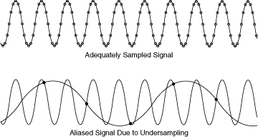
Signal Basics
Aliasing
When the signal is converted back into a continuous time signal, it will exhibit a phenomenon called aliasing.
Aliasing is the presence of unwanted components in the reconstructed signal.
These components were not present when the original signal was sampled.

Slide 25
Sampling of Analog Signals
X(n)= x_{a}(t) = x_{a}(nT)= x_{a}(n/F_{s}) , -∞ < n < ∞
Where, x_{a}(t) is the analog signal
x(n) is the discrete time signal

Slide 26
Sampling
Example 1.4.2
1. Consider the signal
x_{a}(t)=3 cos 100 π t
Determine the minimum sampling rate required to avoid aliasing.
Suppose that the signal is sampled at the rate F_{s}=200 Hz. What is the discrete-time signal obtained after sampling?
Suppose that the signal is sampled at the rate F_{s}=75 Hz. What is the discrete-time signal obtained after sampling?

Slide 27
Sampling
Example 1.4.3
Consider the signal
x_{a}(t)=3 cos 50 π t + 10 sin 300 π t – cos 100 π t
What is the Nyquist rate for this signal?

Slide 28
Sampling
Example 1.4.4
Consider the signal
x_{a}(t)=3 cos 2000 π t + 5 sin 6000 π t + 10 cos 12000 π t
(a) What is the Nyquist rate for this signal?
(b) Assume now that we sample this signal using a sampling rate F_{s}=5000 samples/s. What is the discrete-time signal obtained after sampling?
(c) What is the analog signal y_{a}(t) that we can reconstruct from the samples if we use ideal interpolation?

Slide 29
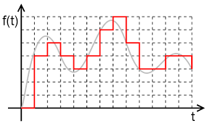
Signal Basics
Quantization
A sequence of samples like x[n] is not a digital signal because the sample values can take on a continuous range of values.
In order to complete analog to digital conversion, each sample value is mapped to a discrete level in a process called quantization.
Quantization is opposite to sampling. It is done on y axis.

Slide 30
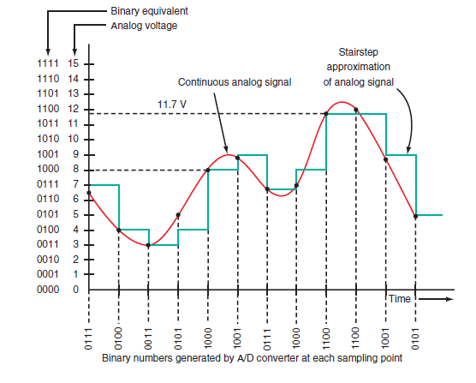
Signal Basics
Quantization
In a B-bit quantizer, each quantization level is represented with B bits, so that the number of levels equals 2^{B}

Slide 31
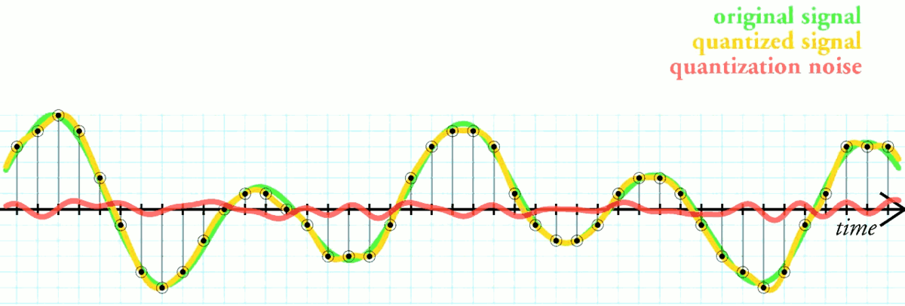
Signal Basics
Quantization Error
Quantization error is the difference between the analog signal and the closest available digital value at each sampling instant from the A/D converter.
When you quantize a signal, you introduce an error which can be defined as q[n]=x_{q}[n]−x[n] where q[n] is the quantization error, x[n] the original signal, and x_{q}[n] of the quantized signal.
The higher the resolution of the A/D converter, the lower the quantization error and the smaller the quantization noise.

Slide 32
Discrete-Time Signals:
Time-Domain Representation
Signals represented as sequences of numbers, called samples
Sample value of a typical signal or sequence denoted as x[n] with n being an integer in the range -∞≤ n ≤∞
x[n] defined only for integer values of n and undefined for noninteger values of n
Discrete-time signal represented by {x[n]}

Slide 33
Discrete-Time Signals:
Time-Domain Representation
Discrete-time signal may also be written as a sequence of numbers inside braces:
{x[n]}={…,-0.2,2.2,1.1,0.2,-3.7,2.9,…}
↑
In the above, x[-1]= -0.2, x[0]=2.2, x[1]=1.1, etc.
The arrow is placed under the sample at time index n = 0

Slide 34
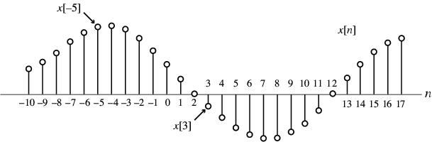
Discrete-Time Signals:
Time-Domain Representation
Graphical representation of a discrete-time signal with real-valued samples is as shown below:

Slide 35
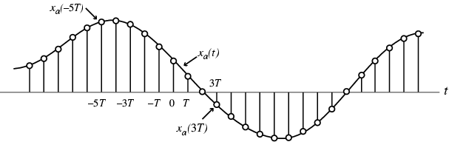
Discrete-Time Signals:
Time-Domain Representation
In some applications, a discrete-time sequence {x[n]} may be generated by periodically sampling a continuous-time signal x_{a}(t) at uniform intervals of time

Slide 36
Discrete-Time Signals:
Time-Domain Representation
Here, n-th sample is given by
x[n]=x_{a}(t) |_{t=nT}=x_{a}(nT), n=…,-2,-1,0,1,…
The spacing T between two consecutive samples is called the sampling interval or sampling period
Reciprocal of sampling interval T, denoted as F_{T} , is called the sampling frequency:

Slide 37
Discrete-Time Signals:
Time-Domain Representation
Unit of sampling frequency is cycles per second, or hertz (Hz) , if T is in seconds
Whether or not the sequence {x[n]} has been obtained by sampling, the quantity x[n] is called the n-th sample of the sequence
{x[n]} is a real sequence, if the n-th sample x[n] is real for all values of n
Otherwise, {x[n]} is a complex sequence

Slide 38
Discrete-Time Signals:
Time-Domain Representation
A complex sequence {x[n]} can be written as {x[n]}={x_{re}[n]}+j{x_{im}[n]} where x_{re} and x_{im} are the real and imaginary parts of x[n]
The complex conjugate sequence of {x[n]} is given by {x*[n]}={x_{re}[n]}-j{x_{im}[n]}
Often the braces are ignored to denote a sequence if there is no ambiguity

Slide 39
Discrete-Time Signals:
Time-Domain Representation
Example - {x[n]}={cos0.25n} is a real sequence {y[n]}={e^{j0.3n}} is a complex sequence
We can write
{y[n]}={cos0.3n + jsin0.3n}
={cos0.3n} + j{sin0.3n}
where {y_{re}[n]}={cos0.3n}
{y_{im}[n]}={sin0.3n}

Slide 40
Discrete-Time Signals:
Time-Domain Representation
Example –
{w[n]}={cos0.3n}- j{sin0.3n}={e^{-j0.3n}} is the complex conjugate sequence of {y[n]}.That is,
{w[n]}= {y*[n]}

Slide 41
Discrete-Time Signals:
Time-Domain Representation
Two types of discrete-time signals:
- Sampled-data signals in which samples are continuous-valued
- Digital signals in which samples are discrete-valued
Signals in a practical digital signal processing system are digital signals obtained by quantizing the sample values either by rounding or truncation

Slide 42
Discrete-Time Signals:
Time-Domain Representation
Example –
Amplitude
Amplitude
Time,t
Time,t
Boxedcar signal
Digital signal

Slide 43
Discrete-Time Signals:
Time-Domain Representation
A discrete-time signal may be a finite-length or an infinite-length sequence
Finite-length (also called finite-duration or finite-extent) sequence is defined only for a finite time interval: N₁≤ n ≤N₂
where - ∞< N₁ and N₂ < ∞ with N₁≤ N₂
Length or duration of the above finite-length sequence is N= N₂ - N₁+ 1

Slide 44
Discrete-Time Signals:
Time-Domain Representation
Example – x[n]=n², -3 ≤n ≤ 4 is a finite-length sequence of length 4 -(-3)+1=8
y[n]=cos0.4n is an infinite-length sequence

Slide 45
Discrete-Time Signals:
Time-Domain Representation
A length- N sequence is often referred to as an N-point sequence
The length of a finite-length sequence can be increased by zero-padding, i.e., by appending it with zeros

Slide 46
Discrete-Time Signals:
Time-Domain Representation
Example –
is a finite-length sequence of length 12 obtained by zero-padding x[n] =n², -3≤n≤4 with 4 zero-valued samples

Slide 47
Discrete-Time Signals:
Time-Domain Representation
A right-sided sequence x[n] has zero-valued samples for n < N₁
A right-sided sequence
If N₁≥ 0, a right-sided sequence is called a causal sequence

Slide 48

Discrete-Time Signals:
Time-Domain Representation
A left-sided sequence x[n] has zero-valued samples for n ＞ N₂
N ₂
n
A left-sided sequence
If N₂≤0, a left-sided sequence is called a anti-causal sequence

Slide 49
Operations on Sequences
A single-input, single-output discrete-time system operates on a sequence, called the input sequence, according some prescribed rules and develops another sequence, called the output sequence, with more desirable properties
x[n]
Discrete-time
y[n]
system
Input sequence
Output sequence

Slide 50
Operations on Sequences
For example, the input may be a signal corrupted with additive noise
Discrete-time system is designed to generate an output by removing the noise component from the input
In most cases, the operation defining a particular discrete-time system is composed of some basic operations

Slide 51
Basic Operations
Product (modulation) operation:
x[n]
y[n]
-Modulator
y[n]=x[n].w[n]
w[n]
An application is in forming a finite-length sequence from an infinite-length sequence by multiplying the latter with a finite-length sequence called an window sequence
Process called windowing

Slide 52
Basic Operations
Addition operation:
x[n]
+
y[n]
  Adder
y[n]=x[n]+w[n]
w[n]
Multiplication operation
A
x[n]
y[n]
y[n]=A.x[n]
  Multiplier

Slide 53
Basic Operations
Time-shifting operation: y[n]=x[n-N] where N is an integer
If N>0, it is delaying operation
  Unit delay
x[n]
y[n]
y[n]=x[n-1]
If N<0, it is an advance operation
x[n]
y[n]
y[n]=x[n-1]
  Unit advance

Slide 54
Basic Operations
Time-reversal (folding) operation:
y[n]=x[n-1]
Branching operation: Used to provide multiple copies of a sequence
x[n]
x[n]
x[n]

Slide 55
Basic Operations
Example - Consider the two following sequences of length 5 defined for 0≤n≤4 :
{a[n]}={3 4 6 –9 0}
{b[n]}={2 –1 4 5 –3}
New sequences generated from the above two sequences by applying the basic operations are as follows:

Slide 56
Basic Operations
{c[n]}={a[n].b[n]}={6 –4 24 –45 0}
{d[n]}={a[n]+b[n]}={5 3 10 –4 -3}
{e[n]}=(3/2){a[n]}={4.5 6 9 –13.5 0}
As pointed out by the above example, operations on two or more sequences can be carried out if all sequences involved are of same length and defined for the same range of the time index n

Slide 57
Basic Operations
However if the sequences are not of same length, in some situations, this problem can be circumvented by appending zero-valued samples to the sequence(s) of smaller lengths to make all sequences have the same range of the time index
Example - Consider the sequence of length 3 defined for 0≤n≤ 2: {f[n]}={-2, 1, -3}

Slide 58
Basic Operations
We cannot add the length-3 sequence to the length-5 sequence {a[n]} defined earlier
We therefore first append {f[n]} with 2 zero-valued samples resulting in a length-5 sequence {f_{e}[n]}={-2 1 –3 0 0}
Then
{g[n]}={a[n]}+{f[n]}={1 5 3 –9 0}

Slide 59
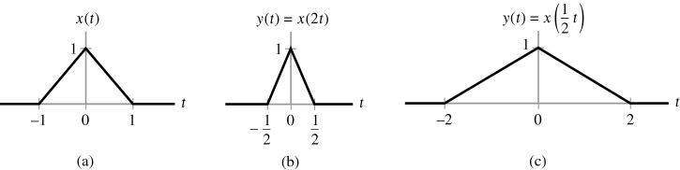
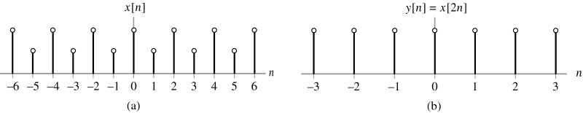
Basic Operations:Time scaling

Slide 60
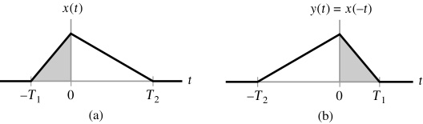
Basic Operations:Reflection

Slide 61
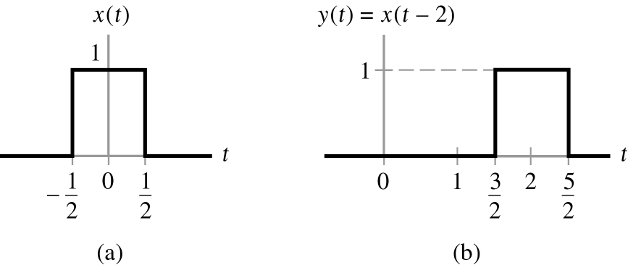
Basic Operations:Time shifting

Slide 62
Basic Sequences
Unit sample sequence -
Unit step sequence -

Slide 63
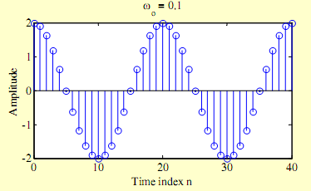
Basic Sequences
Real sinusoidal sequence -
x[n]=Acos(ω₀n+ϕ)
where A is the amplitude, ω₀ is the angular frequency, and ϕ is the phase of x[n]
Example -

Slide 64
Basic Sequences
Exponential sequence -
where A and α are real or complex numbers
If we write
then we can express
where

Slide 65
Basic Sequences
x_{re}[n] and x_{im}[n] of a complex exponential sequence are real sinusoidal sequences with constant (σ₀=0), growing (σ₀>0) , and decaying (σ₀<0) amplitudes for n > 0
Real part
Imaginary part

Slide 66
Basic Sequences
Real exponential sequence -
x[n]=Aα^{n}, -∞< n < ∞
where A and a are real numbers
α=1.2
α=0.9

Slide 67
Signal Basics
Stationary Signals
Stationary signals are constant in their statistical parameters (e.g., amplitude, standard deviation) over time.
stationary signal is one whose long-term statistics do not change with time.

Slide 68
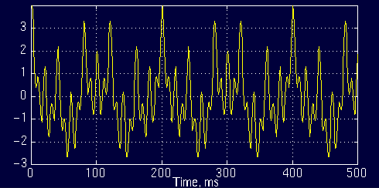
Example: Stationary Signals
For example the following signal
x(t)=cos(2*pi*10*t)+cos(2*pi*25*t)+cos(2*pi*50*t)+cos(2*pi*100*t)
is a stationary signal, because it has frequencies of 10, 25, 50, and 100 Hz at any given time instant. This signal is plotted below:

Slide 69
Signal Basics
Non-Stationary Signals
The statistical parameters (e.g., amplitude, standard deviation) of non-stationary signals are not constant over time.
Non-stationary signal is one whose long-term statistics do change with time.

Slide 70
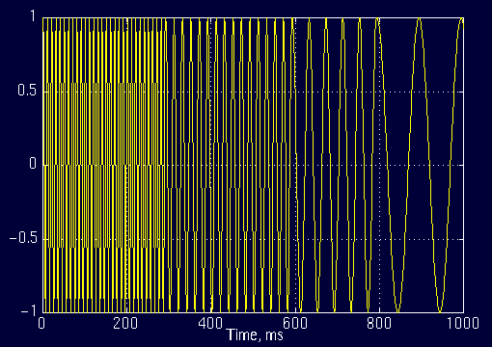
Example: Non-Stationary Signals
Example :
The interval 0 to 300 ms has a 100 Hz sinusoid, the interval 300 to 600 ms has a 50 Hz sinusoid, the interval 600 to 800 ms has a 25 Hz sinusoid, and finally the interval 800 to 1000 ms has a 10 Hz sinusoid.

Slide 71
Signal Basics
Statistical Properties of Signals
A statistic is measure of some attribute of a sample (set of data). Statistical information is needed to analyze a signal properly.
Examples:
Mean
Standard deviation
Variance
Covariance
Correlation
Skewness
Kurtosis
Eigenvectors
Eigenvalues

Slide 72
Signal Basics
Mean
An example set
The symbol X bar to indicate the mean of the set X . All this formula says is “Add up all the numbers and then divide by how many there are”.

Slide 73
Signal Basics
Standard Deviation
The Standard Deviation (SD) of a data set is a measure of how spread out the data is. The average distance from the mean of the data set to a point.
Why are you using (n-1) and not n ?
Calculate SD of A, B and C where
A= [0 8 12 20]
B= [8 9 11 12]
C= [10 10 10 10]

Slide 74
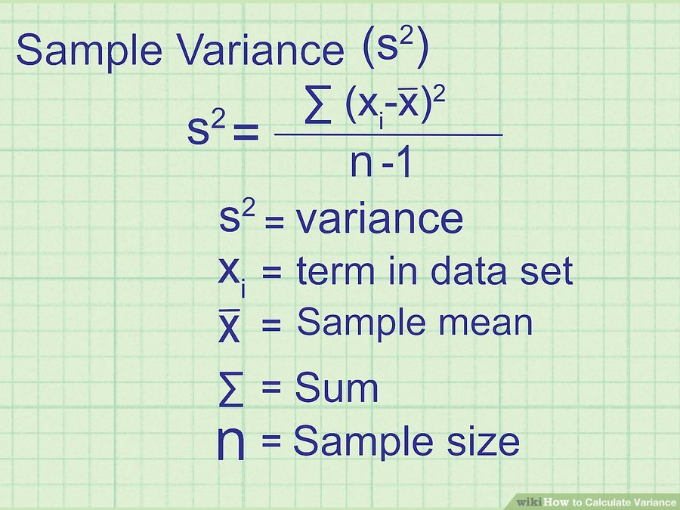
Signal Basics
Variance
The variance of a data set tells you how spread out the data points are. The closer the variance is to zero, the more closely the data points are clustered together.

Slide 75
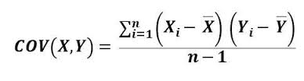
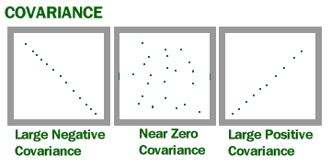
Signal Basics
Covariance
Covariance indicates how two variables are related. A positive covariance means the variables are positively related, while a negative covariance means the variables are inversely related. The formula for calculating covariance of sample data is shown below.

Slide 76

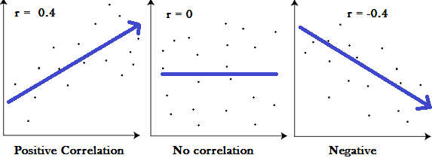
Signal Basics
Correlation
Correlation is another way to determine how two variables are related. In addition to telling you whether variables are positively or inversely related, correlation also tells you the degree to which the variables tend to move together.

Slide 77
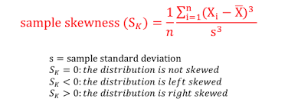
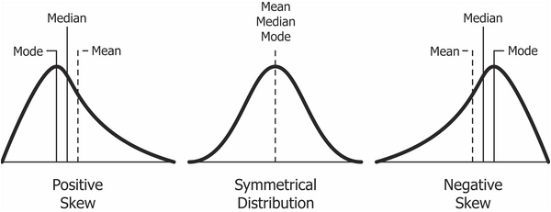
Signal Basics
Skewness
Skewness is a measure of symmetry, or more precisely, the lack of symmetry. A distribution, or data set, is symmetric if it looks the same to the left and right of the center point. Skewness tells you the amount and direction of skew.

Slide 78
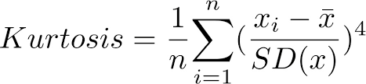
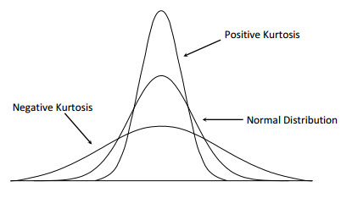
Signal Basics
Kurtosis
Distributions of data and probability distributions are not all the same shape. Kurtosis is the measure of the thickness or heaviness of the tails of a distribution. Kurtosis tells you how tall and sharp the central peak is.

Slide 79
Signal Basics
Eigenvectors and Eigenvalues
A matrix may act on certain vectors by changing only their magnitude, and leaving their direction unchanged (or, possibly, reversing it). These vectors are the eigenvectors of the matrix.
A matrix acts on an eigenvector by multiplying its magnitude by a factor, which is positive if its direction is unchanged and negative if its direction is reversed. This factor is the eigenvalue associated with that eigenvector.

Slide 80
Thank You

