Slide 1

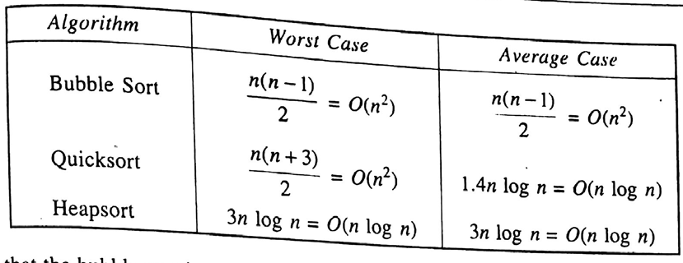
CSE 203: Data Structure
Data Structure
Sorting algorithms:

Slide 2

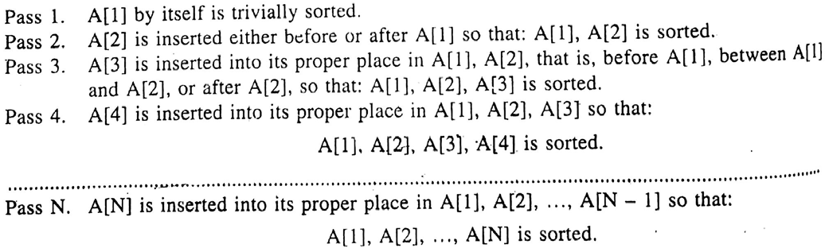
CSE 203: Data Structure
Data Structure
Sorting algorithms:
Next Item
Sorted after Pass 1
5 | 3 | 7 | 10 | 0 | 11 | 8

Slide 3
CSE 203: Data Structure
Data Structure
Sorting algorithms:
Next Item
Sorted after Pass 2
3 | 5 | 7 | 10 | 0 | 11 | 8

Slide 4
CSE 203: Data Structure
Data Structure
Sorting algorithms:
Next Item
Sorted after Pass 3
3 | 5 | 7 | 10 | 0 | 11 | 8

Slide 5
CSE 203: Data Structure
Data Structure
Sorting algorithms:
Next Item
Sorted after Pass 4
3 | 5 | 7 | 10 | 0 | 11 | 8

Slide 6
CSE 203: Data Structure
Data Structure
Sorting algorithms:
Next Item
Sorted after Pass 5
0 | 3 | 5 | 7 | 10 | 11 | 8

Slide 7
CSE 203: Data Structure
Data Structure
Sorting algorithms:
Next Item
Sorted after Pass 6
0 | 3 | 5 | 7 | 10 | 11 | 8

Slide 8
CSE 203: Data Structure
Data Structure
Sorting algorithms:
Sorted after Pass 7
0 | 3 | 5 | 7 | 8 | 10 | 11

Slide 9
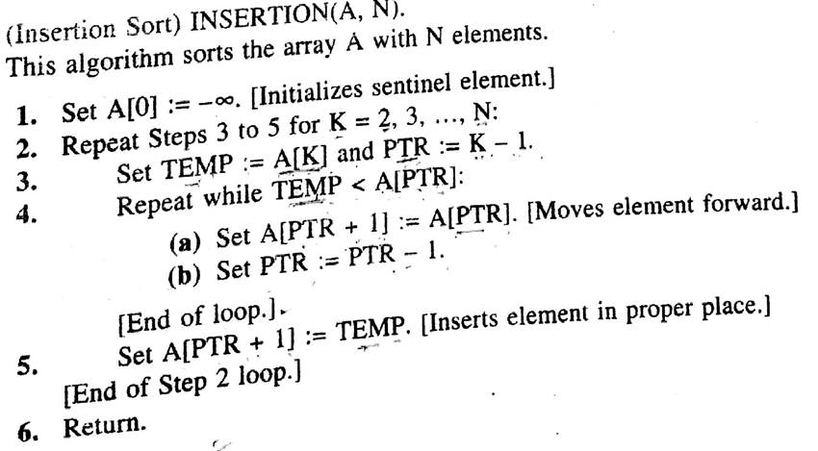
CSE 203: Data Structure
Data Structure
Sorting algorithms:
List of variables:
A: Integer
TEMP: Integer
PTR: Integer
K: Integer
N: Integer
List of loops:
For loop in Step 2
While loop in step 4

Slide 10
CSE 203: Data Structure
Data Structure
Sorting algorithms:
List of variables:
A: Integer
TEMP: Integer
PTR: Integer
K: Integer
List of loops:
For loop in Step 2
While loop in step 4
main(){
int A[10], ITEM, PTR, K, N=9;

Slide 11
CSE 203: Data Structure
Data Structure
Sorting algorithms:
List of variables:
A: Integer
TEMP: Integer
PTR: Integer
K: Integer
List of loops:
For loop in Step 2
While loop in step 4
main(){
int A[10], ITEM, PTR, K, N=9;
A[0]=-99999;
for(K=2;K<=N;K++) //Step 2
{

Slide 12
CSE 203: Data Structure
Data Structure
Sorting algorithms:
List of variables:
A: Integer
TEMP: Integer
PTR: Integer
K: Integer
List of loops:
For loop in Step 2
While loop in step 4
main(){
int A[10], ITEM, PTR, K, N=9;
A[0]=-99999;
for(K=2;K<=N;K++) //Step 2
{
TEMP=A[K]; //Step 3
PTR=K-1 //Step3

Slide 13
CSE 203: Data Structure
Data Structure
Sorting algorithms:
List of variables:
A: Integer
TEMP: Integer
PTR: Integer
K: Integer
List of loops:
For loop in Step 2
While loop in step 4
main(){
int A[10], ITEM, PTR, K, N=9;
A[0]=-99999;
for(K=2;K<=N;K++)
{
TEMP=A[K];
PTR=K-1
while(TEMP<A[PTR]) //Step 4
{
A[PTR+1]=A[PTR];
PTR=PTR-1;
}

Slide 14
CSE 203: Data Structure
Data Structure
Sorting algorithms:
List of variables:
A: Integer
TEMP: Integer
PTR: Integer
K: Integer
List of loops:
For loop in Step 2
While loop in step 4
main(){
int A[10], ITEM, PTR, K, N=9;
A[0]=-99999;
for(K=2;K<=N;K++)
{
TEMP=A[K];
PTR=K-1
while(TEMP<A[PTR])
{
A[PTR+1]=A[PTR];
PTR=PTR-1;
}
A[PTR+1]=TEMP; //Step 5
}
} //Step 6

